Slide 1
Notes:
[0:00, 0:15] [Danilo] Cover while people settle.
Check the clicker. Grafana open on the second screen, stage dashboard in kiosk mode, rig idle (both verdict tiles say OK).
Next: title slide.

Slide 2
Inference Is a Black Box
How We Built GPU-Aware Observability with Fluent Bit and OpenTelemetry
Danilo Souza, AWS Professional Services
Henrique Santana, AWS Support
Observability Day North America, Salt Lake City, 9 November 2026
GPU dashboard = ?
One log line = answer
Notes:
[0:15, 1:00] [Danilo + Henrique] Who we are, one line each, then the thesis.
Danilo: "I'm Danilo, I build platforms for customers at AWS, mostly Kubernetes and ML infrastructure." Henrique: "I'm Henrique, AWS Support, I see a lot of GPU incidents after the fact." Point at the two chips: "We tried to explain a slow inference service with the GPU dashboard and got nothing. The answer was in a log line."
Next: the incident.

Slide 3

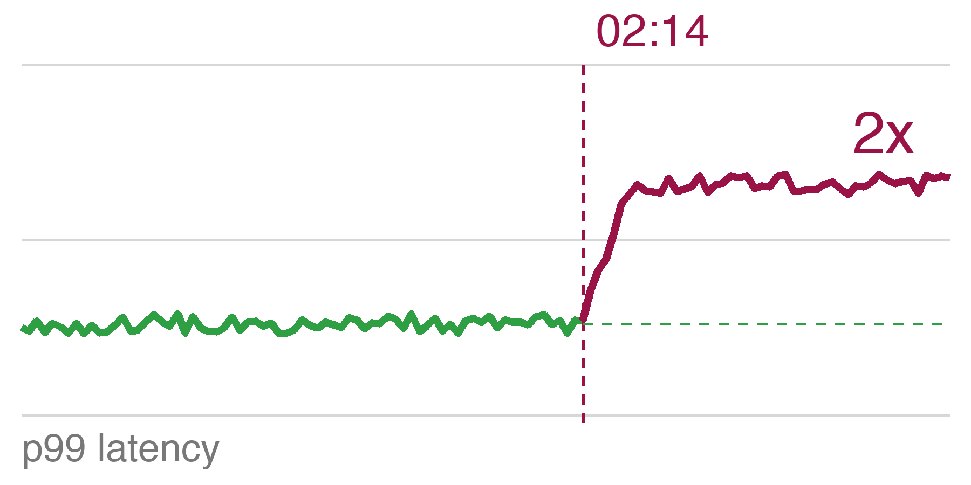
02:14. p99 doubles. Every GPU chart is green.
02:14
The model is healthy.
The pods are Ready.
Nothing is throttled.
Nobody knows why.
Every signal the hardware gives you says: busy and healthy.
Notes:
[1:00, 2:30] [Danilo] The incident.
"It's 02:14. The page fires. Every GPU chart is green." Let the sparkline do the rest. Pause. "Utilisation 95%, memory 90%, both flat for an hour. Pods Ready, nothing throttled, no restarts. Every signal the hardware gives you says busy and healthy. Nobody knows why. That is the black box."
Next: the same counter, opposite story.

Slide 4
Utilisation alone tells you nothing.
95%
our fleet at 02:14
looks saturated
~5%
industry average
looks idle
DCGM_FI_DEV_GPU_UTIL
On its own, this number says nothing about the inference work.
Industry average production GPU utilisation ~5%: Cast AI, State of GPU utilisation 2026 (cast.ai/blog/fractional-gpu-kubernetes)
Notes:
[2:30, 3:00] [Danilo] 30 seconds.
"Across the industry the average production GPU runs at about 5% utilisation. Ours read 95%. Same counter. One looks saturated, one looks idle, and neither tells you anything about the inference work."
Next: Henrique, why GPU memory lies.

Slide 5
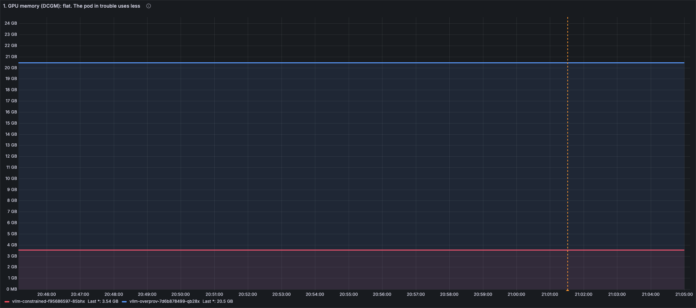
Memory usage is a config value, not a warning.
20.5 GB, flat
gpu-mem-util 0.90
3.5 GB, flat
gpu-mem-util 0.15
DCGM_FI_DEV_FB_USED
Sized once at start-up. Flat forever, including the one about to fall over.
Live rig, Oct 15 2026: two vLLM pods, facebook/opt-125m, EKS Auto Mode, NVIDIA L4 24 GB. Orange line: load starts.
Notes:
[3:00, 4:00] [Henrique] GPU memory is a config value.
"Every LLM server grabs its GPU memory before the first request. vLLM calls it gpu-memory-utilization." Point at the two flat lines. "Two pods, same model. Blue got 90% of the GPU: 20.5 GB. Red got 15%: 3.5 GB. The orange line is where we start a heavy load. Neither line moves. Ever." Then: "Which one is about to fall over? The small one. And this chart, the one most of us page on, cannot tell you."
Next: so what does move?

Slide 6
GPU memory is a car park.
vllm-constrained 15% of the GPU
vllm-overprov 90% of the GPU
cars circling: requests waiting
GPU memory (DCGM)
the size of the car park. Fixed when the pod starts. Flat forever.
KV cache % (the log)
how many spaces are taken right now. Only the server knows.
queue / request time
cars circling for a space. What the user feels.
The GPU exporter reads the size on the sign. The server's log counts the cars.
vLLM reserves its pool at start-up (--gpu-memory-utilization); the KV cache lives inside it. Each running request parks its attention state there; when it is full, new requests wait.
Notes:
[4:00, 5:00] [Henrique] The car park. This slide is why the demo makes sense, do not rush it.
"Think of GPU memory as a car park. When the pod starts, it rents a car park of a fixed size. That's the number DCGM shows you: the size on the sign. Inside, every request that is running parks its working state, that's the KV cache. When the car park is full, new requests circle and wait." Point at red: "Small car park, every space taken, cars circling." Point at blue: "Huge car park, almost empty, we're paying for it." Last line: "The GPU exporter reads the sign. Only the server's own log counts the cars."
Next: Danilo, how we get all three onto one screen.

Slide 7
The pod is the join key.
DCGM
dcgm-exporter --kubernetes
exported_pod
Serving log
Fluent Bit kubernetes filter
pod_name
Traces
OTel Collector k8sattributes
k8s.pod.name
pod_name
WHERE pod_name = $pod
Stamp it on every metric, log record and span. Join at query time. Nothing else is common to all three.
K8s 1.35: Dynamic Resource Allocation is stable; dcgm-exporter 4.8.4 adds pod_uid and ResourceSlice mapping because the device-plugin mapping breaks under DRA. Same join key, new plumbing.
Notes:
[5:00, 6:30] [Danilo] The pipeline, one idea: the pod name.
"Three tools, three signals. DCGM knows which pod owns a GPU. Fluent Bit knows which pod wrote a log line. The OTel Collector knows which pod a request went through. The only thing all three share is the pod name. So we stamp it on everything and join at query time." Click: the pill, then the WHERE. "That's the whole architecture. All the configs are in the repo."
Next: the demo.

Slide 8
Live: which pod is in trouble?
vllm-constrained
15% of the GPU memory
vllm-overprov
90% of the GPU memory
facebook/opt-125m on both · NVIDIA L4 · lots of long requests to red, a trickle to blue
GPU memory
what we page on
KV cache %
how full the car park is
request time
what the user feels
Watch three numbers. Guess which pod breaks first.
Notes:
[6:30, 7:00] [Danilo] Set up the question, then switch to Grafana. Henrique clicks, Danilo narrates.
"Two pods, same model, same GPU. Red got 15% of the memory, blue 90%. We'll send lots of long requests to red and a trickle to blue. Watch three numbers: GPU memory, how full the car park is, and how long a request takes. Which pod breaks first?" Let one person answer.
DEMO, 7:00 to 10:00 (runbook: DEMO-RUNBOOK.md). Henrique runs demo/load.sh at the switch.
1. Idle: both tiles OK. "Both look fine."
2. Load hits (about 20 s): GPU memory tiles do not move. "The number we page on. Red even looks healthiest."
3. KV cache: red climbs to 99-100%, blue stays at 0. "Red's car park is full." (the aha, pause)
4. Request time: red about 12 s, blue about 0.13 s. Verdict tiles flip: MEMORY-CONSTRAINED, OVER-PROVISIONED. "Same hardware. Only the log could tell."
5. Click the top trace ID: two bars, client then vLLM, same pod name. Click the link icon on llm_request, then "This pod: how full it was". "One slow request, one click, that pod's car park at that second: full."
6. Back to the dashboard. "Three signals, one pod name."
If anything stalls: play deck/video, or demo/trace.sh for step 5.
Next: back to slides, the recap.

Slide 9
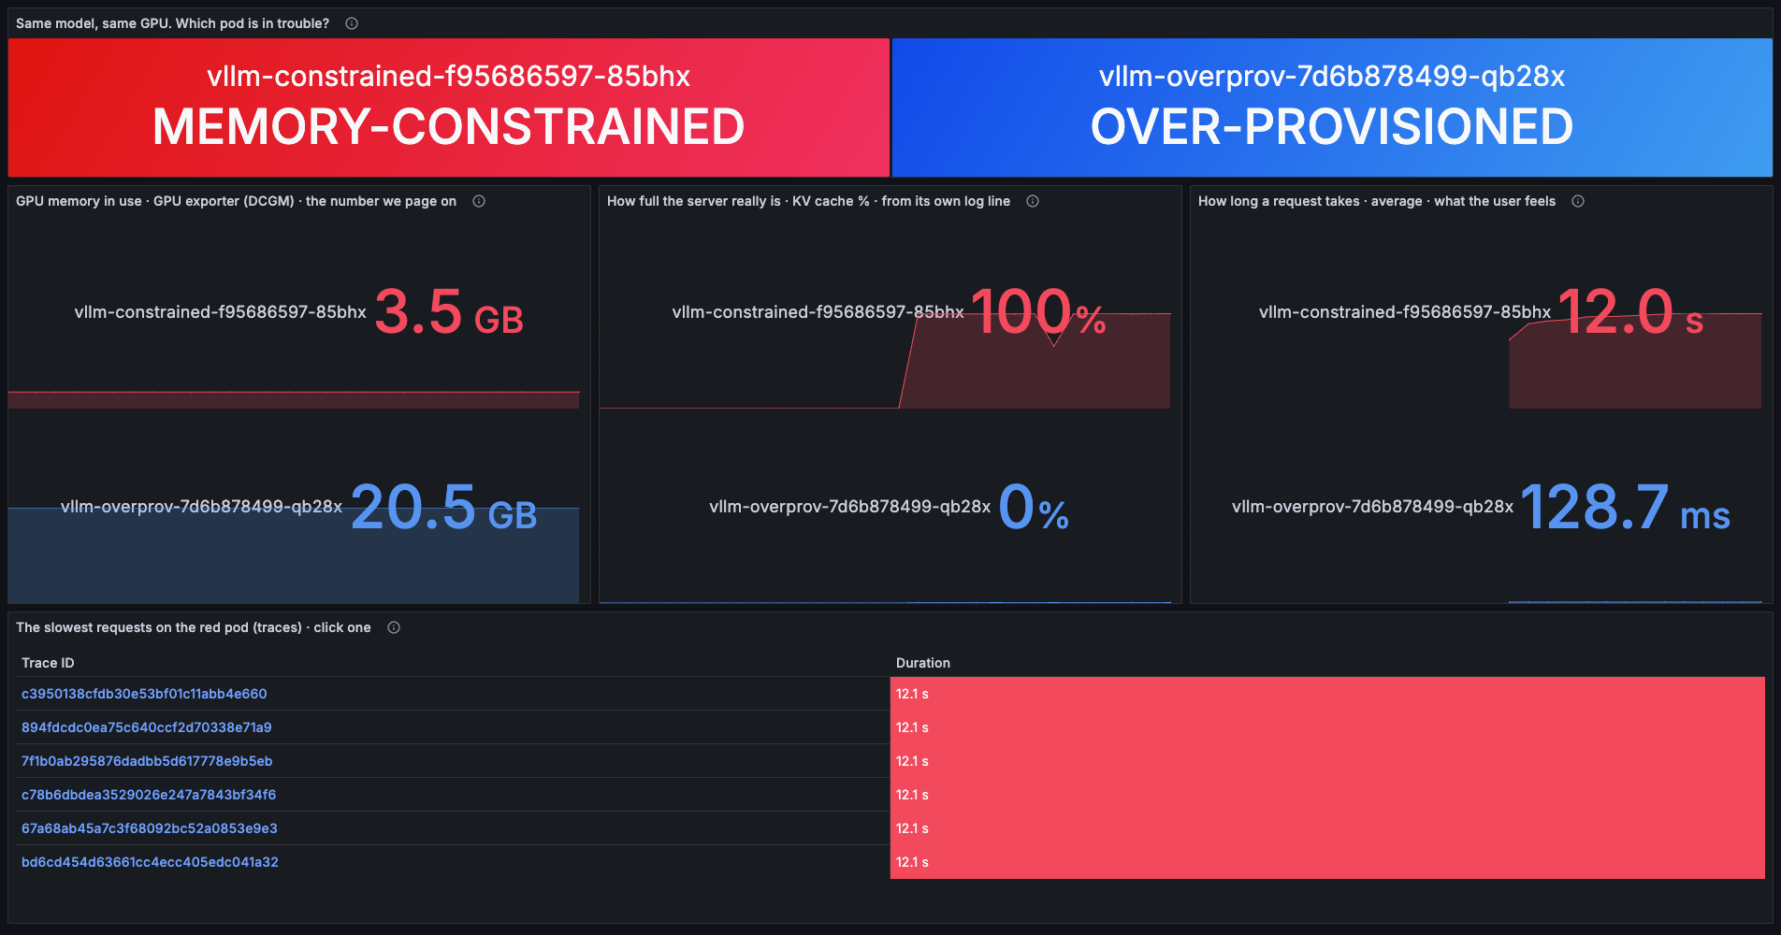
Red is full. GPU memory never moved.
3.5 vs 20.5 GB
GPU memory, both flat
100% vs 0%
KV cache, from the log
12 s vs 0.13 s
request time
1 pod name
on every signal
Stage dashboard, live rig, Oct 15 2026 21:05 Dublin. KV cache % from the vLLM log line (Fluent Bit + Lua); request time from vLLM /metrics; durations from Jaeger.
Notes:
[10:00, 10:30] [Danilo] Recap, or the backup if the demo failed.
"This is what you just saw. GPU memory: 3.5 and 20.5 GB, flat. KV cache from the log: 99% versus 0%. Requests: 12 seconds versus 0.13 seconds. One pod name on every signal." If the demo failed, walk the screenshot with the same four lines.
Next: three things we had to get right, the ones in the abstract. One minute and a half each.

Slide 10
1 · What broke: series per pod name.
Same 2 GPUs, same 7 counters
At fleet scale
1,000 nodes x 8 GPUs x 60 counters x 3 labels
= 1.4M series
before one pod label. Every label you add multiplies by pod churn.
14
series live now
56
seen in the last hour
3 pod restarts. Prometheus keeps every old series until retention ends.
Keep
the pod name (exported_pod)
Drop
every other pod label
Join
at query time
dcgm-exporter: --kubernetes=true ENABLE_POD_LABELS=false 7 counters in counters.csv
Our rig, Oct 15 2026: count({__name__=~"DCGM_.*"}) = 14 live; sum of count(count_over_time(...[1h])) over the 7 counters = 56 after three vLLM restarts. Fleet math: Last9, 10,000 GPUs, one TSDB.
Notes:
[10:30, 12:30] [Henrique] Deep dive 1: what broke, cardinality.
"The first thing we broke was Prometheus. To join on the pod name, dcgm-exporter has to put the pod name on every GPU counter. Every time a pod restarts it gets a new name, so you get a brand new set of series, and Prometheus keeps the old ones until retention." Point at 14 and 56: "Same two GPUs, seven counters. 14 series live. 56 in the last hour, after three restarts." Click: fleet math. "At fleet scale, 1.4 million series before you add a single pod label, and every label multiplies by churn." Then the rule: "Keep the pod name. Drop every other pod label. Join at query time."
Next: the log line.

Slide 11
2 · The log line becomes a metric.
Engine 000: Avg prompt throughput: 11553.3 tokens/s, Avg generation throughput: 6310.2 tokens/s, Running: 93 reqs, Waiting: 98 reqs, GPU KV cache usage: 98.0%
tail
container log
kubernetes
+ pod_name
lua
5 x string.match: tokens/s, KV %, waiting
grep
stats lines only
log_to_metrics
fields -> gauges
prometheus_exporter
:2021
pod_name rides along from the kubernetes filter onward: the join key
For serving engines without a /metrics endpoint. vLLM exposes most of this natively; same pipeline, different regex.
Fluent Bit 5.1. Full filter and pipeline config in the repo. vLLM native metrics: docs.vllm.ai/en/latest/design/metrics
Notes:
[12:30, 14:30] [Danilo] Deep dive 2: the Lua parsing.
Point at the raw line: "This is what vLLM prints every ten seconds. Token throughput, running, waiting, and the KV cache. It's text, not a metric." Walk the pipeline left to right: "Fluent Bit tails the container log, the kubernetes filter adds the pod name, fifteen lines of Lua pull out the numbers, grep keeps only these lines, log_to_metrics turns them into gauges, and Prometheus scrapes them next to DCGM." Honest caveat: "vLLM also exposes most of this on /metrics. This pipeline is for the servers that don't, or when logs are all you get. Same pipeline, different regex."
Next: traces.

Slide 12
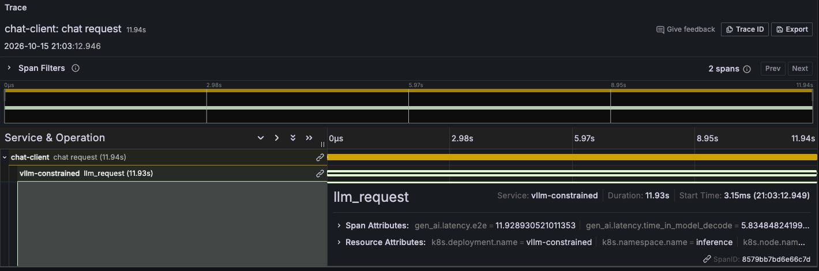
3 · The Collector stamps the pod name.
11.9 s
2 hops, 1 trace, pod vllm-constrained
OTel Collector
processors:
k8sattributes:
extract:
metadata: [k8s.pod.name, ...]
pod_association:
- sources: [{from: connection}]
Grafana Jaeger datasource
tracesToMetrics:
tags:
- {key: k8s.pod.name, value: exported_pod}
queries:
- name: This pod: how full it was
query: vllm_log_kv_cache_usage_pct{...}
The app never knew its pod name. Now one click goes from a slow request to that pod's KV cache.
vLLM --otlp-traces-endpoint (needs vLLM >= 0.10.2; rig 0.30) -> OTel Collector k8sattributes -> Jaeger. Client span + traceparent = two hops in one trace. Grafana Jaeger datasource: tracesToMetrics. Configs: manifests/40-traces, manifests/60-grafana.
Notes:
[14:30, 16:30] [Danilo] Deep dive 3: the OTel Collector config.
"vLLM emits a span per request, and our client adds its own span and a traceparent header, so one trace has two hops: client, then vLLM. That's this 11.9-second request." Left box: "The app never knew its pod name. The Collector's k8sattributes processor looks up who sent the span and adds k8s.pod.name." Right box: "In Grafana, the Jaeger datasource maps k8s.pod.name to the metric label. That's what turned one click from a slow request into that pod's KV cache." Gotcha if time: "vLLM tracing disappeared in the V1 rewrite and came back in 0.10.2. If your traces vanished after an upgrade, that's why."
Next: what to take home.

Slide 13
Steal this for your cluster.
3 numbers
1 filter
1 rule
KV cache %
how full the car park is
15 lines of Lua
+ log_to_metrics
pod name
on every signal
request / queue time
what the user feels
change the regex
keep the pipeline
identity on logs
stable dimensions on metrics
DCGM_FI_PROF_SM_ACTIVE
instead of GPU_UTIL
works for
TGI, Triton, anything that logs
join
at query time
0 new agents
Reproduced clean-room on EKS Auto Mode; all configs in the repo.
Notes:
[16:30, 17:30] [Henrique] Steal this.
"Three numbers: KV cache, request or queue time, and SM active instead of GPU util. One filter: fifteen lines of Lua, change the regex for your server. One rule: the pod name on every signal, nothing else on the metrics. Zero new agents."
Next: thank you and the repo.

Slide 14

Thank you.
github.com/danilosilvase/
gpu-observability-kubecon-na-2026
Danilo Souza, AWS Professional Services
Henrique Santana, AWS
Scan to rate this session.
Notes:
[17:30, 18:00] [Danilo] Thank you, repo, CNCF feedback QR. Then Q&A (about 7 min).
Likely questions and where the answer is: "why not just scrape /metrics" (slide 11 caveat), "does GPU util really not move" (appendix: it does go up, it just cannot say why), "MIG or time-slicing" (dcgm-exporter 4.5+ per-process metrics), "disaggregated prefill/decode" (appendix: the join key becomes request id plus pod), "EKS Auto Mode" (appendix gotcha).

Slide 15
Appendix
Backup slides for Q&A: GPU counters, prefill vs decode, DCGM per pod, the log fields, the join row, Auto Mode gotcha, where this is going.
Notes:
Appendix divider. Only reached from Q&A.

Slide 16
GPU util % cannot tell prefill from decode.
Prefill
Whole prompt in one pass.
Large matmuls. Compute-bound.
Tensor cores busy, memory bus quiet.
Decode
One token per step.
Re-reads the entire KV cache each step. Memory-bandwidth-bound.
Memory bus busy, tensor cores waiting.
GPU_UTIL 100%
GPU_UTIL 100%
DCGM_FI_DEV_GPU_UTIL
One busy thread reads as 100%. The counter has no idea which phase you are in.
DCGM_FI_DEV_GPU_UTIL (field 203) is NVML-polled: 'a kernel ran during the sample window'. The profiling fields on the next slide come from the GPU's hardware profiler.
Notes:
[4:00, 5:00] [Henrique] Utilisation and the two phases.
"GPU_UTIL has a precise meaning: at least one kernel was running during the sample window. One busy thread reads as 100%." Then the phases. "Inference has two phases with opposite shapes. Prefill: the whole prompt in one pass, big matrix multiplies, compute-bound, tensor cores busy. Decode: one token per step, and every step re-reads the entire KV cache, so it's memory-bandwidth-bound, tensor cores mostly waiting." Point at the two identical stamps. "Same number on both. The counter has no idea which phase you're in or how much of the silicon is doing anything."
Next: what the profiler counters say instead.

Slide 17
Three profiler counters, same second.
99.8%
GR_ENGINE_ACTIVE
the profiler's 'busy'
16.6%
PIPE_TENSOR_ACTIVE
tensor cores doing matmuls
80.4%
DRAM_ACTIVE
memory bus
Bandwidth-bound, not compute-saturated, and "utilisation" never said which.
The counter on your dashboard is the least informative one the hardware offers. Serving teams are borrowing MFU and MBU (model FLOPs and bandwidth utilisation) from the training world to say so.
Measured on vLLM by Elastic Observability Labs (2025): DCGM_FI_PROF_GR_ENGINE_ACTIVE 99.8%, PIPE_TENSOR_ACTIVE 16.6%, DRAM_ACTIVE 80.4%. MFU/MBU vocabulary: Lightbits, The Utilization Illusion.
Notes:
[5:00, 6:00] [Henrique] The Elastic numbers. Be precise about which field.
"These aren't our numbers, they're from Elastic Observability Labs measuring a vLLM server, and they used the DCGM profiling fields, not the NVML utilisation counter." Left to right. "Graphics engine active 99.8%: that's the profiler's version of busy. Tensor cores, the units doing the actual matmuls: 16.6%. Memory bus: 80.4%. The card is not computing. It's waiting on memory." Pause. "Bandwidth-bound, not compute-saturated, and utilisation never said which. If you needed more throughput here you'd quantize before you bought hardware." Last line, lightly: "Serving teams are starting to borrow MFU and MBU from the training world, model FLOPs and bandwidth utilisation, precisely because the dashboard counter is the least informative one the hardware offers."
Next: the vocabulary slide.

Slide 18
Counters that lie, counters you can trust.
Misleading on an inference server
Meaningful
DCGM_FI_DEV_GPU_UTIL
any kernel = busy
DCGM_FI_PROF_SM_ACTIVE
share of SMs doing work
DCGM_FI_PROF_SM_OCCUPANCY
resident warps / SM maximum
DCGM_FI_DEV_FB_USED
pre-allocated, flat
DCGM_FI_PROF_DRAM_ACTIVE
bandwidth-bound?
nvidia-smi Volatile GPU-Util
same as GPU_UTIL
DCGM_FI_PROF_PIPE_TENSOR_ACTIVE
tensor cores in use
And none of them know what a token is.
Queue depth, KV cache pressure, tokens per second. The serving framework owns those, the silicon doesn't.
DCGM field IDs: docs.nvidia.com/datacenter/dcgm. PROF_* fields need a profiling-capable GPU and DCGM >= 2.x. SM_OCCUPANCY is a ratio: resident warps over the SM maximum.
Notes:
[6:00, 7:00] [Henrique] Vocabulary slide, the one people photograph. Don't read every row.
"Left: what most GPU dashboards show. GPU_UTIL, framebuffer used, and nvidia-smi's Volatile GPU-Util which is the same thing. Right: what actually describes the work. SM_ACTIVE, how much of the compute is busy. SM_OCCUPANCY, what share of the warps an SM can hold are actually resident. DRAM_ACTIVE, are you bandwidth-bound. PIPE_TENSOR_ACTIVE, are the tensor cores doing matmuls." Then the punchline, slowly: "And none of them know what a token is. Queue depth, KV cache pressure, tokens per second. The serving framework owns those. The silicon doesn't."
Hand back to Danilo.
Next: section three, the one architectural idea.

Slide 19
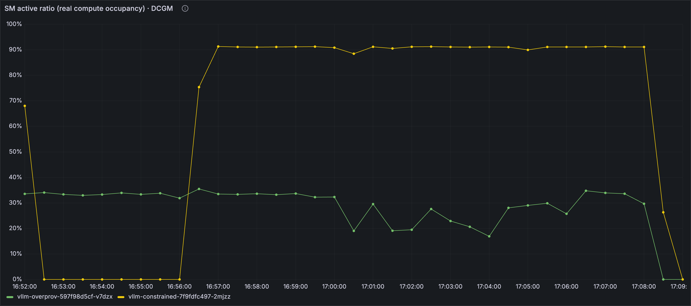
Signal 1: DCGM, per pod.
What it tells you
Which pod holds which GPU
Whether the silicon is busy (SM_ACTIVE, DRAM_ACTIVE)
Power, temperature, pool size
SM active, per pod
What it has no idea about
Why the GPU is busy
How many requests are queued
Whether the KV cache is full
Anything about tokens
--kubernetes=true asks the kubelet who owns each GPU
ENABLE_POD_LABELS=false keep the join key, nothing else (next slide)
dcgm-exporter --kubernetes reads /var/lib/kubelet/pod-resources. EKS Auto Mode: standalone dcgm-exporter, not the GPU Operator (slide 18).
Notes:
[8:00, 8:45] [Danilo] Signal 1, DCGM per pod. Keep it short, the audience knows exporters.
"dcgm-exporter in Kubernetes mode. --kubernetes=true asks the kubelet which pod owns each GPU and stamps exported_pod on every counter. That's the screenshot: SM active, per pod, during our demo." Right side: "It tells you which pod is on which GPU and whether that silicon is busy. It has no idea why, how many requests are queued, whether the KV cache is full, or anything about tokens." Point at the second config line: "ENABLE_POD_LABELS false. That one matters, next slide."
On EKS Auto Mode you run it standalone as a DaemonSet with the pod-resources hostPath; the GPU Operator isn't supported there, we'll come back to that.
Next: cardinality.

Slide 20
The log says six things the GPU can't.
vllm-overprov, steady load
4,711 tok/s · 0 waiting · 0.1% KV cache
vllm-constrained, saturating load
17,227 tok/s · 116 waiting · 99.6% KV cache
tokens/s · running · waiting · KV cache % · prefix hits · preemptions
Six facts about the inference work, and not one of them shows up in a GPU counter.
vLLM V1 engine, vllm/v1/metrics/loggers.py: one stats line every 10 s while the engine is busy (DEBUG level when idle). Numbers from the live rig.
Notes:
[9:30, 10:45] [Danilo] The log line. Read it aloud, it is not on the slide.
"This is one line of vLLM stdout. It prints every ten seconds while the engine is busy." Read the raw line for the over-provisioned pod from memory, then point at the grey row: "4,700 tokens a second, nothing waiting, cache at 0.1%." Click: the red row appears. "Constrained pod, same model, same second: 17,000 tokens a second, 116 waiting, cache at 99.6%, and a Preemptions field that only shows up once the scheduler starts evicting work." Then: "Six facts about the inference work, and not one of them shows up in a GPU counter."
Next: how five lines of Lua turn that into metrics.

Slide 21
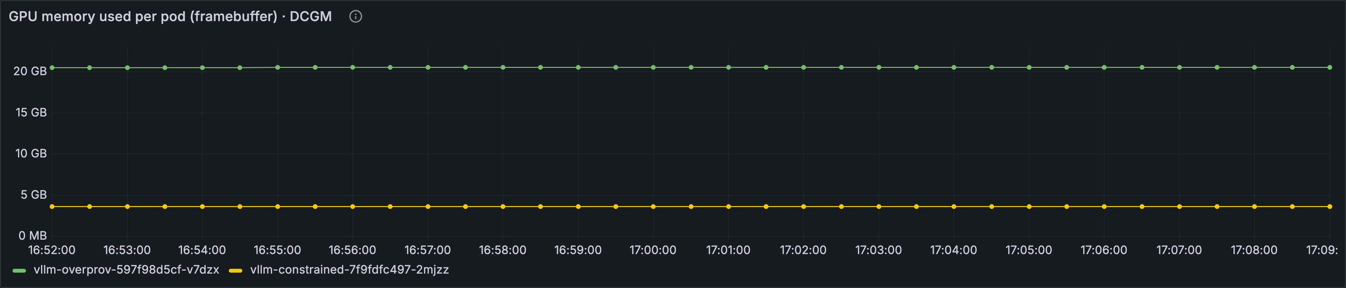
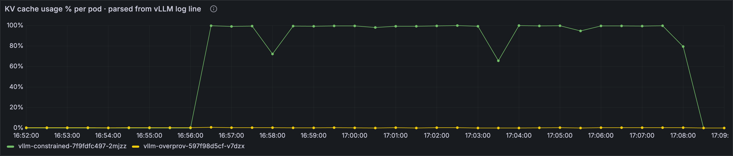
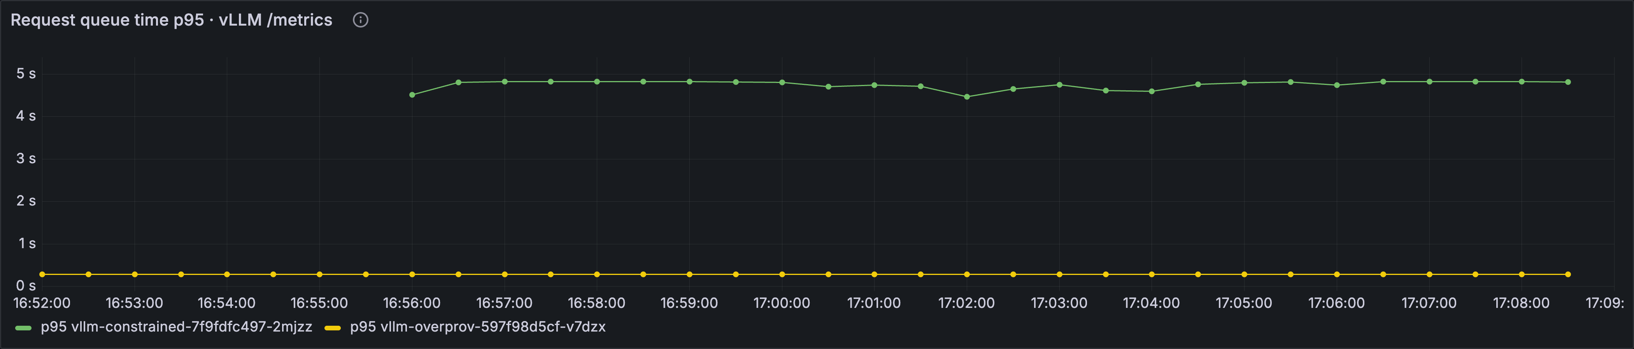
Same pod name. Three sources. One row.
16:56 load hits
flat
DCGM memory
100%
KV cache (log)
0.3 s to 4.8 s
queue time p95 (/metrics)
Opened.
No new agent, no vendor, no eBPF. Just the pod name on every signal.
Grafana dashboard uid gpu-inference-obs, variable $pod matches exported_pod (DCGM), pod_name (Fluent Bit) and pod (vLLM, traces). Constrained pod, 16:52 to 17:09.
Notes:
[17:30, 19:30] [Danilo] The join. Slow down here. Two minutes on one slide is fine.
"One Grafana dashboard. One pod variable. Three data sources that never heard of each other: DCGM through exported_pod, Fluent Bit through pod_name, vLLM and the traces through pod." Point at the red line: "Right there, where the line jumps, the load hits. Top row, DCGM memory: flat. Middle row, KV cache from the log line: pegs at 100%. Bottom row, queue time from vLLM: 0.3 to 4.8 seconds. Same second, same pod name." Pause. "The incident from slide three is this picture." Click: the word appears. "Opened." Close: "No new agent, no vendor, no eBPF. Just the pod name on every signal, and the discipline to keep it there."
Next: one thing that broke. Henrique.

Slide 22
What silently broke along the way.
What we expected
Every DCGM how-to assumes the GPU Operator. Check your platform's driver model before you follow one.
What happened
EKS Auto Mode supports neither the GPU Operator nor the NVIDIA DRA driver. Drivers and device plugin ship with the AMI.
Fix
Standalone dcgm-exporter DaemonSet, pod-resources hostPath, SYS_ADMIN. Seven counters.
GPU Operator
Also in the repo: Fluent Bit Kube_Tag_Prefix must match the tail tag or the join key arrives empty; a 1-GPU pod on a 2-GPU NodePool never finishes a RollingUpdate, use Recreate.
EKS Auto Mode GPU support: docs.aws.amazon.com/eks/latest/userguide/device-management-nvidia-dra-device-plugin.html. Two more gotchas (Fluent Bit Kube_Tag_Prefix, 1-GPU RollingUpdate) in the repo README.
Notes:
[19:30, 19:50] [Henrique] One gotcha, 20 seconds. Cut this slide first if running late.
"Every DCGM how-to assumes the NVIDIA GPU Operator, so check your platform's driver model before you follow one. EKS Auto Mode ships the drivers and the device plugin on its GPU AMIs and supports neither the Operator nor the NVIDIA DRA driver. So: standalone dcgm-exporter DaemonSet, pod-resources hostPath, SYS_ADMIN capability, seven counters." One breath on the grey line: "Two more in the repo README: Fluent Bit's Kube_Tag_Prefix has to match the tail tag exactly or the pod name silently never arrives, and a one-GPU pod on a two-GPU NodePool never finishes a RollingUpdate, use Recreate."
Next: where this is going. Danilo.

Slide 23
The join key is moving into the router.
Today: join in Grafana
one pod, one request
PromQL on pod_name
Next: join key = request id + pod
prefill and decode on different pods
llm-d, NVIDIA Dynamo
Then: router consumes the join
routes on queue depth and KV cache
Gateway API Inference Extension
join key
llm-d on AWS: aws.amazon.com/blogs/machine-learning/introducing-disaggregated-inference-on-aws-powered-by-llm-d. Gateway API Inference Extension: github.com/kubernetes-sigs/gateway-api-inference-extension.
Notes:
[19:50, 20:30] [Danilo] Where this is going, 40 seconds. Pre-empts "isn't this solved".
Left to right, vendor-neutral first: "Today the join happens in Grafana. Next, disaggregated serving splits one request across two pods, llm-d and NVIDIA Dynamo, shipping the KV cache between them over NIXL and EFA, up to 70% more tokens per second at concurrency 128, so the join key becomes request id plus pod. Then the router itself consumes queue depth and KV cache to decide where traffic goes, the Gateway API Inference Extension endpoint picker and Dynamo's KV-aware router, and the join leaves Grafana entirely." Same shape on KServe, if that is your serving layer: the join key is still the pod.
One aside, said once, not shown: CloudWatch's OTel-native Container Insights for EKS, June this year, wires DCGM into OTel with pod labels out of the box, so signal one is becoming a checkbox. Signals two and three are still yours to wire.
If asked after: XID/ECC/thermal faults, output quality, eBPF GPU profiling, Dynamo internals are all out of scope today.
Next: takeaways.

