Slide 1
Coroutine baked attribute
Maxim Danilov

Slide 2

Who I am
Maxim Danilov
Wine drinker
Pfessional Skier
Trailrunner

Slide 3
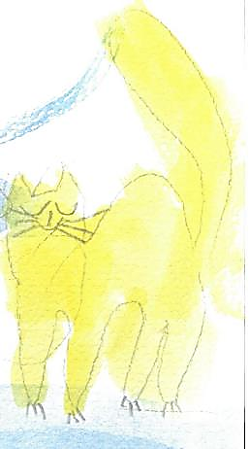


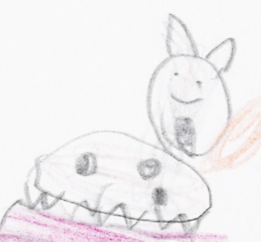
Special thanks to my family for the support:
my wife
Elena
cat
Kisa
daughter Maja
son
Mark
dog
Marselle

Slide 4
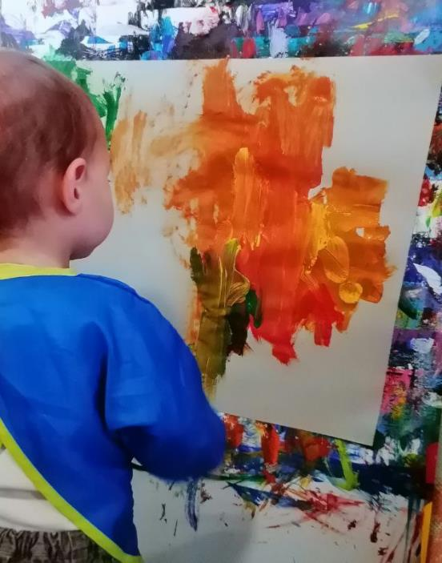

Thanks to my children for the illustrations

Slide 5

Coroutine baked Attribute
Or method

Slide 6
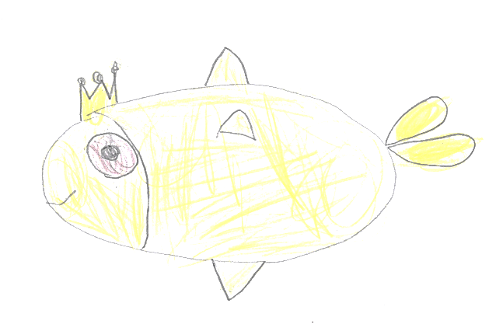
Coroutine:
def _attr(attr = None):
while True:
val = yield attr
if isinstance(val, tuple):
attr = val[0]

Slide 7
Coroutine:
def _attr(attr = None):
while True:
val = yield attr
if isinstance(val, tuple):
attr = val[0]

Slide 8
Coroutine:
def _attr(attr = None):
while True:
val = yield attr
if isinstance(val, tuple):
attr = val[0]

Slide 9

Work with coroutine:
... #start coroutine
coro = _attr()
coro.send(None)
... #read
next(coro)
... #write coro.send((value,))

Slide 10
Work with coroutine:
... #start coroutine
coro = _attr()
coro.send(None)
... #read
next(coro)
... #write coro.send((value,))

Slide 11
Work with coroutine:
... #start coroutine
coro = _attr()
coro.send(None)
... #read
next(coro)
... #write coro.send((value,))

Slide 12

Coroutine‑backed attribute
class CoroAttribute:
def _attr(self, att = None):
while True:
val = yield attr
if isinstance(val, tuple):
attr = val[0]
attr = property(
lambda self:next(self._attr), # setter
lambda self,val:self._attr.send((val, ))) #getter

Slide 13
Coroutine‑backed attribute
class CoroAttribute:
def _attr(self, att = None):
while True:
val = yield attr
if isinstance(val, tuple):
attr = val[0]
attr = property(
lambda self:next(self._attr), # setter
lambda self,val:self._attr.send((val, ))) #getter

Slide 14

Coroutine‑backed attribute (read & write)
class CoroAttribute:
def __init__(self, attr=None):
#start coroutine
self._attr = self._attr()
self._attr(attr)
... #read
CoroAttribute().attr
... #write
CoroAttribute().attr = value

Slide 15
Coroutine‑backed attribute (read & write)
class CoroAttribute:
def __init__(self, attr=None):
#start coroutine
self._attr = self._attr()
self._attr(attr)
... #read
CoroAttribute().attr
... #write
CoroAttribute().attr = value

Slide 16
Coroutine‑backed attribute (read & write)
class CoroAttribute:
def __init__(self, attr=None):
#start coroutine
self._attr = self._attr()
self._attr(attr)
... #read
CoroAttribute().attr
... #write
CoroAttribute().attr = value

Slide 17
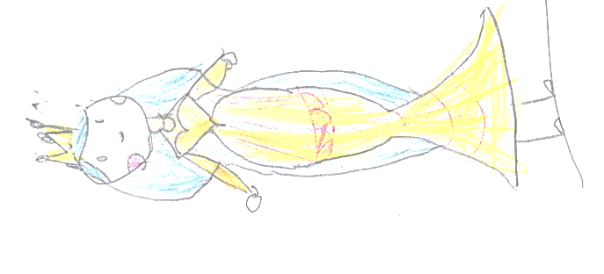
Coroutine based attribute:
Unified “gate” for reads and writes We can add validation, permission checks, logging, etc.
Cached and «like» Protected Internal value changeable through interface
or through generator.gi_frame.f_locals
Observable Each yield can raise event (“opening…”, “reading…”, ..)
Thread safety with threading.RLock To resolve „generator already executing“ in multithreaded apps

Slide 18

Try it yourself at home
Get code from talk repository
Run shell
Create object and check how it works

Slide 19


Thank for your attention!
Maxim Danilov
maxim@wpshop.at
Play with code:
github.com/danilovmy/pyconpl2025

