Slide 1


RESTfull-API
with pure Django

Slide 2
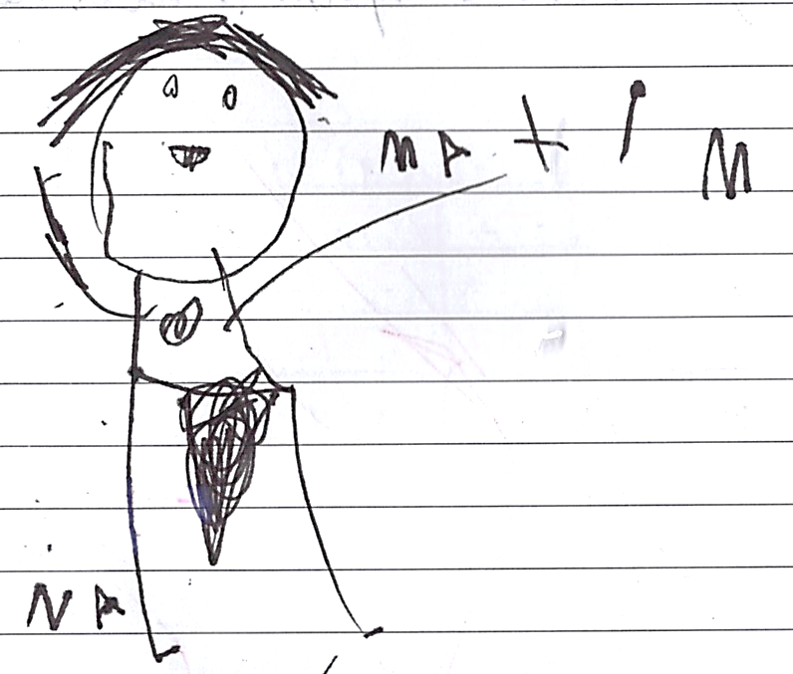
Who I am
Professional skier ⛷️
Trail runner 🏃‍♂️
Sommelier 🍷🍾
Mentor for developer community for free 👴. (and not free for companies).

Slide 3
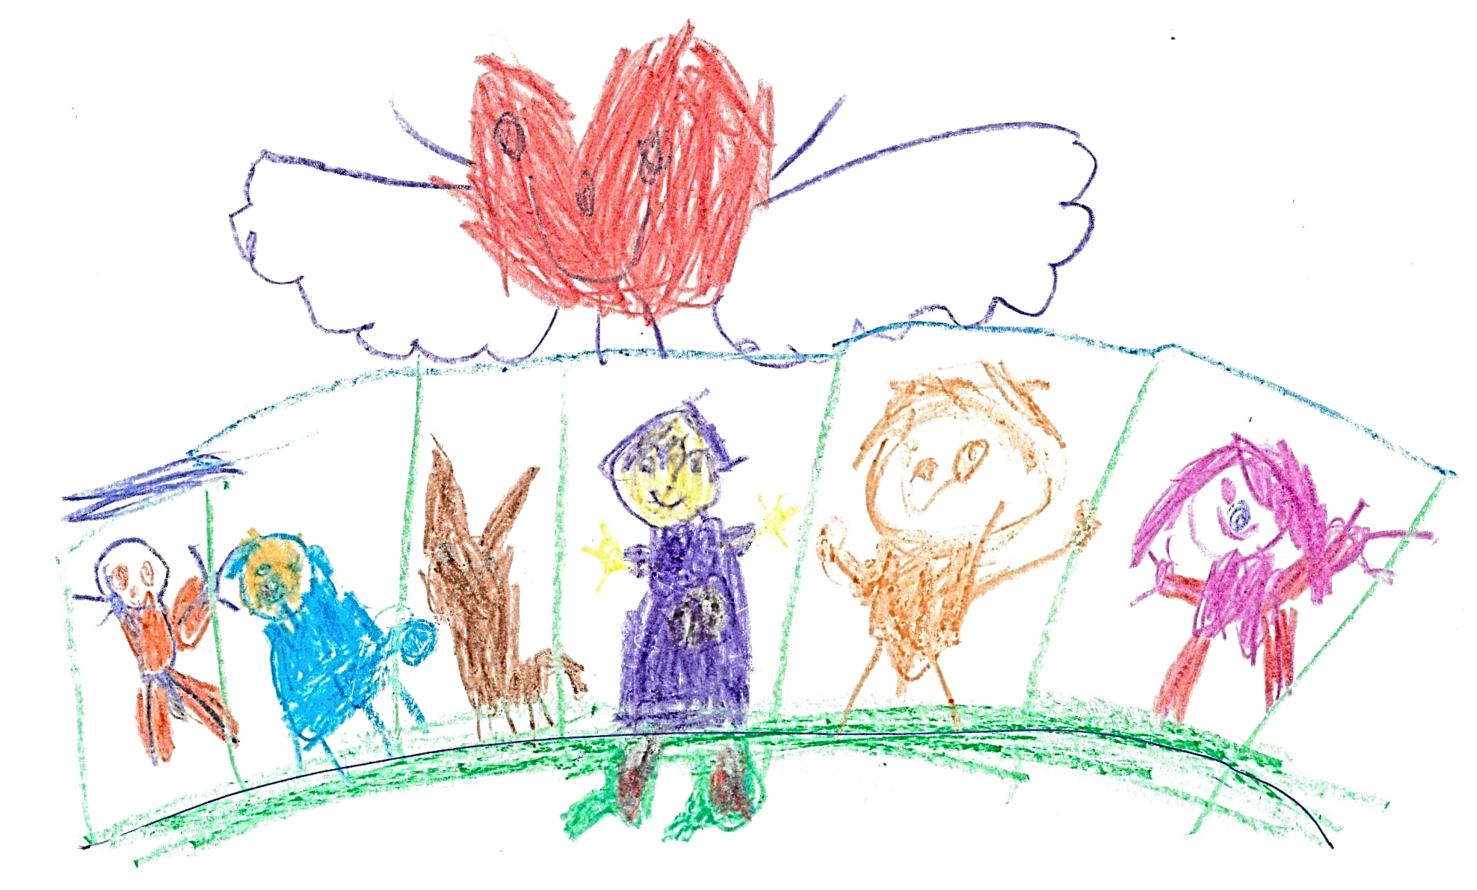
Thanks for support for my family

Slide 4


Thanks Maja & Mark for illustrations

Slide 5

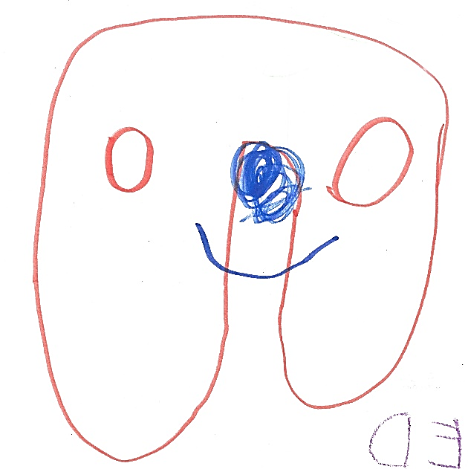
Links
https://github.com/danilovmy/pyconpt2025/tree/main/workshop
Slides & code samples from this workshop

Slide 6

What is REST (Re-presentative State Transfer)
6 Principles, how server application can be built.
Author Roy Fielding, 2000

Slide 7


REST priciples (1 from 6)
Server independent from clients

Slide 8
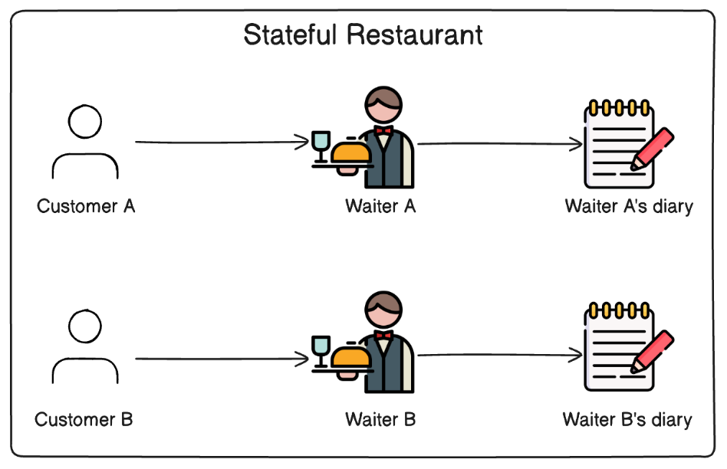
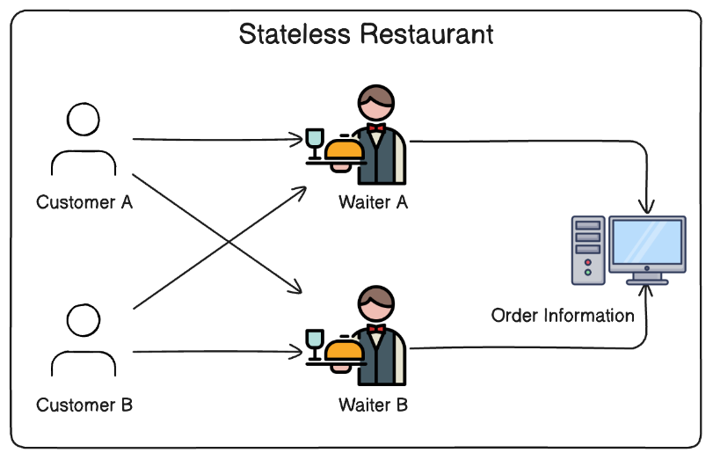


REST priciples (2 from 6)
Statelessness.

Slide 9

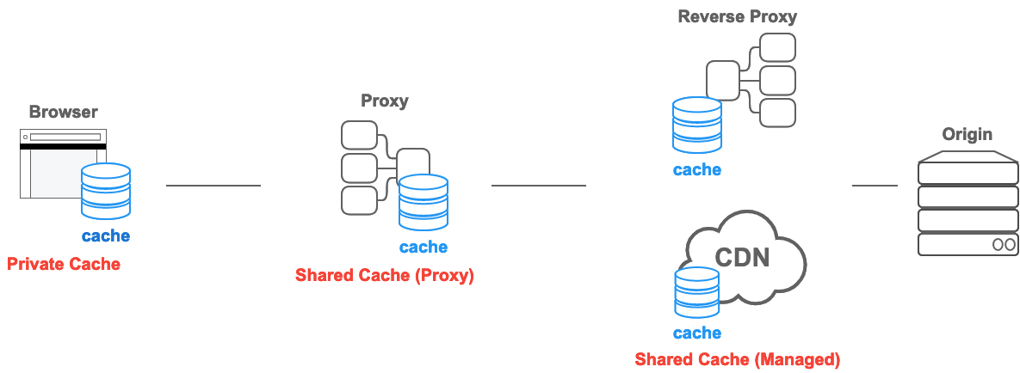
REST priciples (3 from 6)
Сacheability.

Slide 10



REST priciples (4 from 6)
Uniform interface.
OPTIONS

Slide 11

REST priciples (5 from 6)
Layered server system.
Client 1
G
A
T
E
W
A
Y
C
1
Server
I
R
U
Client 2
D
PROXY
C
2
Server
I
R
Client 3
U
D
I

Slide 12



REST priciples (6 from 6)
Optional code-on-demand
7.1, RFC 4329. obsolete
GET /product/id HTTP/1.1
Content-Type: content-type: text/javascript; charset=utf-8
7.2, RFC 4329
GET /product/id HTTP/1.1
Content-Type: content-type: application/javascript; charset=utf-8

Slide 13


REST priciples (>6 from 6)
Any other suggestions are just a extension of Roy Fielding's original idea
A good extension for REST documentation from AWS
https://aws.amazon.com/what-is/restful-api/

Slide 14
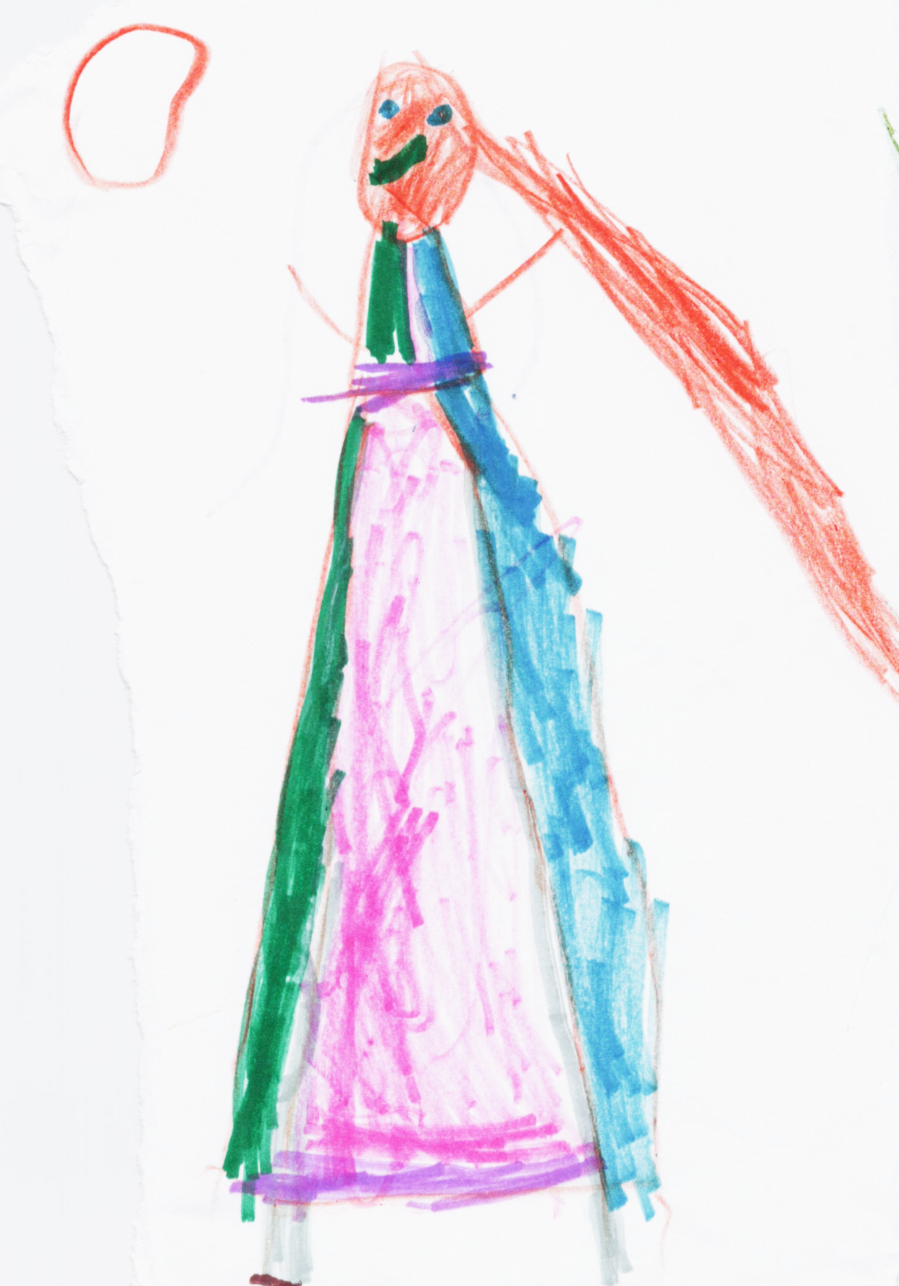
RESTfull api
APIs following the REST architectural style are called REST APIs
Web services containing REST APIs are RESTful web services.
Under RESTful APIs are meant RESTful web services.

Slide 15

APIs in Django are not RESTfull…
Generally, statefil due sessions
The Routing for Request Methods not in a box
Handlers for TRACE, HEADS, PATCH request methods not in the box
API autodocumentation is not in the box

Slide 16

APIs elements in Django:
Django
middleware
middleware
middleware
url-dispatcher
view.as_view
Validators
webserver
Models ORM
Collect context
middleware
middleware
middleware
render to response
serializers

Slide 17

APIs elements in Django:
Middleware in Django:
Applied on every request
Reduced performance
Breaks statelessy
Not every middleware suited for every request
middleware
middleware
middleware
url-dispatcher

Slide 18

Middlware alternatives:
method / function decorator
from django.utils.decorators import method_decorator
from django.utils.decorators import decorator_from_middleware_with_args
cache_func = decorator_from_middleware_with_args(CacheMiddleware)
@method_decorator('get', cache_func(3600))
def ProductDetail(DetailView):
...

Slide 19


Important changes in Django 5.2
@method_decorator('get', cache_func(3600))
def ProductDetail(DetailView):
…
async def get(self, *args, **kwargs):
…

Slide 20

APIs elements in Django:
Url dispatcher in Django:
Class URLResolver aka “urlpatterns”
Provide appropriated handler by URI from request
Single url or group of urls can be wrapped by decorator instead of using middleware.
middleware
url-dispatcher
view.as_view

Slide 21

Middlware alternatives:
wrappers for groups of urls (still not async)
from authlib.integrations.django_oauth2 import ResourceProtector
jwt_protector = ResourceProtector()
urlpatterns = [path(‘api/', jwt_protector(include('api.urls')))]

Slide 22

APIs elements in Django:
sync/async FB views or GCB views
GCBView.dispatch Provide handler
for appropriate request.method
response object should be returned
url-dispatcher
view.as_view
Validators

Slide 23

APIs elements in Django:
Django.forms.Form as a data validator.
Simple data validation with Validators
Complex validation on Form._post_clean()
view.as_view
Validators
Models ORM

Slide 24

APIs elements in Django:
Model. refresh_from_db() – to fetch data from DB
Model.save() – to save data to DB
Complex DB validation on Model.full_clean()
Model.clean()
Model.validate_unique()
Some methods formally a-sync
Validators
Models ORM
Collect context

Slide 25
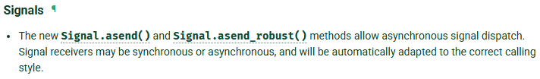

@receiver(my_signal)
async def my_async_receiver(sender, **kwargs):
await logging.ainfo(f"{sender} signal received")

Slide 26

APIs elements in Django:
Weakest part in GCBV, not designed to be async
Designed to perform final business logic
Models ORM
Collect context
serializers

Slide 27

APIs elements in Django:
Django.core.serializer as a result serializer, (improvements in Dj5.2)
Knows, how to serialize specific data.
Should not perform data validation
Not designed to be async!
Collect context
render to response
serializers

Slide 28

APIs elements in Django:
JsonResponse / HttpResponse class for response.
StreamingHttpResponse for partially prepeared data (async)
middleware
render to response
serializers

Slide 29

APIs elements in Django:
Last middleware in Django „convert_exception_to_response”.
To serialize Exception from Django.core.exceptions in Response.
middleware
render to response

Slide 30

Async APIs elements in Django:
A
A
A
Django
middleware
middleware
middleware
url-dispatcher
view.as_view
A
Validators
webserver
A
A
Models ORM
A
Collect context
middleware
middleware
middleware
render to response
serializers
A

Slide 31
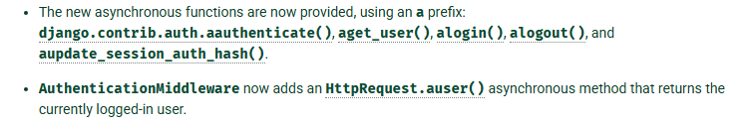
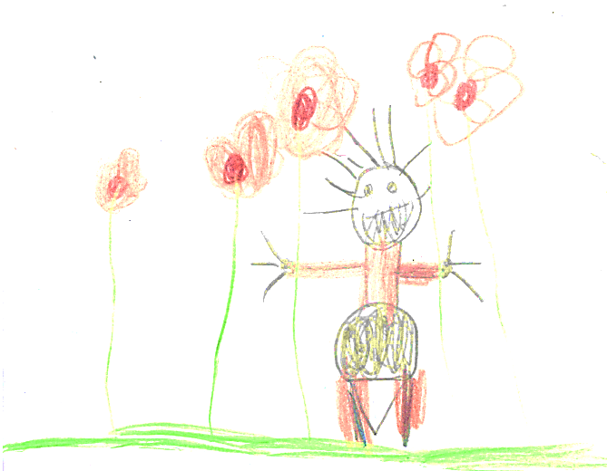

API decorators in Django:
Auth/permissions decorator (in general async)
Cache decorators (async in last version)

Slide 32


REST API Autodocumentation:
Request.method.OPTION to provide yaml documentation about the API
Handler.doctring used to provide information for yaml generation
dockstring is updated automatically by the linter
www.youtube.com/watch?v=MeoKMdyPRWo

Slide 33

Summary:
Raw Django has EVERYTHING you need to create REST APIs
REST APIs in Raw Django can be a synchronous or asynchronous
Raw Django is not ready to offer full async functionality
Know you framework for fun and profit!

Slide 34

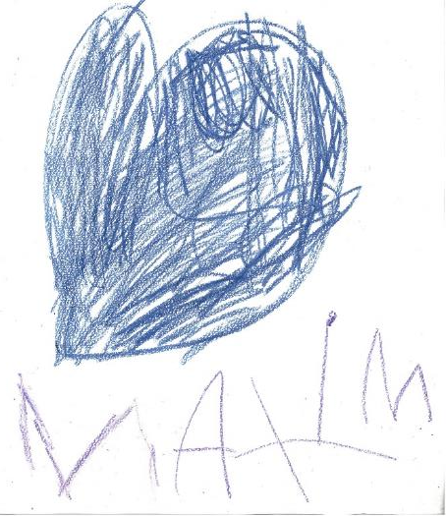
Thank you for your attention!
Maxim Danilov
maxim@wpshop.at
Link to slides & code
https://github.com/danilovmy/pyconpt2025/tree/main/workshop

