Slide 1
Pilot Campaign: Performance and Insights
Daniela A. Nomura
Novembro/2020

Slide 2
Introduction
We have studied the Pilot CRM Campaign where 2.240 randomly selected customers were contacted by phone regarding the acquisition of a gadget. To make the next campaign the most profitable as possible and to understand the features of the customers who accepted the offer, we carried a detailed study based on the data of the last 5 campaigns, customer's information and historic behavior.
On the next slides you will find:
Overview of the Campaign;
Customer’s profile (Customers who accepted at least one offer x Customers who didn’t accept any offer);
Customer's segmentation based on historical behavior;
Predictive model to improve the profit of the campaign;
Conclusions

Slide 3
Pilot Campaign
After 5 campaigns, 463 (20.7%) of the 2,240 clients who were contacted bought the product at least once and 667 offers were accepted.
The amount of accepted offer per campaign and the success rate are shown above:
As we can see, Campaign 4 performed better and Campaign 2 performed worse. Even at Campaign 4, only 7.5% of the contacted customers effectively bought the gadget, showing that it is possible to better select the customers most likely to purchase, in order to reduce the costs of the campaign and improve the profit.
The ROI of the campaign was – 45%.
 | Campaign 1 | Campaign 2 | Campaign 3 | Campaign 4 | Campaign 5
Accepted offers | 144 | 30 | 163 | 167 | 163
Success Rate (%) | 6,4 | 1,3 | 7,3 | 7,5 | 7,3

Slide 4
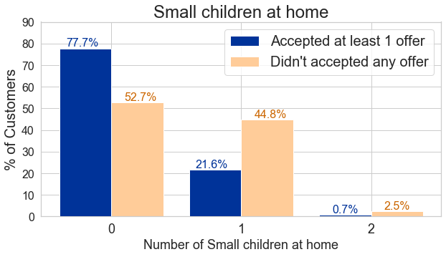
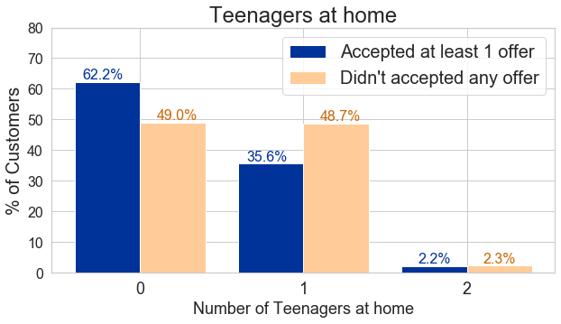
Customer’s Profile
To better understand the characteristic features of the respondents, we split the customers into two groups: The ones who accepted the offer at least once and the ones who never accepted any offer.
One interesting feature of the customers who accepted the offer is the higher proportion of customer who doesn’t have children or teenagers at home, when compared to the group who didn’t accepted the offer.

Slide 5
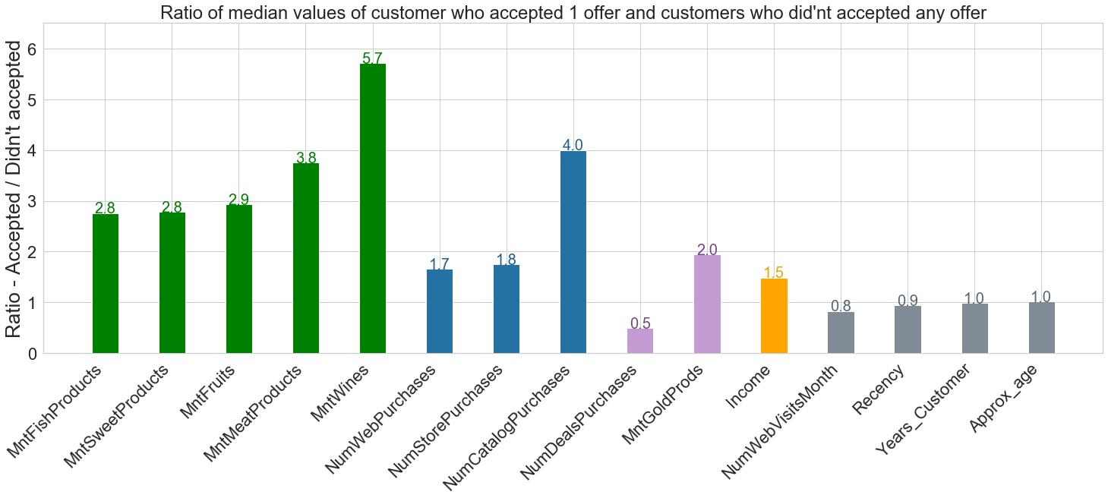
Customer’s Profile
Comparing the median values of the customers who accepted the offer at least once with the ones who didn’t accept any offer, we can see that the group of respondents are the best customers!
They spent more, in the last 2 years, in all categories: Wine (5.7 times more!), Fruits, Meat, Fish and Sweet;
They did more transactions in all 3 channels (Web, Catalog and Store);
They spent 2 times more in gold products and did less purchases with discount;
The median value of the income is 1.5 times higher for the customers who accepted the offer;
The representative values of Web site visits, Recency, Age and Date of enrollment are similar for both groups.

Slide 6
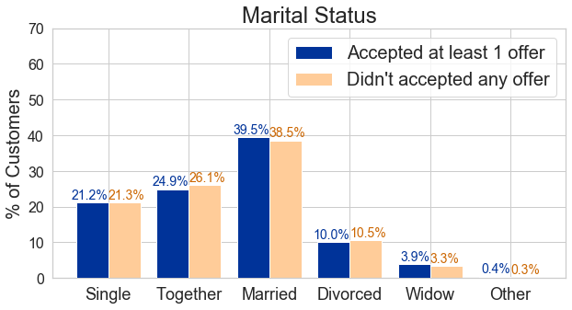
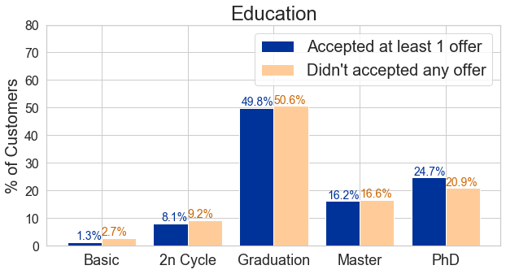
Customer’s Profile
Regarding the Marital Status, we can see that most of our clients are Married, followed by Together, Single, Divorced and Widow. There is no big difference when comparing the share of which status between the two groups of customers.
For the Education values, most of the customers are Graduated, followed by PhD, Master, 2nd Cycle and Basic. For the customers that accepted the offer at least once, we have slightly higher participation of customers with a PhD degree and lesser from the Basic and 2nd cycle.
Regarding the age, the median value of the clients who accepted the offer is 51 years old and for the clients who didn’t accept is 50 years old and the range distribution is between 24 and 80 years old.

Slide 7
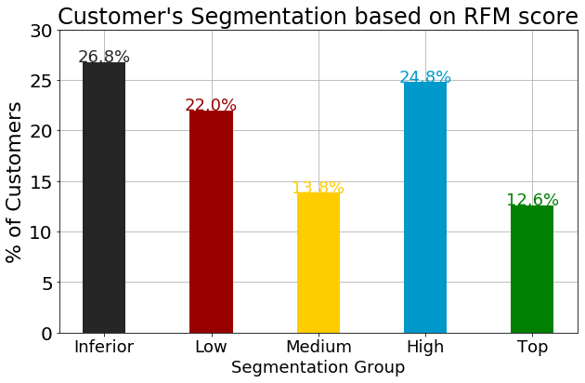
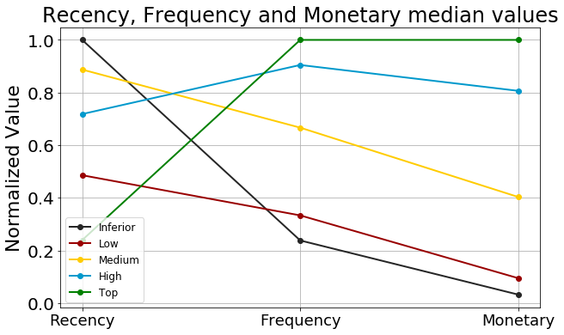
Customer’s Segmentation
Based on customer’s Recency, Frequency and Monetary Value we segment the customers into 5 groups: Top, High, Medium, Low and Inferior. The customers from the TOP group are our most profitable customers, as they shop more (high frequency), spend more (high monetary value) and are still active (low recency value). The top clients represents 12.6% our customers.

Slide 8
Customer’s Segmentation
Using this Customer’s segmentation, we could focus the campaign on our most engaged customers, that would be the groups: Top, High and Medium. Using this approach from Campaign 1 to 5, we can compare the number of contacted customers and the amount of gadgets sold considering the entire base of customers and only the best customers:
 | Unique Customers | Gadgets sold
All Customers | 2212 | 660
Best Customers | 1134 | 552
Difference (%) | -48.7% | -16.4%
As we can see, by only contacting the most active and loyal customers, we would reduce the contact costs in 48.7% and the revenue from the gadgets sold would decrease in only 16.4%.
By focusing only on our best customers, we would increase the ROI of the Campaign from -45% to -11%. Still not the ideal situation, but already an improvement. In order to make the next campaign highly profitable, we worked on a predictive model.

Slide 9
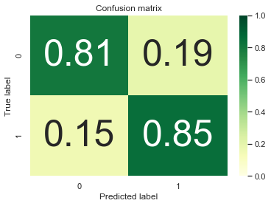
Predictive Model
Using a logistic regression model to predict the probability of the customer accept or not the next campaign, we could correctly predict 85% of the customers who would accept the offer and 81% who wouldn’t accept the offer on the last campaign. It means that using the selected customers by the model, the success rate of the campaign would increase from 15 to 44%.
By calling only the customers that the model predicted are likely to accept the offer, we would contact 71% less customers and the amount of gadgets sold would decrease only 15%.
The main features for the model were: amount of the offers accepted before, if the client accepted the offer on Campaign 5, if accepted on Campaign 1, the RFM Score, If accepted on Campaign 3, Number of Catalog Purchases, amount spent on meat, recency value, for how long the customer is enrolled with the company, amount spent on wine, if accepted campaign 4, amount spent on gold products, if accepted Campaign 2, number of Web purchases, if there is teenagers at home, the income, amount spent on fruits, amount spent on sweet, amount spent on fish, Education level and small children at home.

Slide 10
Conclusions
Using a data-driven approach it is possible to increase the profit of the campaigns by better selecting the customers most likely to purchase;
The customers who bought at least 1 offer at Campaigns 1 to 5 were mostly the ones with no small children or teenager at home and the ones with better income, higher amount of spending and transactions and with more gold transactions and less purchases with discount, being our best costumers;
Segmenting the customers based on their Recency, Frequency and Monetary value, it is possible to select only our more engaged and profitable customers, increasing the ROI of the campaign from -45% to -11%;
Using a logistic regression model it was possible to correctly predict 85% of the customers who respond to the last campaign, what would increase the success rate of the campaign from 15 to 44%, saving a lot of costs and time by contacting much less customers.
The collaboration between data scientists and the marketing team is essential to increase campaign’s profit and to drive better decision-making, supporting the company’s growth.

