Slide 1

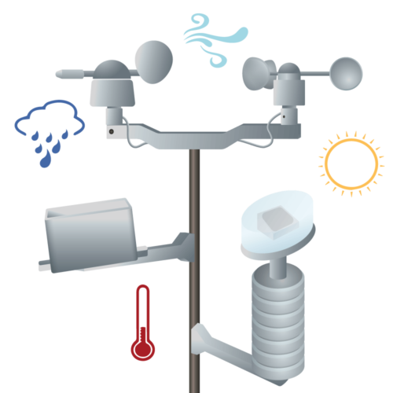



Weather prediction
Computer
MongoDb
Anaconda container
Python
predictor & notifier
Sends data through HC-12 device
Python training
script
Python serial listener

