Slide 1


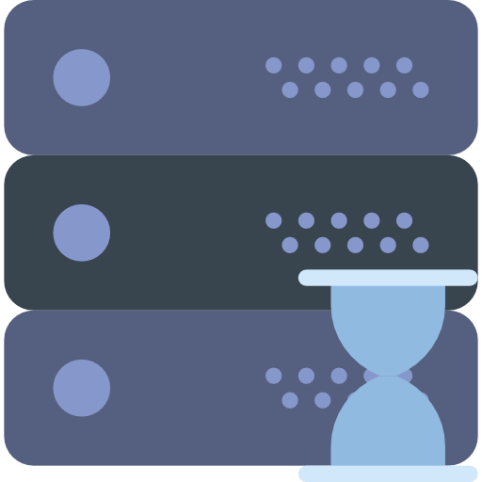
Face recognition wrapper
Docker compose
(On Raspberry pi)
Video stream
/dev/video0
MongoDB
Python server
Mosquito
(MQTT)

