Slide 1


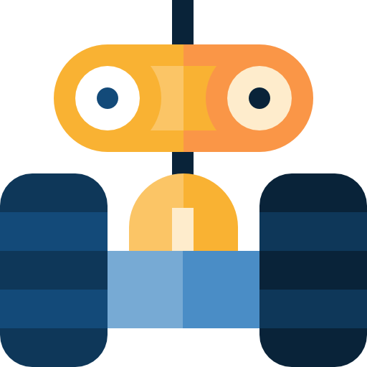
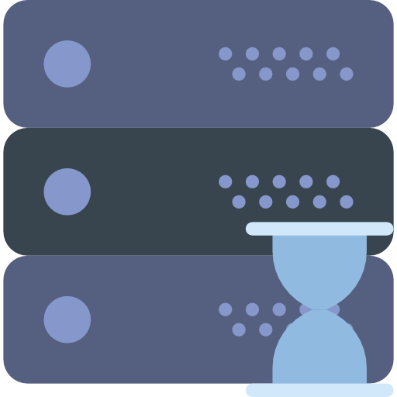
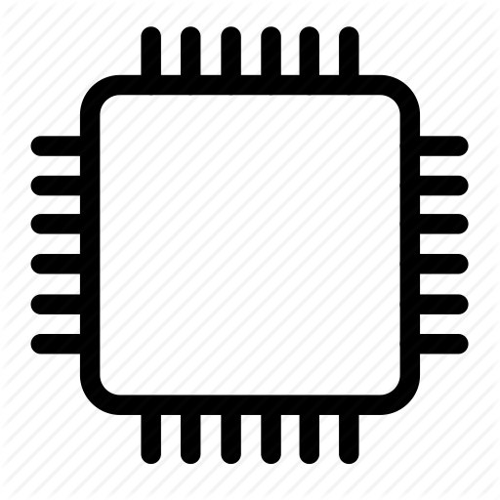

Face recognition wrapper
Raspberry pi
Android → robot data flow
Uv4l streamming
Receives streamming
Get video stream from camera
Robot hardware
(lights, motors, camera)
Android App
Docker container
Python server
Microcontroller (Arduino)
Electric signals
Low level serial
commands
Receives obstacle status
Sends motor and light commands
Receives commands,
Send obstacle data
Mosquito
(MQTT)

