Slide 1
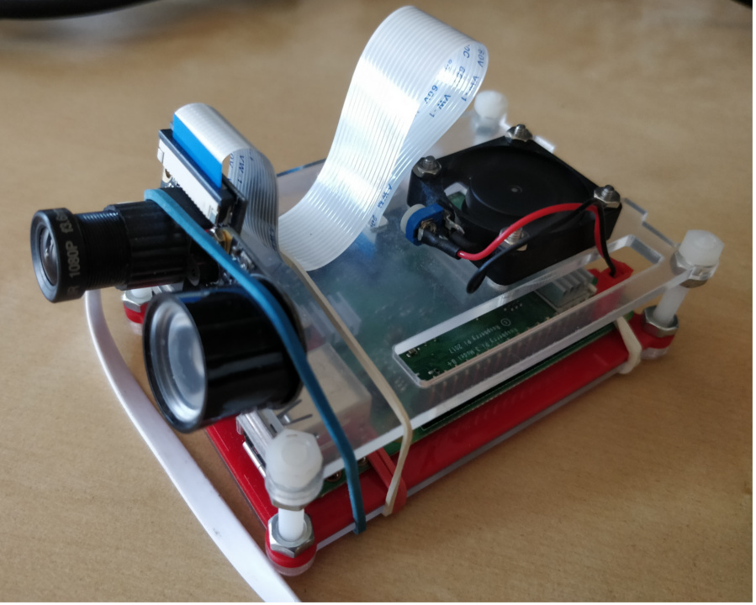
Smart door camera
* Purpose
* Technical overview
* Software architecture
* Detection pipeline
* Performance
and conclusions
* Further references

Slide 2
Purpose
The smart door camera is a device that will sit at the door or porch and report who’s there before answering the door or if the occupants are not home message them via various channels.
The key advantages over the competition:
- it’s a low budget project for hobists (under 100$)
- it will process all data locally, no subscription for external services is needed, reduces bandwidth because the processing is locally
- it’s open source, easy to learn and modify

Slide 3
Purpose
So, how does it work now?
First thing there’s no User Interface yet, so the user profiles will be created with HTTP requests like so :
curl -X POST -d name=some_name http://machine_ip:8080/user/some_numeric_id
curl -F "user_id=1" -F "photo=@/path_to_picture/picture.jpg" http://machine_ip:8080/face/face_number
With the device running, all persons that come in the detection range will emit a configurable alert SMS / Email / TTS etc. For example if the user is not home it will receive a SMS alert, and if it’s home it will hear the text to speech from a IOT speaker.

Slide 4

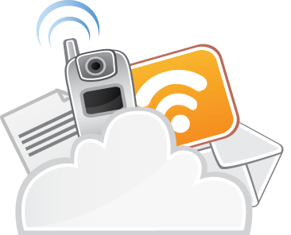
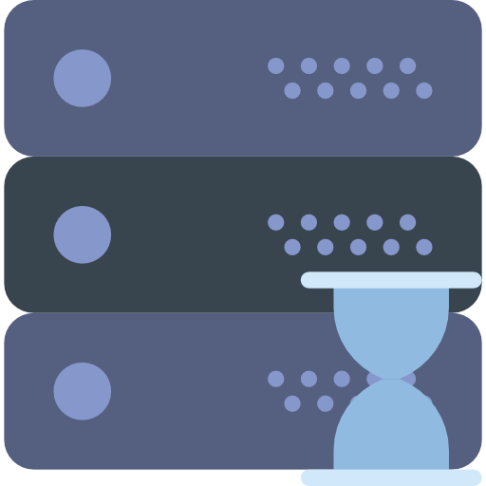
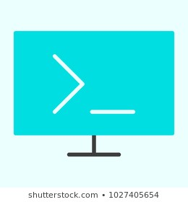
Software architecture
Docker compose – high level architecture
External
MongoDB
Mosquito
(MQTT)
SMS Api
EMAIL
Text To Speech speaker
Face tracker
Face tracker webservice
Person monitor
CURL / Future UI

Slide 5
Software architecture
The architecture revolves around a unix system and several components tide up using docker and docker compose. It’s suited for a development board like a Raspberry Pi
The backend offers a REST API for creating user profiles, upload their faces and other CRUD operations. This will be used in the future for creating a nice UI for the project.

Slide 6
Software architecture
For permanent storage of user data the system used a mongoDb container
There is a container running the actual face recognition and detection from the video stream
The event of finding of a face is transmitted over MQTT, so there is a need for a MQTT broker, i’ve chosen Mosquitto for this.

Slide 7
Software architecture
Finally there is a container running the monitoring process. It listens to the MQTT events and decides if it should send an alert. This process handles the email / sms / text to speech alerts

Slide 8
Detection pipeline
For the actual image processing i’ve chosen python because of it’s active computer vision community.
The system restrictions are:
- a low power computer (development board) this means we don’t have a lot of processing power
- the detections should be near real time because the alert should be as quick as possible

Slide 9
Detection pipeline
To meet these demands the pipeline does the following:
- reads a frame from the video
- it resizes the image to a low resolution version and performs movement detection
- if movement is detected, the original frame (which wasn’t resized) is cropped to contain only the moving part and it’s sent to some background workers which will do the actual face recognition and detection

Slide 10
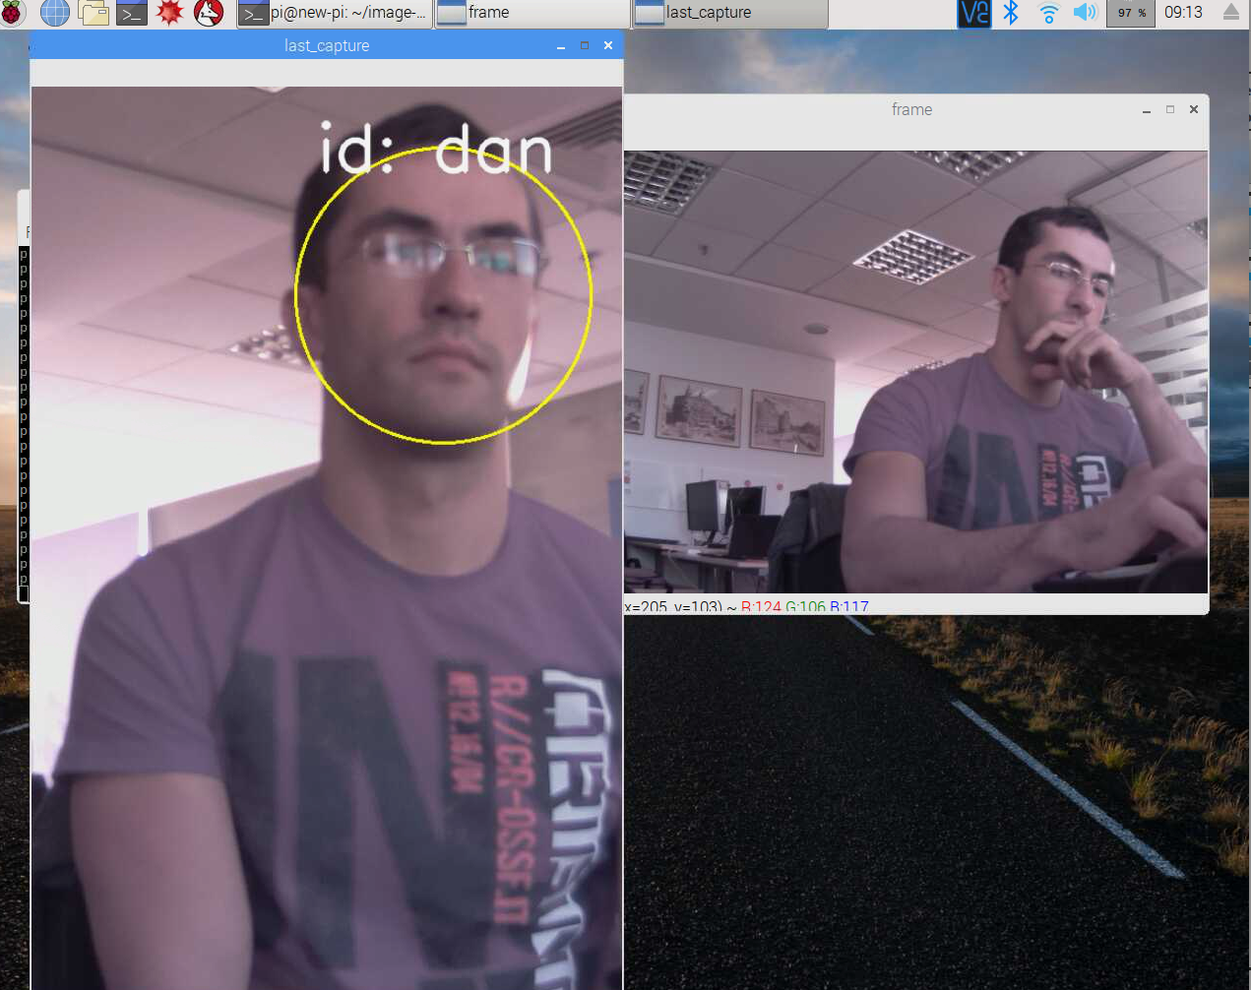
Detection pipeline
The main program loop
reads from camera,
runs movement detection
communicates with subprocesses
and send a MQTT alerts
With motion detection
technique the actual
search size of the
image is reduced

Slide 11
Detection pipeline
- if the background process Queue has found a valid detection, users details are extracted from the database, encoded along with the image using base 64 and JSON and sent over MQTT
Some implementation details:
Motion detection: i’m using openCV for performing motion detection. This is done by substracting pixel matrixes, applying threshold value, eliminating zones with little differences, and creating a minimum rectangle that fits all parts of the image that contains accepted movement

Slide 12
Detection pipeline
* Face detection and recognition:
First we resize the image containing motion to a low resolution, and then for the detection part i’ve chosen a 17k star library on github named “face_recognition” that works well and it’s super easy to use. The library API has the following steps:
1. load face images, and create the 128 feature encodings
2. find faces in a picture of interest
3. encode found faces as well using the 128 feature encodings
4. compare face encodings in the picture of interest with the ones in the known pictures to find a match

Slide 13
Performance and conclusions
Using this technique I was able to process about 0.5 - 1 frame per second on a raspberry pi 3, and the algorithm it works well at close range (under 4 meters).
Other development boards on the market have 10x the processing power of a raspberry pi so higher frame rates can be achieved or higher resolutions like UDOO (check the references section)

Slide 14
Performance and conclusions
Higher frame rates will mean a faster detection and a more accurate against movement. Higher resolution will mean a detection will be possible over a longer distance.
I think this is a great project for people who want to get started with the computer vision world, microservices and public APIs

Slide 15
Performance and conclusions
If you like this project, you can help by contributing here: https://github.com/danionescu0/image-processing-projects
Ideas for future improvements:
- a nice full-featured UI with easy configuration for alerts, view last detections, add persons etc
- improve the system by adding a hardware PIR sensor (motion sensor) to conserve energy even further

Slide 16
Performance and conclusions
- video conference from the phone application
- improve the face detection algorithm to differentiate between pictures and people (this is a hard one)

Slide 17
Further references
A great library for face detection, easy to use and accurate
https://github.com/ageitgey/face_recognition
General purpose computer vision library
https://opencv.org/
A great blog about movement detection, also
a lot of computer vision projects explained:
https://www.pyimagesearch.com/2015/05/25/basic-motion-detection-and-tracking-with-python-and-opencv/
A 10x more powerfull development board (UDUU)
https://shop.udoo.org/eu/x86.html?___from_store=other&popup=no

Slide 18
Thank you

