Slide 1
HW2
Goal: To learn how to write simple SQL queries (what we learnt in chapter 3) for MySQL
Total Points: 25
Due: Oct 31, 2016 (Monday) by 11:59 pm

Slide 2
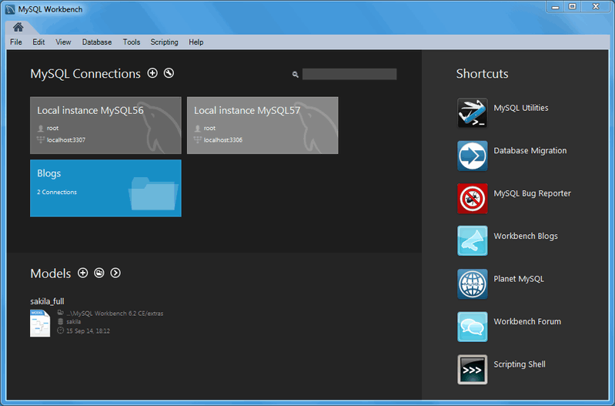
Task #1: Install MySQL & MySQL workbench (5 points)
Install MySQL and MySQL workbench in your laptop (5 points)
  https://dev.mysql.com/downloads/workbench/
  What to submit
    Screen shot of MySQL installation on your laptop

Slide 3
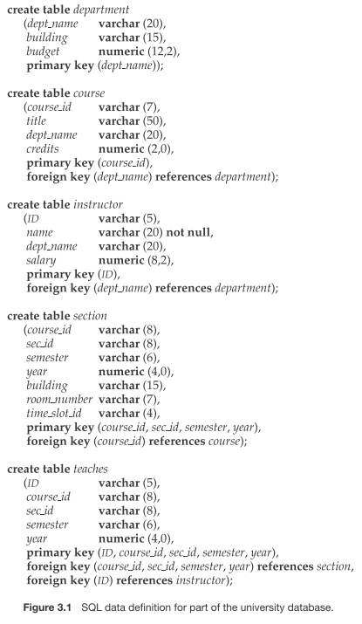
Task # 2. Create a University Database (5 points)
Write the SQL queries compatible with MySQL
What to submit
  All SQL queries used for creating this database.

Slide 4
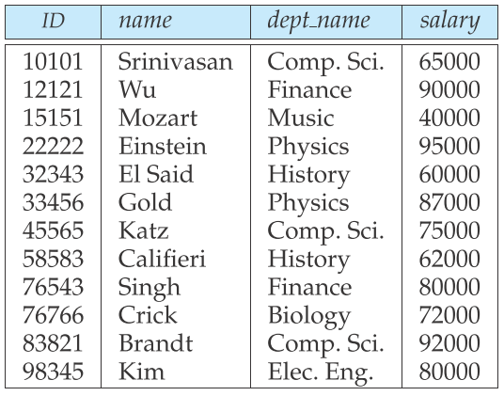
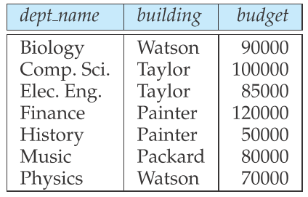
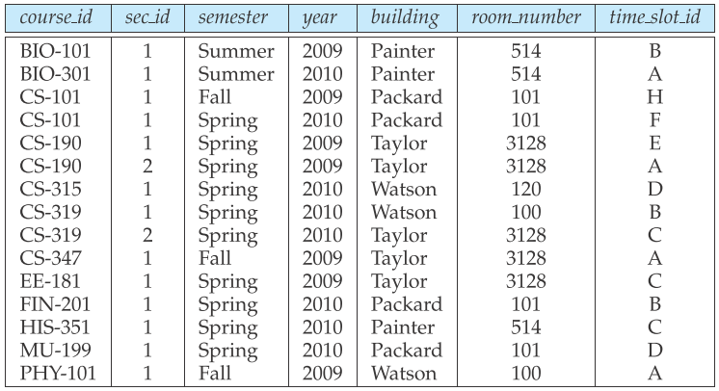
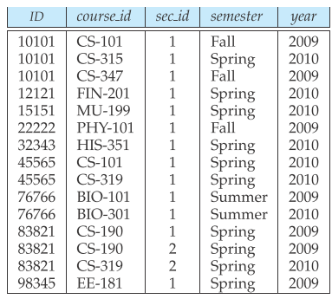
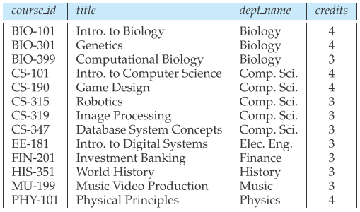
Task #3. Populate Tables with Data (5 points)
department relation
instructor relation
section relation
course relation
teaches relation
What to submit
All the SQL queries to insert data into these tables
Screen Shots of all these tables (after data insertion is complete)
  Make sure that you only show top 10 tuples of each table

Slide 5
Task #3: Write SQL queries for the following (10 points)
Retrieve the names of all instructors, along with their department names and department building name.
For all instructors of Comp. Sci. department who have taught some course, find their names and the course ID of the courses they taught.
Find the names of all instructors whose salary is greater than at least one instructor in the Finance department.
Find courses that taught either in Fall 2009 or in Spring 2010.
Find names and average salaries of all departments whose average salary > 42000.
What to submit
All the SQL queries
Screen Shots of the results of these SQL queries

Slide 6
Submission
Submit on Canvas
File format: doc/docx/pdf

Slide 7
Tips
You may use the SQL script I provided for initial guideline
Use “Discussions” section in Canvas to discuss any technical issue (e.g., installation problem, SQL command syntax for MySQL, etc.)
  Please don’t post your final SQL code

