Slide 1
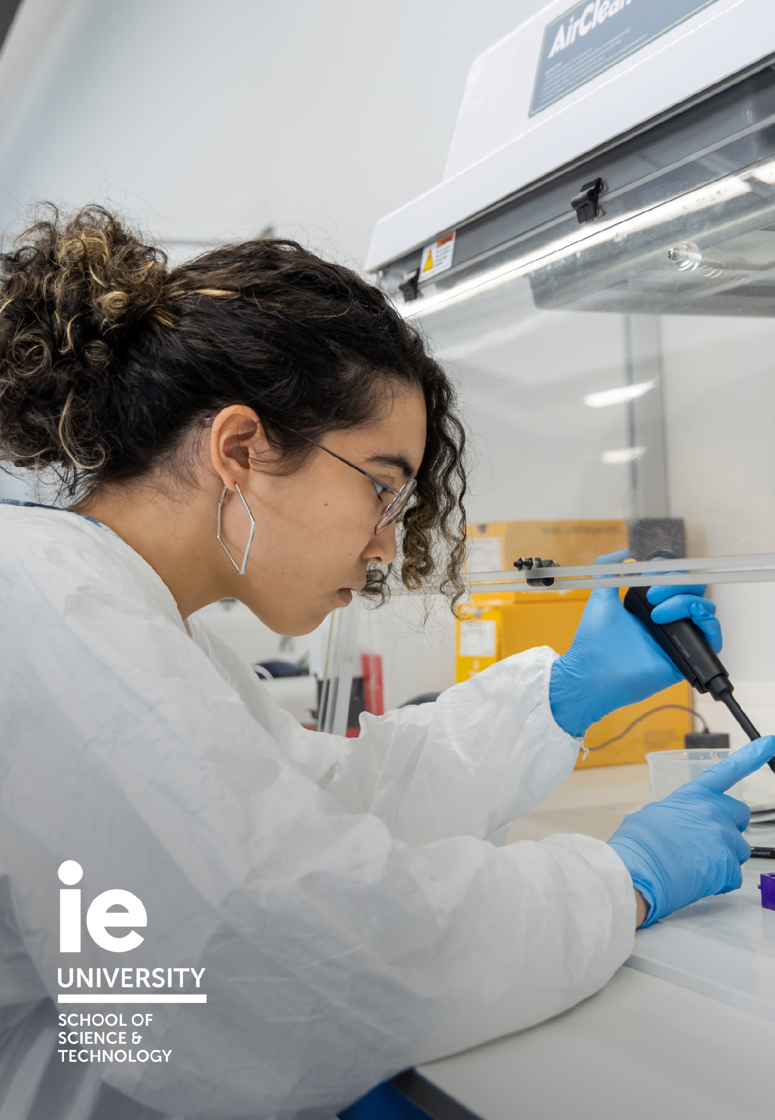

HOMEWORK MODULE 2
Wednesday, 14th October
Solve all mandatory exercises in module 2
3.3% of your overall score
(participation grade)

Slide 2

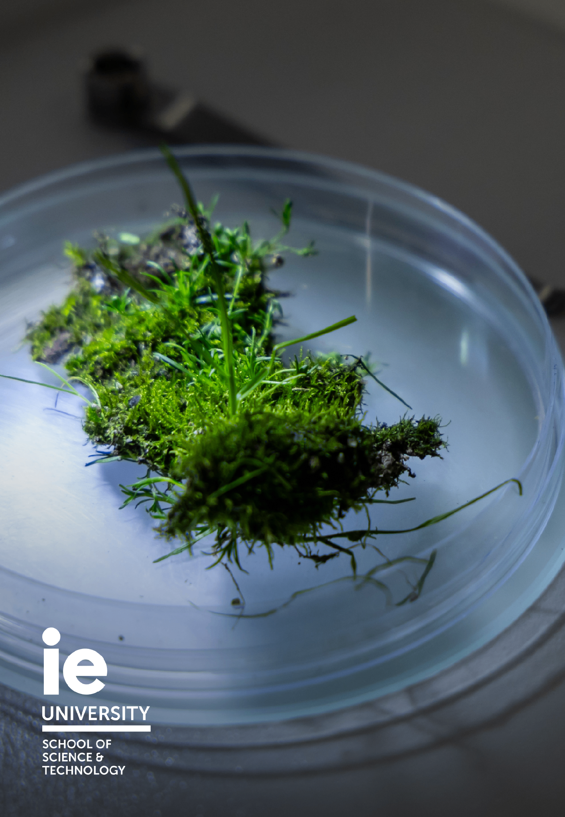
MIDTERM
Monday, 19th October
Modules 1 and 2
1 hr 20 minutes (full session)
15% of your overall score

Slide 3


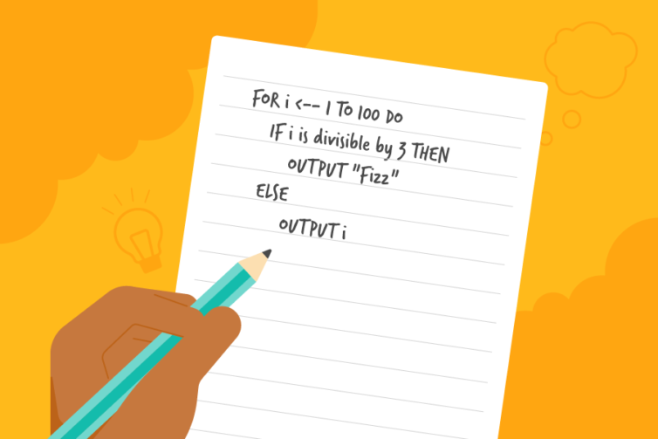
MIDTERM
EXAM
THREE PARTS
MULTIPLE CHOICE
1 hr 20 min
Six questions. Same as quizzes
PROBLEM SOLVING
DEBUGGING
Three questions. Explain why a code fails and fix it
Two questions. Explain how you would approach a coding challenge

Slide 4
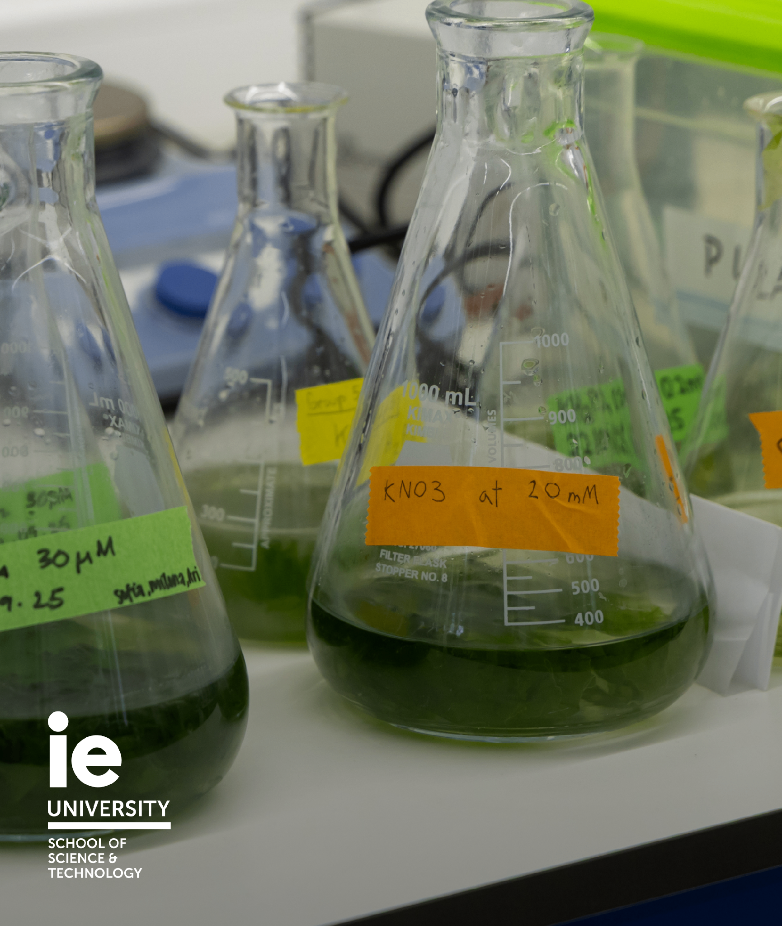

(FUN) SIDE PROJECTS
Until End of Course
1
2
Google Colab report-style
+0.25 on the final exam
Maximum of 0.75
(three projects)
3

Slide 5


SESSION 9 · STRUCTURES
DICTIONARIES

Slide 6



SHELF
PAINTING
ONE ROOM, FOUR STRUCTURES
list
tuple
Ordered · repeats · editable
Fixed after you hang it
Choose storage by what must stay true.
DRAWER
LABELLED LOCKERS
set
dict
Only what is inside matters
A key points to a value

