Slide 1
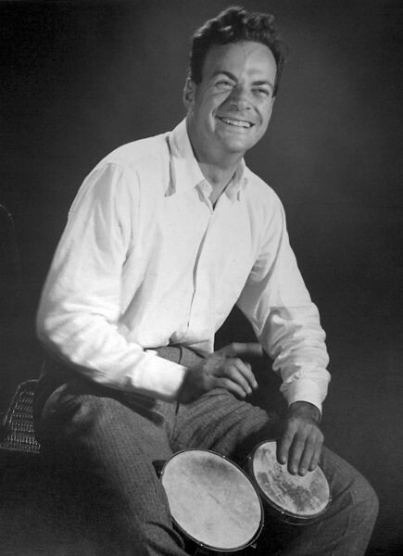
"What I cannot create, I do not understand"
- Richard Feynman

Slide 2
WEATHER
ROUTING
Energy-efficient routes with just-in-time arrival
Notes:
Opening only. Do not show the route comparison yet. The visual endpoint mismatch is intentionally saved for the final slide. Design follows the IE School of Science & Technology 2025 template in OneDrive/design.
Session framing: AI can generate large amounts of mostly correct code. These two cases show why domain knowledge and coding intuition remain essential for finding the small mistakes that matter.

Slide 3
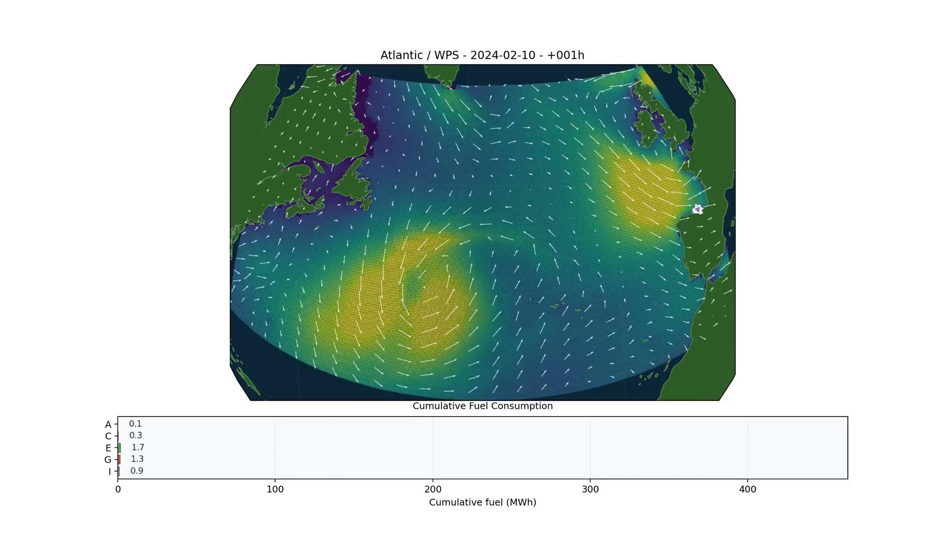
COMPETING TO BE THE MOST EFFICIENT

Slide 4
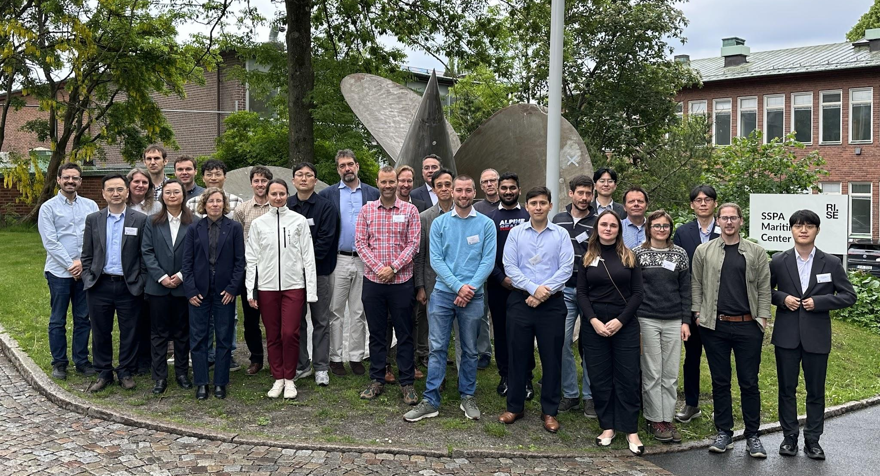


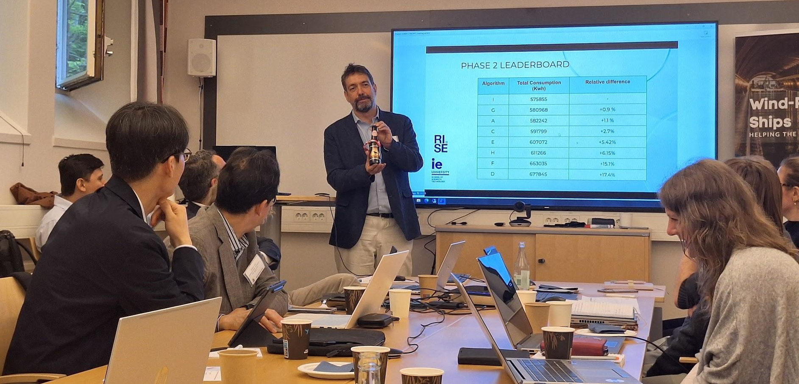



THE SWOPP BENCHMARK TESTED COMPETING APPROACHES
8
participants from academia and industry
The workshop supported continuing the benchmark line into SWOPP4.

Slide 5
AN EXISTING ROUTING SYSTEM
SWOPP3 added a new Atlantic endpoint to a mature codebase
1
PORT CODE
ports = {
dictionary lookup
"ESSDR": { ... },
2
WEATHER
hourly fields
"new_port": { ... },
3
INTERPOLATION
...
place and time
}
4
CONSUMPTION
vessel model
Several complex layers could explain a disagreement
Notes:
The competition introduced a new Atlantic endpoint into an existing system. The code included port lookups, great-circle geometry, ERA5 weather data, interpolation, and the vessel-consumption model. The port code is deliberately anonymized on this slide so the final key comparison remains a reveal.

Slide 6
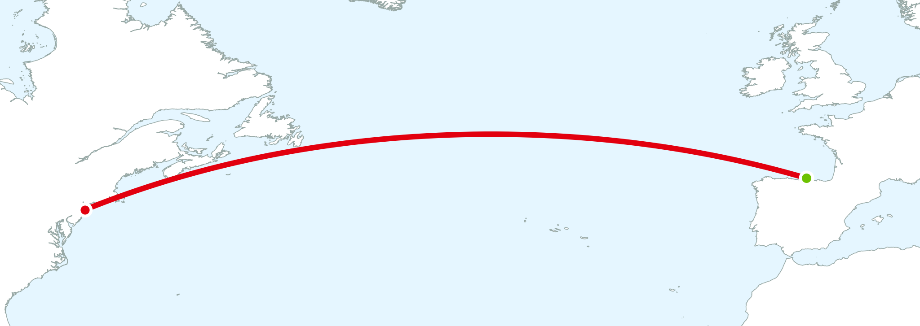
VALIDATE OUR GREAT CIRCLE
AGAINST THEIR REFERENCE
Sail distance, passage time, energy consumption

Slide 7
THE COMPUTED VALIDATION DID NOT MATCH
The program finished normally and produced plausible values
>>> check_great_circle_baseline()
No exception
passage_time_h
354 MATCH
The route looked reasonable
sailed_distance_nm
MISMATCH
energy_consumption
MISMATCH
Knowing the expected result told us the output was wrong
Notes:
Daniel's account: the team computationally checked the great-circle validation results. The fixed 354-hour passage time agreed, while the route-dependent numbers did not reproduce the organizers' validation. The repository meeting note records that Frederik's great-circle results did not match ours. Do not show the route geometry yet.
Clarify that 354 hours was fixed in the validation setup. Its match did not validate the route. Distance and energy depended on the endpoint and therefore exposed the disagreement.

Slide 8
THE DEBUGGING SEARCH
Complex implementation details became the main suspects
weather interpolation
consumption model
The AI agent kept revising the machinery
The input still looked ordinary
great-circle maths
coordinate conventions
Your turn: what evidence would you request?
Notes:
State the chronology clearly. The agent concentrated on complex code paths. Daniel proposed asking the organizers for the actual routes behind their validation numbers. That request supplied the evidence needed for a direct point-by-point comparison. Attribution to Daniel is based on his firsthand account.
Teaching point: the AI agent kept changing complex implementation details. Coding intuition shifted the investigation toward the exact reference inputs.

Slide 9
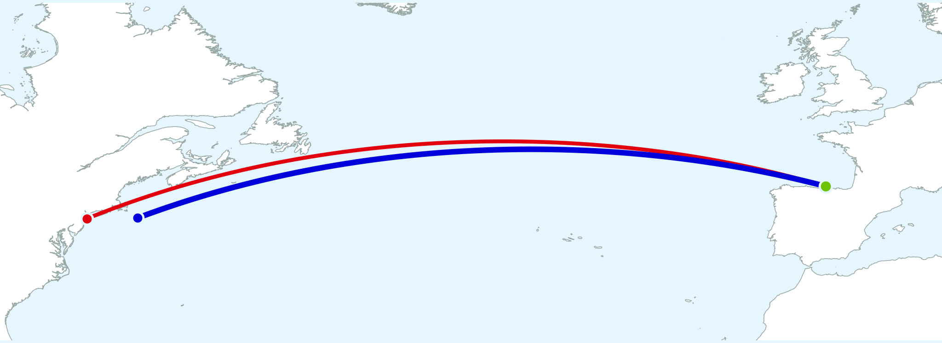
THE REFERENCE ROUTES EXPOSED THE WRONG ENDPOINT
Both port codes were valid, so no exception was raised
"dst_port": "USNYC"
405 km
+197 nm
between endpoints
on our route
"dst_port": "USNYS"
+22.4%
calm-water energy
Notes:
Final reveal. The reference routes showed that our configuration ended at USNYC while SWOPP3 required USNYS. Repository values: USNYC=(40.53, -73.80), USNYS=(40.60, -69.00). Python calculations use the competition starting-kit great_circle_waypoints and haversine_nm functions. The endpoints are 405.487 km apart. The wrong route adds 196.709 nautical miles. At the fixed 354-hour passage time, the controlled calm-water calculation with routetools.performance.predict_power gives 22.371% more energy. This controlled comparison excludes wind, waves, and wingsails. The original bug was the dictionary key, not the vessel model.
Both port codes were valid dictionary values, so the lookup could succeed without an exception. The algorithm then calculated the wrong route correctly.

Slide 10
CLIMATE CHANGE AND INSURANCE
How life expectancy will change due to temperature
Notes:
Opening only. Do not show the route comparison yet. The visual endpoint mismatch is intentionally saved for the final slide. Design follows the IE School of Science & Technology 2025 template in OneDrive/design.
Session framing: AI can generate large amounts of mostly correct code. These two cases show why domain knowledge and coding intuition remain essential for finding the small mistakes that matter.

Slide 11





RISING AWARENESS
AXA Future Risks Report. 2025 Edition
https://www.axa.com/en/about-us/future-risks-report

Slide 12


COLLABORATING WITH
VIENNA INSURANCE GROUP
3
year long project with the biggest company in Eastern Europe

Slide 13
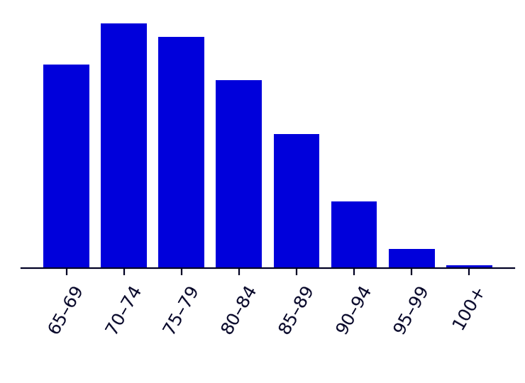
THE PROJECT
How does climate change affect life after 65?
WHAT WE HAVE
1
TEMPERATURE
projections to 2099
2
DEATHS
from heat and cold, by age group
3
SINGLE AGES
8 grouped totals into single-year estimates
4
RESULT
8 numbers, one per age band
life expectancy and inequality at 65+
Four steps and thousands of lines could hide a mistake
Notes:
Project in one sentence: we estimate how temperature-related deaths change life expectancy at 65 and how unequal ages at death are, under climate projections. Population data arrive in 5-year bands plus one open band (100 and over). Life tables need single years of age, so step 3 splits each band with a smoothing model that must keep each band's total. Five R scripts: demography, attribution, single age, master table, decomposition.

Slide 14
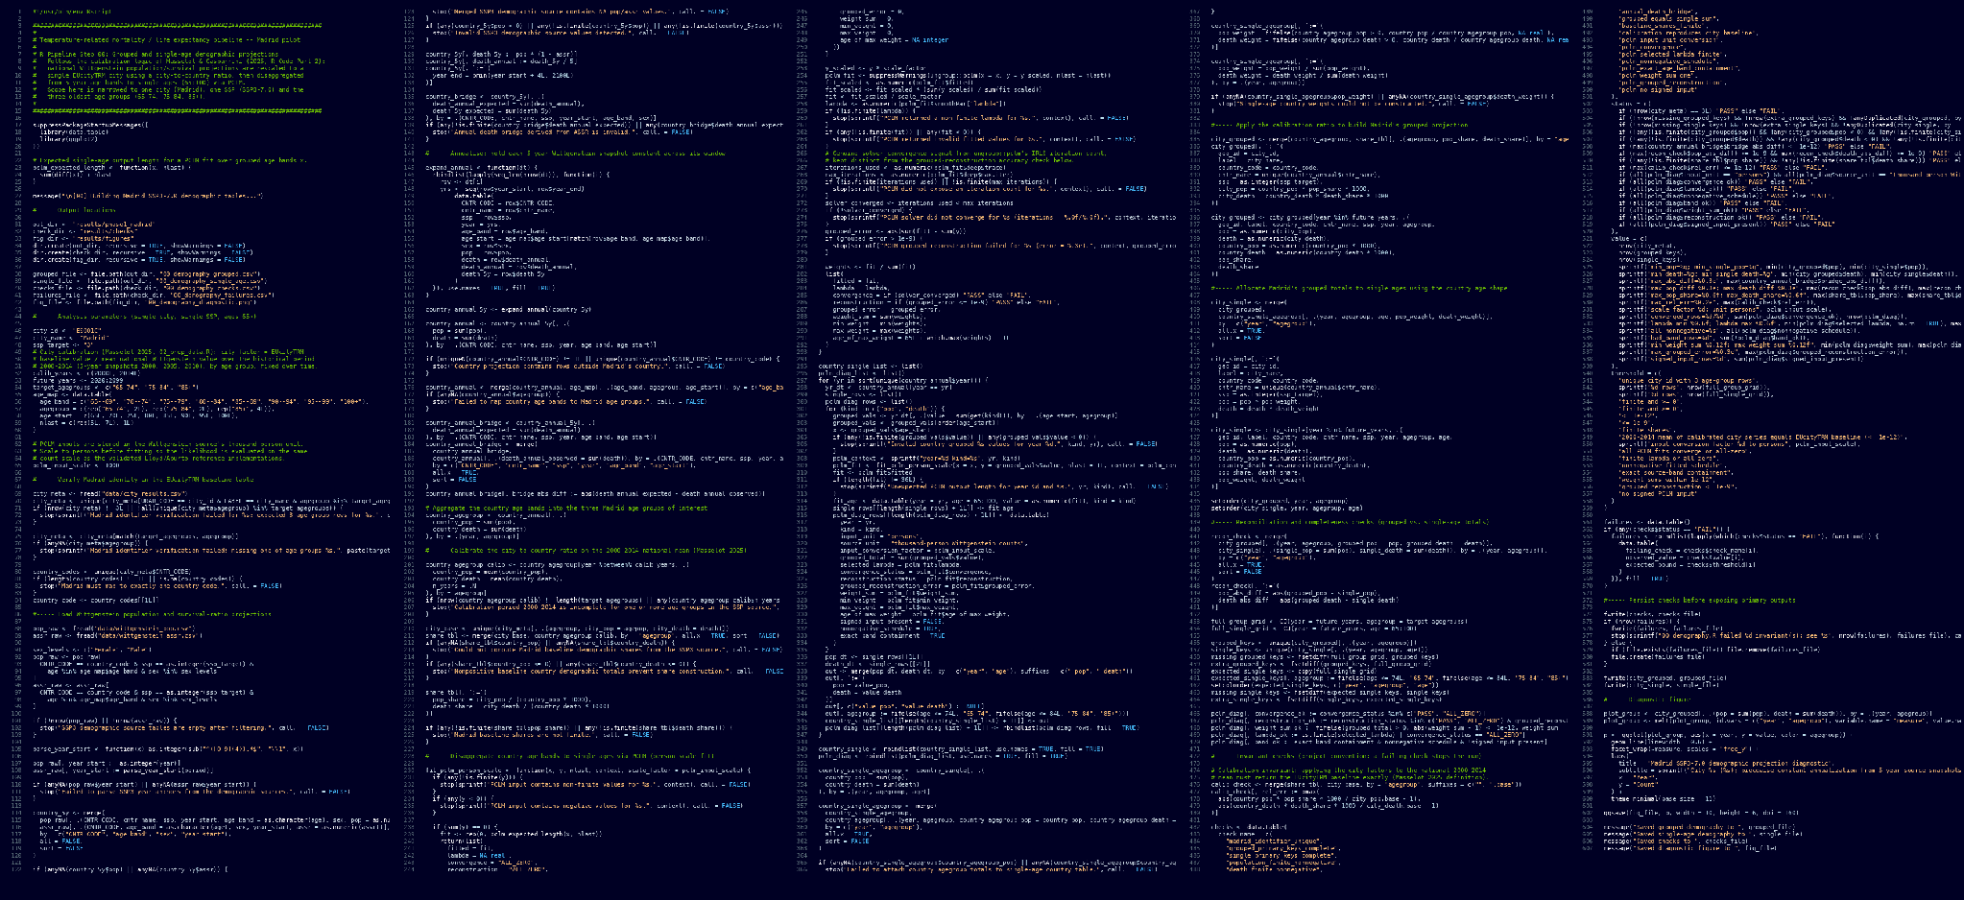
THE PROGRAM
Five scripts, 2,016 lines of mostly correct R
607 of 2,016
lines shown: one of five scripts
Notes:
Real code, step 00 (demography) before the fix, commit 6399498's parent. Let students look at it for a few seconds. Nobody will find the problem by reading this. The next slides show how you notice something is wrong without reading any of it.
Frame the code wall as the effect of AI-assisted development: volume and speed increase, but accountability does not. Most of these lines were useful and correct; one small setting still changed the result.

Slide 15
THE OUTPUT DID NOT MAKE SENSE
The program finished normally and every check passed
>>> pclm(x, people, nlast = 1)
No exception
95–99 total
271,668 MATCH
Every check passed
people at age 95
344
people at age 99
248,375
Knowing what a population looks like told us the output was wrong
death rate, ages 96 to 99
0.74 to 0.15
Notes:
Spain, 2050, both sexes, real function and real inputs. The pipeline's own checks passed: totals matched and the solver converged. Ask: does 344 people at age 95 and 248,375 at age 99 look right when the whole 95-99 band holds 271,600 people? In the pipeline itself, Madrid 2050 showed 22 people at 95 and 15,791 at 99.

Slide 16
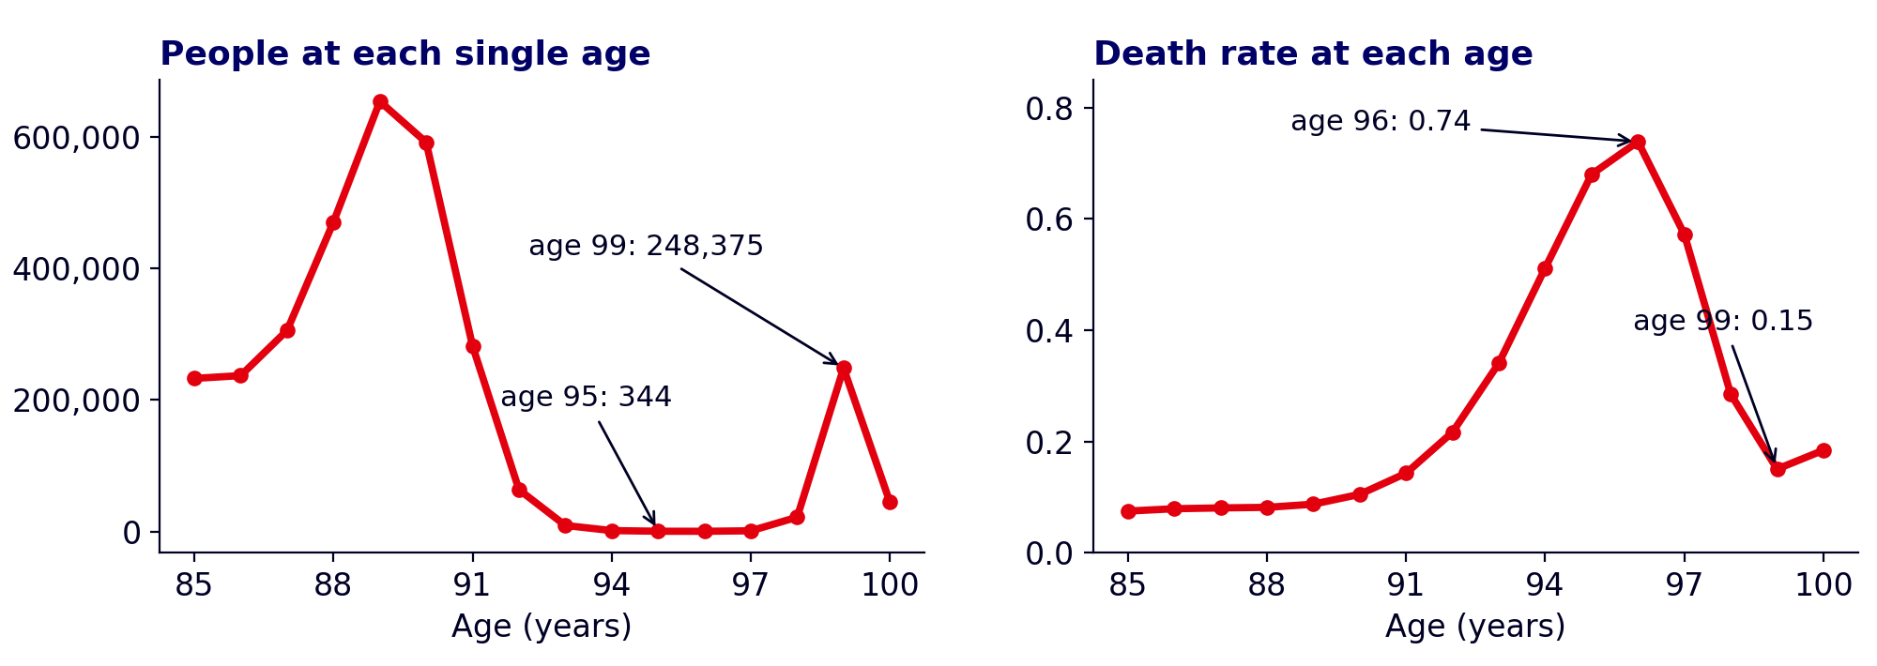
THE ACTUAL OUTPUT
People and death rates by single year of age, Spain 2050
344
248,375
0.74 → 0.15
people aged 95
people aged 99
death rate, ages 96 to 99
Notes:
Let the figures sit. Mortality should rise with age at these ages; here it climbs to 0.74 at age 96 and falls to 0.15 at 99. The people curve has a hump near 89 and then almost nobody at ages 93 to 97, followed by a spike at 99. The 95-99 band total is still 271,600 (within 0.03%).

Slide 17
WHAT IS THE OUTPUT TELLING US?
Where do the numbers go wrong, and where do they stop?
smoothing strength
unit scaling
Most of the code was correct
Domain knowledge exposed the small mistake
convergence
the input data
Your turn: where would you look first?
Notes:
Give students two minutes in pairs. Prompts: Which ages are wrong, and where do the bad values begin and end? Do they line up with the edges of the age bands? Which band is different from all the others (the last one has no upper limit)? The faint words are real suspects the team investigated first: unit scaling (people vs thousands) and smoothing strength were both tried. Neither was the cause. Input numbers for reference (Spain 2050, persons): 65-69 2,878,300; 70-74 3,458,200; 75-79 3,267,100; 80-84 2,656,100; 85-89 1,900,100; 90-94 948,000; 95-99 271,600; 100+ 44,600.

Slide 18
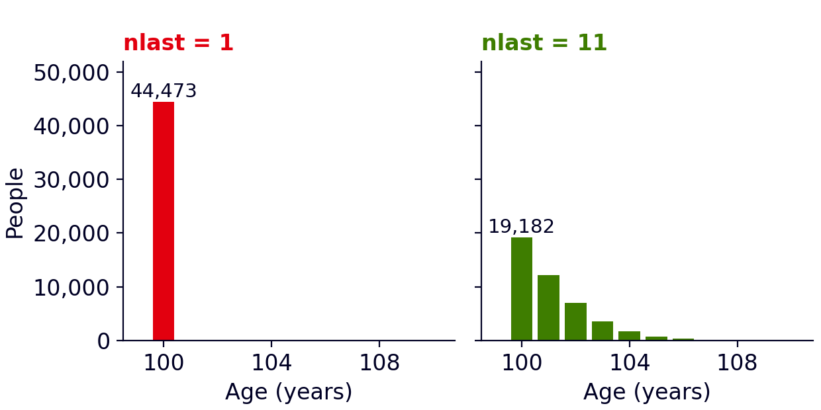
THE LAST BAND GOT ONE YEAR
A single setting told the program that 100+ is only one year wide
44,473
people forced into age 100
19,182
at age 100 in the modelled spread
A tall column at 100 pulls the curve up at 99 and empties ages 93 to 97
nlast = 1
ONE ARGUMENT
nlast = 11
Inside 2,016 lines
Notes:
Real code: ungroup::pclm(x, y, nlast = 1L) in pipeline/00_demography.R before commit 6399498. nlast is the number of single years the last (open) band is spread over. With 1, the program must put all 100+ people at age 100, and the smooth curve has to connect to that tall column while still adding up to each band's total. The people come out of ages 93 to 97 and pile up at 99. The smoothing dial ended at its lowest allowed value (0.125). Turning it up to 1000 with nlast = 1 still leaves a bump at 99, so the one-year band is the cause.
Define nlast explicitly: it is the number of single ages used to represent the final open-ended age interval. Eleven is a modelling choice that produces a more plausible spread and is supported by the benchmark described on the next slide.

Slide 19
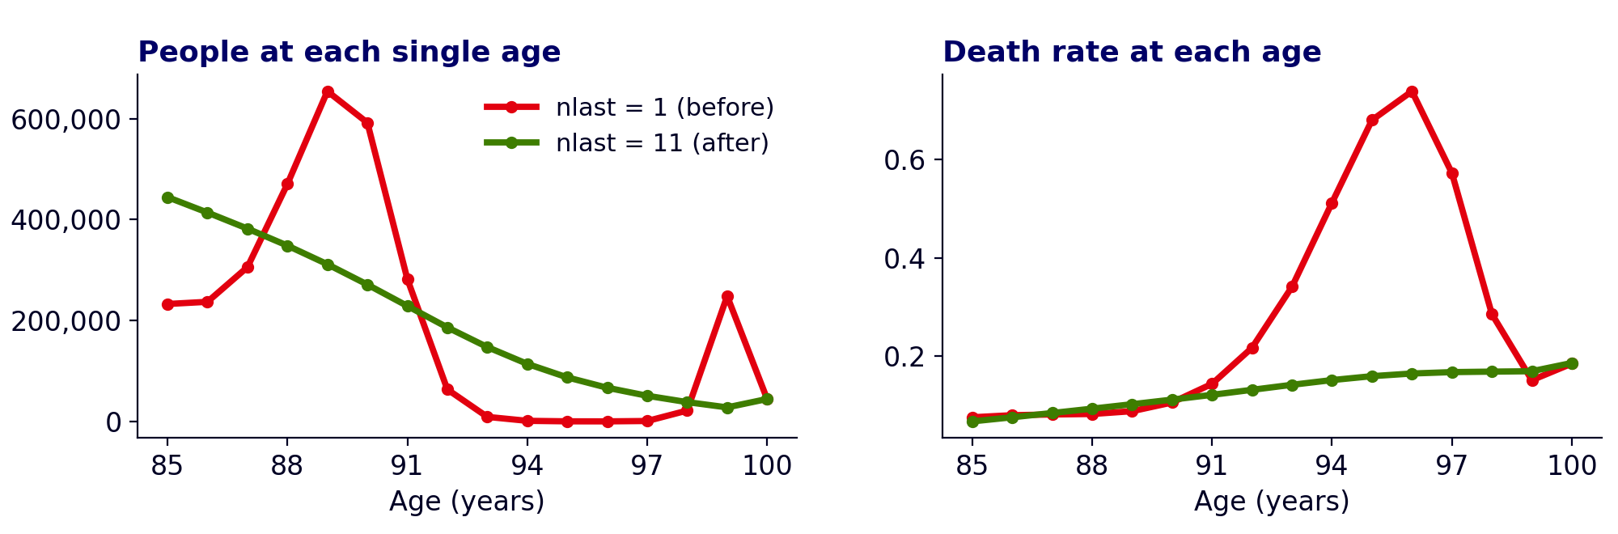
THE FIX AND THE LESSON
Richard Feynman: “What I cannot create, I do not understand.”
1
BUILD THE INTUITION
2
USE DOMAIN KNOWLEDGE
3
USE CODING INTUITION
doing the work yourself teaches you what to expect
recognize when a plausible output is impossible
trace the anomaly to the small mistake
AI can produce thousands of mostly correct lines. Your judgement finds the consequential mistake.
Notes:
Fix (commit 6399498): spread 100+ over ages 100 to 110 (nlast = 11), then add those eleven ages back into one 100+ group. A benchmark on observed Eurostat data for six countries (2015 to 2019) cut the error in life expectancy at 65 from 0.167 to 0.007 years. The team also added a check that fails the run if the death rate drops more than 5% between consecutive ages. Message: AI can write plausible code at speed, but it will not tell you that 248,375 next to 344 is impossible. That judgement is yours, and it holds in any language.
Closing synthesis: the wrong-port case crossed a valid-input boundary; the population case distorted an open-age boundary. Both programs passed internal checks but violated an external expectation. Feynman's quotation appeared on his Caltech blackboard: “What I cannot create, I do not understand.” Source: Christopher Sykes, No Ordinary Genius: The Illustrated Richard Feynman, 1994, p. 238. Final message: build things yourself before delegating heavily to AI, because practice creates the judgement needed to recognize and locate consequential mistakes.

Slide 20
"What I cannot create, I do not understand"
- Richard Feynman

