Slide 1
Computer Programming I
Monty Hall Problem
Dr. Daniel Precioso
dprecioso@faculty.ie

Slide 2

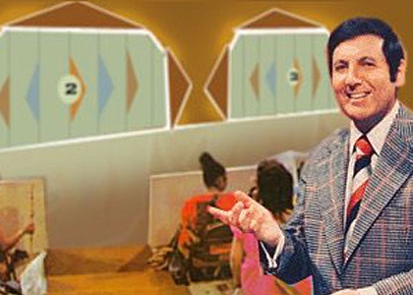
Let’s Play a Game

Slide 3
Let’s Make a Deal!
Suppose you're on a game show, and you're given the choice of three doors:
Behind one door is a car.
Behind the others, goats.

Slide 4
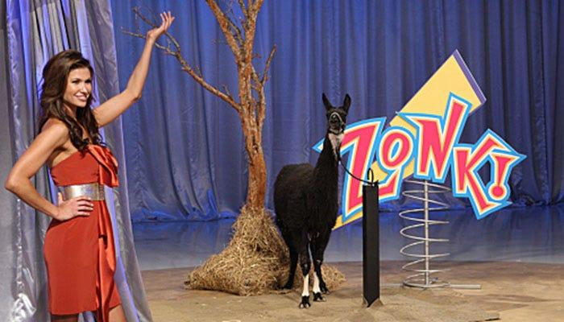
Let’s Make a Deal!
You pick a door, say No. 1, and the host, who knows what's behind the doors, opens another door, say No. 3, which has a goat.
He then says to you,
"Do you want to pick door No. 2?"
Is it to your advantage to switch your choice?

Slide 5
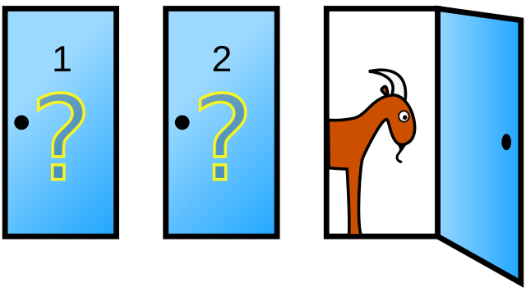
Ask Marilyn
The problem became famous as a question from reader Craig F. Whitaker's letter quoted in Marilyn vos Savant's "Ask Marilyn" column in Parade magazine in 1990.

Slide 6
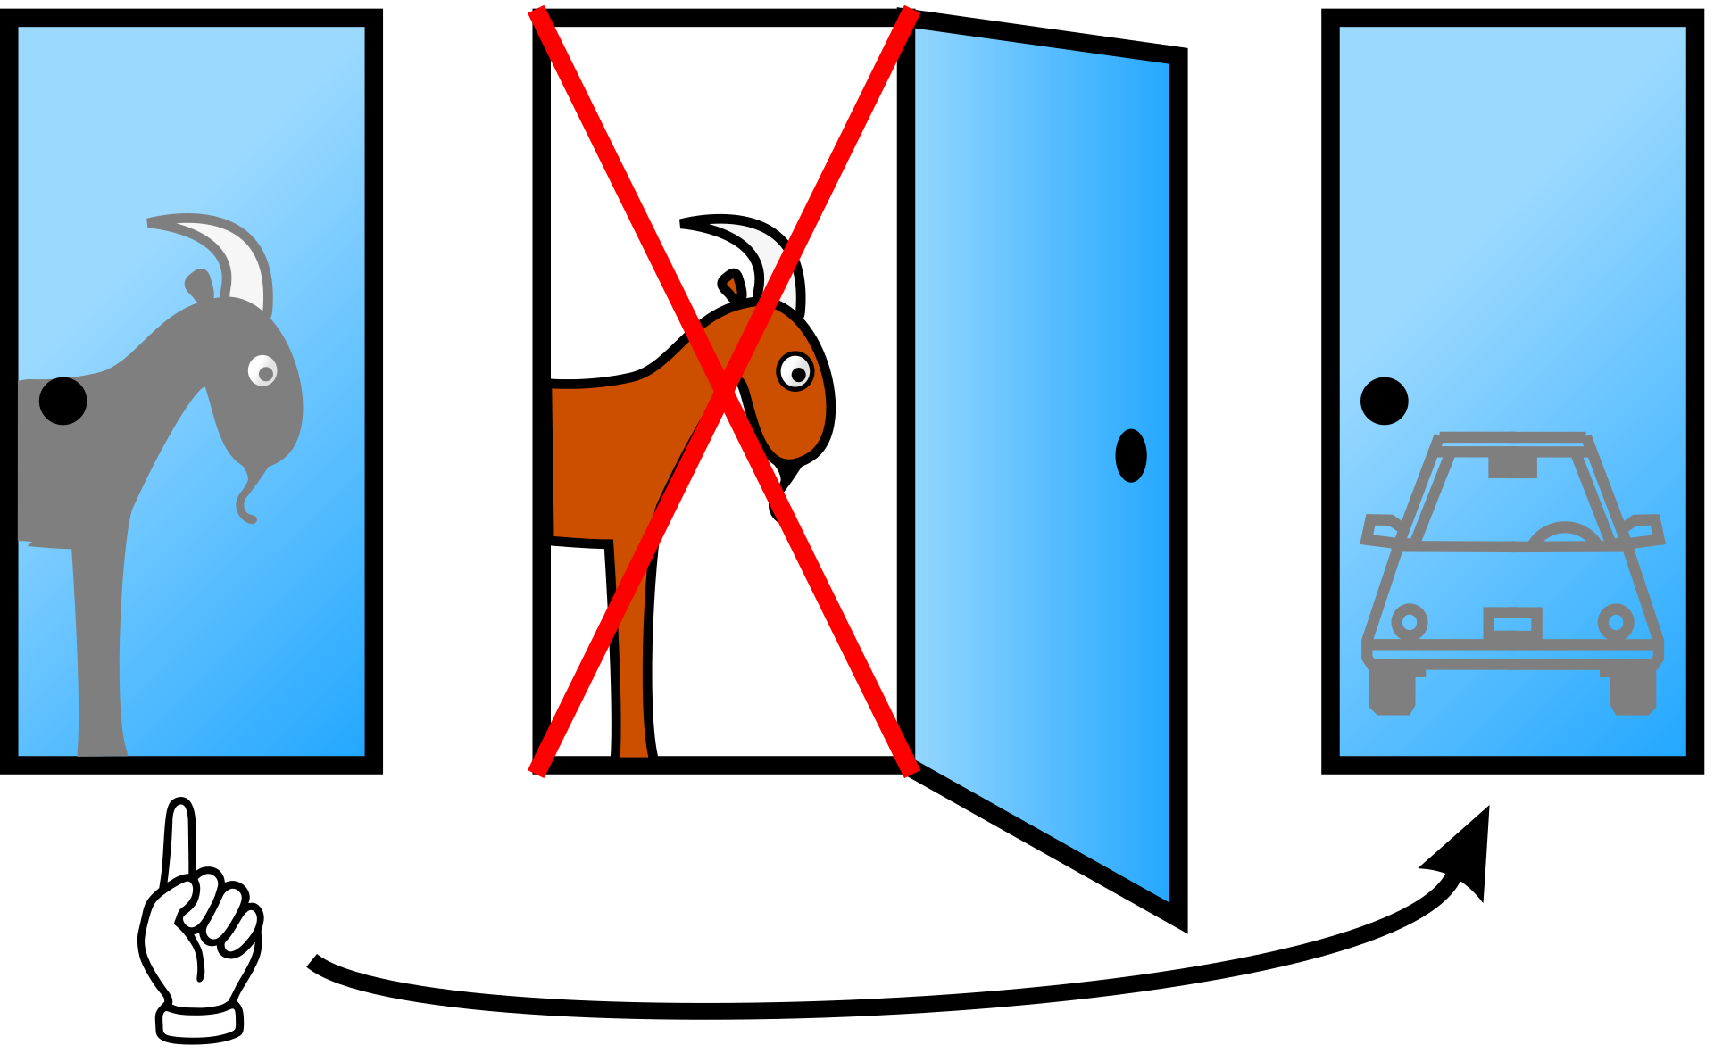
Ask Marilyn
Savant's response was that the contestant should switch to the other door.

Slide 7
Ask Marilyn
The switching strategy has a ⁠2/3⁠ probability of winning the car.
The strategy of keeping the initial choice has only a ⁠1/3⁠ probability.
 | Original pick
 | Goat 1 | Goat 2 | Car
Keep | Lose | Lose | Win!
Switch | Win! | Win! | Lose

Slide 8
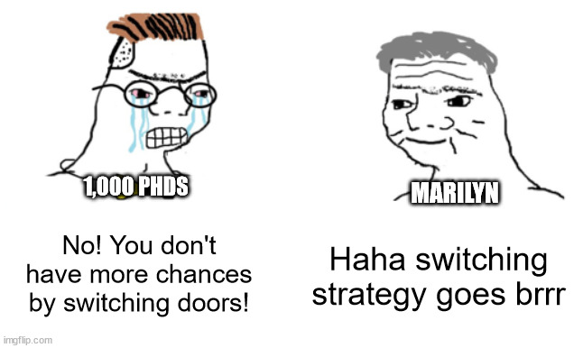
Ask Marilyn - Public Reaction

Slide 9

Ask Marilyn - Public Reaction
Paul Erdős remained unconvinced until he was shown a computer simulation demonstrating Savant's predicted result.

Slide 10
Time to Simulate
Monty Hall ourselves!

