Slide 1
Computer Programming I
Session 3.6
Dr. Daniel Precioso
dprecioso@faculty.ie

Slide 2
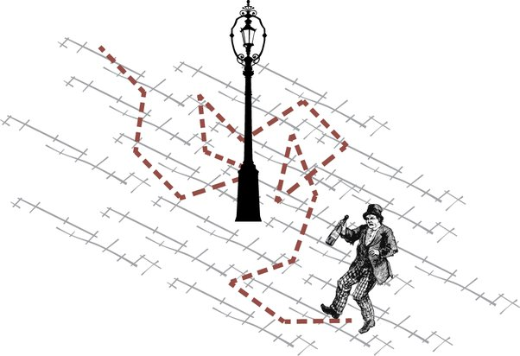
Random Walk
A random walk is a process where each step is determined randomly.
For our example, we can image someone walking forward, but tumbling randomly to the left (-1) or right (+1) in each step they take.

Slide 3

Random Walk in NumPy
For our example, we can image someone walking forward, but tumbling randomly to the left (-1) or right (+1) in each step they take.
It is like tossing a coin up in the air “S” times.
Where S is the number of steps.
How can we implement this in NumPy?

Slide 4
Random Walk in NumPy
Array of random steps:
+1 | +1 | -1 | -1 | +1 | -1 | +1 | +1 | +1 | -1 | +1
Random walk:
0 | 1 | 2 | 1 | 0 | 1 | 0 | 1 | 2 | 3 | 2
How can we implement this in NumPy?

Slide 5
Random Walk in NumPy
Origin = 0
Function: random_walk(s)
s = number of steps
Outputs a different walk every time.
To repeat the same experiment: np.random.seed(number)
End
After “s” steps

Slide 6
Random Walk in NumPy
Function: random_walk(s)
s = number of steps
Generates a different walk every time.
Function: random_walks(s, n)
n = number of walks

Slide 7
NumPy Review
Exercise.
Where did the 5th walker end up after 17 steps?
Exercise.
The walk begins at an origin of 0. How can we start at -30 instead?

Slide 8
NumPy Review
Exercise.
Imagine two people taking a random walk independently, but they only move when both agree on the direction:
Both choose +1, then move +1.
Both choose -1, then move -1.
If one chooses +1 and the other -1 (or vice versa), they stay in place.
Implement this in NumPy.

Slide 9
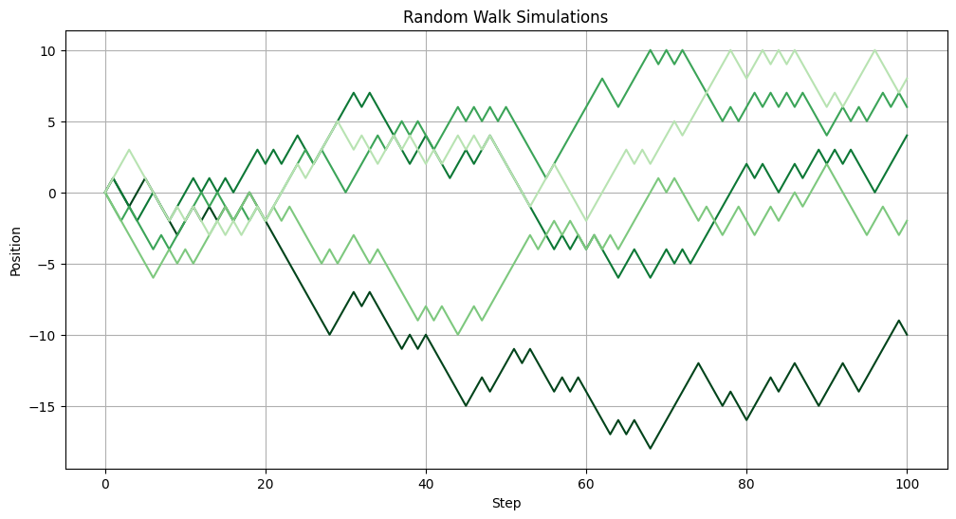
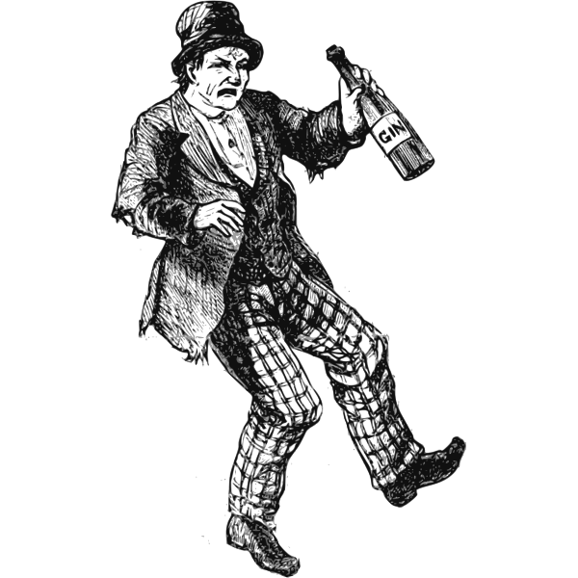
Simulation

Slide 10
Practice your Intuition
After 100 random steps:
Where do you think the walkers are most likely to end up?
What’s the farthest distance you expect them to reach?
Challenge:
Does your intuition change if we increase the number of steps to 1,000 or 10,000?
How would the distribution of their positions look?

Slide 11
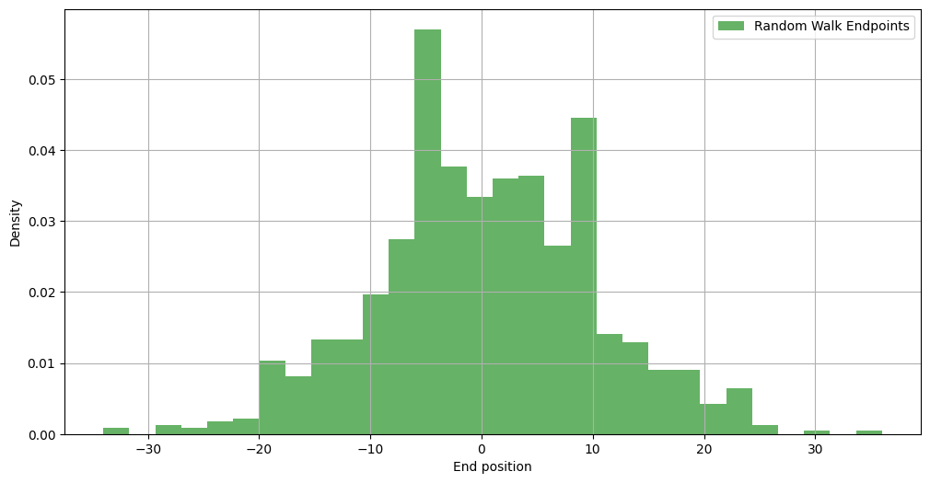
Distribution of Random Walks
For 1,000 walkers and 100 steps.

Slide 12
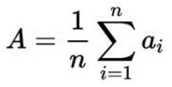
Average (Mean)
The average is the central value of a dataset.
Calculated by summing all values and dividing by the total count.
np.mean(a)
In Random Walks:
After many random steps, the average position tends to approach zero.

Slide 13
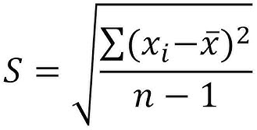
Standard Deviation
Standard deviation measures how spread out the values are.
A small deviation means values are close to the average;
a large one means they are spread out.
np.std(a)
In Random Walks:
It helps predict how far the walkers could be from the average after many steps.

Slide 14
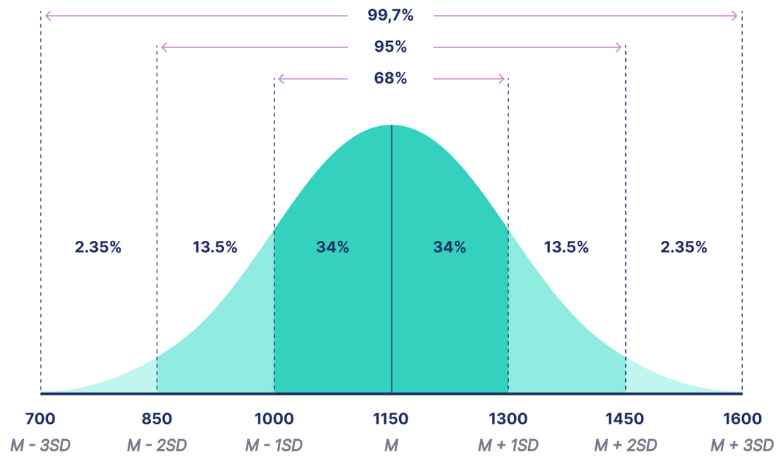
Normal Distribution
The normal distribution (or Gaussian distribution) is a bell-shaped curve describing how data points are distributed around the mean.

Slide 15
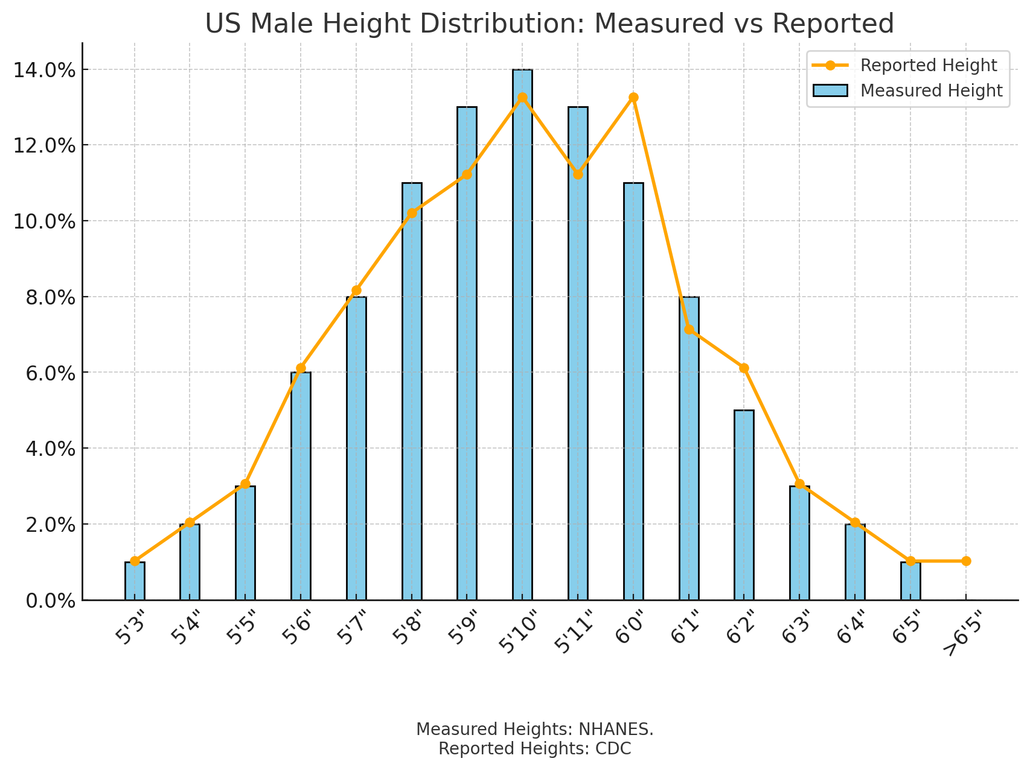
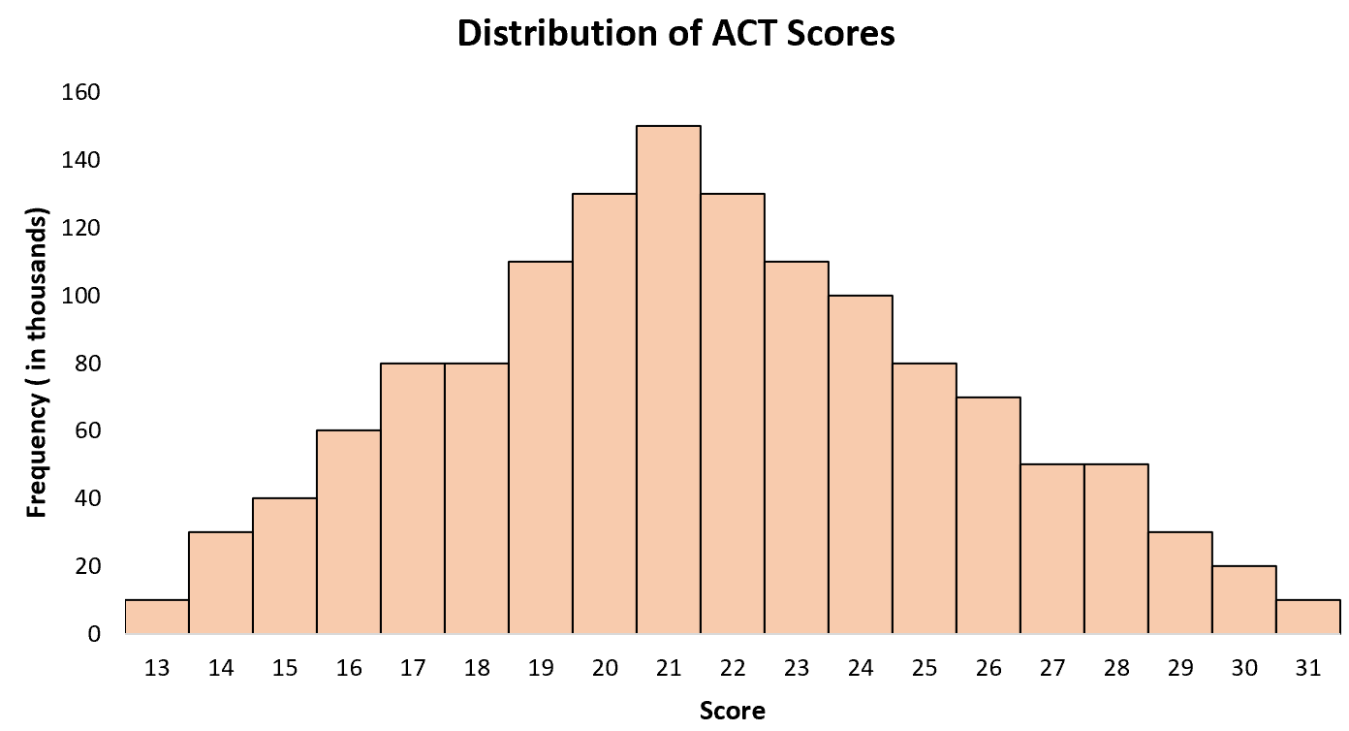
Normal Distribution in NumPy
np.random.normal(mean, std, size)
Generates "size" random values from a normal distribution.

