Slide 1
Welcome to
Computer Programming I
Dr. Daniel Precioso
dprecioso@faculty.ie.edu
Notes:
"Computer programming is the art and science of writing very precise instructions to tell a computer what you want it to do for you" - Andrew Ng
Reference: https://learn.deeplearning.ai/courses/ai-python-for-beginners/

Slide 2
Have you ever
programmed before?

Slide 3


Why Programming?
Programming helps the advancement of humanity.
Notes:
"Programming more broadly has helped advance humanity in so many ways.
The Hubble Space Telescope images that have helped us unravel the mysteries of the universe are processed and analyzed using computer programs written by scientists.
The particle accelerators that discovered the Higgs boson were only made possible because developers wrote software to analyze the data they collected in order to drive forward our understanding of physics."

Slide 4


Why Programming?
Programming helps the advancement of humanity.
Notes:
"Our daily use of the Internet too was made possible only through people writing computer programs.
When you pick up your phone and send a message to someone else, well, you're using a computer program that someone else wrote."

Slide 5
Why Programming?
Programming gives you an edge.
Automate repetitive tasks.
Analyze lots of data.
Build, improve and use AI models.
Notes:
Remember the entrance exam?

Slide 6




Programming in 2026
Notes:
Remember the entrance exam?

Slide 7


Programming in 2026
Interview Process (2026)
Introductory conversation
Live Python problem-solving
Machine Learning foundations
Notes:
Remember the entrance exam?

Slide 8

Have you ever used
Python for programming?

Slide 9
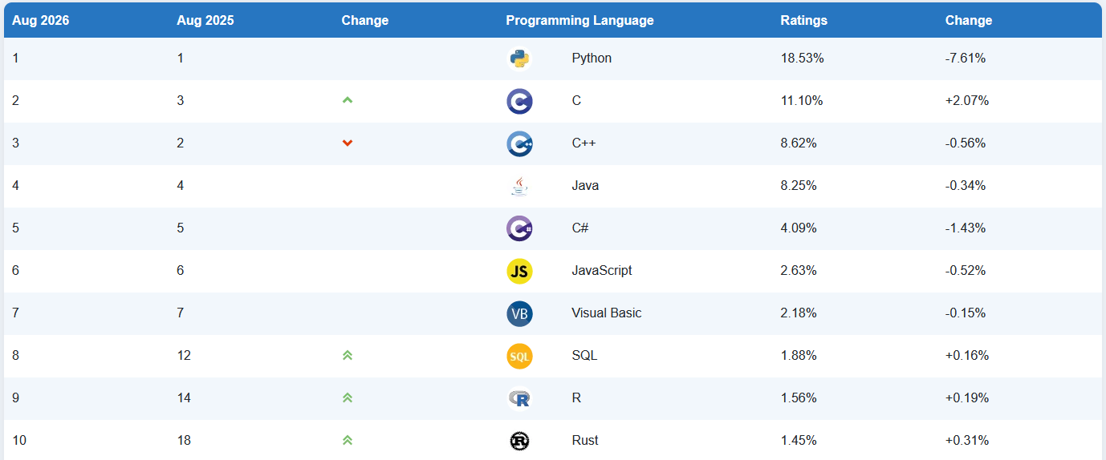
Why Python?
The TIOBE Programming Community index is an indicator of the popularity of programming languages.

Slide 10








Python is Everywhere
Many successful companies
use Python
Notes:
Spotify: Backend services and data analysis
Uber: its engines are written in Python
Instagram: Deployed in Django web framework

Slide 11


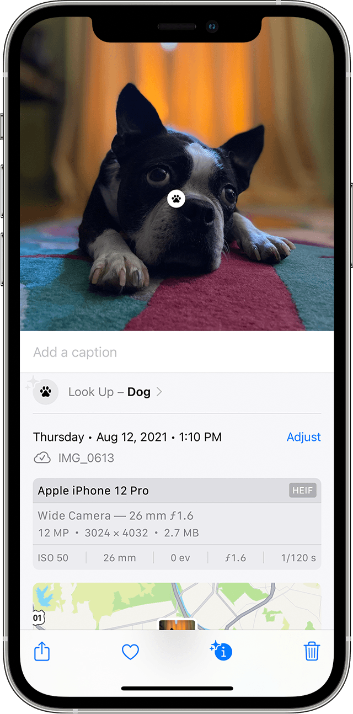
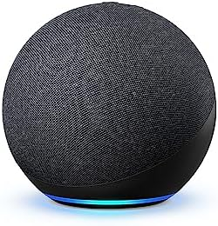
Python is
Everywhere in AI

Slide 12

Goal of the Subject

Slide 13

Goal of the Subject

Slide 14
How do I
pass this subject?

Slide 15
Evaluation Criteria
Criteria | Percentage
Class participation | 10%
Quizzes + Mid-term exam | 30%
Group Project: Algebra | 15%
Final exam | 45%
Notes:
3% each quiz, 15% mid-term exam

Slide 16
Evaluation Criteria
Criteria | Percentage
Class participation | 10%
Quizzes + Mid-term exam | 30%
Group Project: Algebra | 15%
Final exam | 45%
Attendance >= 80%
Homework
Notes:
Students who do not comply with the 80% attendance rule during the semester will fail both calls for this Academic Year (ordinary and extraordinary) and have to re-take the course (i.e., re-enroll) in the next Academic Year.
Can afford to miss 6 classes.

Slide 17
Class Participation
There will be homework exercises for each module.
Doing them will add +1 to your participation score (+3.3% overall).
+1
0
+1
+1

Slide 18
Class Participation
If you claim to have done the exercises,
you may be randomly selected to explain some of them.
+1
0
+1
+1

Slide 19
Class Participation
After you explain your solution to the class,
everyone who raised their hand will get their +1.
+1
0
+1
+1

Slide 20
Class Participation
However, if you were dishonest, all the classroom will get a negative -1.3.
-1.3
-1.3
-1.3
-1.3

Slide 21
Evaluation Criteria
Criteria | Percentage
Class participation | 10%
Quizzes + Mid-term exam | 30%
Group Project: Algebra | 15%
Final exam | 45%
Mid-term:
19th October
17th December
Notes:
3% each quiz, 15% mid-term exam

Slide 22

Quizzes & Exams
They will be done on paper. Bring a pen!
Quizzes: Multiple choice (theory and practice).
You need to explain your choice.
Right answer + Good logic | Full points
No answer Wrong answer Wrong logic | Zero points

Slide 23
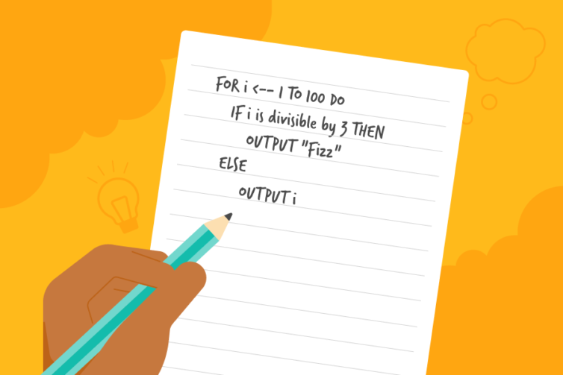
Quizzes & Exams
Exams: Three parts.
Multiple choice (same as quizzes).
Debugging:
  You will be shown a piece of faulty code.
  You need to explain why the code fails.
  You will provide a solution / fixed code.
Problem solving / Pseudocoding
  Explain how you would approach a coding challenge

Slide 24
Evaluation Criteria
Criteria | Percentage
Class participation | 10%
Quizzes + Mid-term exam | 30%
Group Project: Algebra | 15%
Final exam | 45%
27th November
In collaboration with Linear Algebra
Notes:
3% each quiz, 15% mid-term exam

Slide 25




Code of Conduct
Punctuality Matters:
Arrive on time to prevent interruptions.
Consequence: More than 5 minutes late will be marked as absent.
Preparedness:
Be ready for class: get water, use the restroom, and settle in beforehand.
If you need to leave during class, please raise your hand and ask, otherwise you will be marked absent.
Respectful Conduct:
Maintain a positive learning environment. Avoid behaviors that disrupt others.
Consequence: You may be asked to leave, resulting in an absence for that session.
No Phones / Headphones:
Using your phone during class is disruptive.
Consequence: You will be asked to leave and marked absent.
Notes:
For further reference: Review the University's Code of Conduct (available in all your syllabi).

Slide 26
How will we use Python?

Slide 27
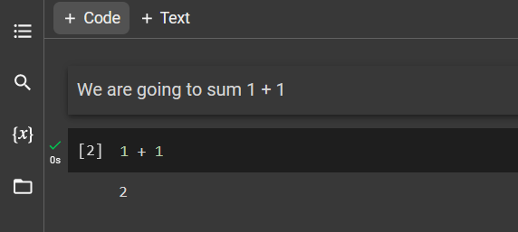
How will we use Python?
Notebook
Interactive document that combines code, visualizations, explanations, and documentation.
Interactive
Beginner friendly
Gemini integration

Slide 28

Using Google Colab
Colaboratory (Colab) allows you to write and execute Python in your browser, with zero configuration required.
You can access Google Colab in the following link:
https://colab.research.google.com/

Slide 29
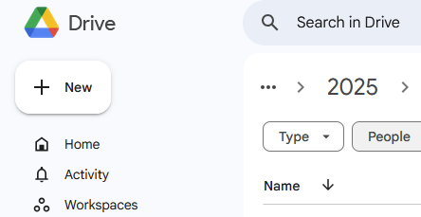
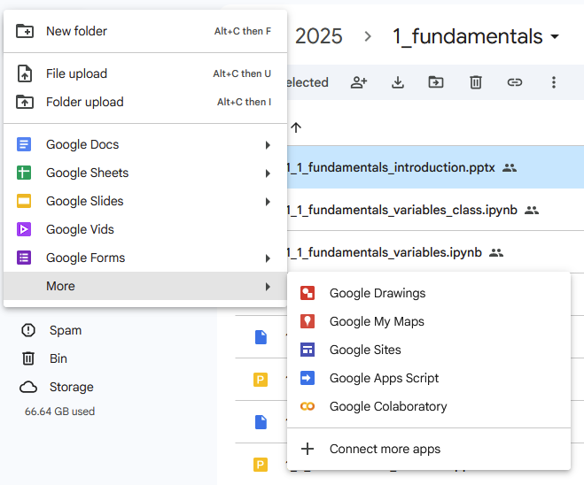
Using Google Colab
Go to Google Drive (use a computer)
Click on "+ New" at the top left corner
Click on "More" and then on "Connect more apps"
(You see "Google Colaboratory" on my list because I already did this process)

Slide 30
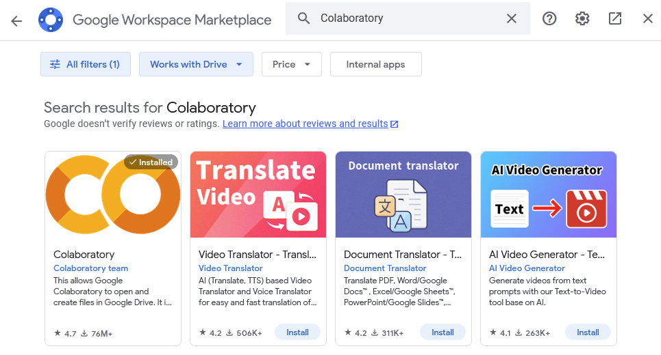
Using Google Colab
In the Google Workspace Marketplace,
search for "Colaboratory" and click on install.

Slide 31
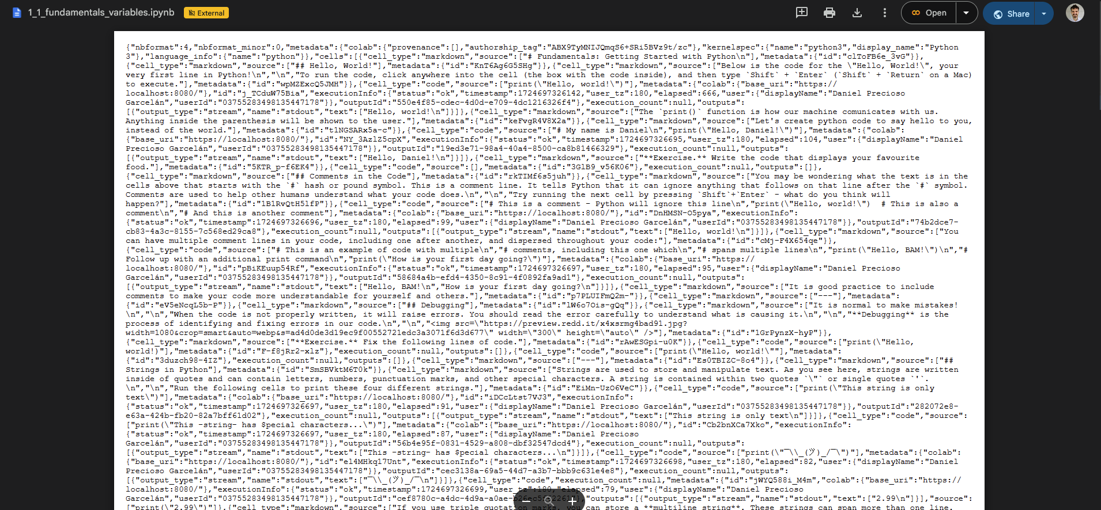
Using Google Colab
When you click on a link to Google Colab, you may seen the following screen.
Find the "Open" button and select "Colaboratory" from the list of options.

Slide 32

Using VSCode (like a pro)
 | Windows | Mac
Spanish | VSCode and Python for Windows (Spanish) | VSCode and Python for Mac (Spanish)
English | VSCode and Python for Windows (English) | VSCode and Python for Mac (English)
Extra tutorial (first part is for Mac, second is for Windows):
https://www.youtube.com/watch?v=MCxQvrMT1CM

Slide 33
VSCode - Virtual Environment
After installing VSCode and Anaconda, follow the video below to create a virtual environment in VSCode.
Create a virtual environment in VSCode
In the video, “pip install discord” is used as an example.
For this exercise, use “pip install numpy” instead.

Slide 34
VSCode - Jupyter Notebooks
Once you have created a Python environment, the final step is to install Jupyter to work with notebooks (similar to Google Colaboratory).
How to use Jupyter Notebooks in VSCode
With Jupyter installed, you are all set to start coding in VSCode!

Slide 35

Creating a Notebook in VS Code
You need to have Anaconda installed!
Create a new file with the termination “.ipynb”
Click to open the notebook.
It works just the same as Google Collaboratory.
You can save the notebook with “Ctrl + S” (Windows) or “Command-S” (Mac)
Notes:
Integrating Jupyter Notebooks in VSCode enhances their power and usability. VSCode provides a comfortable environment to write, execute, and debug your notebook’s code. The process is straightforward: simply open VSCode, create a new Jupyter Notebook, and you're greeted with an interface where you can write Python code, Markdown text, and see the results inline. This seamless integration in a familiar IDE environment is particularly beneficial for those who are already comfortable with VSCode. It combines the best of both worlds – the powerful editing capabilities of VSCode and the interactive nature of Jupyter Notebooks.

Slide 36
Let’s start
programming!

