Slide 1
Computer Programming I
Fundamentals Session 3
Dr. Daniel Precioso
dprecioso@faculty.ie.edu

Slide 2
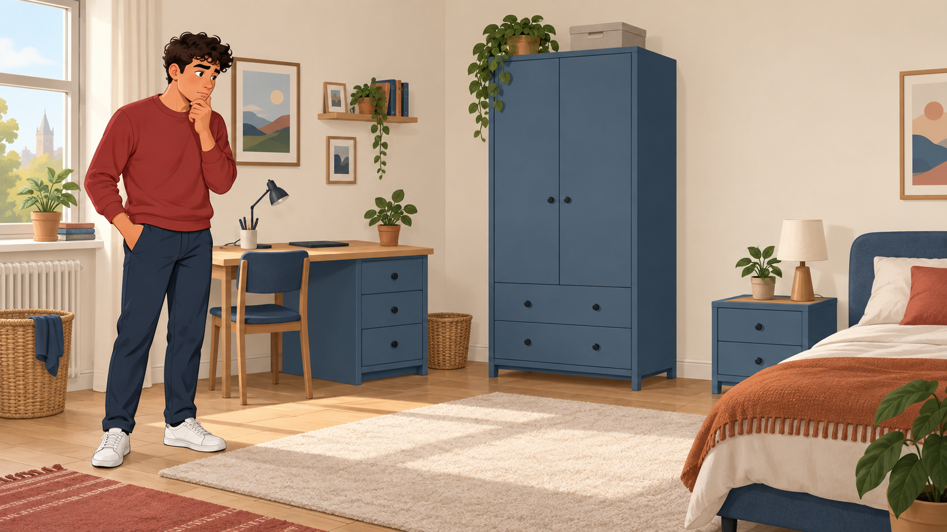
Search the drawers…

Slide 3
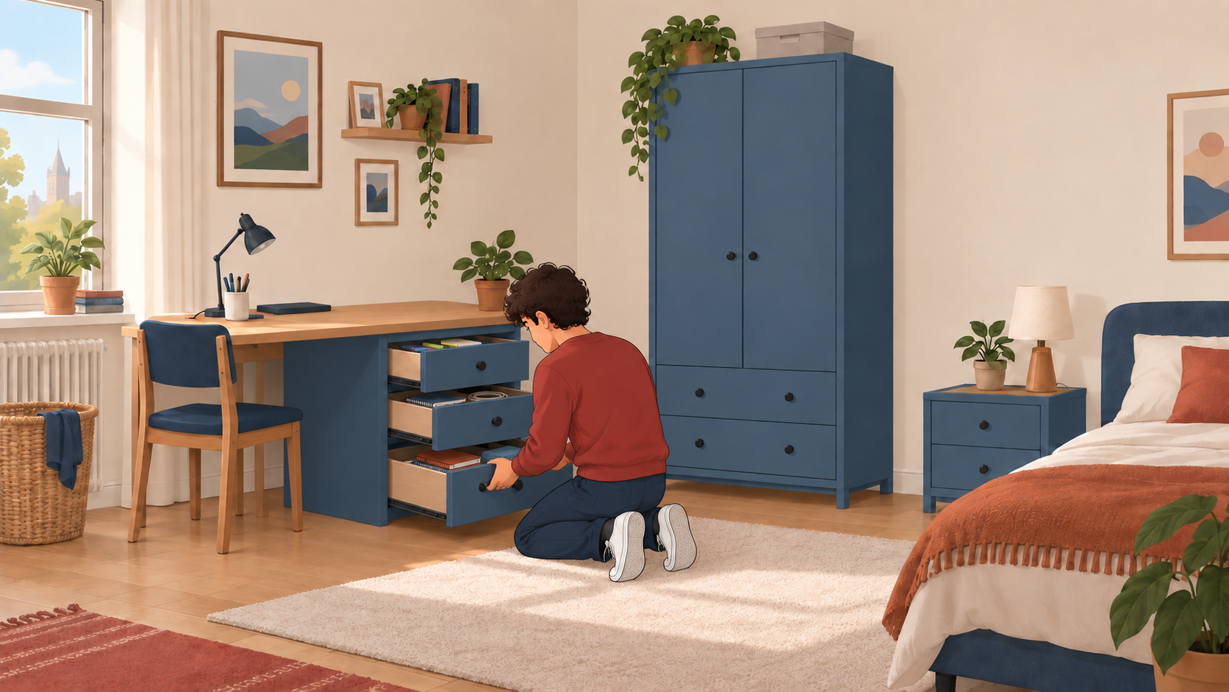
Open 1st drawer
Open 2nd drawer
Open 3rd drawer

Slide 4
Loops in Python

Slide 5
For Loop (with range)
for drawer in range(1, 5):
print(drawer)
It’s the same!
print(1)
print(2)
print(3)
print(4)
range(start, stop, step)
Mathematically: [start, stop)

Slide 6
For Loop (sequence)
drawers = [1, 2, 3, 4, 5]
for drawer in drawers:
print(drawer)
It’s the same!
print(1)
print(2)
print(3)
print(4)
print(5)

Slide 7
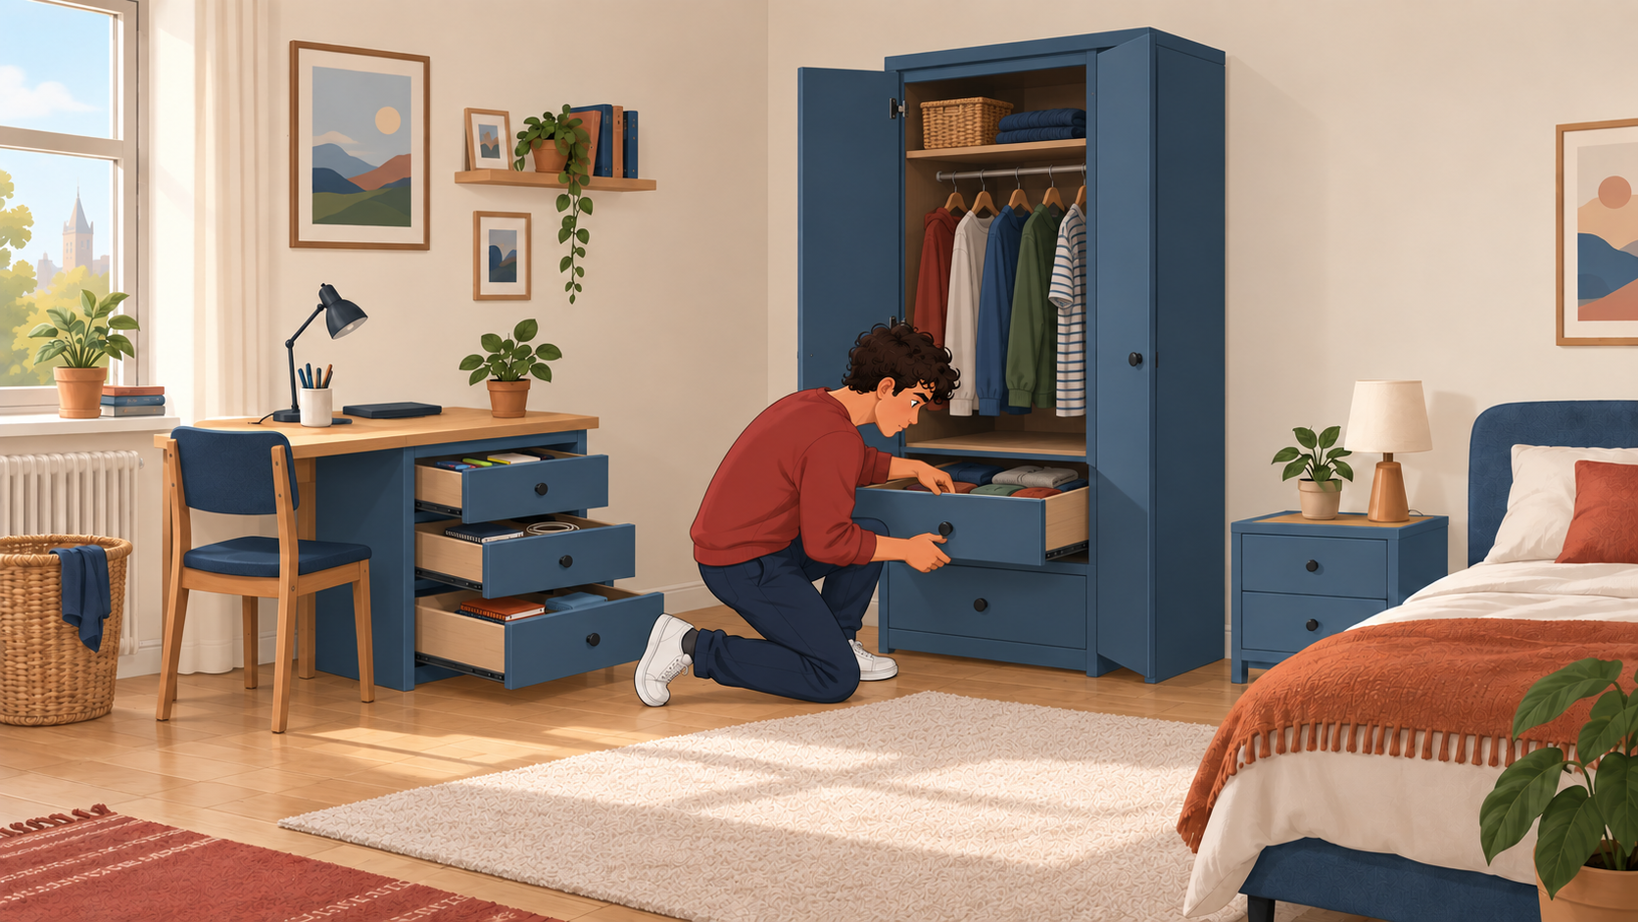
Desk
When finished
Wardrobe
Open 1st drawer
Open 1st drawer
Open 2nd drawer
Open 2nd drawer
Open 3rd drawer

Slide 8
Nested Loop
for furnit in ["desk", "ward"]:
for drawer in range(3):
print(furnit, drawer)
It’s the same!
print("desk", 0)
print("desk", 1)
print("desk", 2)
print("ward", 0)
print("ward", 1)
print("ward", 2)
A nested loop is a loop inside another loop, where the inner loop runs completely each time the
outer loop runs once.

Slide 9
Continue
for furnit in ["desk", "ward"]:
for drawer in range(3):
if (furnit == "ward") and (drawer == 0):
continue
print(furnit, drawer)
The continue command in a loop skips the rest of the current iteration and jumps to the next one, without exiting the loop entirely.

Slide 10
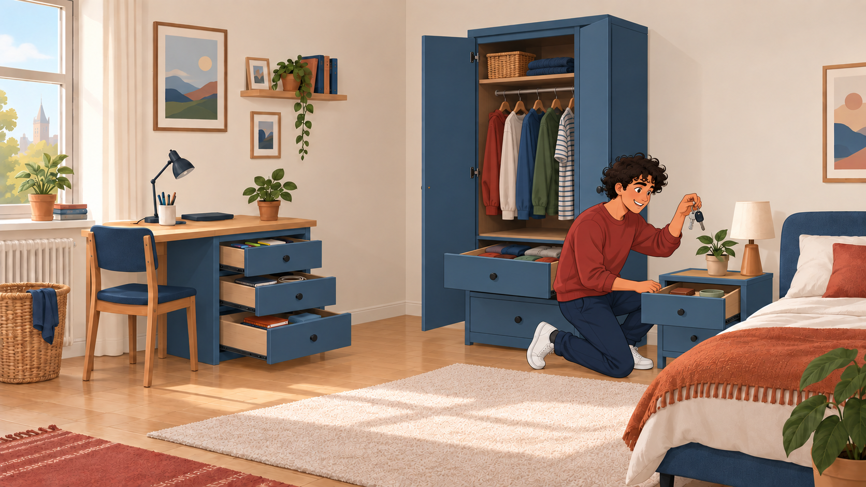

Slide 11
Break
for item in ["glasses", "keys", "money", "phone"]:
print(item)
if (item == "keys"):
break
The break command immediately exits the loop it is in, stopping all further iterations.
continue skips one step. break skips all remaining steps.

Slide 12
While Loop
With the while loop we can execute a set of statements as long as a condition is true.
num = 1
while num <= 5:
print(num)
num = num + 1
This loop will keep going until the variable num gets higher than 5
It is important to update the variable num.
If we don’t, the loop will never stop!

Slide 13
In Detail:
For Loop Step by Step

Slide 14
For Loop (Step by Step)
Program starts
The value of y is set to 2
y = 2
for x in [1, 3]:
y = y + x
print(y)
print(x)

Slide 15
For Loop (Step by Step)
Memory: y = 2
y = 2
for x in [1, 3]:
y = y + x
print(y)
print(x)
For loop starts
The value of x is 1
Memory update!
y = 2, x = 1

Slide 16
For Loop (Step by Step)
Memory: y = 2, x = 1
y = 2
for x in [1, 3]:
y = y + x
print(y)
print(x)
Inside the for block
Compute y + x = 2 + 1
Value of y is updated to 3
Memory update!
y = 3, x = 1

Slide 17
For Loop (Step by Step)
Memory: y = 3, x = 1
y = 2
for x in [1, 3]:
y = y + x
print(y)
print(x)
Inside the for block
Python outputs “3”

Slide 18
For Loop (Step by Step)
Memory: y = 3, x = 1
y = 2
for x in [1, 3]:
y = y + x
print(y)
print(x)
End of for block
Python moves to the next step of the loop

Slide 19
For Loop (Step by Step)
Memory: y = 3, x = 1
y = 2
for x in [1, 3]:
y = y + x
print(y)
print(x)
For loop continues
The value of x is 3
Memory update!
y = 3, x = 3

Slide 20
For Loop (Step by Step)
Memory: y = 3, x = 3
y = 2
for x in [1, 3]:
y = y + x
print(y)
print(x)
Inside the for block
Compute y + x = 3 + 3
Value of y is updated to 6
Memory update!
y = 6, x = 3

Slide 21
For Loop (Step by Step)
Memory: y = 6, x = 3
y = 2
for x in [1, 3]:
y = y + x
print(y)
print(x)
Inside the for block
Python outputs “6”

Slide 22
For Loop (Step by Step)
Memory: y = 6, x = 3
y = 2
for x in [1, 3]:
y = y + x
print(y)
print(x)
End of for loop
There are no more steps
(check the indentation) The loops finishes

Slide 23
For Loop (Step by Step)
Memory: y = 6, x = 3
y = 2
for x in [1, 3]:
y = y + x
print(y)
print(x)
Python prints “3”
(the last value of x in the loop)

Slide 24
Exercises
What will Python print here?
word = ""
for letter in ["y", "e", "s"]:
word = word + letter
print(word)
for s in ["a", "b", "c"]:
s = "a"
print(s)
Run the code to verify your answer!

Slide 25
Exercises
What will Python print here?
m = ""
for s in ["o", "n"]:
m = s + m
print(m)
num = 0
for num in [1, 2, 3]:
num = num + num
print(num)
Run the code to verify your answer!

