Slide 1

Happy Halloween!
Session 17

Slide 2
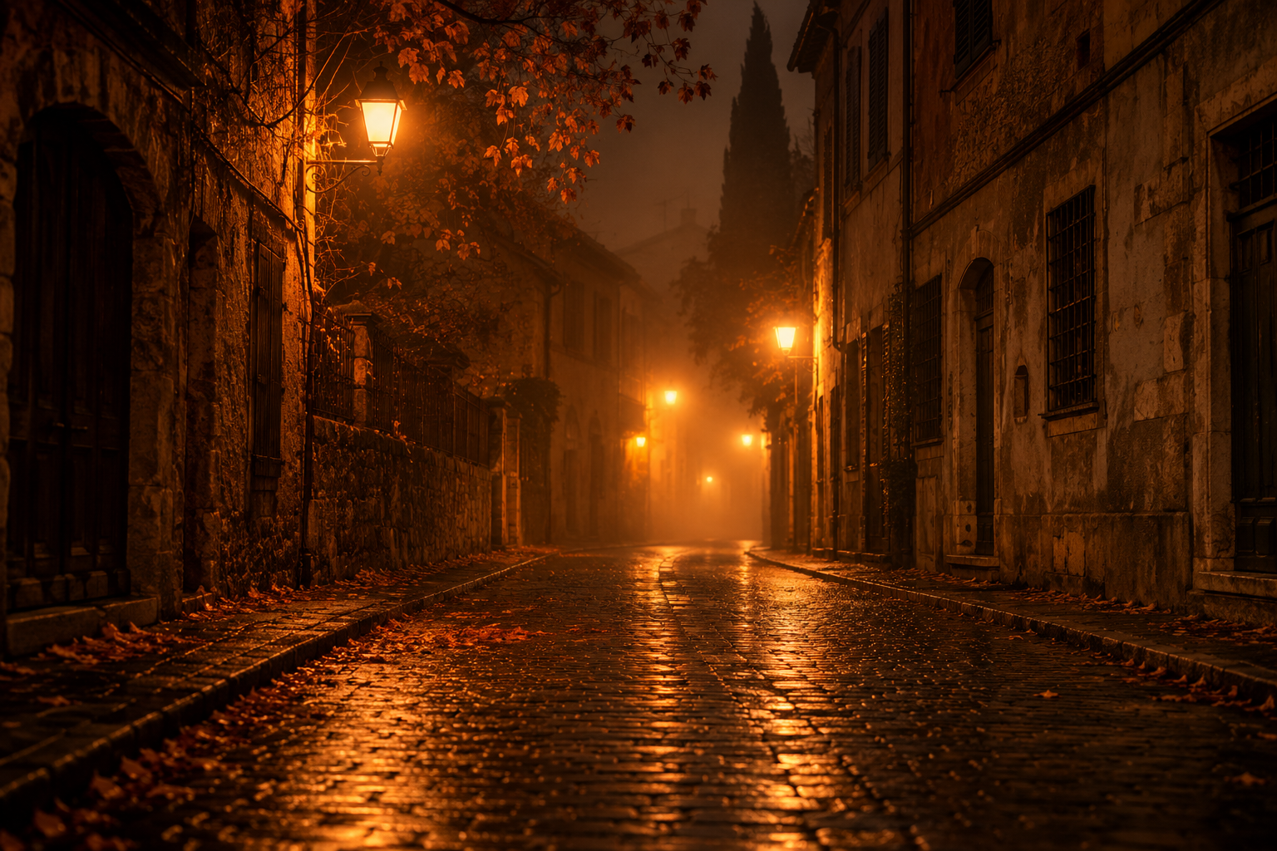

The Ghost Camera
Last night we went ghost hunting with a very special device: a ghost camera.
Ghosts are invisible, so we could not see anything in the dark. But the camera beeps when a ghost is nearby, and every time it beeped, we snapped a picture.

Slide 3
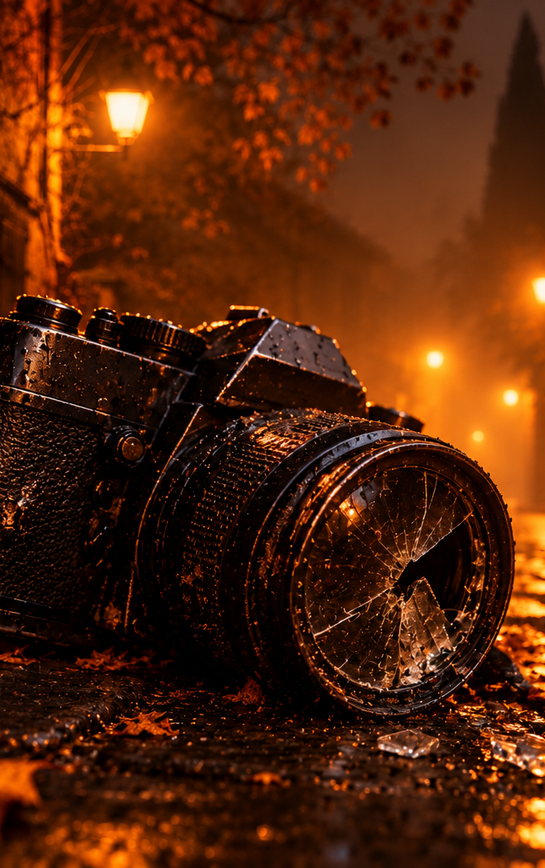
The Ghost Camera
By the end of the night, the camera had met so many ghosts that it got completely spooked… and broke.
When we downloaded the pictures, every photo was broken, and each one in a very different way.

Slide 4
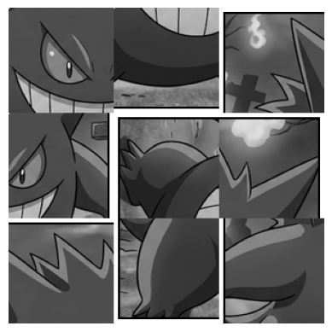
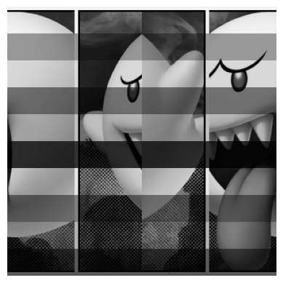
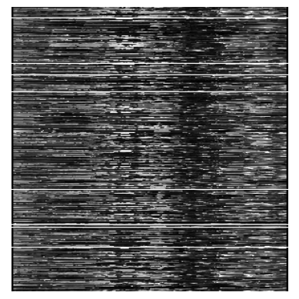
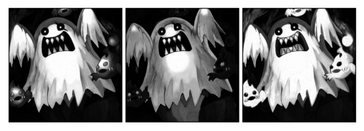
photo_1
photo_3
photo_4
photo_5

Slide 5
The Camera Log
22:13 BEEP! Ghost nearby ............. photo_1 saved
ERROR: memory shattered. 9 fragments shuffled inside the photo.
23:02 BEEP! Ghost nearby ............. photo_2 saved
ERROR: sensor frozen. Flattened, halves swapped, contrast lost.
00:31 BEEP! Ghost nearby ............. photo_3 saved
ERROR: interference on the sensor rows. Photo cut into 4 strips.
01:45 BEEP! Ghost nearby ............. photo_4 saved
ERROR: lens cursed. Rows scrambled. Photo cut into 5 strips.
NOTE: 3 lenses found in the camera bag.
03:33 BEEP! BEEP! BEEP! STRONG GHOST . photo_5 saved (colour)
NOTE: ghost surrounded by small ORANGE flames.
ERROR: colour channels separated and shuffled. Very low light.
03:34 CAMERA FAILURE. Too many ghosts.

Slide 6
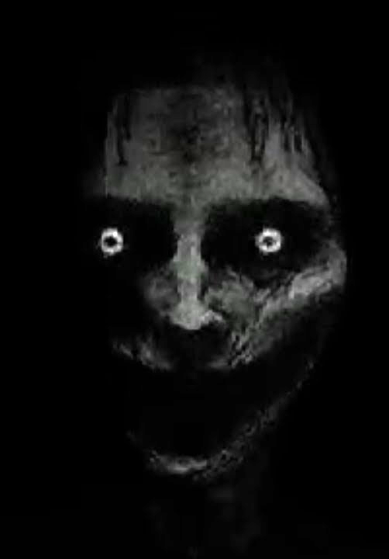
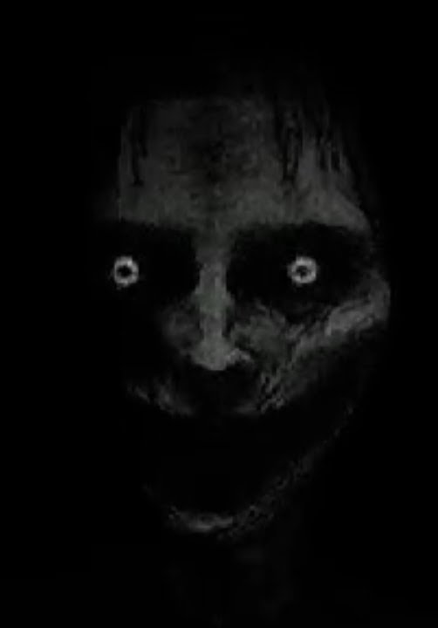
Our Mission
Who did we catch? We do not know yet: the photos will tell us.
Load the broken files,
use the log to understand what happened to each photo,
recover all five pictures,
and find the case number to close the investigation.

Slide 7
Let's Go!
Form groups of 2-3 and start fixing the images.
Each image broke in a different way.
You will need to use a plethora of NumPy tools to fix all of them.
Go to the website and follow the instructions
(Module 3, session 17)
First group to find the case number wins!

