Slide 1
Computer Programming I
Session 3.7
Dr. Daniel Precioso
dprecioso@faculty.ie

Slide 2
An Image is Worth
a Thousand Words

Slide 3
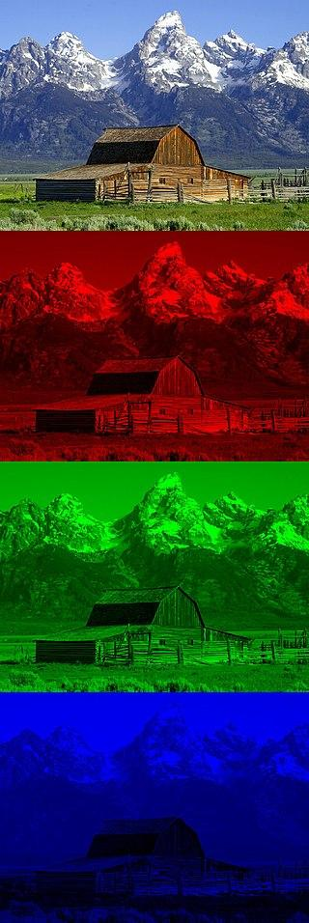
What is an Image?
A computer image is a picture composed of an array of elements called pixels.
Each pixel represents a single point in the image and has a specific color value.

Slide 4
What is an Image?
The RGB color model is an additive color model in which the red, green and blue primary colors of light are added together in various ways to reproduce a broad array of colors.

Slide 5
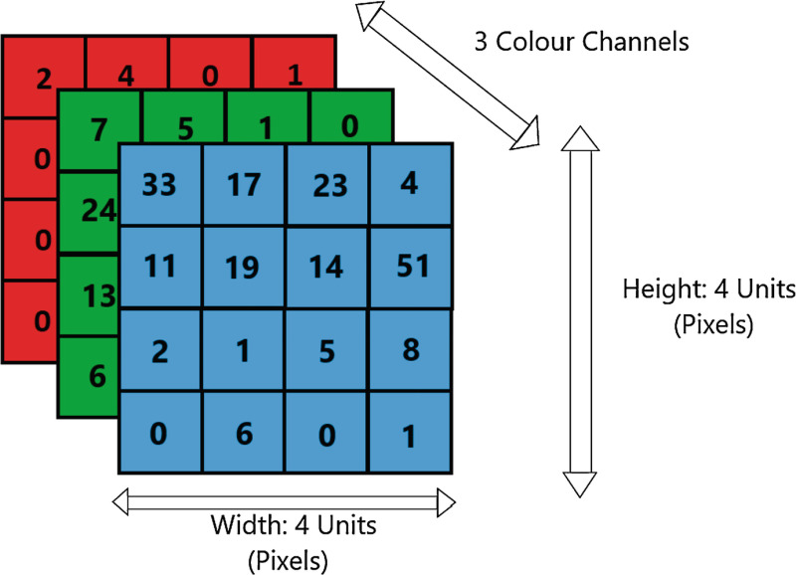
What is an Image?
In digital imaging, RGB values are often stored in a structured format known as an array.
An RGB image can be represented as a three-dimensional NumPy array, where the dimensions correspond to the height, width, and color channels (red, green, and blue) of the image.

Slide 6
Is an Image Worth
a Thousand Words?

Slide 7
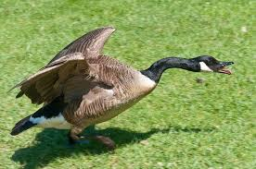
The Size of an Image
A goose (pl.: geese) is a bird of any of several waterfowl species in the family Anatidae. This group comprises the genera Anser (grey geese and white geese) and Branta (black geese). Some members of the Tadorninae subfamily (e.g., Egyptian goose, Orinoco goose) are commonly called geese, but are not considered "true geese" taxonomically. More distantly related members of the family Anatidae are swans, most of which are larger than true geese, and ducks, which are smaller.
The term "goose" may refer to such bird of either sex, but when paired with "gander", refers specifically to a female one (the latter referring to a male). Young birds before fledging are called goslings. The collective noun for a group of geese on the ground is a gaggle; when in flight, they are called a skein, a team, or a wedge; when flying close together, they are called a plump.
Two genera of geese are only tentatively placed in the Anserinae; they may belong to the shelducks or form a subfamily on their own: Cereopsis, the Cape Barren goose, and Cnemiornis, the prehistoric New Zealand goose. Either these or, more probably, the goose-like coscoroba swan is the closest living relative of the true geese.
Fossils of true geese are hard to assign to genus; all that can be said is that their fossil record, particularly in North America, is dense and comprehensively documents many different species of true geese that have been around since about 10 million years ago in the Miocene. The aptly named Anser atavus (meaning "progenitor goose") from some 12 million years ago had even more plesiomorphies in common with swans. In addition, some goose-like birds are known from subfossil remains found on the Hawaiian Islands.
Geese are monogamous, living in permanent pairs throughout the year; however, unlike most other permanently monogamous animals, they are territorial only during the short nesting season. Paired geese are more dominant and feed more, two factors that result in more young.
Plain text, 1000 words
5 KB
RGB Image 700 x 465
950 KB

Slide 8
The Size of an Image
Images take up space!
How does our computer deal with it?
Image Compression
JPEG (JPG): Uses lossy compression, which discards some image data to reduce file size.
PNG: Utilizes lossless compression, preserving all image data.

Slide 9
Can we Compress
Images Ourselves?

Slide 10
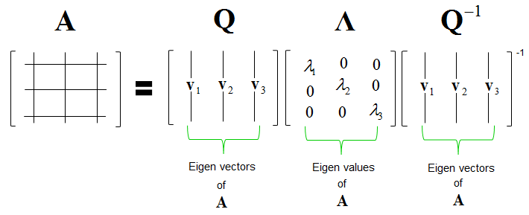
Eigenvalue Decomposition

Slide 11
Eigenvalue Decomposition
Eigendecomposition of a real, symmetric matrix.
Original matrix
N x N
Eigen vectors
N x N
Eigenvalues
N
Eigen vectors T
N x N
We have to store “N” more values!

Slide 12
Eigenvalue Decomposition
Retain the “K” most significant eigenvalues.
Original matrix
N x N
Eigen vectors
N x K
Eigenvalues
K
Eigen vectors T
K x N
Small “K” means less information to store.

Slide 13

Eigenvalue Decomposition
NumPy can do this with its “linalg” package!

