Slide 1
Computer Programming I
Building an AI Model
Dr. Daniel Precioso
dprecioso@faculty.ie

Slide 2
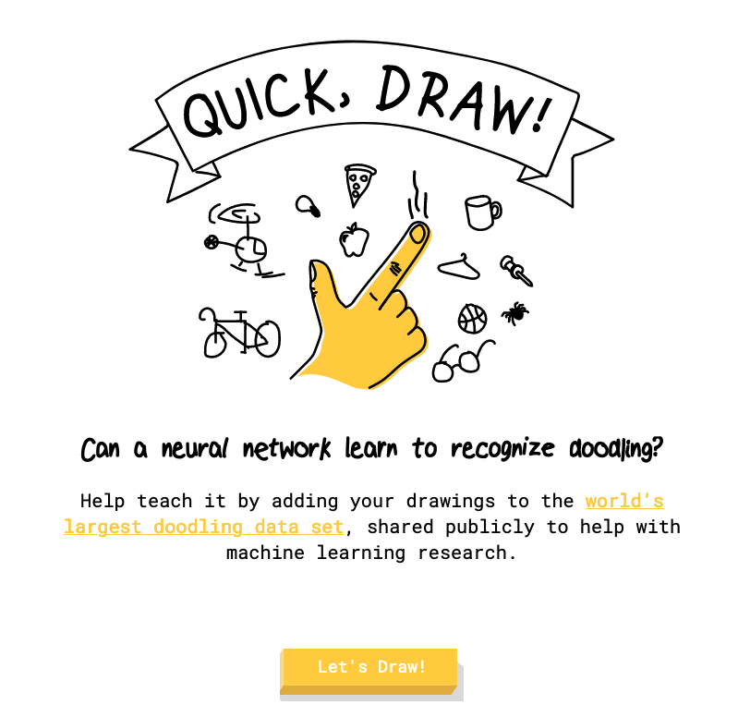
Notes:
Google “Quick, Draw!” is an online game that challenges users to draw a given object or concept within a limited time frame (usually 20 seconds).
The objects can range from common items like "cat" or "tree" to more abstract concepts like "happiness" or "courage."

Slide 3
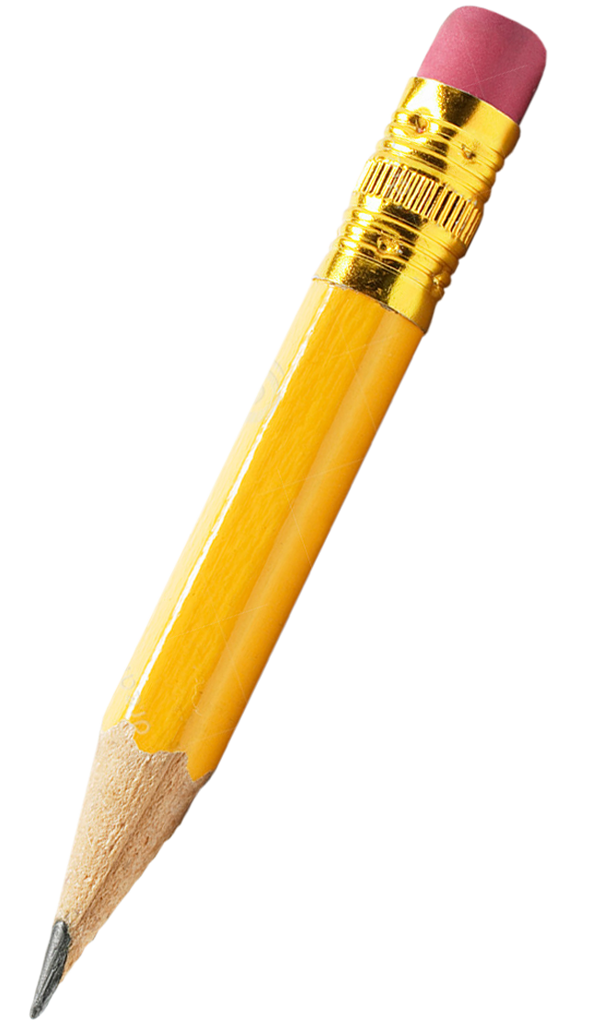

How does “Quick, Draw!” works?
Sequence
User
Drawing Recognition
Position
Patterns
Notes:
Drawing Recognition:
As the user draws, Google's machine learning algorithms analyze the strokes and patterns to recognize the object being drawn.
The system tracks the sequence of strokes, their positions, and the timing of each stroke.

Slide 4
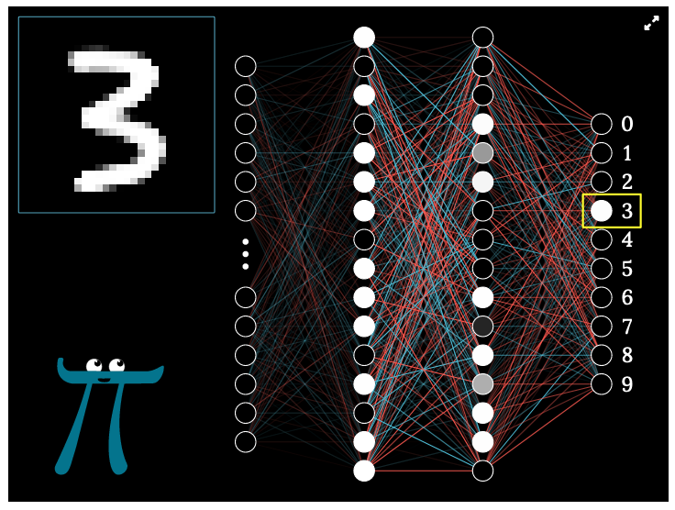
How does “Quick, Draw!” works?
Neural Network Architecture
“Quick, Draw!” employs a neural network architecture, specifically a Convolutional Neural Network (CNN).
CNNs are well-suited for image recognition tasks as they can learn to extract hierarchical features from the input images.
Example: Digit recognition
Neural Network in action:
identify hand-drawn digits 0-9

Slide 5

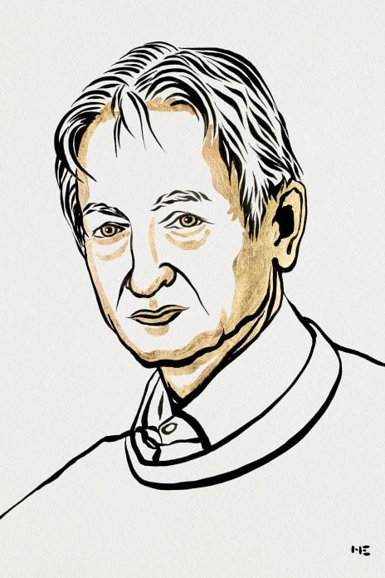
Nobel Prize Physics 2024
Their research, drawing on principles of physics, forms the foundation of modern machine learning systems.
Hopfield developed an associative memory system capable of storing and reconstructing data patterns, while Hinton introduced methods that allow networks to autonomously discover data properties and perform tasks such as image recognition.
John J.
Hopfield
Geoffrey E.
Hinton

Slide 6
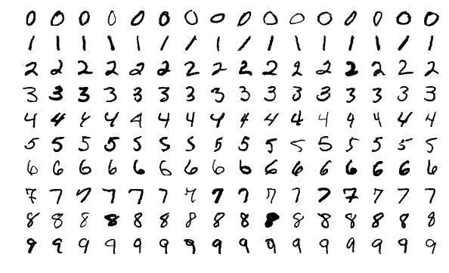
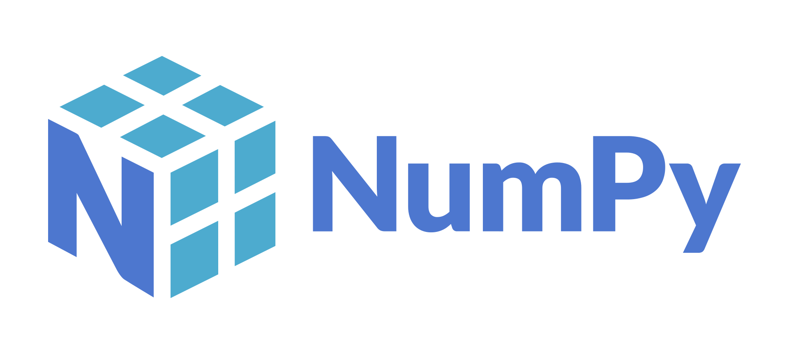
Image Recognition
With NumPy, we can perform basic image recognition.
Let’s give a try to the MNIST problem.

