Slide 1
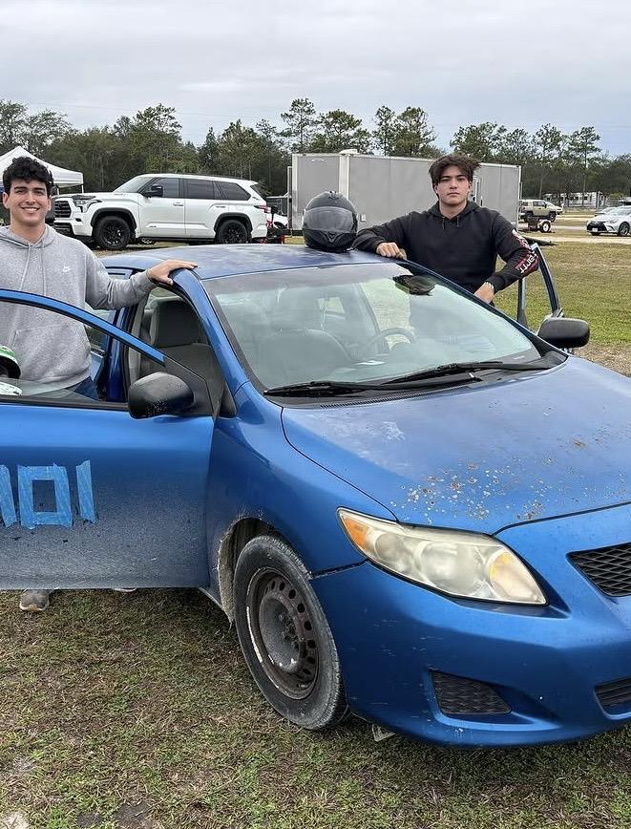
ERGONOMIC FIT
IN THE COCKPIT
How Seat Clearance and Steering Wheel Reach
Affect Race Car Driver Performance, Comfort, and Fatigue
INSERT CAR / COCKPIT IMAGE
Fauni · Rosen · Coyne · Spillman · Walsh · Bonnoront
Dr. Jad Atweh · April 2026
EIN3241 · Human Factors & Ergonomics · University of Florida · Spring 2026

Slide 2
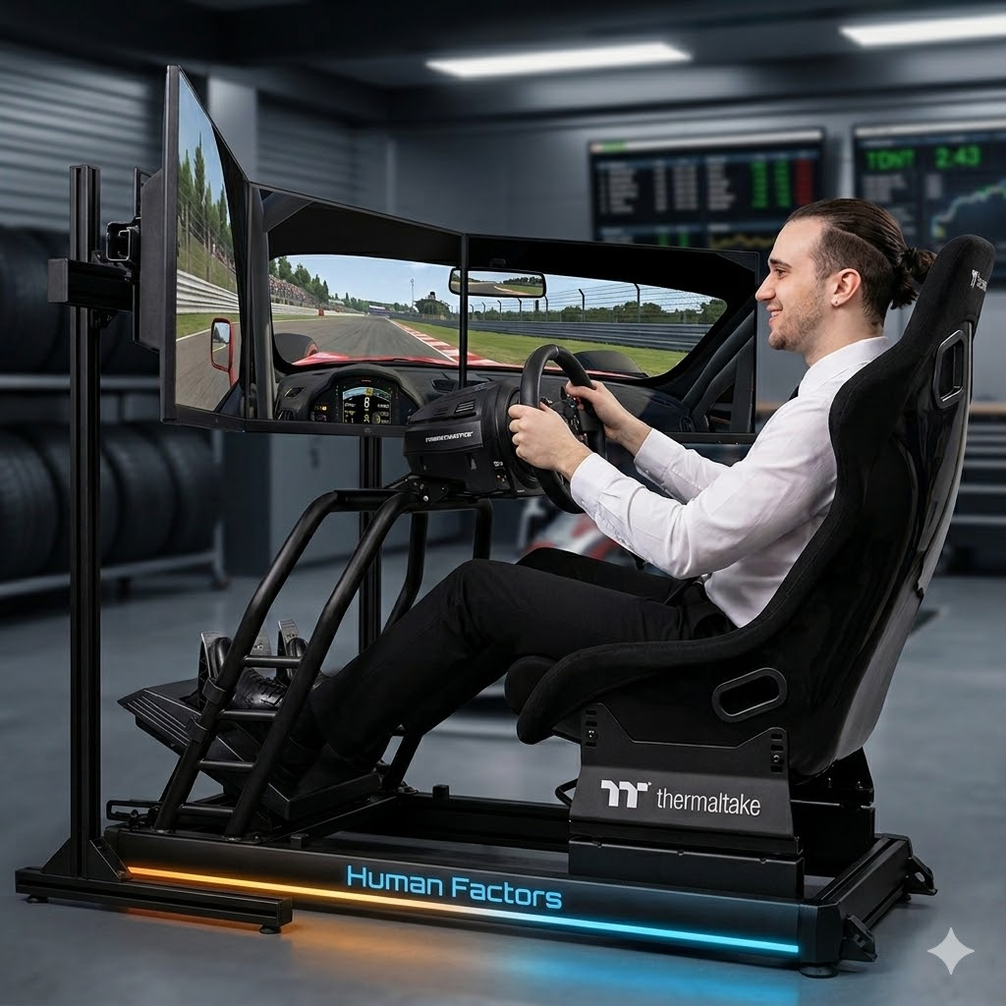
INTRODUCTION
Problem Statement
Problem Statement:
Despite the critical role of cockpit fit in driver performance, no existing study has isolated the combined effects of seat clearance and steering wheel reach distance on driver outcomes.
Why it matters
Driver performance depends on precision, reaction time, and endurance
The Problem
Poor cockpit fit increases fatigue, reduces control, and causes errors
Research Gap
No study isolates seat clearance and reach distance together
EIN3241 — Human Factors & Ergonomics · University of Florida · Spring 2026

Slide 3
BACKGROUND
What the Research Tells Us
Existing Work
Research Gaps
Seat fit directly affects posture, muscle activation, and lap time (Rosalie & Rosalie, 2021)
G-forces create high physical strain, increasing error rates and fatigue over time (Mungai, 2025)
Non-neutral postures increase biomechanical effort, slowing reaction time (Marklin et al., 2005)
NASA-TLX captures workload; physical demand dominates at high performance levels (Tse, 2019)
Limited research on moderate ergonomic variation (not just extreme postures)
No studies isolating seat clearance and reach distance together
Lack of integration between workload, posture, and performance metrics
Extending Prior Work
Tests seat clearance + reach distance simultaneously
Focuses on typical users (40th–60th percentiles) instead of extremes
Links ergonomics → workload (NASA-TLX) → performance outcomes
EIN3241 — Human Factors & Ergonomics · University of Florida · Spring 2026

Slide 4
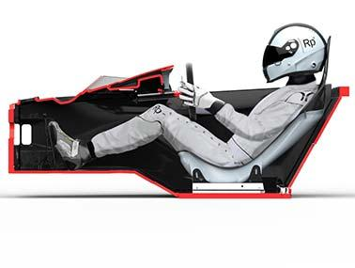
INTRODUCTION
Research Question and Hypothesis
Research Question:
How do seat clearance and steering wheel reach distance affect race car driver performance, comfort, and perceived workload in a controlled simulator environment?
Optimal seat clearance (+2 cm) will significantly outperform undersized and oversized conditions across all four dependent variables.
H1 (Seat Fit)
Moderate reach distance (0 cm offset) will significantly outperform close and far conditions across all four dependent variables.
H2 (Wheel Reach)
A significant interaction effect will exist, where the combination of optimal seat and moderate reach will produce the best outcomes overall.
H3 (Interaction)
EIN3241 — Human Factors & Ergonomics · University of Florida · Spring 2026

Slide 5
METHODS
Independent Variables
IV1 — Seat Clearance
IV2 — Steering Wheel Reach
The difference between the participant's hip breadth and the width of the seat
The horizontal distance from the driver's seat back to the steering wheel, adjusted relative to the participant's functional arm reach
Undersized
−2 cm
Close
−4 cm
Compressed posture, restricted ROM
Cramped arms, shoulder & wrist strain
Optimal
+2 cm
Moderate
0 cm
Natural posture, proper lateral support
Natural 120° elbow angle — optimal position
Oversized
+6 cm
Far
+4 cm
Excess space, compensatory stabilization
Forward lean, upper limb fatigue
EIN3241 — Human Factors & Ergonomics · University of Florida · Spring 2026

Slide 6
METHODS
Dependent Variables & Controls
What We Measured
To eliminate outside noise, we ran everything on an F1 24 simulator — same track, same car, same weather, every single time.
Race Time:
Seconds over 66 laps — primary performance measure
F1 2024 spec car — identical every session
Track limit violations — auto-logged by simulator
Medium tires, full fuel load
Error Count:
Perceived workload, 6 subscales, post-race
Clear, dry, 22°C weather (fixed in software)
NASA-TLX:
Cockpit camera — fixed for all participants
Body Part Discomfort:
1–10 scale, 5 body regions, post-race
Lower back
Hips and buttocks
Shoulders
Arms and wrists
Neck
Time trial mode — no opponents
Same track every session (Barcelona)
Fixed steering sensitivity & force feedback
EIN3241 — Human Factors & Ergonomics · University of Florida · Spring 2026

Slide 7
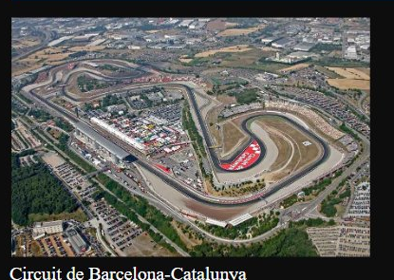
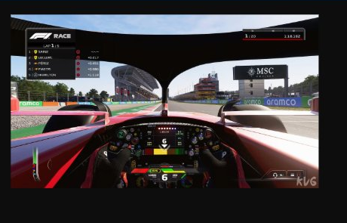
METHODS
Experimental Setup
Circuit de Barcelona-Catalunya
F1 24 Simulator — Cockpit View
4.675 km
16 corners
66 laps
Time Trial
Circuit length
Technical layout
Per race session
No opponents — full control
EIN3241 — Human Factors & Ergonomics · University of Florida · Spring 2026

Slide 8


METHODS
Study Design & Setup
Design
Mixed-subjects 3×3 factorial — 9 conditions
Each participant tested across 3 reach conditions, assigned to 1 seat level
9
conditions
Participants
30 simulated males, ages 20–22 (UF student profile)
90
Anthropometrics
40th–60th percentile, 173–180 cm, 70–84 kg
total races
Data Sources
AI simulation (Claude, Anthropic 2025) + survey (~67 UF students)
30
participants
10
obs per condition
EIN3241 — Human Factors & Ergonomics · University of Florida · Spring 2026

Slide 9
METHODS
Procedure
Pre-Study
Week 1
Week 2
Week 3
Week 4
Screening
Questionnaire
Hip breadth measured
Arm reach measured
Condition assigned
2-hr race on Barcelona
No data collected
Eliminates track learning effect
Data Collection
66 laps — full race
NASA-TLX after
Body part discomfort after
Data Collection
66 laps — full race
NASA-TLX after
Body part discomfort after
Data Collection
66 laps — full race
NASA-TLX after
Body part discomfort after
Counterbalancing :
6 orderings × 5 participants · every condition appeared equally as Race 1, 2, and 3 · all 9 conditions covered exactly 10 times
EIN3241 — Human Factors & Ergonomics · University of Florida · Spring 2026

Slide 10
RESULTS
What We Found
Mixed Factorial ANOVA | Seat Clearance: Between-Subjects × Reach Distance: Within-Subjects | N = 30 | α = .05
BEST CONDITION
WORST CONDITION
PERFORMANCE GAP
HIGHEST WORKLOAD
6,598 sec
6,855 sec
257 sec
81.3 TLX
Optimal seat × Moderate reach — fastest race time
Undersized seat × Close reach — slowest race time
Race time difference: best vs. worst condition
Undersized × Close — highest NASA-TLX score
Source
Race Time
Error Count
NASA-TLX
Avg BPD
Seat Clearance
F(2,27)=99.78
p<.001, η²=.881
F(2,27)=74.67
p<.001, η²=.847
F(2,27)=31.59
p<.001, η²=.701
F(2,27)=166.66
p<.001, η²=.925
Reach Distance
F(2,54)=73.21
p<.001, η²=.731
F(2,54)=28.56
p<.001, η²=.514
F(2,54)=29.21
p<.001, η²=.520
F(2,54)=79.17
p<.001, η²=.746
Seat × Reach
(Interaction)
F(4,54)=0.35
p=.841 ns
F(4,54)=1.29
p=.286 ns
F(4,54)=0.47
p=.760 ns
F(4,54)=0.69
p=.601 ns
✓ H1 Supported | ✓ H2 Supported | ✗ H3 Not Supported — IVs act independently (no interaction effect)
EIN3241 — Human Factors & Ergonomics · University of Florida · Spring 2026

Slide 11
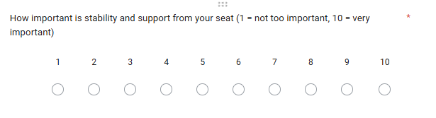
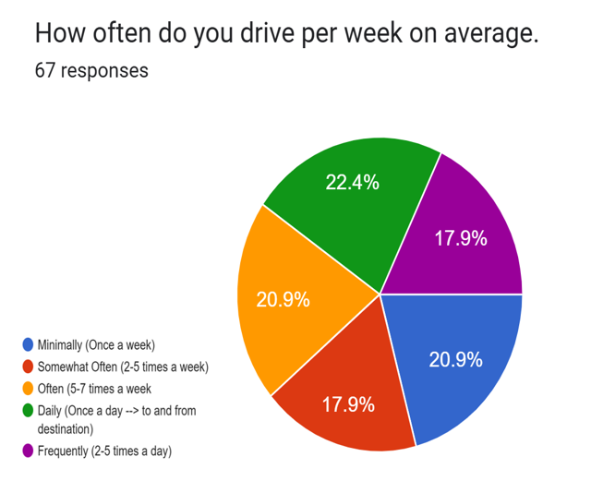


RESULTS
Survey – Qualitative Analysis
67 participants, 62 of which were in the range of ages 18-25 (median 21). Users were asked a series of questions to help supplement out data and add to our understanding of our experiment.
Notes:
Not the average of people, we know that the ai simulation is but we wanted to keep it broad and open to the public without having too much scrutiny
Assumptions of the words “Stability”, “Tiredness”, “Discomfort”, “Accesibility”. → Not easy to track, and so it was left up to the users discretion with our guidance on how to think about these words. Stability was described as overal lumbar and hip support throughout the drive
Not too many participants, would have liked to get the number in the hundreds
good split of data with a range of 4.5% spread, between 22.4% and 17.9%

Slide 12
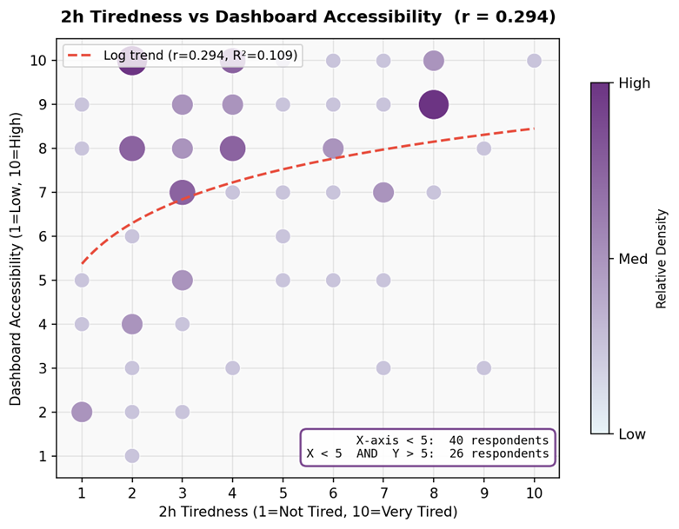
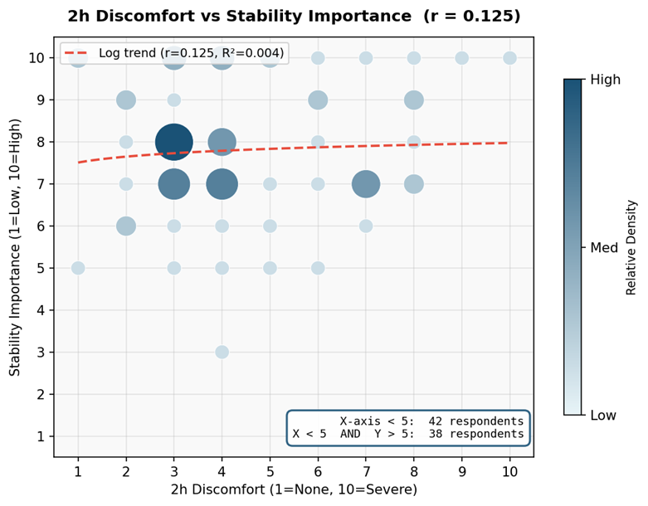
RESULTS
Survey Results — Real World Data
Tiredness vs. Control Accessibility
Discomfort vs. Seat Stability
38.8%
59.70% (40/67), < 5 Tiredness
65% (26/40), also > 5 Accessibility
56.7%
62.69% (42/67), < 5 Discomfort
90.48% (38/42), also > 5 Stability
Notes:
bubble charts in excel, bigger and darker the data point, means there were many of the same response criteria that double counts
while data isn’t well tested with quantitative backing, people find their preferred seating position through trial and error, so we are willing to take the step to assume that there is a real correlation between tiredness and accessibility and discomfort and stability to a degree,rather than it just being opinionated.

Slide 13
DISCUSSION
What the Data Tells Us
Best seat + reach = fastest times, fewest errors, lowest workload, least discomfort
Worst outcomes: undersized seat + close reach condition
Optimal Configuration Wins Across All Metrics
Just 2-4 cm shifts caused significant performance drops
Forces compensatory muscle activation → slower, less coordinated responses
Small Deviations, Big Consequences
Seat clearance and reach distance each improve performance on their own
Optimizing both together = highest performance outcomes
Independent but Additive Effects
EIN3241 — Human Factors & Ergonomics · University of Florida · Spring 2026
Notes:
after analyzing survey data and simulated data saw that the best results came from the optimal seat clearance and reach, with the worst results coming from undersized seat clearance and close reach. We also sw that a shift in 2-4 inches already mad very big performance drops, and lastly, we saw seat and reach distance can be improved individually but optih led to highest performance outcomes

Slide 14
DISCUSSION
Limitations
Narrow Sample Reduces Generalizability
Qualitative Survey Lacks Objective Discomfort Measurement
Male only, 40th–60th percentile
Excludes female drivers and broader body types
Self-reported only, no physiological or biomechanical validation
Perceived discomfort may not reflect actual physical strain
Between-Subjects Seat Factor Design Introduces Individual Variability
Simulated Conditions and Unverified Survey Data
Simulator removes real-world pressure and vehicle variability
67-person survey is qualitative only, no statistical verification
Baseline driving skill and motor coordination not fully controlled
May have introduced unexplained variability in results
EIN3241 — Human Factors & Ergonomics · University of Florida · Spring 2026

Slide 15
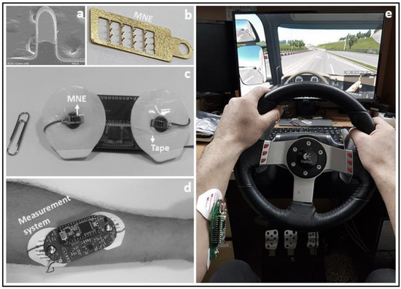
CONCLUSION
Future Work
Future Work
Validate findings using real drivers in controlled testing
Include female drivers and broader anthropometric range
Add EMG to quantify muscle activation patterns
Test larger ergonomic deviations (5th/95th percentile)
Expand survey: larger sample, controlled settings, quantitative data
Explore adaptive cockpit systems responding to driver fatigue
Ergonomic fit is not a comfort preference — it is a measurable driver performance variable.
EIN3241 — Human Factors & Ergonomics · University of Florida · Spring 2026

Slide 16
CONCLUSION
References
Anthropic. (2025). Claude (AI language model). https://www.credo.ai/ai-vendor-directory/anthropic-claude
Coyne, C. M. (2026, April 20). Car comfortability [Survey]. Google Forms. https://docs.google.com/forms/d/e/1FAIpQLSficDHPrR6rdvr-5j0m3BGEBwHGs1aTaTI7Hjoeu_xvb_Pg6Q/viewform?usp=headerhttps://docs.google.com/forms/d/e/1FAIpQLSficDHPrR6rdvr-5j0m3BGEBwHGs1aTaTI7Hjoeu_xvb_Pg6Q/viewform?usp=header
Hart, S. G., & Staveland, L. E. (1988). Development of NASA-TLX (Task Load Index): Results of empirical and theoretical research. Advances in Psychology, 52, 139–183.
Lane Community College Academic Technology Center. (n.d.). Python. https://inside.lanecc.edu/atc/software/t/13310
Mungai, G. (2025). Physiological conditioning in motorsports athletes: A systematic review [Master's thesis, Charles University, Faculty of Physical Education and Sport].
Paquet, V., Joseph, C., & D'Souza, C. (2012). Computer re-sampling for demographically representative user populations in anthropometry: A case of doorway and clear floor space widths. WORK: A Journal of Prevention, Assessment & Rehabilitation, 41(S1), 4098–4101. https://doi.org/10.3233/wor-2012-0703-4098
Pick, A. J., & Cole, D. J. (2006). Dynamic properties of a driver's arms holding a steering wheel. Proceedings of the Institution of Mechanical Engineers, Part D: Journal of Automobile Engineering, 220(12), 1765–1775. https://doi.org/10.1243/09544070JAUTO273
Rosalie, S. M., & Rosalie, S. (2021). Customizing female racing drivers' seat fit can improve their performance. Journal of Expertise, 4(1), 56–79. https://www.journalofexpertise.org
Satti, A. T., Kim, J., Yi, E., Cho, H.-Y., & Cho, S. (2021). Microneedle array electrode-based wearable EMG system for detection of driver drowsiness through steering wheel grip. Sensors, 21(15), 5091. https://doi.org/10.3390/s21155091
SnapLap. (n.d.). Catalunya circuit. https://www.snaplap.net/catalunya-circuit/
Tse, K. (2019). Measuring driving workload using NASA TLX. Apex Performance Engineering / Formula Delta Driver Science Blog. https://kktse.github.io/jekyll/update/2019/09/14/driver-workload-nasa-tlx-ota-smp.html
EIN3241 — Human Factors & Ergonomics · University of Florida · Spring 2026

Slide 17
CONCLUSION
Appendix A - AI Data Simulation Prompt
The following prompt was provided to Claude (Anthropic, 2025) to generate the simulated dataset used in this study:
"I need you to simulate a dataset for a mixed-subjects 3x3 factorial Human Factors study examining the effect of seat clearance and steering wheel reach distance on race car driver performance, comfort, and perceived workload in an F1 simulator environment.
Study parameters:
30 male participants, ages 20–22, modeled within the 40th–60th percentile anthropometric range (173–180 cm, 70–84 kg)
IV1 — Seat Clearance: 3 levels (Undersized: −2 cm, Optimal: +2 cm, Oversized: +6 cm from each participant's measured hip breadth)
IV2 — Steering Wheel Reach: 3 levels (Close: −4 cm, Moderate: 0 cm, Far: +4 cm from each participant's optimal reach position)
9 conditions total, 10 observations per condition, 90 total race observations
Each participant completes 3 races — one per reach level — assigned to one seat level for the full study
Latin Square counterbalancing across 6 reach condition orderings, 5 participants per ordering
Dependent variables to simulate for each observation:
Race Time in seconds over 66 laps at Circuit de Barcelona-Catalunya. Baseline optimal ~6,600 sec. Penalties: Undersized +150 sec, Oversized +80 sec, Close reach +120 sec, Far reach +60 sec. Noise SD ±45 sec.
Driving Error Count (track limit violations). Baseline optimal ~10 errors. Penalties: Undersized +7, Oversized +4, Close +6, Far +3. Noise SD ±3.
NASA-TLX Score (0–100, weighted). Baseline optimal ~55. Penalties: Undersized +15, Oversized +8, Close +14, Far +7. Noise SD ±8.
Average Body Part Discomfort (1–10 scale, 5 regions: lower back, hips/buttocks, shoulders, arms/wrists, neck). Baseline optimal ~3.5. Penalties: Undersized +2.2, Oversized +1.2, Close +2.0, Far +1.0. Noise SD ±1.0. Apply regional weighting so seat clearance most affects lower back and hips, reach distance most affects shoulders and arms.
Use Python with numpy and a fixed random seed of 42 for reproducibility. Output the dataset as an organized Excel file with the following sheets: Raw Data (one row per race observation), Summary Statistics (means and SDs by condition), ANOVA-Ready data, and Participant Profiles. All simulation parameters should be grounded in the ranges reported in vehicle ergonomics literature."
EIN3241 — Human Factors & Ergonomics · University of Florida · Spring 2026

