Slide 1
SOFSTICA AI HACKATHON 2026
TRACK 2 · COHORT & DATA QUALITY EXPLORER
HONESTY AS A FEATURE
CohortFit
Turn a plain-English cohort into a transparent, reproducible query — then judge whether that cohort's data are fit to trust, separating a real clinical finding from a data error.
github.com/danisaysskol/CohortFit
Muhammad Danish · Soem Aylani
Research and educational prototype only. Not for clinical use. Do not use for diagnosis, treatment, triage, or emergency decisions.
Notes:
[~15s] This is CohortFit, our Track 2 entry. In one line: it turns a plain-English cohort description into a transparent, reproducible query, then tells you whether that cohort's data are actually fit to trust. Our pitch is honesty as a feature.

Slide 2
01 · THE PROBLEM
Hospital data are rich, but hard to trust
One admission spans dozens of linked tables — labs, meds, diagnoses, ICU observations. Before that data can support credible research, a researcher has to clear two hurdles at once.
DEFINE
JUDGE
Which patients are in the cohort?
Is that cohort's data fit to trust?
Translating a plain-English question into correct, reproducible inclusion and exclusion logic across many joined tables.
A value of 801 mmHg — is it a real extreme, or a data error? Getting this wrong poisons every downstream result.
Research and educational prototype only. Not for clinical use.
Notes:
[~25s] Hospital data are rich but hard to use — one admission spans dozens of linked tables. Before you can trust an analysis you face two hurdles at once: define the cohort correctly across many joins, and judge whether the data support it. Is a blood pressure of 801 a real extreme or a data error? Get that wrong and every downstream result is poisoned.

Slide 3
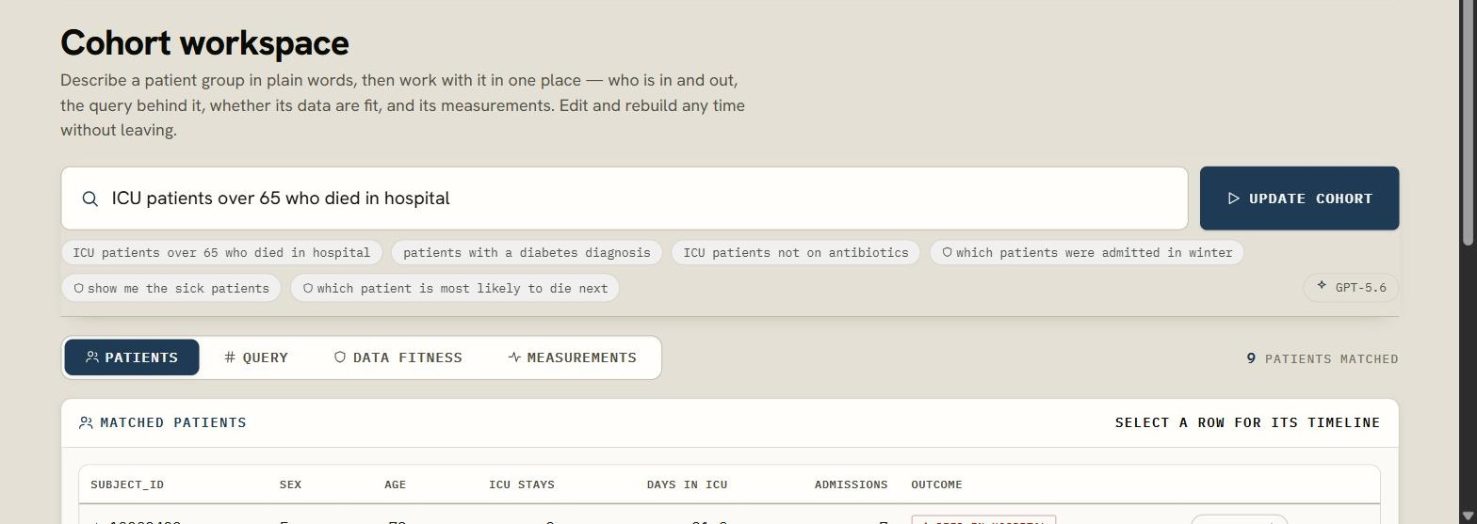
02 · WHAT IT DOES
One cohort, one workspace — four lenses on the same patients
COHORTS WORKSPACE
EN
Describe in plain English
"ICU patients over 65 who died in hospital"
01
Patients
Matched patients + per-patient event timelines
02
Query
Visible in/out funnel · IR & SQL · reproducible-recipe export
03
Data fitness
The red / amber / green scorecard
04
Measurements
Coverage · units · coding
Research and educational prototype only. Not for clinical use.
Notes:
[~25s] CohortFit puts all of that in one workspace. Describe the cohort in plain English, then work with it through four lenses on the same patients: the matched patients and their event timelines, the query behind them, a data-fitness scorecard, and the cohort's measurements — coverage, units, coding. Edit and rebuild any time without leaving.

Slide 4
03 · HOW IT WORKS — AI WHERE IT'S NECESSARY
The model proposes a query; a deterministic compiler runs it
→
→
PLAIN ENGLISH
VALIDATED JSON IR · GPT-5.6
DETERMINISTIC DUCKDB
"ICU patients over 65 who died in hospital"
Strict structured outputs; fields schema-checked
Compiled SQL runs the cohort — same input, same result
No free-text SQL from the model
The model never writes executable SQL — it only fills a schema-validated query object.
PROVENANCE FUNNEL
Every claim traces to a source row — patient-level output points back to the data.
All patients
100
Abstains when unsupported — declines rather than fabricating an answer.
Age ≥ 65
44
Had an ICU stay
44
Died in hospital → COHORT
9
Research and educational prototype only. Not for clinical use.
Notes:
[~30s] The AI is used only where it's necessary. Your words become a validated JSON query with strict structured outputs, and a deterministic DuckDB compiler validates every field against the schema before running it — so the model never writes executable SQL, and a hallucinated column becomes a clarification, not a bad query. Every claim traces back to a source row, and when the data can't support an answer it abstains. The provenance funnel shows 100 patients down to the 9 that match — every step visible.

Slide 5
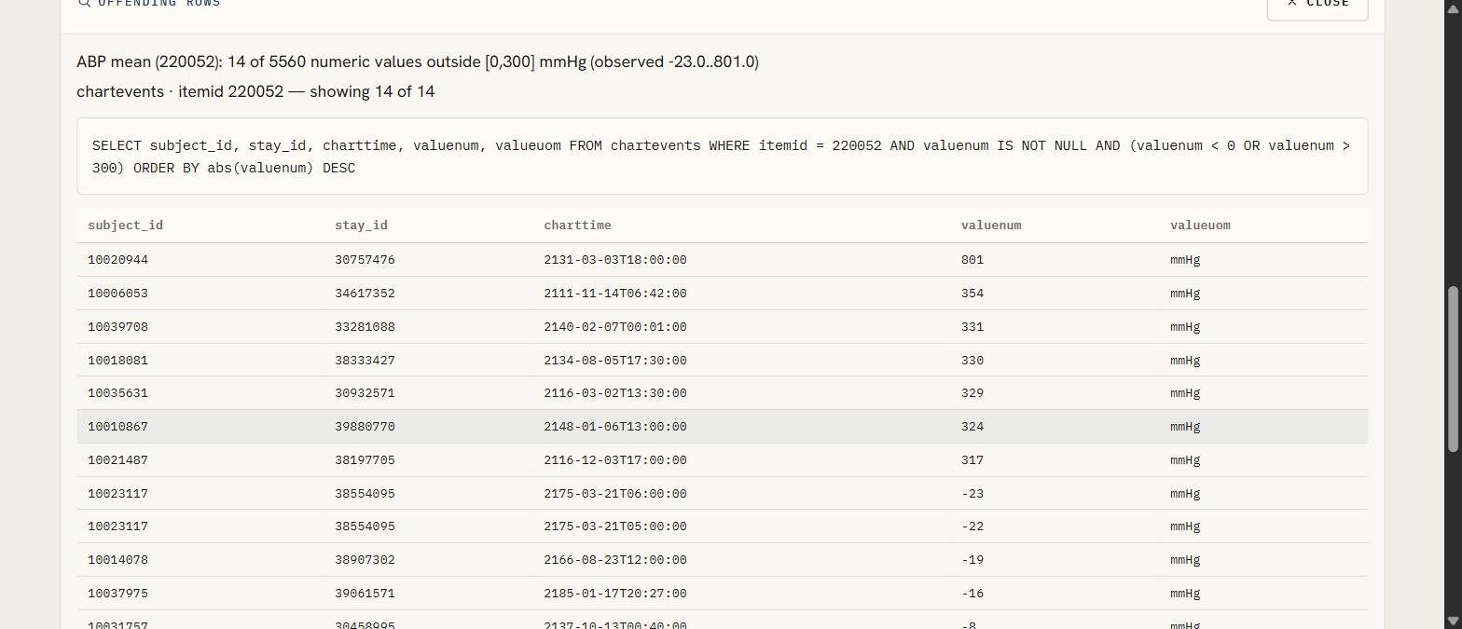
04 · DATA QUALITY YOU CAN TRUST
A five-dimension scorecard — every flag drills to the real rows
Plausibility
Units
Temporal
Completeness
Duplicates
REAL BUGS IT CATCHES — EVERY ONE POINTS TO A REAL ROW
FINDING DRILL-IN
801
mmHg arterial BP mean
chartevents · itemid 220052 · impossible range
2
units in one MCHC column
labevents · itemid 51249 · g/dL and % mixed
2,168
labs charted outside their admission window
labevents · temporal misalignment
Classified — data error vs verified finding vs caveat
Reversible — rule-backed fixes; source never edited
Research and educational prototype only. Not for clinical use.
Notes:
[~30s] Data quality is the heart of it: a five-dimension scorecard, and every flag drills to the real offending rows. These are genuine bugs in the demo — an arterial BP of 801 mmHg, MCHC recorded in two units in one column, 2,168 labs charted outside their admission window. Each is classified — data error versus a verified clinical finding — and any fix is reversible and rule-backed. We never edit the source.

Slide 6
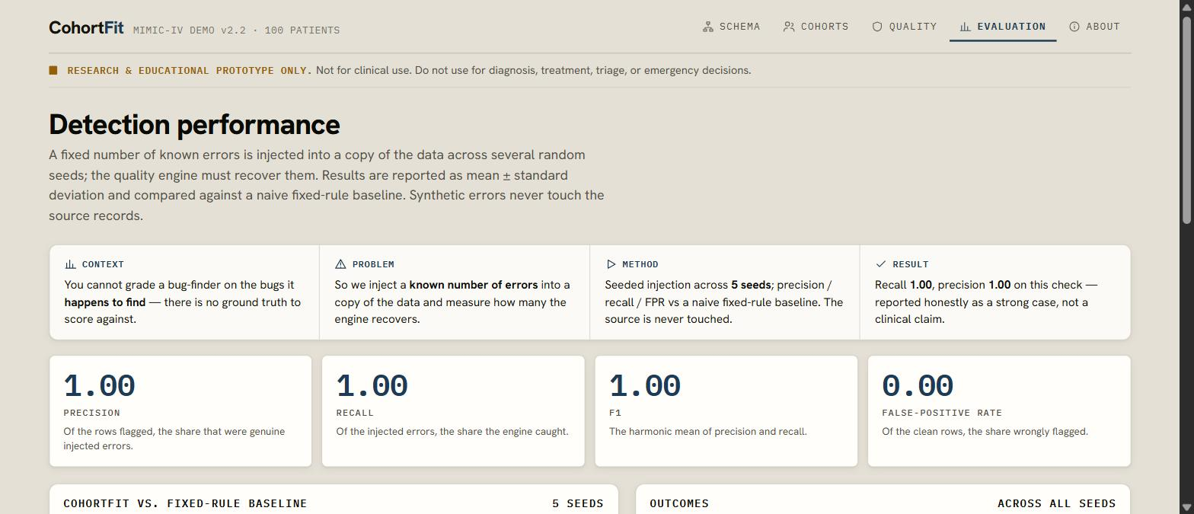
05 · EVALUATION & EVIDENCE
Measured honestly, and reproducible from a stored recipe
9
1.00
0.00
~14×
Gold cohort — exact set match
Precision & recall · temporal check
False-positive rate · 5 seeds
Precision vs a flag-everything baseline
EVALUATION VIEW
HONEST CAVEAT
Those perfect scores cover one dimension — temporal, the easy, cleanly-separable case. The other four are evidenced by real, clickable findings, not injection.
Provenance funnel 100 → 44 → 44 → 9, hand-verified against gold SQL.
Reproducible recipe — IR + SQL + subject_ids export to a re-runnable file.
Research and educational prototype only. Not for clinical use.
Notes:
[~30s] And we measure it honestly. Cohort correctness is an exact set match against a hand-verified gold query. On the temporal check, precision and recall are 1.00 across five seeds — but we're explicit that this is one dimension, the easy one; the other four are evidenced by real clickable findings, not injection. Against a naive flag-everything baseline we hold about 14x the precision at the same recall. And every cohort exports as a re-runnable recipe.

Slide 7
06 · SAFETY, HONESTY & AN HONEST FAILURE
It says "I can't" — and that is the point
Research-only boundary
Provenance & uncertainty
AI content marked
Data minimization
Banner on every screen; no automated clinical action.
Source rows and data gaps shown for every output.
Generated text is visually distinct from source data.
Schema & aggregates to the LLM — never raw patient rows.
FAILURE TESTED — THREE WAYS IT DECLINES
"Which patients were admitted in winter?"
"Patients under 12 AND over 65"
"Which patient is most likely to die next?"
ABSTAINS
CLARIFIES
Dates are shifted — seasonality is unknowable.
Contradictory criteria — asks before guessing.
REFUSES
Prediction is out of scope for this tool.
Research and educational prototype only. Not for clinical use. Do not use for diagnosis, treatment, triage, or emergency decisions.
Notes:
[~25s] Safety is built in — research-only banner on every screen, provenance and uncertainty on every output, AI content marked, and we minimize what's sent to the model. Most importantly it's failure-tested: it knows when to say no. Ask for patients admitted in winter and it abstains, because the dates are shifted and seasonality is unknowable. Contradictions it clarifies; predictions it refuses.

Slide 8
07 · LIMITATIONS, NEXT STEPS & CLOSE
Honest about the limits — and it runs today
LIMITATIONS
100 patients from one center, date-shifted and ICU-centric — a small, non-representative sample. Results are illustrative, not clinical evidence; no fairness or outcome claims.
RUNS WITH ONE COMMAND
docker compose up
FastAPI + DuckDB · Next.js 14 · 32 backend tests pass
WITH MORE TIME
Harder-dimension evaluation — near-duplicate & unit checks
Leakage / index-time guards for predictive cohorts
Validation on a larger dataset
CohortFit tells you when the data can't support the answer — honesty is the feature.
github.com/danisaysskol/CohortFit
Muhammad Danish · Soem Aylani
Research and educational prototype only. Not for clinical use. Do not use for diagnosis, treatment, triage, or emergency decisions.
Notes:
[~20s] We're honest about the limits — 100 patients is illustrative, not clinical evidence — and about what's next: harder-dimension evaluation, leakage guards, a larger dataset. But it runs today with one command. The differentiator is simple: CohortFit tells you when the data can't support the answer. Honesty is the feature. Thank you.

