Slide 1
parameter and localparam in Verilog
Parameter : Parameters are constant values.
Syntax: parameter parameter_name=constant_expression;
Parameters are constants. It is not allowed to modify parameter values at runtime. A parameter value can be changed at compile time using defparam, or when a module containing parameters is instanced.
The constant expression can contain previously declared parameters. When changes are detected on the previously declared parameters, all parameters that depend on this value are automatically updated.

Slide 2
Localparam
A localparam is a constant similar to a parameter.
Syntax:
localparam name = value;
A localparam is a constant that is similar to a parameter, but which cannot be modified with a defparam, or by the ordered or named parameter value assignment in a module instance statement.
Local parameters can be assigned to a constant expression containing a parameter that can be modified with the defparam, or by the ordered or named parameter value assignment.

Slide 3
module top;
reg [15:0] a;
reg [15:0] b;
wire [15:0] sum1;
wire [15:0] sum2;
...
adder add1(a,b,sum1);
defparam add1.width = 16;
...
adder #(16) add2(a,b,sum2);
...
endmodule
module adder(a,b,sum)
parameter width = 8;
input [width-1:0] a;
input [width-1:0] b;
output [width-1:0] sum;
assign sum = a + b;
endmodule

Slide 4
module adder #(parameter width = 8)
(
input [width-1:0] a,
input [width-1:0] b,
output [width-1:0] sum
);
assign sum = a + b;
endmodule
module top;
reg [15:0] a;
reg [15:0] b;
wire [15:0] sum1;
wire [15:0] sum2;
adder #(.SIZE(16)) add_0 (a,b,sum2);
...
endmodule

Slide 5
module adder(a,b,sum)
parameter height = 8;
parameter width = 10;
localparam length = 4;
input [width-1:0] a;
input [height-1:0] b;
input [length-1:0] c;
output [width-1:0] sum;
assign sum = a + b + c;
endmodule
module top
reg [15:0] a;
reg [15:0] b;
wire [15:0] sum1;
adder #(.width(16), .height(4), .length(5)) add_0 (a,b,sum2);
endmodule
//error as length is not accessible outside the module adder

Slide 6
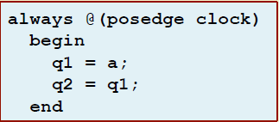
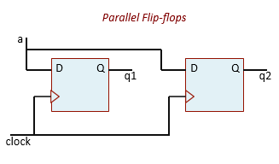
Synthesis of sequential statements
Example 1

Slide 7
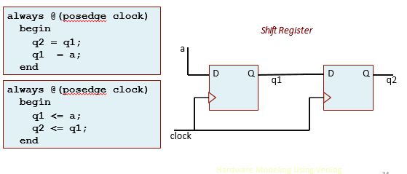
Example 2

Slide 8
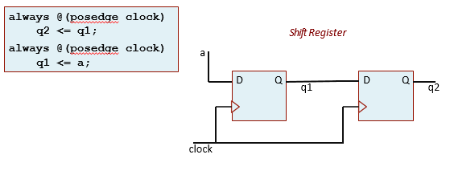
Example 3

Slide 9
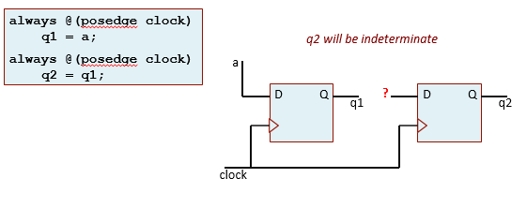
Example 4

Slide 10
Finite state Machine(FSM)
Combinational and Sequential Circuits
In a combinational circuit, the outputs depend only on the applied input
values and not on the past history.
In a sequential circuit, the outputs depend not only on the applied input
values but also on the internal state.
-The internal states also change with time.
-The number of states is finite, and hence a sequential circuit is also referred to as a Finite State Machine (FSM).
Most of the practical circuits are sequential in nature.

Slide 11
Mealy and Moore FSM
Finite State Machines (FSM) are sequential circuit used in many digital systems to control the behavior of systems and dataflow paths.
A common classification used to describe the type of an FSM is Mealy and Moore state machines.
A Moore FSM is a state machine where the outputs are only a function of the present state.
A Mealy FSM is a state machine where one or more of the outputs is a function of the present state and one or more of the inputs.

Slide 12
Representation of FSM
A FSM can be represented either in the form of a state table or in the form of a state transition diagram.
Variations exist, e.g. Algorithmic State Machine (ASM) chart.
Example:
– A circuit to detect 3 or more 1’s in a serial bit stream.
– The bits are applied serially in synchronism with a clock.
– The output will become 1 whenever it detects 3 or more consecutive 1’s in the stream.

Slide 13
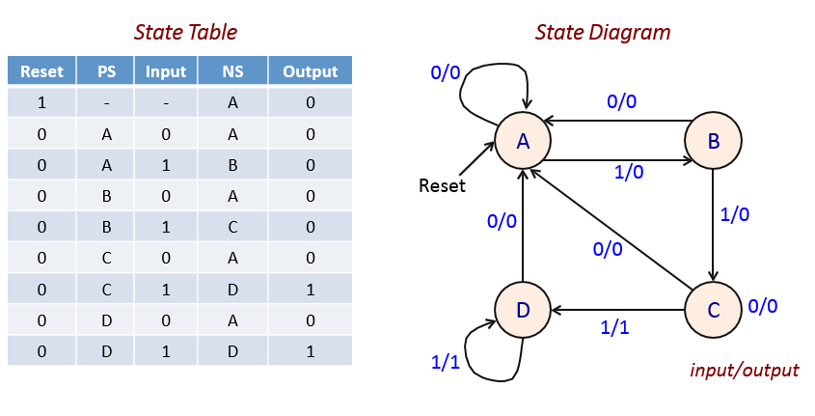

Slide 14
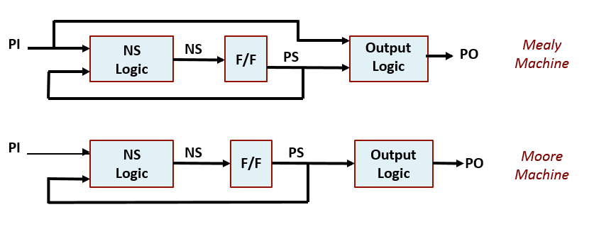
Pictorial depiction

Slide 15
Moore FSM 1
module Moore(clk,reset,PI,PO);
input clk,reset,PI;
output reg PO;
reg [1:0]PS,NS;
localparam A=2’d0,B=2’d1,C=2’d2,D=2’d3;
always@(PS,PI) //Define next state combinational logic
case(PS)
A:if(PI) NS=B; else NS=A;
B:if(PI) NS=C; else NS=A;
C:if(PI) NS=D; else NS=A;
D:if(PI) NS=D; else NS=A;

Slide 16
default:NS=2’bxx;
endcase
always@(negedge reset or posedge clk) //Define state update sequential logic
If(!reset) PS<=A;
Else PS<=NS;
always@(PS) //Define o/p combinational circuit
if(PS==D) PO=1;
else PO=0;
endmodule

Slide 17
Moore FSM 2
module Moore(clk,reset,PI,PO); //defining next state and o/p in same always block
input clk,reset,PI;
output reg PO;
reg [1:0]PS,NS;
localparam A=2’d0,B=2’d1,C=2’d2,D=2’d3;
always@(PS,PI)
begin //Define next state combinational logic
case(PS)
A:if(PI) NS=B; else NS=A;
B:if(PI) NS=C; else NS=A;
C:if(PI) NS=D; else NS=A;
D:if(PI) NS=D; else NS=A;

Slide 18
default:NS=2’bxx;
endcase
if(PS==D) PO=1; //Define o/p combinational circuit
else PO=0;
end
always@(negedge reset or posedge clk) //Define state update sequential logic
If(!reset) PS<=A;
Else PS<=NS;
endmodule

Slide 19
Moore FSM 3
module Moore(clk,reset,PI,PO); //defining next state and state update in same input clk,reset,PI; always block
output reg PO;
reg [1:0]PS,NS;
localparam A=2’d0,B=2’d1,C=2’d2,D=2’d3;
always@(negedge reset or posedge clk) //Define state update sequential logic if(!reset) PS<=A; and next state combinational logic
else
case(PS)
A:if(PI) NS=B; else NS=A;
B:if(PI) NS=C; else NS=A;
C:if(PI) NS=D; else NS=A;
D:if(PI) NS=D; else NS=A;

Slide 20
default:NS=2’bxx;
endcase
always@(PS) //Define o/p combinational circuit
if(PS==D) PO=1;
else PO=0;
endmodule

Slide 21
Mealy FSM
module Mealy(clk,reset,PI,PO)
input clk,reset,PI;
output reg PO;
reg [1:0]PS,NS;
localparam A=2’d0,B=2’d1,C=2’d2,D=2’d3;
always@(PS,PI) //Define next state combinational logic and output
case(PS) specifications
A:if(PI) NS=B; PO=0; else NS=A; PO=0;
B:if(PI) NS=C; PO=0; else NS=A; PO=0;
C:if(PI) NS=D; PO=1; else NS=A; PO=0;
D:if(PI) NS=D; PO=1; else NS=A; PO=0;
default:NS=2’bxx;
endcase

Slide 22
always@(negedge reset or posedge clk) //Define state update sequential if(!reset) PS<=A; logic
else PS<=NS;
endmodule

Slide 23
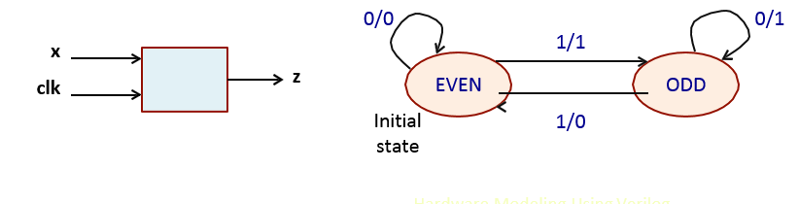
Example
Design of a serial parity detector.
A continuous stream of bits is fed to a circuit in synchronism with a clock. The circuit will be generating a bit stream as output, where a 0 will indicate “even number of 1’s seen so far” and a 1 will indicate “odd number of 1’s seen so far”.

Slide 24
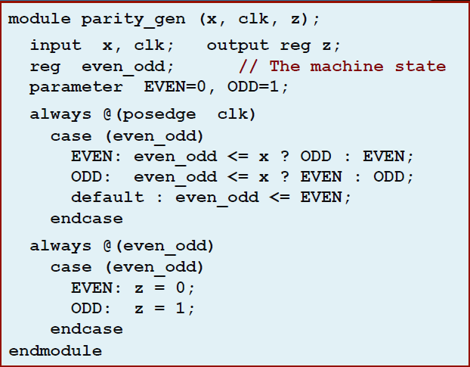

Slide 25
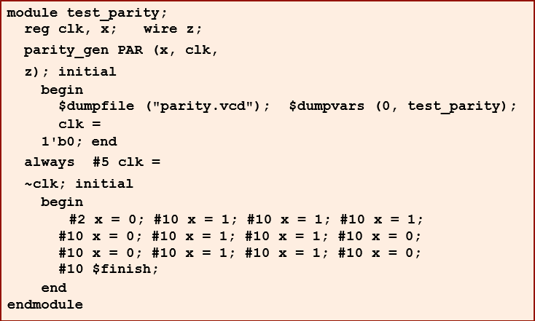

Slide 26
Assignment
Design both Mealy and Moore type FSM’s(having reset also input) of a sequence generator (overlapping and non overlapping)with last four binary digits of your group number(using D flipflops and logic gates.)

