Slide 1

NUIMS
Members:
JAWAD AHMED (BSCS201959)
SHARJEEL AKRAM (BSCS201960)
DANISH KHAN (BSCS201950)
M ANAS (BSCS201949)
M ZUBAIR (BSCS201930)

Slide 2
Contents
Introduction
Problem Statement
Proposed Solution
C4 Diagrams
Implementation
Individual Contribution
Challenges
Future Work

Slide 3
Introduction
The project is Inventory Management System.
Inventory Management System is developed in Python Flask using HTML CSS Bootstrap.

Slide 4
Introduction
Admins can add and update products of each category.
Admin can approve or disapprove the request of product from user.
Students and staff can issue products from any category but it should request admin for approval.

Slide 5
Problem statement
We are required to build and Inventory Management System in Python Flask framework using HTML and CSS/Bootstrap.
The objective of our software system is to manage an inventory management system for Namal University.

Slide 6
Proposed solution
HTML is used to build pages of system.
CSS and Bootstrap is used to design those created pages.
MySQL is used to create database for the system.
Flask framework is used in python to render pages created by HTML and integrate database with them.

Slide 7
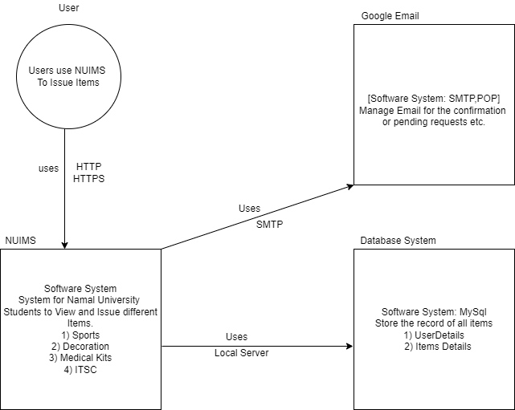
C4 diagrams
Context Diagram

Slide 8
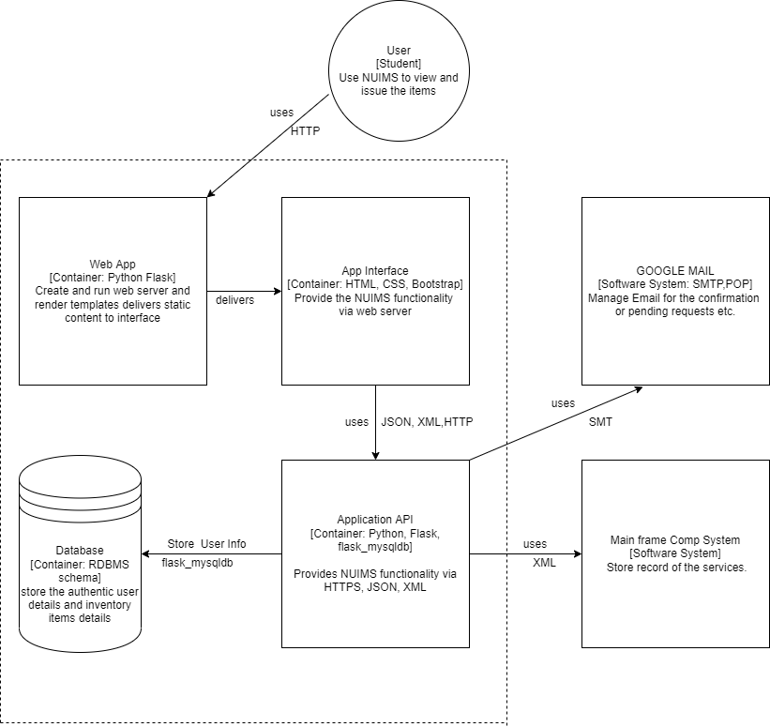
C4 diagram
Container Diagram

Slide 9
implementations
Database tables: Users Items Issue Products | Python functions: Index() registration() Login() Admin Dashboard() Main Dashboard User Management Products Category Show All Products Add Products Admin Detail | 5. User Dashboard() Main Dashboard Products Category Show All Products User Detail 6. Logout()

Slide 10
Individual contribution
Jawad Ahmed
-Admin Dashboard
-User Dashboard
-CSS Designing
-Flask code Implementation
-Report contribution
Danish Khan
-Database Design
-Flask Integration with MySQL
-C4 Diagrams
-UML implementation
-Report Contribution
Mian Muhammad Zubair
-Home Page Designing
-HTML pages
-Database Design
-Flask code Implementation
-Report contributions
Muhammad Anas
-Database tables structure
-User Dashboard Designing
-C4 Diagrams
-Python Flask implementation -Report contribution
Sharjeel Akram
-Home Page Designing
-Sign Up page and Login Page
-Database Designing
-Python Flask implementation -Report contribution
TechLions
Group Members

Slide 11

Challenges
Database connectivity with python flask
Fetching data from database tables in the manner proposed by designers.
Creating two different views i.e.
Admins
Students

Slide 12
Future work
Our system is just for one department. It can be further extend to many departments.
There could be added online exam portal so that it could conduct online exam.
Results: If student fail one or more subjects, he/she can enrolled in that while studying in the next semester.

Slide 13

Thank you

