Slide 1
Web application using django
submitted by
Danish jya
Mob-9565848688
Email- jyadanish2018@gmail.com

Slide 2
OBJECTIVE
THE GOAL IS TO BUILD AN APPLICATION THAT HELPS USERS FIND THE MOST FUEL-EFFICIENT ROUTE FOR VISITING SCHOOLS IN A SPECIFIC REGION BASED ON THE PROVIDED PINCODE.

Slide 3
PROBLEM STATEMENT
THE TASK IS TO DEVELOP A SINGLE-PAGE DJANGO WEB APPLICATION THAT ALLOWS USERS TO ENTER A PINCODE AND OBTAIN A LIST OF SCHOOLS IN THAT REGION. THE APPLICATION SHOULD THEN CALCULATE THE MOST FUEL-EFFICIENT ORDER TO VISIT THESE SCHOOLS AND DISPLAY THE OPTIMIZED ROUTE TO THE USER.

Slide 4
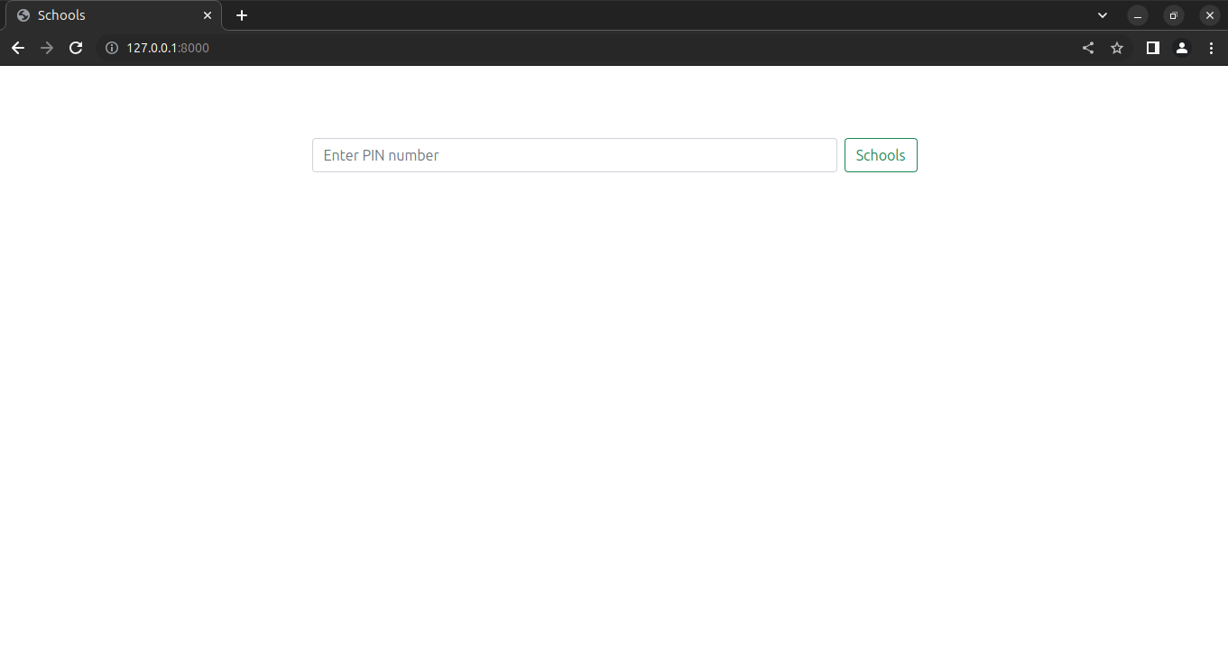
LANDING PAGE
Here visitor enter the pincode

Slide 5
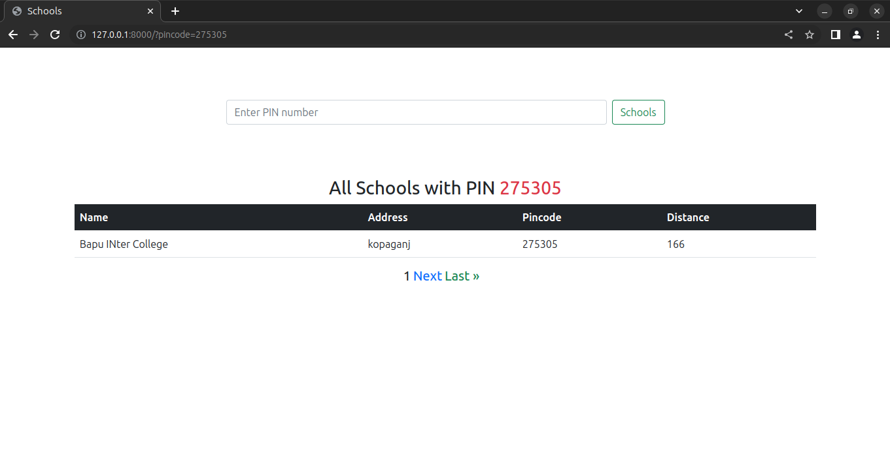
SCHOOL LISTING
School based on the pincode

Slide 6
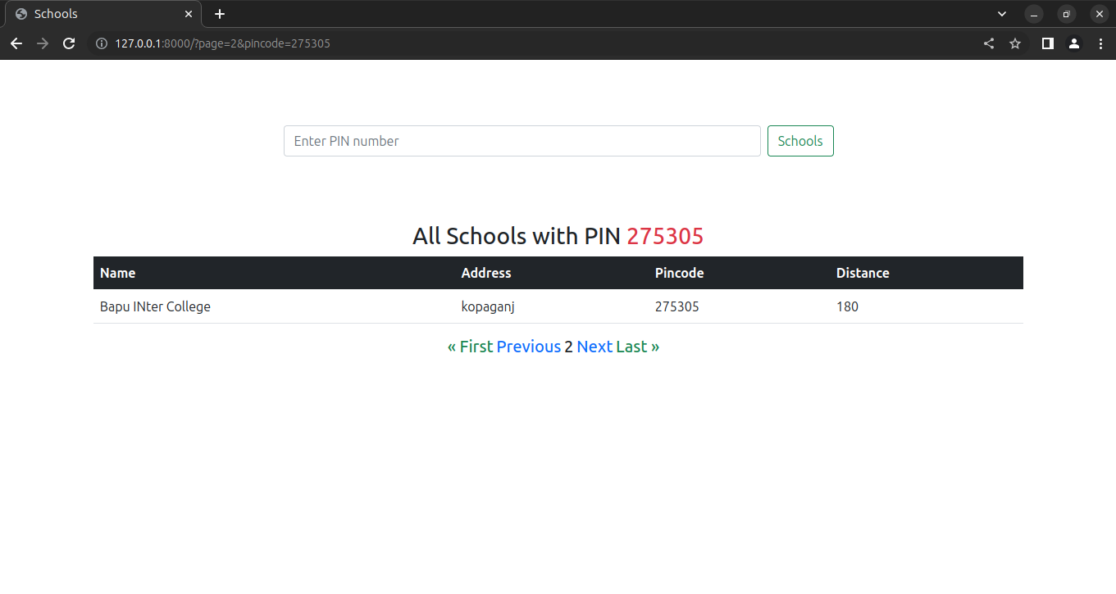
pagination
We can go next page by click on next

Slide 7
ROUTE OPTIMIZATION:
Visitor receive optimize distance route

Slide 8
Thank you

