Slide 1
FINAL INTERNSHIP DEFENSE • 2026
MarketPilot AI
Autonomous E-Commerce Marketing Platform & Agentic Campaign Orchestration System
CANDIDATE INFORMATION
Danish Riaz
BS Computer Science (Final Year)
Quaid-i-Azam University (QAU), Islamabad
SUPERVISION & STACK
Host: NESCOM
Coordinator: Dr. Inayatullah Khan
Stack: React 18 • FastAPI • Supabase RLS • Gemini 2.5

Slide 2
01. PROBLEM LANDSCAPE
E-Commerce Bottlenecks in Emerging Markets
Why traditional manual marketing workflows fail modern digital retail merchants
CRITICAL
COST FRICTION
Attention Economy Crisis
Creative Burnout & Agency Costs
✦ Rapid Proliferation of Local D2C Stores
✦ Decaying Organic Reach on Social Feeds
✦ Daily Content Drops Imperative
✦ 15+ Hours Spent Weekly on Scriptwriting
✦ Expensive Outsourced Advertising Retainers
✦ Slow Turnaround for Viral Trend Jacking
CAPITAL LOSS
LOCALIZATION
Margin Blindness & Ad Losses
Linguistic & Regional Deficit
✦ Zero Profit-Margin Consideration in Ad Tools
✦ Paid Ads Running on Negative-Margin SKUs
✦ High Commercial Store Failure Rate
✦ Generic Western English Ad Copy
✦ Lack of Roman Urdu & Regional Dialects
✦ Missed South Asian Buyer Emotional Triggers

Slide 3
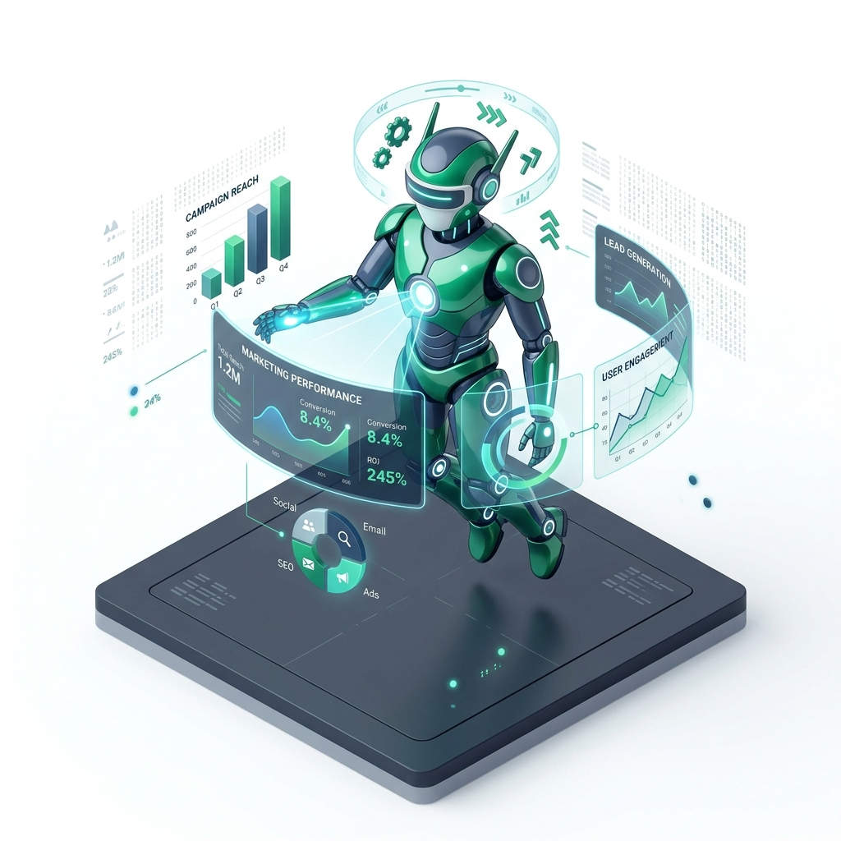
02. PROPOSED SOLUTION
MarketPilot AI: The Autonomous Marketing Copilot
An intelligent agentic platform unifying catalog economics, live trends, and localized copy
AUTOMATION
Autonomous Closed-Loop Pipeline
✦ Zero-Copywriting Manual Friction
✦ Direct Inventory-to-Campaign Dispatch
PROFIT FIRST
Margin-Grounded Strategy Engine
✦ Strict SKU Profit Margin Guardrails
✦ Automatic High-Margin Prioritization
BILINGUAL
Hyper-Localized Regional Synthesis
✦ Dual Roman Urdu & Nastaliq Generation
✦ Culturally Nuanced Viral Video Hooks
AUTONOMOUS AI AGENT CORE ENGINE

Slide 4
03. AGENTIC ARCHITECTURE
Autonomous 5-Phase Execution Lifecycle
Deterministic end-to-end flow from raw catalog ingestion to scheduled multichannel dispatch
PHASE 01
PHASE 02
PHASE 03
PHASE 04
PHASE 05
Catalog Ingestion
Trend Radar
Strategy Planner
Creative Studio
Cadence Dispatch
✦ Supabase Realtime Sync
✦ Margin Tier Tagging
✦ Active Inventory Audit
✦ Social Signal Scraping
✦ Momentum Velocity
✦ Breakout Narrative Audio
✦ 4-Pillar Campaign Matrix
✦ Algorithmic SKU Pairing
✦ Targeted Audience Logic
✦ 3-Second Hook Generation
✦ Dual-Language Scripts
✦ Visual Directing Cues
✦ 70/20/10 Balance Meter
✦ Fatigue Saturation Guard
✦ Unified Social Calendar

Slide 5
04. SYSTEM ARCHITECTURE
Decoupled Three-Tier System Architecture
High-concurrency, asynchronous, and strictly typed enterprise engineering
FRONTEND
BACKEND
DATABASE & LLM
Presentation Layer
React 18 & Vite Ecosystem
Application Layer
FastAPI & Python 3.12 Engine
Data & AI Layer
Supabase & Gemini 2.5 Flash
✦ TypeScript Static Type Safety
✦ Tailwind CSS Component Architecture
✦ Context-Preserving SPA Routing
✦ Responsive Bento Grid Layouts
✦ Non-Blocking AsyncIO Web Handlers
✦ Pydantic v2 Contract Validation
✦ Modular Router Decomposition
✦ Fault-Tolerant Error Handling
✦ PostgreSQL Database Kernel
✦ Row Level Security (RLS) Isolation
✦ Structured Deterministic JSON Schemas
✦ Zero-Mock Production Guardrails

Slide 6

05. CORE MODULES: SECURITY
Zero-Trust Authentication & 6-Digit Email OTP
Production-grade multi-tenant identity without external link redirects
VERIFICATION
Cryptographic 6-Digit Code
✦ Authentic Gmail Verification Dispatch
✦ Zero Mock Bypass Endpoints
DEFENSE
Anti-Spam Throttling Engine
✦ 60-Second UI Resend Lockout
✦ Rate-Limiting Attack Mitigation
SECURITY
PostgreSQL Kernel RLS Isolation
✦ Strict auth.uid() = user_id Policy
✦ Zero 3rd-Party Tracking Exposure
PRODUCTION CRYPTOGRAPHIC OTP PROTOCOL

Slide 7
06. CORE MODULES: COMMAND CENTER
Executive Dashboard & Real-Time KPI Telemetry
Unified operational visibility consolidating catalog economics, campaign pipeline, and trends
62% AVG MARGIN
94/100 VELOCITY
Catalog Margin Health
Trend Velocity Radar
✦ Automated Profit Margin Segmentation
✦ Hero Anchor SKU Tracking (≥ 60%)
✦ Low-Stock Scarcity Warning (< 20 Units)
✦ Real-Time Velocity Index Tracking
✦ Regional Viral Sound Surges
✦ Early Trend Lifecycle Detection
100% PRODUCTION
OPTIMAL CADENCE
Creative AI Throughput
Cadence Balance Audit
✦ Zero-Hallucination Ad Script Synthesis
✦ Automated 3-Second Hook Generation
✦ Dual English & Roman Urdu Output
✦ 70/20/10 Balance Meter Compliance
✦ Single-SKU Saturation Detection
✦ Unified Calendar Dispatch Queue

Slide 8

07. CORE MODULES: INVENTORY
Intelligent Product Catalog & Margin Economics
Algorithmic categorization safeguarding commercial ad spend and merchant profitability
HERO TIER
Hero Anchor Tier [ ≥ 60% Margin ]
✦ Primary Paid Advertising Target
✦ Maximum Profit Margin Generator
GROWTH TIER
Growth Driver Tier [ 40% – 59% ]
✦ Balanced Organic Engagement
✦ High-Volume Volume Driver
CLEARANCE
Clearance & Scarcity Tier [ < 20 Units ]
✦ Automated FOMO & Flash Sale Copy
✦ Working Capital Cash Recovery
MARGIN-DRIVEN SKU CLASSIFICATION

Slide 9
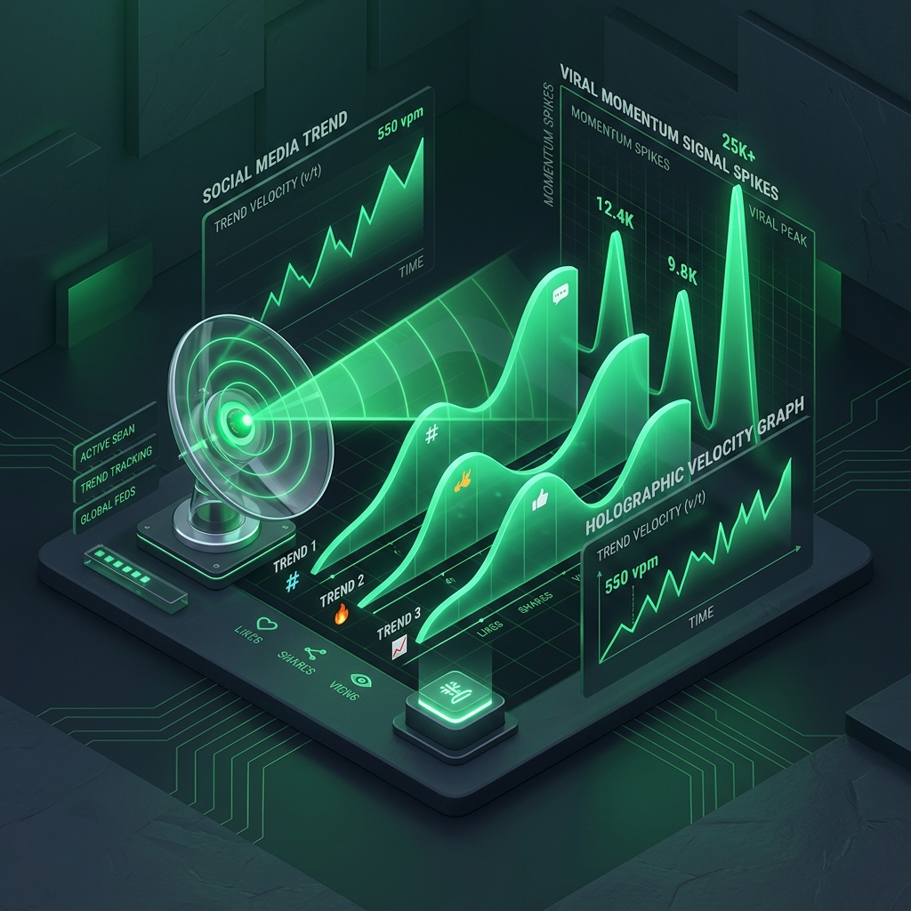
08. CORE MODULES: INTELLIGENCE
Live Trend Intelligence & Cultural Virality Radar
Continuous scraping and algorithmic pairing of trending social narratives with inventory
SIGNALS
Cross-Platform Signal Scraping
✦ TikTok & Instagram Viral Audio Ingestion
✦ Google Trends Regional Surge Monitoring
VELOCITY
Velocity & Saturation Scoring
✦ Real-Time Growth Acceleration Math
✦ Early-Stage Window Capitalization
PAIRING
Automated Semantic Product Pairing
✦ Direct Keyword-to-SKU Cross-Referencing
✦ Grounded Cultural Storytelling
REAL-TIME VIRALITY RADAR TELEMETRY

Slide 10
09. CORE MODULES: STRATEGY
Multi-Pillar Autonomous Campaign Planner
4 distinct marketing angles synthesized simultaneously for unified omnichannel dominance
Pillar 1: HERO ANCHOR
Pillar 2: CONVERSION
Pillar 3: VIRALITY
Pillar 4: BUNDLE AOV
Hero Product Blitz
Direct Response
Cultural Trend Hijack
High-Margin Bundling
✦ Focus on ≥ 60% Margin SKUs
✦ Maximum Paid ROAS Objective
✦ Direct Brand Value Proposition
✦ Urgent Problem-Solution Framing
✦ High-Converting Pain/Gain Scripts
✦ Clear Frictionless Action Triggers
✦ Viral Meme & Audio Integration
✦ Algorithmic Audience Magnet
✦ Exponential Organic Impressions
✦ Average Order Value (AOV) Boost
✦ Complementary Inventory Pairs
✦ Enhanced Customer Perceived Value

Slide 11

10. CORE MODULES: CONTENT
Creative AI Studio & Grounded Prompt Engineering
Structured video storyboarding eliminating generic copy and hallucinated claims
HOOK SYSTEM
3-Second Scroll-Stopping Hooks
✦ Visual + Text Pattern Interrupts
✦ Optimized for TikTok / Reels / Shorts
STORYBOARD
Scene-by-Scene Visual Directing
✦ Explicit B-Roll Visual Directives
✦ Actor On-Screen Action Guides
VERACITY
Deterministic Grounding Guardrails
✦ Strict Verified Product Feature Injection
✦ Zero Hallucinated Technical Specs
PRODUCTION AI VIDEO STORYBOARDING STUDIO

Slide 12
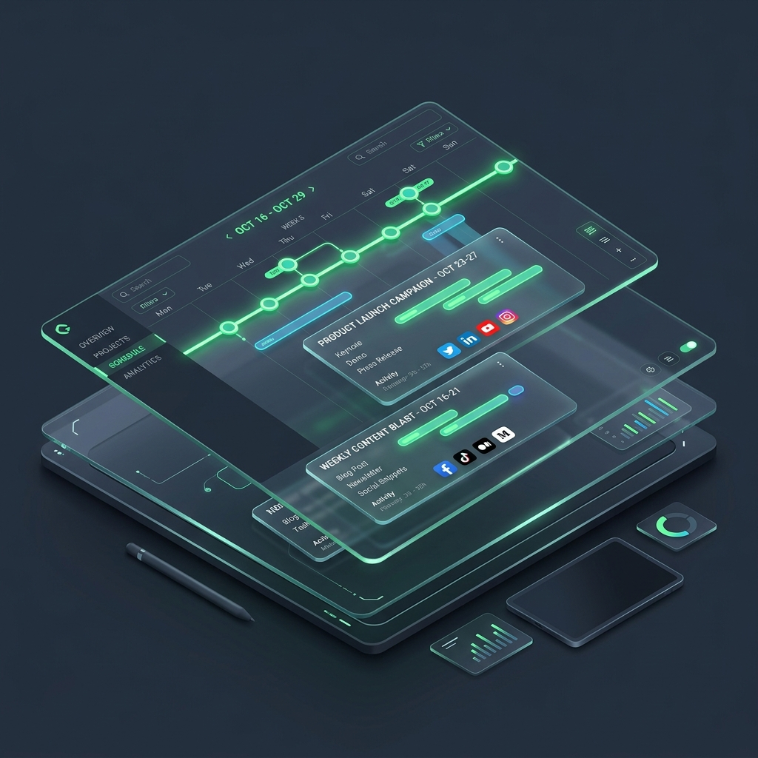
11. CORE MODULES: LOCALIZATION
Localized Urdu Engine & Dynamic Cadence Calendar
Authentic cultural resonance combined with automated anti-fatigue scheduling
URDU ENGINE
Dual-Script Regional Localization
✦ Conversational Roman Urdu Copy
✦ Authentic Urdu Nastaliq Typography
CADENCE METER
70/20/10 Content Balance Meter
✦ 70% Value-Add Educational Content
✦ 20% Direct Hard-Sell / 10% Viral
SCHEDULING
Anti-Fatigue Saturation Protection
✦ Automated Single-SKU Frequency Caps
✦ Multi-Channel Social Scheduling
OMNICHANNEL EDITORIAL CALENDAR & DISPATCH

Slide 13
12. CONCLUSION & ROADMAP
Technical Evaluation, Impact & Future Vision
Internship project achievements and future enterprise growth vectors
FULL-STACK
ROI IMPACT
Production-Grade Delivery
Measurable Commercial Impact
✦ React 18 + FastAPI + Supabase + Gemini
✦ 100% Production Ready (Zero Mock Bypass)
✦ High-Concurrency AsyncIO Engine
✦ 90% Reduction in Campaign Creation Time
✦ Guaranteed Margin-Grounded Ad Spend
✦ Elimination of Negative-Margin Ad Waste
PHASE II
PHASE III
Autonomous Social API Dispatch
Self-Optimizing Feedback Loops
✦ Direct Meta Graph & TikTok Marketing APIs
✦ Single-Click Automated Campaign Publishing
✦ Live Social Ad Spend Tracking
✦ Closed-Loop ROAS Telemetry Feedback
✦ Automated Creative A/B Variant Testing
✦ Predictive Virality Machine Learning Models

