Slide 1

M V S ◆ Weekly Review
Projects Setup
2026 Week 43, 22/10/2026
MVS ICT & Telecom
Sales Pipeline & Project Tracking
Presenter: Danish Akbar
Position: IT Support
Modern Vision Solutions 2026

Slide 2
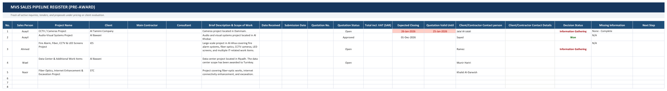
M V S ◆ SALES PIPELINE
Sales Pipeline Register
▼ Quotation Status
▼ Expected Closing
▼ Decision Status
▼ Missing Info
Sales quote life cycle:
• Open (Active / Pending)
• Approved (Client accepted)
• Not Approved (Rejected)
• Closed (Contract final)
• Cancelled (Withdrawn)
Dynamic Month Selector:
• Dynamic calendar month
• Guideline: 5-10d to Validity
• Tracks month-by-month
• Drives win probability
Opportunity outcome:
• Won (PO awarded)
• Lost (Bid lost)
• Info Gathering (Pre-bid)
• Under Review (Client eval)
• On Hold (Deferred)
Dependent data validation:
• N/A (Auto-set when Won)
• BOQ Pending
• Pricing Clearance
• Scope of Work (SOW)
• Commercial Specs
Modern Vision Solutions 2026 • MVS ICT & Telecom Slide 2 of 5

Slide 3
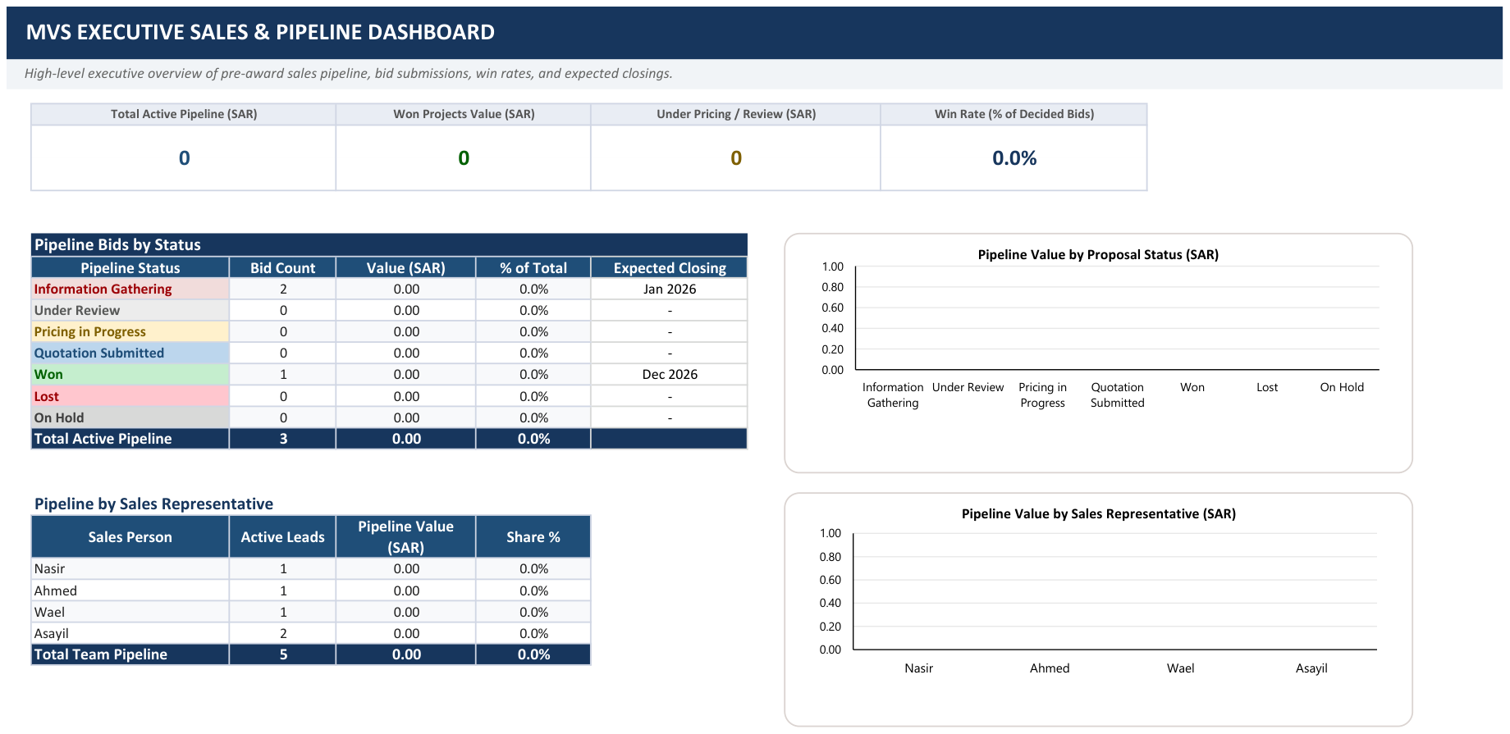
M V S ◆ SALES PIPELINE
Sales Pipeline Dashboard
Modern Vision Solutions 2026 • MVS ICT & Telecom Slide 3 of 5

Slide 4
M V S ◆ PROJECTS EXECUTION
Projects Execution & Milestone Register
▼ PO Status (Col E)
▼ Technical Report (Col O)
▼ Invoice Status (Col P)
▼ Milestone Status (Col N)
Contract execution phase:
• In Progress (Active work)
• Completed (Finished)
• On Hold (Client hold)
• Cancelled (Terminated)
• Syncs to executive cards
Consultant / client report:
• In Progress (Drafting)
• Submitted (Under review)
• Resubmitted (Revised)
• N/A (Not required)
• Required for billing
Milestone invoicing state:
• Not Invoiced (Pending work)
• Partially Invoiced
• Fully Invoiced (Billed)
• Overdue (Payment delayed)
Work breakdown progress:
• Completed (Scope done)
• In Progress (On-going)
• Pending (Next milestone)
• On Hold (Blocked)
Modern Vision Solutions 2026 • MVS ICT & Telecom Slide 4 of 5

Slide 5
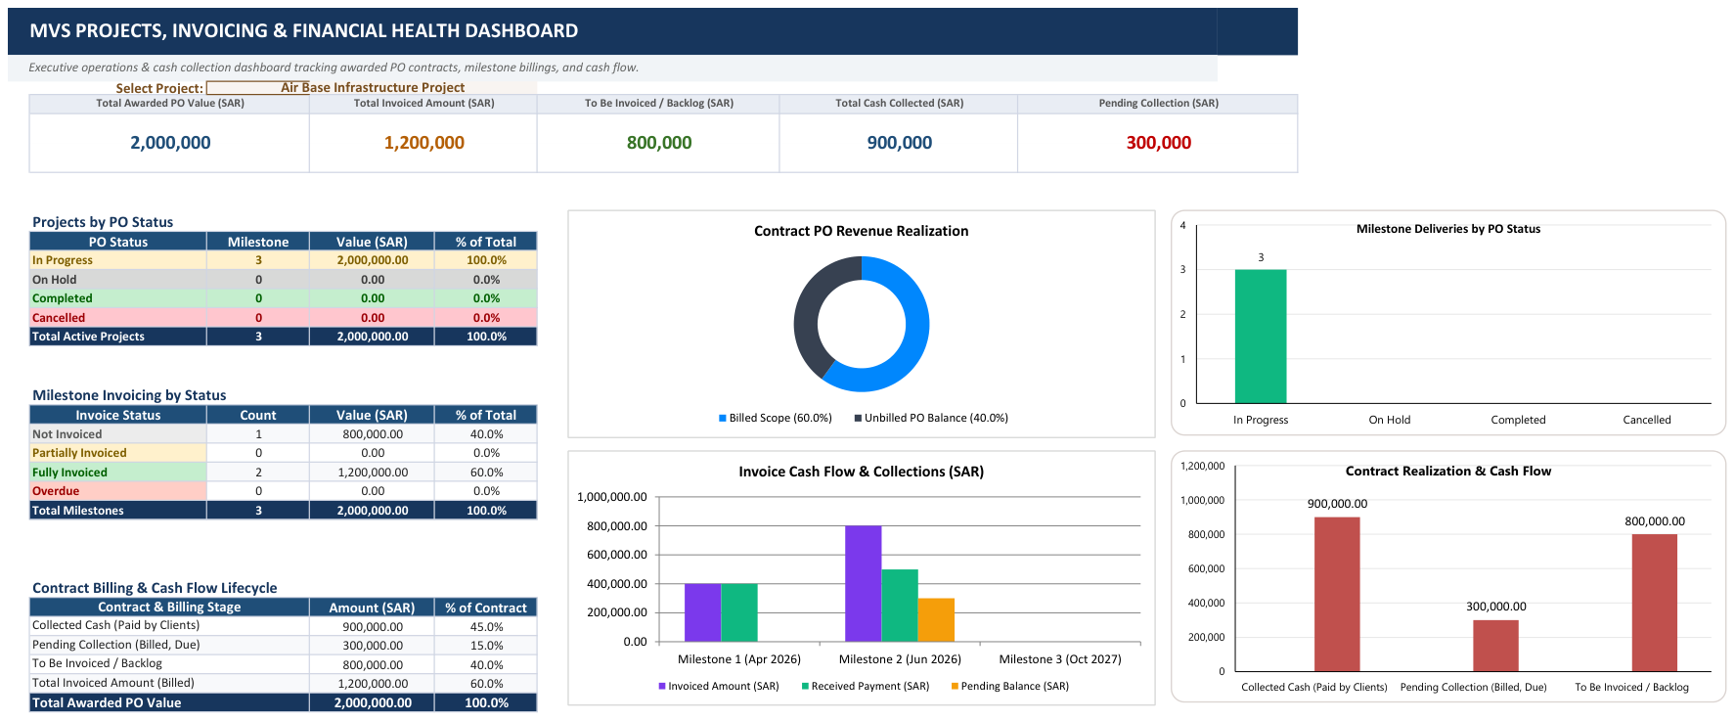
M V S ◆ PROJECTS DASHBOARD
Projects & Financial Health Dashboard
Modern Vision Solutions 2026 • MVS ICT & Telecom Slide 5 of 5

