Slide 1

M V S ◆ Weekly Review
Weekly Progress & IT Assets
2026 Week 44, 29/10/2026
MVS ICT & Telecom
Weekly Presentation
Presenter: Danish Akbar
Position: IT Support

Slide 2
M V S ◆ WEEKLY OPERATIONS
Weekly Progress & Next Steps (Week 44)
◆ Pipeline & Project Tracker Web Portal
● IN PROGRESS (45%)
◆ Salam CCS — KPI Framework
● IN PROGRESS (15%)
• Completed So Far (45%): Finalized Tracker (Sales Pipeline & Projects structure) and initiated core Executive, Sales & PM web portal layouts.
• Pending Team Feedback: Awaiting review and feedback from MVS team members while live database and KPI integration continues.
• Target Go-Live: Scheduled to be finalized and live by Next Thursday’s Weekly Meeting.
• Initial Phase (15% Done): Recently initiated work on the Salam CCS KPI structure covering SLA compliance, PMR/CMR tracking, and patrolling.
• Planned KPIs to Include: SLA Compliance, CMR/PMR Completion, Patrolling (TPC/POI), Staff Attendance & Best-Performing Team Ranking.
• Data Coordination: Requested operational data and KPI inputs from Mr. Tahir Anjum yesterday; configuration will proceed upon receipt.
• Timeline: Multi-week development scope; full implementation will progress step-by-step (Data Collection → KPI Scoring Logic → Dashboard Build → Live Rollout).
◆ FO Route Survey Application (DCP-1)
◆ UPDATES & MAINTENANCE
◆ IT Assets & Cloud Shared Folders
✓ ON TRACK
• System Updates Deployed: Added batch automation tools for utility classification, highway mapping, and ROW ownership across Routes 1 & 2.
• Ongoing Maintenance: Performing continuous range-level survey validation, segment alignment checks, and utility inheritance updates.
• Operational Support: Supporting office teams with routine route data refinements and production sync.
• Cloud Shared Folders (OneDrive): Structured centralized OneDrive shared folders with role-based access control for department and project files.
• Pending Approval: Submitted structure and access details via email; currently awaiting confirmation and approval from Mr. Mounir.
• Asset & Telecom Control: Verified custody across 77 hardware units (73 active, 4 in office stock) and 58 telecom lines across Main Office and 3 project sites.
Modern Vision Solutions 2026 • MVS ICT & Telecom Slide 2 of 3

Slide 3
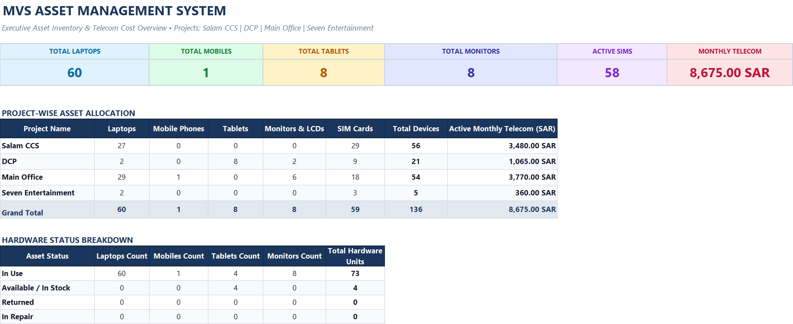
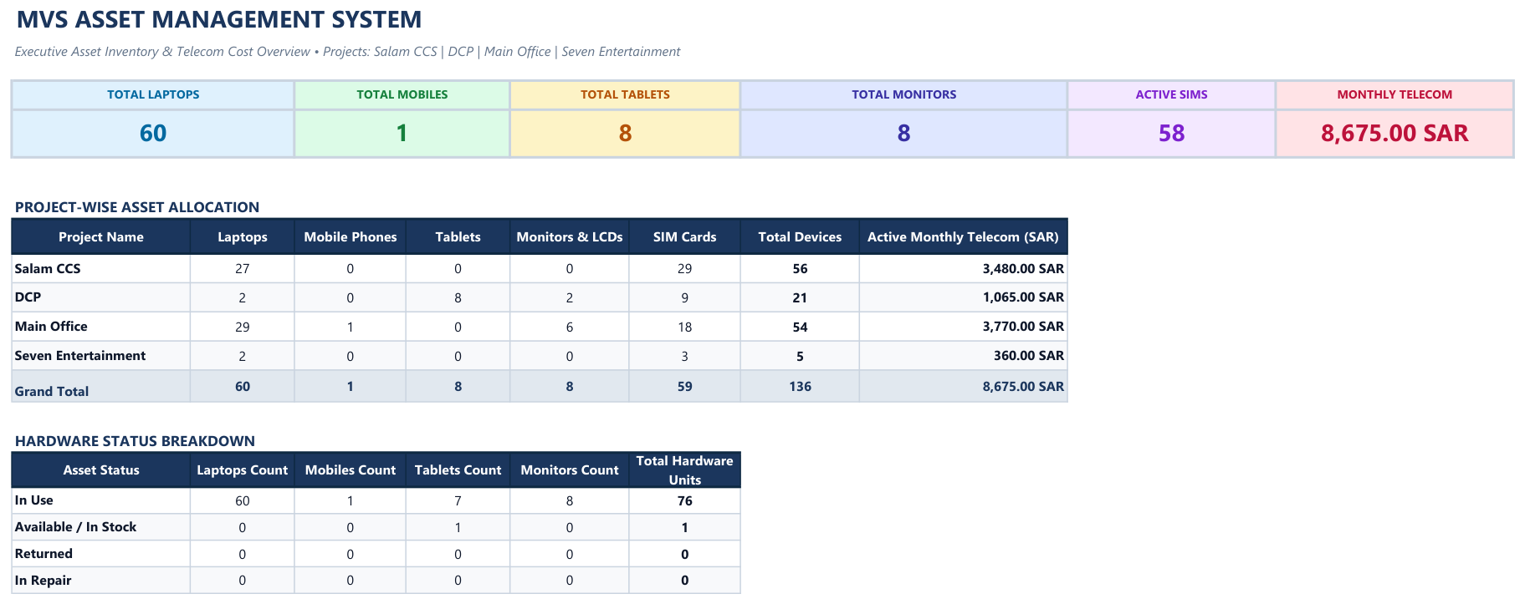
M V S ◆ ASSET MANAGEMENT
IT Assets & Telecom Inventory Dashboard
Modern Vision Solutions 2026 • MVS ICT & Telecom Slide 3 of 3

