Slide 1

M V S ◆ Weekly Review
Weekly Progress & IT Assets
2026 Week 43, 22/10/2026
MVS ICT & Telecom
Weekly Presentation
Presenter: Danish Akbar
Position: IT Support

Slide 2
M V S ◆ WEEKLY OPERATIONS
Key Deliverables & Tasks Completed (Week 43)
◆ Sales Pipeline & Project Tracking
✓ COMPLETED
◆ MVS IT Asset Inventory Maintenance
✓ COMPLETED
• Pipeline & Milestone Architecture: Restructured into Pipeline & Projects sheets; added multi-phase invoicing milestones.
• Validation & Closing Logic: Linked Quotation-to-Decision status & enforced 5-10 days Expected Closing rule (per GM).
• Automated Technical Reporting: Added Technical Report status column with auto-updating Invoice Status logic.
• Executive KPI Charts: Integrated dynamic PO Realization & Cash Flow milestone charts with live formula lookups.
• New Hardware Enrollment: Registered newly assigned laptops and integrated them into the active tracking system.
• Data & Specs Enrichment: Updated missing technical details, specifications, and serial records across existing devices.
• Peripherals & Accessories Allocation: Logged company laptop bags and peripheral custody for team members.
• Weekly Custody Verification: Audited active device allocation across Main Office and projects to reflect live status.
◆ FO Route Survey Application (DCP-1)
✓ COMPLETED
◆ IT Support & Corporate Admin Deliverables
✓ COMPLETED
• KMZ Automation & Coordinates: Integrated coordinate picking and automated KMZ export tools for ILA sites.
• Route & Segment Realignment: Re-stationed Route 05 & 2R sections; chained 189 segments (R1-05 to Spark).
• Calculation Discrepancy Fix: Resolved route survey export length variance and recalculated with full data protection.
• Command-Line System Backup: Downloaded full ~1.8 GB production database backup via CLI prior to updates.
• Site Swaps & Production Sync: Audited site naming swaps (r5-22 to r5-26) and deployed migrations via Git.
• Corporate Quotation Terms: Updated official sales PDFs (Sales Rep Nasir Qazi, 100% bank transfer terms).
• Official MVS Letterhead CVs: Standardized multiple engineering CVs onto official corporate letterhead.
• Quotation Product Media: Updated official quotation document by embedding 15 product images and specifications.
• Office IT Infrastructure: Configured meeting room Bluetooth audio and automated executive presentation decks.
Modern Vision Solutions 2026 • MVS ICT & Telecom Slide 2 of 3

Slide 3
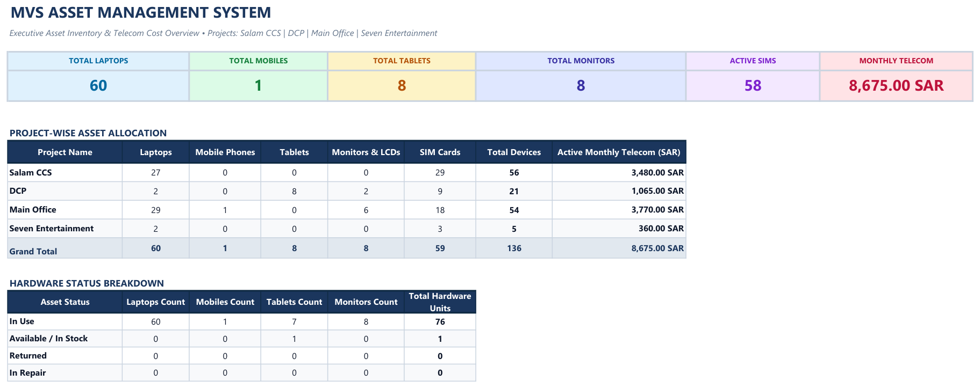
M V S ◆ ASSET MANAGEMENT
IT Assets & Telecom Inventory Dashboard
Modern Vision Solutions 2026 • MVS ICT & Telecom Slide 3 of 3

