Slide 1


The Shift in Dominance among Teams in the English Premier League
Danish Bhatkar

Slide 2

About English Premier League
Elite professional league in England – formed in 1992
Consists of 20 teams – each team plays 38 matches in a season
Every season the bottom 3 teams are relegated and the top 3 teams from the Championship division (second-tier) are promoted to Premier League
Some historic clubs are Manchester United, Chelsea, Arsenal, Liverpool and Manchester City
Known for fast-paced and physically demanding style of play
Considered as one of the best Football Leagues across the globe

Slide 3
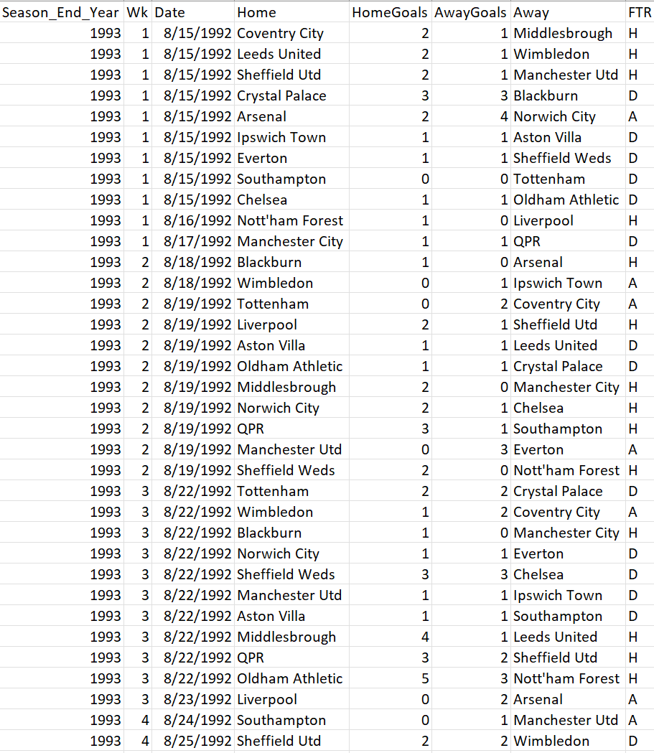
Source Data : Premier League Matches 1993-2023
The source data (shown on the right) was obtained from Kaggle
Each row in the data provides details about all the matches played in the last 30 years
Variable | Definition
Season_Year_End | Year in which the season ends (A season starts in August and ends in May in the following year)
Wk | Week number of the season
Date | Matchday Date
Home | Home Team
HomeGoals | Goals Scored by Home Team
AwayGoals | Goals Scored by Away Team
Away | Away Team
FTR | H – Home Team won D – Draw A – Away Team won
Data Source - https://www.kaggle.com/datasets/evangower/premier-league-matches-19922022

Slide 4
Source Data : Premier League Matches 1993-2023
The dataset contains information about every match played in the Premier League from 1993 to 2023. The original purpose of the data was to analyze the following:-
Best performing team in the last 30 years
Best way to collect points, attacking or defensive style
Goals scored and conceded by various teams
Head-to-head record
Advantage of playing on the home turf

Slide 5
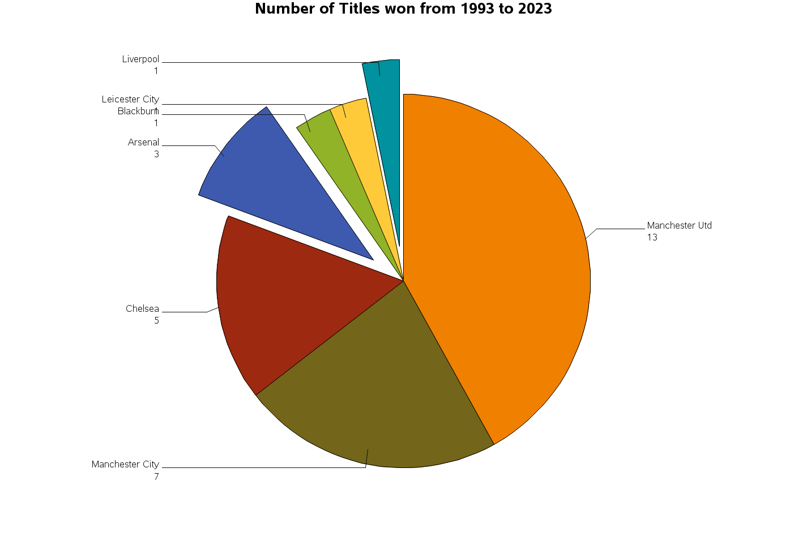
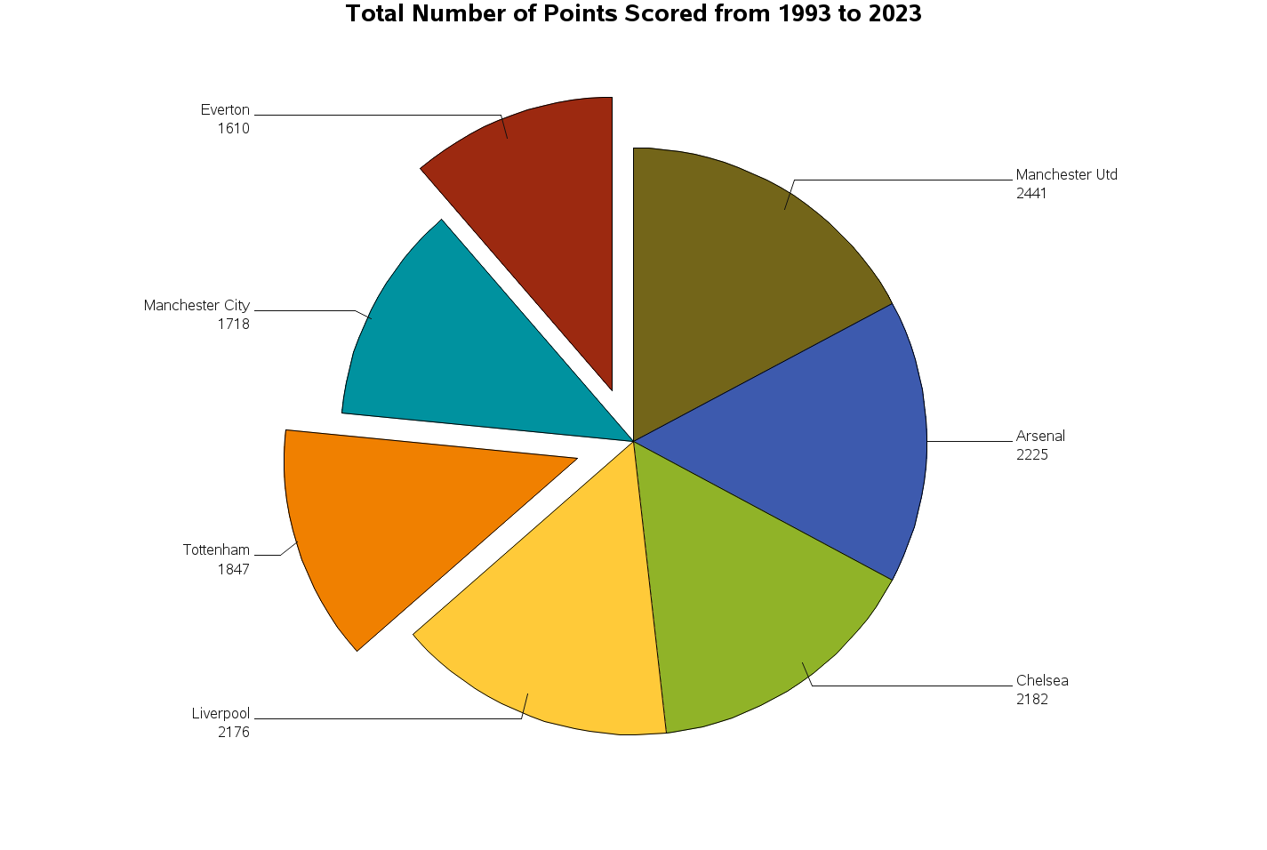
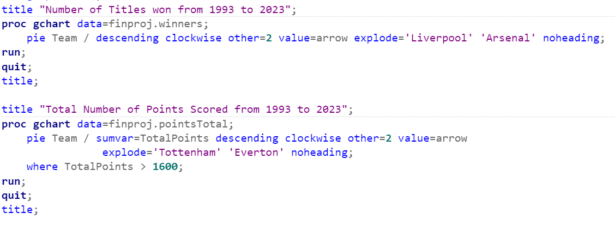
Data Analysis
Analyzing the Performances of All Teams
First pie chart indicates the number of titles won by each team (top 7)
Second pie chart displays the total points scored in all the seasons by each team (top 7)
Arsenal and Liverpool have very few titles but are in the top 4 considering the points scored
Everton and Tottenham are among the top 7 teams with regards to the overall points scored but have not won any titles in the 30-year-period
Since Manchester United, Manchester City, Arsenal, Chelsea and Liverpool are the common 5 clubs in both the visuals, we can consider them as the top 5 clubs in the last 30 years

Slide 6
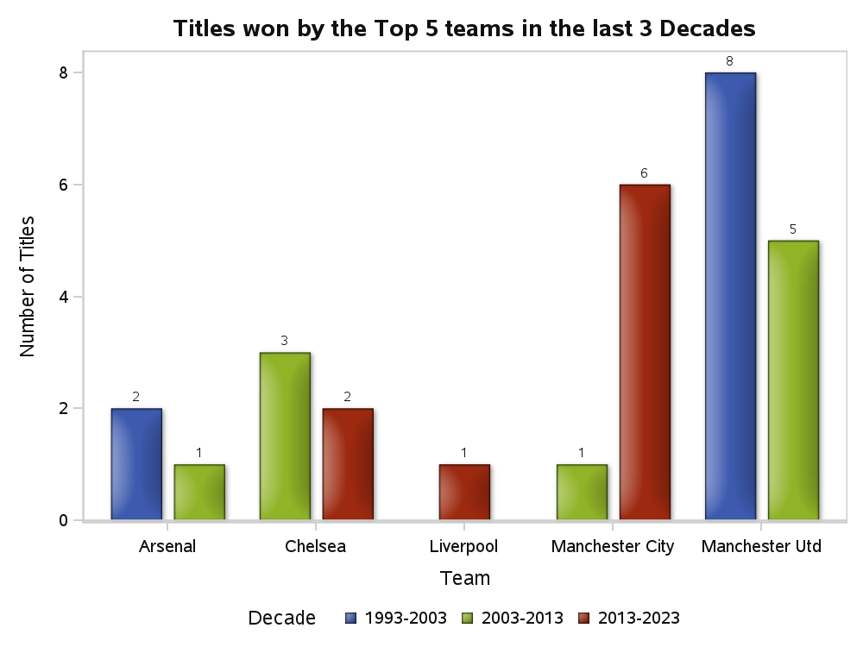
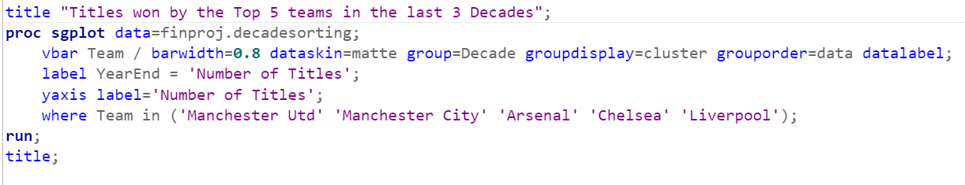
Data Analysis
Performance of Top 5 Teams by Decade
The clustered bar graph displays the titles won by the top 5 teams in each decade.
All teams except Manchester City have a decreasing trend
Manchester United and Manchester City top the charts followed by Chelsea
Manchester United has not won a single title in the last decade
For further analysis, we can consider Manchester United, Manchester City (looking at their domination), and Chelsea (since the club has won 5 titles and won 2 of them in the last decade itself).

Slide 7
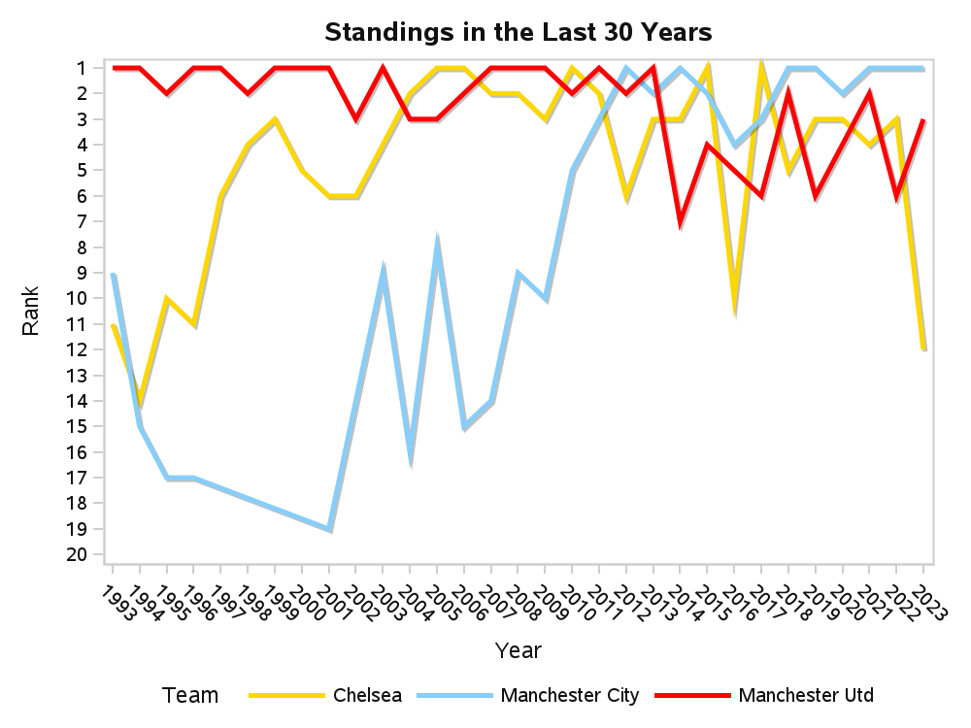
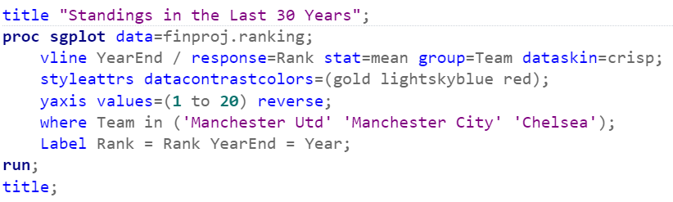
Data Analysis
Analyzing the performance trends
The line chart shows the ranks of the top 3 teams in the last 30 years
Chelsea has been quite inconsistent in the last decade
Manchester United has lost their edge in recent years
Meanwhile, Manchester City has a steep improvement in its performance
Chelsea was topping the charts for a short interval of time. On the other hand, a shift of power can be seen from Manchester United to Manchester City.

Slide 8
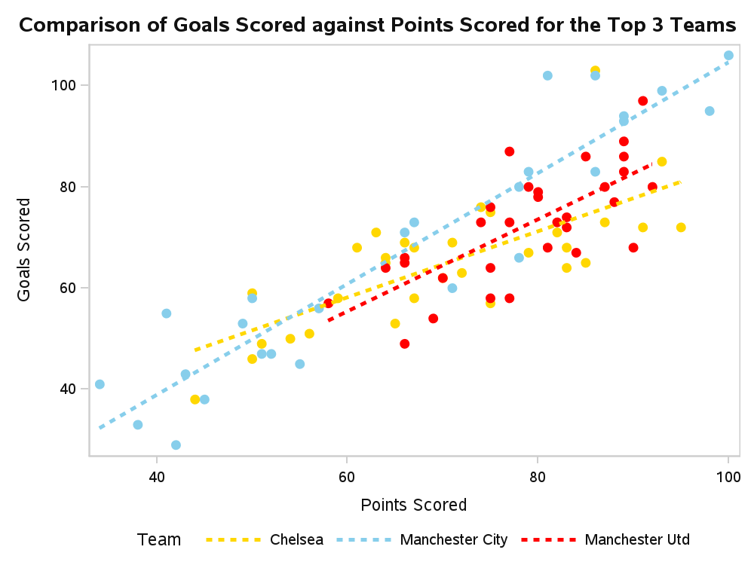
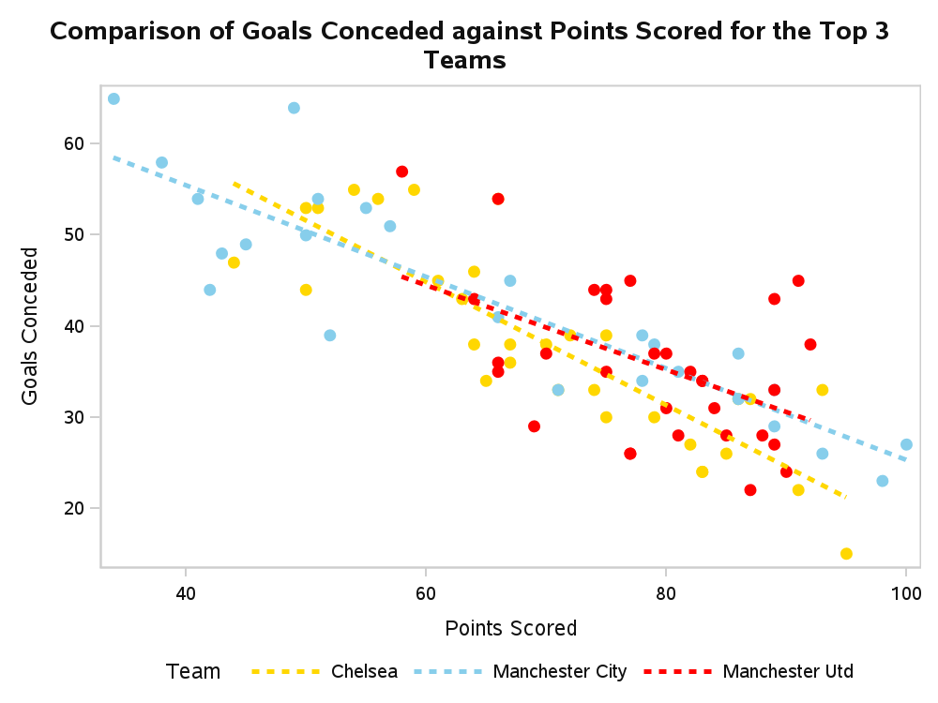
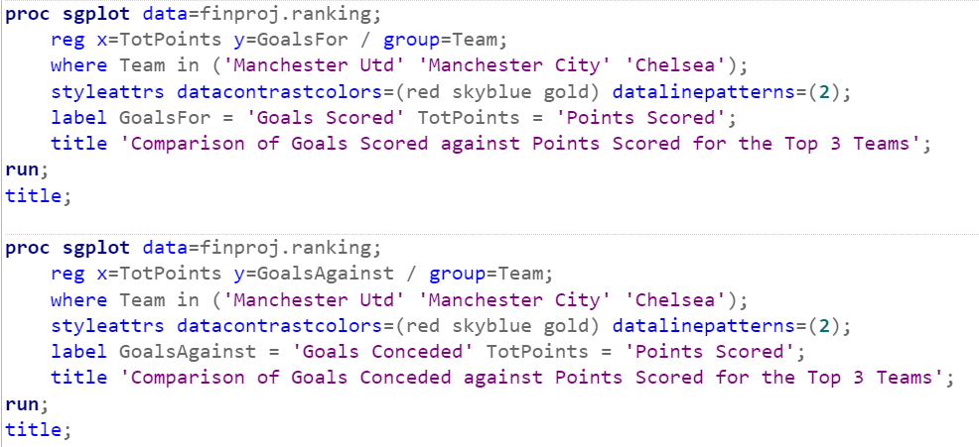
Data Analysis
Analyzing the Attacking/Defensive strategies
The first scatter plot displays the number of goals scored against points scored in each season and the second chart displays the number of goals conceded against points scored in each season
Both the charts have a median line to visualize the trend
Focus must be only on the right end of both the charts since this area explains the attacking and defensive strategies of the teams when they are at their best (most points scored)
Manchester City is the best at goalscoring among the top 3 teams whereas Chelsea is quite well at defending goals when at its best. It can be inferred that Manchester City is reliant on their attackers whereas Chelsea depends on its defenders to perform well.

Slide 9
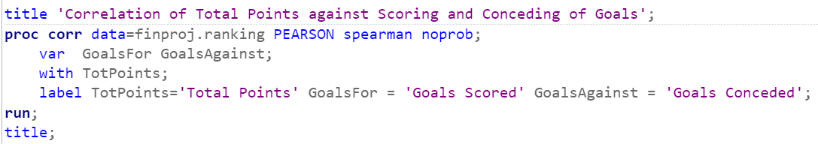
Correlation of Total Points against Scoring and Conceding of Goals
Predictive Analysis
Implemented PROC CORR step to calculate Pearson’s and Spearman’s Correlation Coefficients
The correlation coefficient explains the relativity of Total Points with the Goals Scored and Goals Conceded by a team
The Total Points parameter is more strongly related to Goals Scored as compared to Goals Conceded in both the calculations
It can be inferred that if Team A scores more goals than Team B, then Team A is likely to score more points than Team B.
Pearson Correlation Coefficients, N = 626
 | GoalsFor | GoalsAgainst
TotPoints Total Points | 0.88579 | -0.81598
Spearman Correlation Coefficients, N = 626
 | GoalsFor | GoalsAgainst
TotPoints Total Points | 0.86412 | -0.81146
Simple Statistics
Variable | N | Mean | Std Dev | Median | Minimum | Maximum | Label
TotPoints | 626 | 52.68530 | 16.34248 | 50.00000 | 11.00000 | 100.00000 | Total Points
GoalsFor | 626 | 51.23323 | 14.99717 | 48.00000 | 20.00000 | 106.00000 | Goals Scored
GoalsAgainst | 626 | 51.23323 | 12.77748 | 51.00000 | 15.00000 | 100.00000 | Goals Conceded

Slide 10
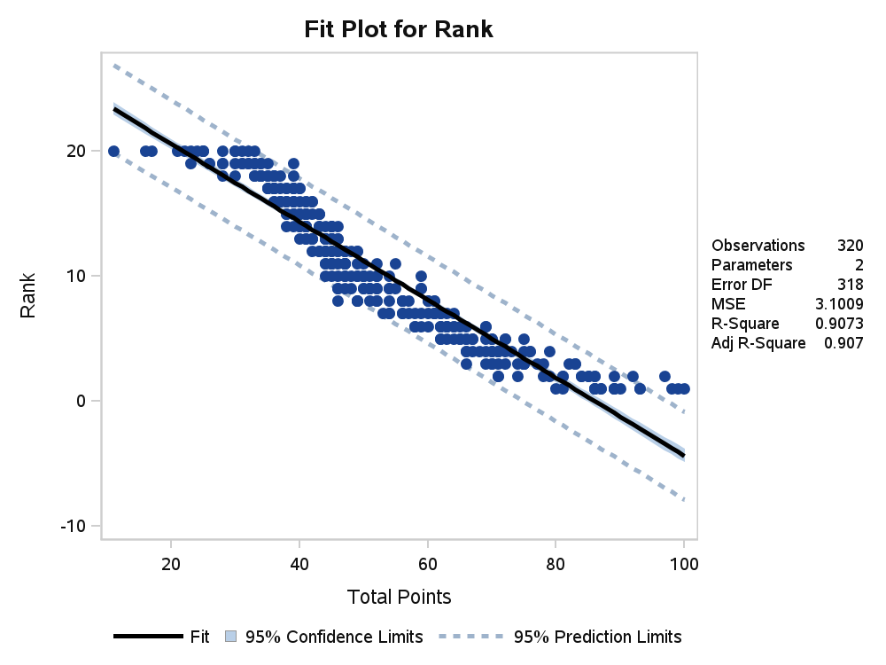
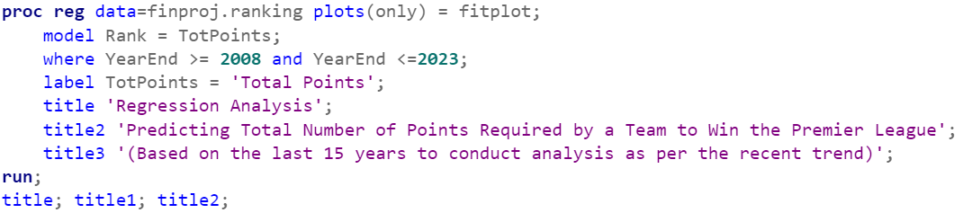
Linear Regression Method
Predictive Analysis
Predicting Total Number of Points Required by a Team to Win the Premier League
(Based on the last 15 years to conduct analysis as per the recent trend)
Number of Observations Read | 320
Number of Observations Used | 320
Analysis of Variance
Source | DF | Sum of Squares | Mean Square | F Value | Pr > F
Model | 1 | 9653.92959 | 9653.92959 | 3113.32 | <.0001
Error | 318 | 986.07041 | 3.10085
Corrected Total | 319 | 10640
Root MSE | 1.76092 | R-Square | 0.9073
Dependent Mean | 10.50000 | Adj R-Sq | 0.9070
Coeff Var | 16.77070
Parameter Estimates
Variable | Label | DF | Parameter Estimate | Standard Error | t Value | Pr > |t|
Intercept | Intercept | 1 | 26.82235 | 0.30865 | 86.90 | <.0001
TotPoints | Total Points | 1 | -0.31177 | 0.00559 | -55.80 | <.0001
PROC REG method implemented to process regression analysis by considering the “Rank” as dependent variable on “TotalPoints” variable.
Linear Regression provides a linear relation between multiple variables. The equation in this case can be read as :-
Rank = 26.822 – (0.312 * TotalPoints)
For Rank=1, we get TotalPoints = 82.825. Thus, we can assume that a team scoring 83 points or more has high chances of winning a title

Slide 11
Summarizing the Results
Based on the above analysis, we can make the following observations:-
Clearly, Manchester United is the most successful team in the last 30 years winning 13 titles and scoring the most points in all seasons. (slide 11)
Although, there are teams such as Arsenal, Liverpool, and Tottenham who have been consistent in scoring points, they have won a total of 4 titles only amongst themselves. (slide 11)
Chelsea did dominate the league between 2004 and 2011 but since then the journey for the team has been downhill. (slide 13)
Among the top 3 teams, only Chelsea and Manchester City have won titles in the last decade, that hints at the downfall of Manchester United. (slide 12)
Manchester United and Manchester City have opposite slopes of progress as seen above. (slide 13)
Manchester City’s strength is scoring goals while Chelsea’s strength is its defense. Manchester United stands on the weaker side in both the cases. (slide 14)
Considering the above points, it can be concluded that Manchester City has been the best team in recent years and the trajectory has been upwards.
The dominance of English Football has shifted from Manchester United to Manchester City.

Slide 12
References
https://www.kaggle.com/datasets/evangower/premier-league-matches-19922022
https://documentation.sas.com/doc/en/pgmsascdc/9.4_3.5/pgmsaswlcm/home.htm
https://www.90min.com/posts/the-2022-premier-league-table

