Slide 1
HEALTHCARE ASSISTANT
SOFTWARE PROJECT MANAGEMENT
DATE: 10/11/2024
FINAL PROJECT (PHASE - II)
TEAM MEMBERS:
Danish Faizan Mohammed <dmohammed2@hawk.iit.edu> A20561062
Syed Mujtaba Hussain LNU, <s11@hawk.iit.edu> A20552291
Krut Patel <kpatel172@hawk.iit.edu> A20527993
Ashrafhusen Arifbhai Raj <araj11@hawk.iit.edu> A20560969

Slide 2
Scrum:
Scrum is an Agile framework that divides work into short, iterative cycles called sprints to deliver increments of a project. It defines clear roles, including the Product Owner, Scrum Master, and Development Team, to ensure focus and accountability. Scrum also emphasizes regular meetings for planning, reviewing, and improving to maintain progress and adapt quickly to feedback.

Slide 3
Project Scope and Objectives:
Develop a healthcare assistant system to streamline patient and administrative tasks.
Follow the Waterfall development methodology for structured progression through project phases.
Implement features for patient data management, appointment scheduling, and healthcare recommendations.
Aim to enhance efficiency and accuracy in healthcare settings.
Use of GenAI Technologies and Healthcare Domain Focus:
Utilize Generative AI technologies to automate the generation of use cases, requirements, and design documents.
Employ GenAI for task estimation and productivity analysis within the project management process.
Focus on the healthcare domain to improve patient care through AI-driven insights and decision-making tools.
Ensure the system meets industry standards and enhances provider-patient interactions.

Slide 4
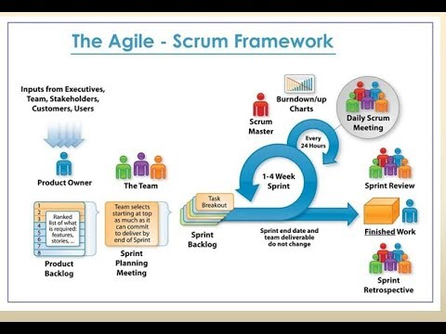
ROLES & RESPONSIBILITIES
Product Owner: Product Owner is responsible for defining the product vision, managing the product backlog, and ensuring the development team delivers value to the customer.
Requirements Engineer: Gathers and analyzes user needs to develop detailed use cases and requirements for the project.
System Engineer: Designs and plans system architecture and components based on requirements to ensure functionality and integration.
Scrum Master: A Scrum Master facilitates the Scrum process by guiding the team, ensuring adherence to Scrum practices, removing obstacles, and fostering a collaborative environment to maximize productivity and efficiency.
Software Developer: Implements the system by coding the application, ensuring it meets the predefined requirements and design.
Test Engineer: Conducts systematic tests to validate the functionality and performance of the software against the requirements.
Documentation Engineer: Creates comprehensive documentation that covers the design, development, and usage of the system to assist users and maintainers.
Technologies Used:
Jupyter Notebook
AutoGen
OpenAI

Slide 5
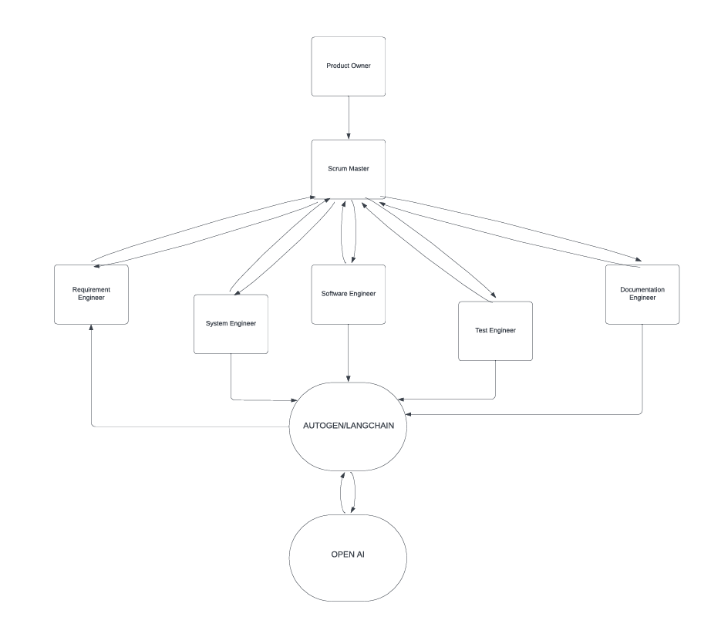
ARCHITECTURE

Slide 6
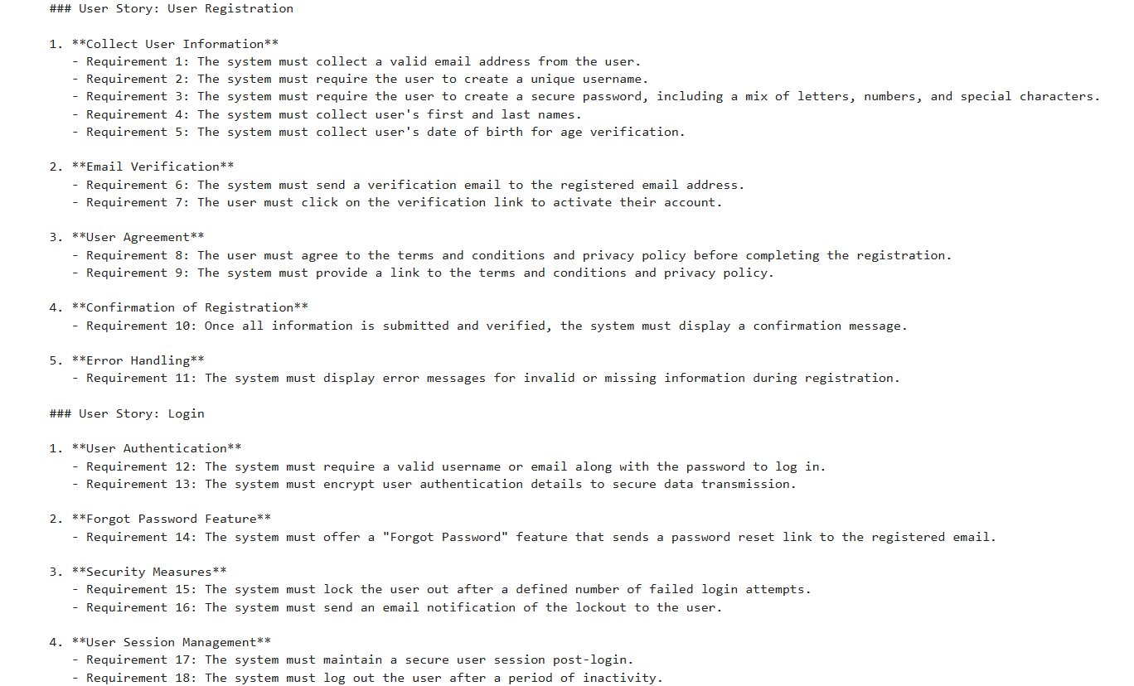
Output - AUTOGEN

Slide 7
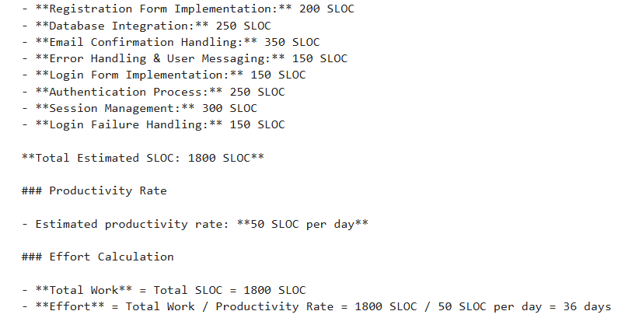
Output - AUTOGEN

Slide 8
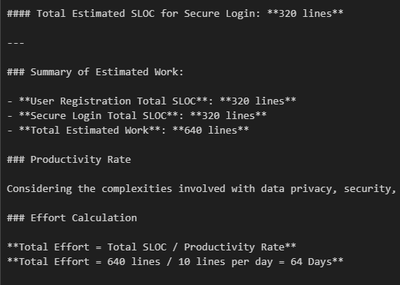
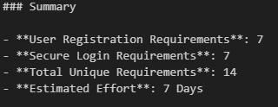
Output Got From Langchain/LangGraph Run

Slide 9
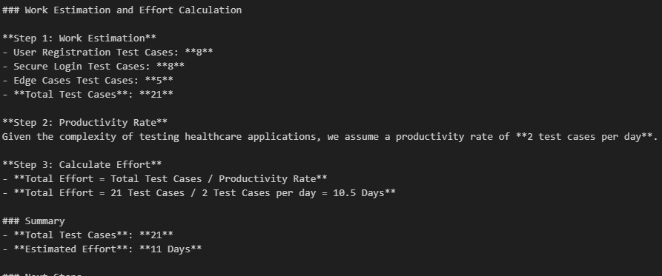
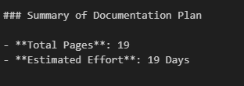
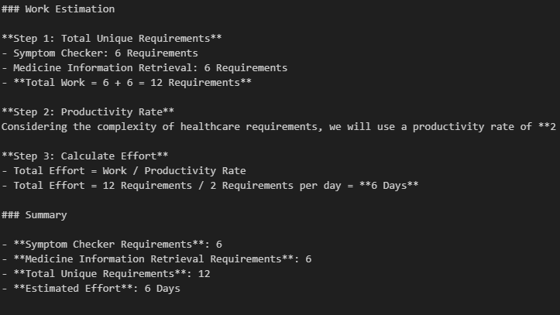

Slide 10
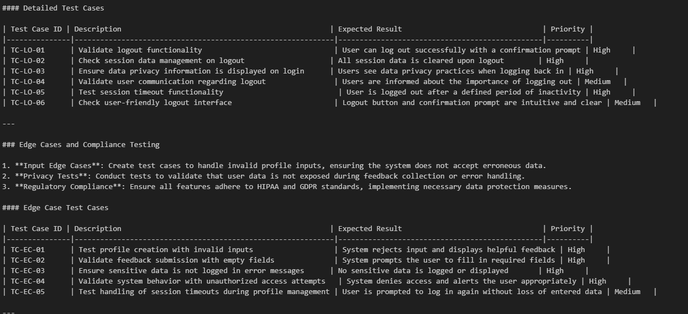

Slide 11
ANALYSIS-AUTOGEN
Run 1: Estimated SLOC for Sprint 1
Registration Form Implementation: 200 SLOC
Database Integration: 250 SLOC
Email Confirmation Handling: 350 SLOC
Error Handling & User Messaging: 150 SLOC
Login Form Implementation: 150 SLOC
Authentication Process: 250 SLOC
Session Management: 300 SLOC
Login Failure Handling: 150 SLOC
Total Estimated SLOC for Sprint 1: 1800 SLOC
Productivity Rate
The productivity rate used for calculation in both runs was set at 50 SLOC per day.
Effort Calculation for Run 1
Total Work (SLOC) = 1800 SLOC
Effort = Total Work / Productivity Rate = 1800 SLOC / 50 SLOC per day = 36 days
Run 2: Estimated SLOC for User Registration
Frontend Components
Registration Form: 200 SLOC
Form Validation: 150 SLOC
API Call to Backend: 50 SLOC
Backend Components
API Endpoint for Registration: 200 SLOC
Input Validation: 100 SLOC
User Data Storage (Database Interaction): 250 SLOC
Password Hashing: 100 SLOC
Email Confirmation Logic: 150 SLOC
Database Schema Changes
User Table Structure and Constraints: 100 SLOC
Total Estimated SLOC for User Registration in Run 2: 1300 SLOC
Effort for Run 2: 1300 SLOC / 50 SLOC per day = 26 days

Slide 12
Analysis
LangChain/LangGraph after Different Sprint
Summary of Estimated Work
Symptom Checker Total SLOC: 300 lines
Medicine Information Retrieval Total SLOC : 410 lines
Total Estimated Work : 710 lines
LangChain/LangGraph 1 -
Summary of Requirements
1. User Registration and Secure Login: 8
2. Symptom Checker: 7
Total Unique Requirements : 15
LangChain/LangGraph 2 -
User Registration Requirements: 7
Secure Login Requirements : 7
Total Unique Requirements : 14
Develop a Glossary : 100 SLOC
Enhance Symptom Checker Logic : 150 SLOC
Expand Dietary Suggestions : 120 SLOC
Implement Visual Cues : 130 SLOC
Create an FAQ Section for Data Privacy : 90 SLOC
Total Estimated SLOC : 590

