Slide 1
HEALTHCARE ASSISTANT
SOFTWARE PROJECT MANAGEMENT
DATE: 10/11/2024
FINAL PROJECT (PHASE - I)
TEAM MEMBERS:
Danish Faizan Mohammed <dmohammed2@hawk.iit.edu> A20561062
Syed Mujtaba Hussain LNU, <s11@hawk.iit.edu> A20552291
Krut Patel <kpatel172@hawk.iit.edu> A20527993
Ashrafhusen Arifbhai Raj <araj11@hawk.iit.edu> A20560969

Slide 2
Project Scope and Objectives:
Develop a healthcare assistant system to streamline patient and administrative tasks.
Follow the Waterfall development methodology for structured progression through project phases.
Implement features for patient data management, appointment scheduling, and healthcare recommendations.
Aim to enhance efficiency and accuracy in healthcare settings.
Use of GenAI Technologies and Healthcare Domain Focus:
Utilize Generative AI technologies to automate the generation of use cases, requirements, and design documents.
Employ GenAI for task estimation and productivity analysis within the project management process.
Focus on the healthcare domain to improve patient care through AI-driven insights and decision-making tools.
Ensure the system meets industry standards and enhances provider-patient interactions.

Slide 3
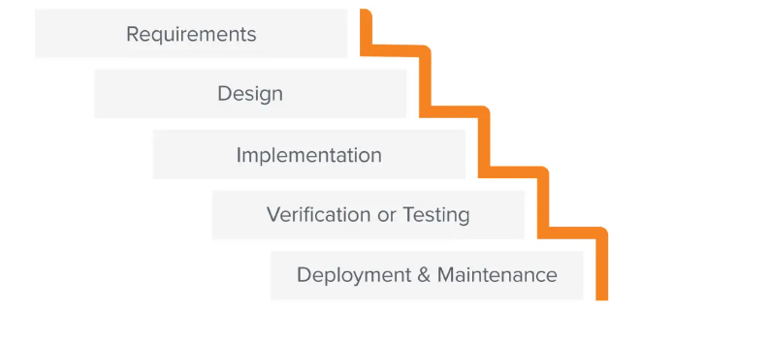
ROLES & RESPONSIBILITIES
Project Manager: Coordinates project tasks, communicates between agents, and ensures adherence to the Waterfall methodology.
Requirements Engineer: Gathers and analyzes user needs to develop detailed use cases and requirements for the project.
System Engineer: Designs and plans system architecture and components based on requirements to ensure functionality and integration.
Software Developer: Implements the system by coding the application, ensuring it meets the predefined requirements and design.
Test Engineer: Conducts systematic tests to validate the functionality and performance of the software against the requirements.
Documentation Engineer: Creates comprehensive documentation that covers the design, development, and usage of the system to assist users and maintainers.
Technologies Used:
Jupyter Notebook
AutoGen
OpenAI

Slide 4
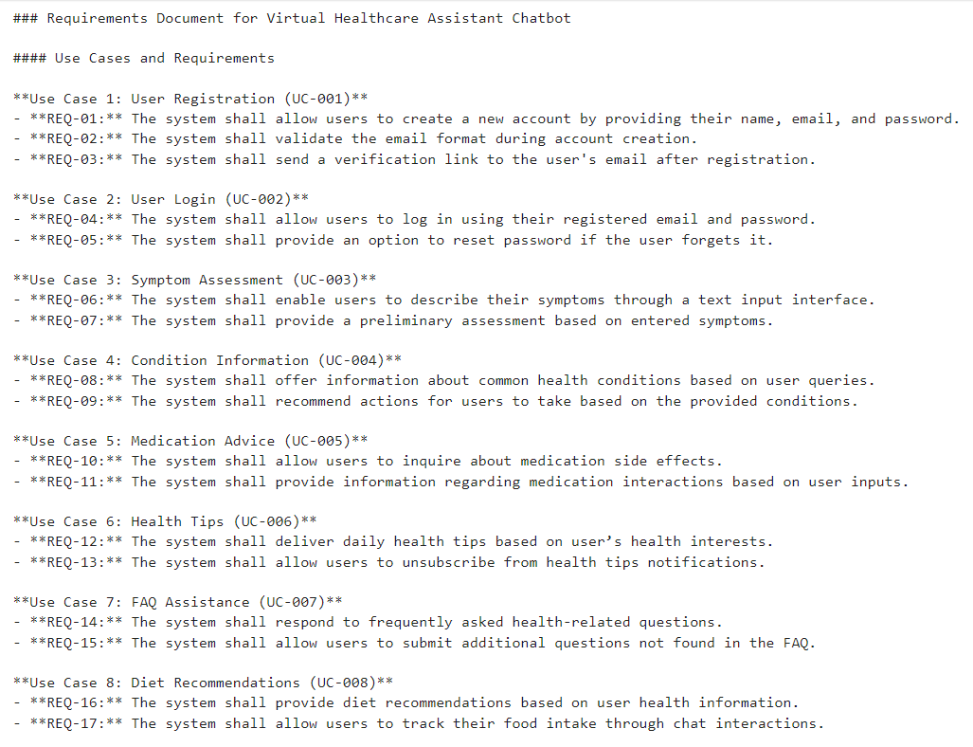
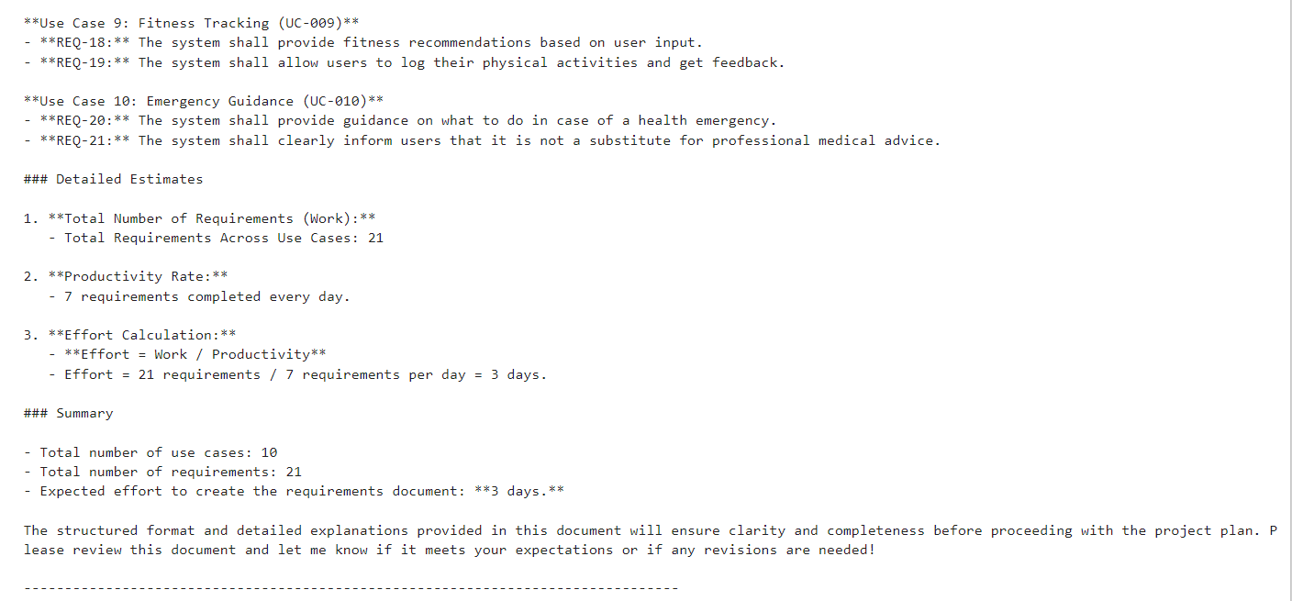
USE CASES & REQUIREMENTS
Generated by Requirements Engineer

Slide 5
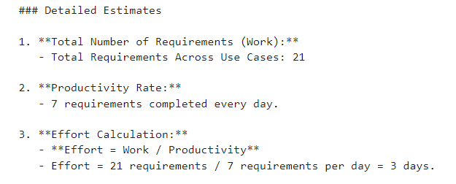
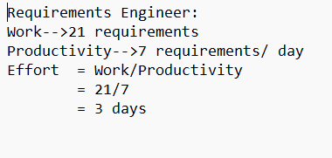
ANALYSIS
REQUIREMENTS ENGINEER:

Slide 6
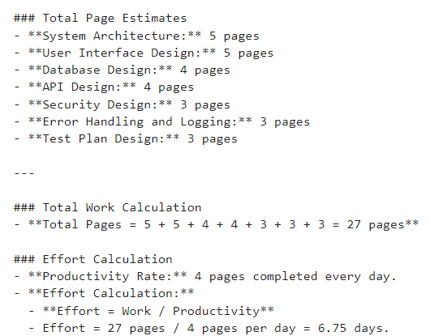
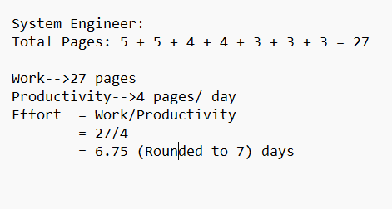
ANALYSIS
SYSTEM ENGINEER:

Slide 7
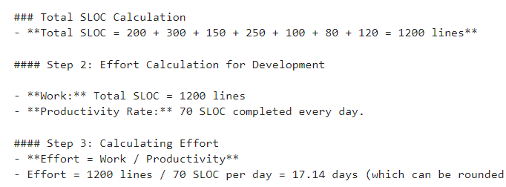
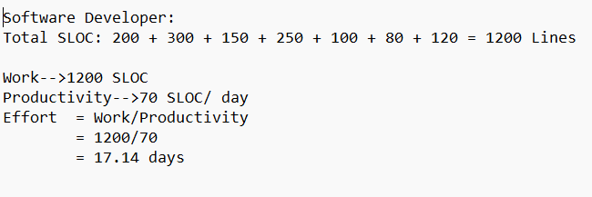
ANALYSIS
SOFTWARE DEVELOPER:

Slide 8
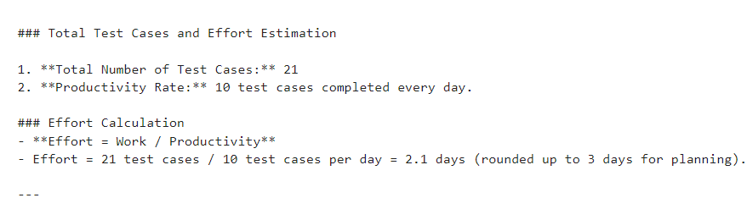
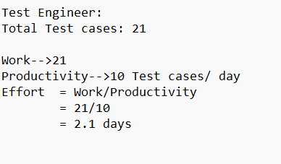
ANALYSIS
TEST ENGINEER:

Slide 9
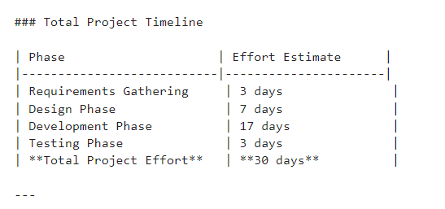
ANALYSIS
DOCUMENTATION ENGINEER:

Slide 10
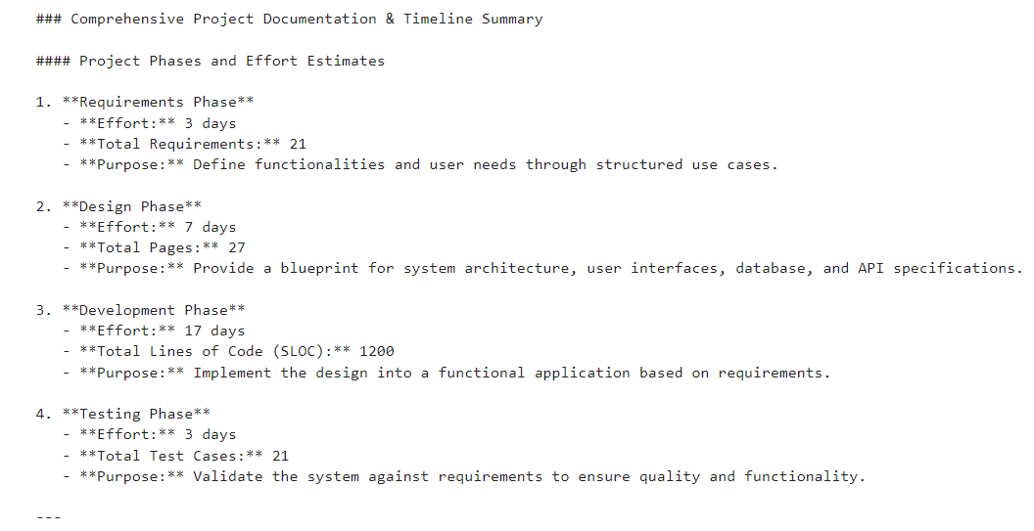
ANALYSIS
SUMMARY OF ALL PHASES:

