Slide 1

Muhammmad Shayan Shamsi, 24519
Khizar Asad, 23988
Muhammad Danish Raza, 24796​

Slide 2
Project introduction
Loopify is a new audio player and manager. It allows you to put audio files of your choice into a playlist and then listen to the sequence once or to infinity and beyond!
Because, as they say, art is eternal ☺

Slide 3
motivation
We felt that there is a need for a program that can play music from the command line. Furthermore, such a program should not just be functional but also educational so that those wanting to see how the program works can open the source code and play around with it as they like.

Slide 4
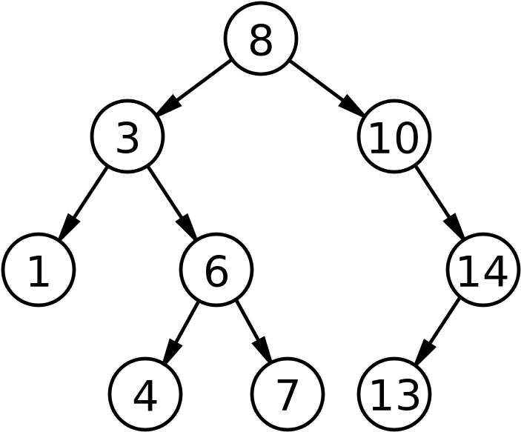
solution

Slide 5
reasoning
We used a circular linked list for the purpose of making an audio playlist because it was the most natural choice. For searching audio files, we decided to use a binary search tree. A BST made sense because of our prior experience in implementing a search engine using BST as a class assignment.

Slide 6
Complexity analysis
Method Name | Best Case | Average Case | Worst Case
Insert | O(1) | O(log n) | O(n)
Find | O(1) | O(log n) | O(n)
Delete | O(1) | O(log n) | O(n)
The above analysis is for BST as the priority queue was only used for playing music.

Slide 7
resources
Data Structures and Algorithm Analysis in Java, Mark Allen Weiss
Data Structures & Algorithms in Java, Robert Lafore
​Algorithms, Robert Sedgewick and Kevin Wayne

Slide 8
THANK YOU
Muhammad Shayan Shamsi,
m.shamsi.24519@khi.iba.edu.pk
Khizar Asad,
K.asad.23988@khi.iba.edu.pk
Muhammad Danish Raza

