Slide 1
Supply Chain Management
Insights on Product, Supplier, Customer & Operational Efficiency
Analysis by Danish Iqbal

Slide 2
Understanding the Problem
Supply chain inefficiencies can lead to:
Overstocking or stock outs
High production or shipping costs
Poor customer satisfaction due to delays or defects
Limited visibility into:
Which products are truly profitable
Which suppliers or routes are hurting quality and cost
How customer demographics affect sales patterns

Slide 3
5,77,604.86
₹
Total Revenue Generated

Slide 4
1. Top Selling Products
These SKUs are consistently outperforming others in unit sales.
SKU10 and SKU94 are top performers, nearing 1,000 units sold each.
SKU | Units Sold
SKU10 | 996
SKU94 | 987
SKU9 | 980
SKU37 | 963
SKU36 | 963
SKU11 | 960
SKU78 | 946
SKU40 | 933
SKU44 | 919
SKU91 | 916
SELECT SKU, SUM(number_of_products_sold) AS total_salesFROM supplyGROUP BY SKUORDER BY total_sales DESCLIMIT 10;

Slide 5
2. Location-wise Revenue Distribution
Mumbai and Kolkata lead in total revenue, each contributing over ₹137K.
Delhi, despite being a major metro, trails behind in revenue compared to others.
These patterns suggest regional differences in customer demand, brand engagement, or logistical reach.
Location | Revenue
Mumbai | 137755.02
Kolkata | 137077.55
Chennai | 119142.84
Bangalore | 102601.73
Delhi | 81027.72
SELECT location, SUM(revenue_generated) AS total_revenueFROM supplyGROUP BY locationORDER BY total_revenue DESC;

Slide 6
3. Revenue by Product Type
Haircare leads the revenue chart, followed closely by cosmetics and skincare.
These three categories account for a significant share of overall revenue and should be prioritized for promotions and supply chain efficiency.
Product Type | Top SKU | Revenue
Haircare | SKU51 | 9866.47
Cosmetics | SKU38 | 9692.32
Skincare | SKU31 | 9655.14
SELECT * FROM ( SELECT RANK() OVER (
PARTITION BY product_type ORDER BY SUM(revenue_generated) DESC) AS sales_rank, product_type, sku, SUM(revenue_generated) AS total_revenue FROM supply GROUP sku, product_type ORDER BY sales_rank DESC ) AS fist_supply WHERE sales_rank = 1 ORDER BY total_revenue DESC;

Slide 7
4. Inefficiencies in Production
Haircare and skincare dominate this list, with multiple SKUs showing misalignment between manufacturing and demand.
SKU | Product Type | Sold | Production Volume | Overproduction Gap
SKU2 | Haircare | 8 | 971 | 963
SKU3 | Skincare | 83 | 937 | 854
SKU25 | Haircare | 142 | 934 | 792
SKU45 | Haircare | 24 | 794 | 770
SKU76 | Haircare | 241 | 985 | 744
SKU70 | Haircare | 32 | 775 | 743
SKU56 | Skincare | 93 | 826 | 733
SKU93 | Haircare | 114 | 824 | 710
SKU75 | Skincare | 106 | 759 | 653
SKU82 | Skincare | 336 | 955 | 619
SKU8 | Cosmetics | 150 | 769 | 619
SKU39 | Skincare | 176 | 791 | 615
SKU60 | Skincare | 380 | 929 | 549
… | … | … | … | …
SELECT SKU, product_type, number_of_products_sold, production_volumes,(production_volumes - number_of_products_sold)AS overproduction_gap FROM supply WHERE number_of_products_sold < (production_volumes * 0.5)
ORDER BYoverproduction_gap DESC;

Slide 8
5. Cost Outliers
Many of the products are from the skincare category, with cosmetics and haircare also appearing in the list.
These products may be low-margin and should be evaluated for cost optimization, sourcing alternatives, or price adjustment.
SKU | Product Type | Mfg. Cost
SKU7 | Cosmetics | 99.47
SKU23 | Cosmetics | 98.61
SKU13 | Skincare | 97.83
SKU83 | Haircare | 97.73
SKU15 | Skincare | 97.12
SKU68 | Haircare | 97.11
SKU10 | Skincare | 96.53
SKU42 | Skincare | 96.42
… | … | …
SELECT SKU, product_type, manufacturing_costs
FROM supply WHERE manufacturing_costs > (
SELECT AVG(manufacturing_costs) + STDDEV(manufacturing_costs) FROM supply)
ORDER BY manufacturing_costs DESC;

Slide 9
6. Revenue Efficiency
Products with low revenue per unit may have:
Lower pricing strategy
Discounted selling
High production or shipping costs eating into margins
SKU | Product Type | Revenue (₹) | Units Sold | ₹ / Unit
SKU78 | Haircare | ₹ 1,292.46 | 946 | ₹ 1.37
SKU91 | Cosmetics | ₹ 1,935.21 | 916 | ₹ 2.11
SKU59 | Cosmetics | ₹ 1,061.62 | 484 | ₹ 2.19
SKU58 | Skincare | ₹ 2,021.15 | 896 | ₹ 2.26
SKU10 | Skincare | ₹ 2,330.97 | 996 | ₹ 2.34
SELECT SKU, product_type, revenue_generated, number_of_products_sold,
(revenue_generated / number_of_products_sold) AS revenue_per_unit FROM supply WHERE (revenue_generated / number_of_products_sold) < 10 -- adjust threshold as needed
ORDER BY revenue_per_unit ASC;

Slide 10
7. Lead Time Analysis
Identifying gaps in lead times can help pinpoint bottlenecks, regional inefficiencies, and areas for process improvement.
In some cases, shipping is slower than manufacturing, indicating last-mile or logistics delays.
City | Avg. Manufacturing Time (days) | Avg. Shipping Time (days)
Bangalore | 11.78 | 16.28
Chennai | 12.65 | 18.65
Delhi | 13.53 | 14.6
Kolkata | 15 | 19.44
Mumbai | 19.73 | 15.32
SELECT Location,
AVG(manufacturing_lead_time) AS avg_manufacturing_lead_time,
AVG(shipping_lead_time) AS avg_shipping_lead_time
FROM supply GROUP BY Location
ORDER BY Location;

Slide 11
8. Bottlenecks
Long durations may indicate: Supplier delays, Inventory handling inefficiencies, Transportation or route issues.
These SKUs are candidates for process reengineering or vendor review.
SKU | Product Type | Mfg. Days | Warehouse Days | Ship Days | Total Days
SKU1 | Skincare | 30 | 23 | 30 | 83
SKU30 | Haircare | 30 | 27 | 26 | 83
SKU60 | Skincare | 24 | 29 | 27 | 80
SKU49 | Cosmetics | 28 | 28 | 24 | 80
SKU9 | Skincare | 23 | 29 | 27 | 79
SKU54 | Haircare | 29 | 26 | 22 | 77
SELECT SKU, product_type, manufacturing_lead_time, shipping_lead_time, stock_lead_times, (manufacturing_lead_time + shipping_lead_time + stock_lead_times) AS total_supply_chain_time FROM supply ORDER BY total_supply_chain_time DESC;

Slide 12
9. Logistics & Quality
Goal: Identify which transportation options deliver the best balance of speed, cost, and quality.
Mode | Avg. Defect Rate (%) | No. of Shipments
Road | 2.62 | 29
Rail | 2.32 | 28
Sea | 2.31 | 17
Air | 1.82 | 26
SELECT transportation_modes, ROUND(AVG(defect_rates), 2) AS avg_defect_rate, COUNT(*) AS num_shipments
FROM supply GROUP BY transportation_modes
ORDER BY avg_defect_rate DESC;

Slide 13
10. Inventory Efficiency
This analysis surfaces SKUs with disproportionately low revenue per unit sold, despite relatively high stock or volume.
These products may appear to perform well on paper due to sales quantity or availability, but their per-unit profitability is weak.
The metric used:
Revenue per Unit Sold= Total Revenue/Units Sold
SKU | Category | Revenue | Units Sold | Revenue/Unit
SKU45 | Haircare | 93 | 24 | 3.88
SKU48 | Haircare | 30 | 29 | 1.03
SKU49 | Cosmetics | 97 | 99 | 0.98
SKU97 | Haircare | 46 | 62 | 0.74
SELECT SKU, product_type, stock_levels, number_of_products_sold, ROUND((stock_levels / number_of_products_sold), 2) AS stock_to_sales_ratio FROM
supply ORDER BY stock_to_sales_ratio DESC;

Slide 14
11. Product-Type by Demographics
Tailor marketing, product development, and customer experience strategies.
Metrics: Order Count, Units Sold, Total Revenue, Average Order Value (AOV)
Demographic | Orders | Units Sold | Revenue | Avg. Order Value
Unknown | 31 | 15211 | 173090.1 | 5583.55
Female | 25 | 12801 | 161514.5 | 6460.58
Male | 21 | 7507 | 126634.4 | 6030.21
Non-binary | 23 | 10580 | 116365.8 | 5059.38
SELECT customer_demographics, COUNT(*) AS total_orders, SUM(number_of_products_sold)AS total_units_sold, ROUND(SUM(revenue_generated), 2) AS total_revenue, ROUND(AVG(revenue_generated), 2) AS avg_revenue_per_orderFROM supplyGROUP BY customer_demographicsORDER BY total_revenue DESC;

Slide 15
Key Takeaways & Next Steps
Top-Selling SKUs and high-revenue product types are concentrated in skincare and haircare.
Some products with low sales but high production indicate potential overstocking or misaligned demand.
High shipping or manufacturing costs are dragging down profit margins on select SKUs.
Lead times and transportation modes affect defect rates, air has the lowest, while road and rail need attention.
There’s clear geographical variation in revenue and performance, Mumbai and Kolkata are high-performing cities.
Demographic insights show female and non-binary customers are valuable segments; however, many orders lack customer info ("Unknown").

Slide 16
Strategic Next Steps
Optimize Inventory: Reassess SKUs with low ROI to avoid overproduction.
Cost Efficiency: Focus on reducing shipping costs and defects, especially in road/rail transport.
Targeted Marketing: Double down on high-converting customer groups (e.g., Female & Non-binary) with tailored campaigns.
Data Completeness: Improve data capture—especially for demographics—to fuel better decision-making.
Geo-Strategy: Prioritize top-performing cities for promotions, partnerships, and logistics improvements

Slide 17
Final Thought:
What gets measured gets managed. Our data is more than a report, it’s a roadmap to efficiency, profitability, and deeper customer connection.

Slide 18
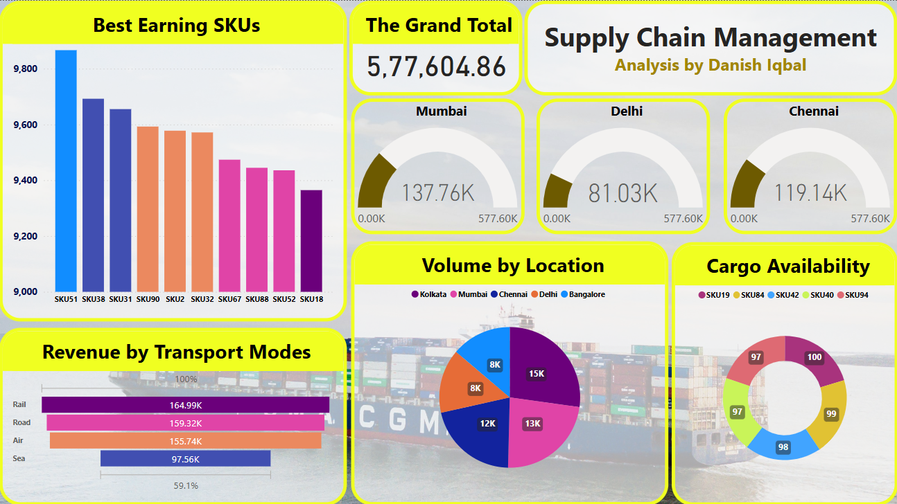
Microsoft PowerBI Dashboard

Slide 19
THANKS!
If you have any questions,
please write to me at: danishmarazi@gmail.com.

