Slide 1


E-commerce Sales Analysis

Slide 2

OVERVIEW
Project Objective
This project dives into the CreepShwal e-commerce dataset using Microsoft Excel to uncover meaningful patterns in customer behavior, regional sales performance, and channel effectiveness — culminating in a fully interactive dashboard for decision-making.
Analyze Sales Data
Identify Customer Behavior
Examine the complete e-commerce dataset to understand revenue patterns, volumes, and performance over time.
Segment customers by gender, age group, and geography to reveal who is driving the most purchases.
Understand Sales Trends
Build a Dashboard
Detect seasonal patterns and category-level trends across months, channels, and regions.
Create an interactive Excel dashboard using Pivot Tables with filters for Gender, Channel, and State.

Slide 3

TOOLS & PREP
🧹 Data Cleaning Steps
Tools Used & Data Cleaning
Remove Duplicates
Identified and removed duplicate records to ensure accurate aggregation and counts.
The analysis was conducted entirely in Microsoft Excel, using its built-in data management and visualization capabilities to transform raw records into structured, analysis-ready data.
Handle Missing Values
🧰 Tools Used
Addressed null and blank cells across key fields including customer ID, state, and channel.
Microsoft Excel — primary analysis environment
Pivot Tables — data summarization and aggregation
Charts & Graphs — visual representation of findings
Data Cleaning Techniques — ensuring data integrity
Format Columns
Standardized Date, Gender, and State columns for consistent filtering and grouping.
Create Age Groups
Segmented customer ages into Teen, Adult, and Senior buckets for demographic analysis.

Slide 4

DATA PROCESSING
Data Processing & Dashboard
Raw data was converted into a structured, analysis-ready format through calculated column creation. The resulting interactive dashboard enables dynamic filtering for business insights at a glance.
1
Step 1: Raw Data Ingestion
Imported the CreepShwal dataset into Excel and performed an initial audit of all columns, data types, and record counts.
2
Step 2: Calculated Columns
Created derived columns for Month (extracted from order date) and Age Group (binned from age field) to enable richer segmentation.
3
Step 3: Pivot Table Construction
Built Pivot Tables summarizing sales by gender, state, channel, order status, and age group — the backbone of all analysis.
4
Step 4: Interactive Dashboard
Assembled all charts and slicers into a single dashboard with filters for Gender, Channel, and State for dynamic exploration.

Slide 5

ANALYSIS
Gender & Order Status Analysis
Two of the most striking findings from the dataset relate to who is buying and how successfully those orders are fulfilled — painting a clear picture of the customer base and operational reliability.
👩 Gender Analysis
📦 Order Status Breakdown
Women Drive Sales
Higher Order Volume
Delivered Orders Dominate
Low Cancellation & Returns
Female customers contribute a higher proportion of total sales revenue compared to male customers across all channels and states.
The number of orders placed by female customers is consistently greater, making women the primary target audience for marketing campaigns.
The overwhelming majority of orders in the dataset have a Delivered status, indicating strong fulfillment performance across all channels.
Cancelled and returned orders represent a very small fraction of total records, signaling positive customer satisfaction post-purchase.
Key Takeaway: Female customers are the primary buyers and orders are overwhelmingly fulfilled successfully — a strong foundation for scaling operations.

Slide 6

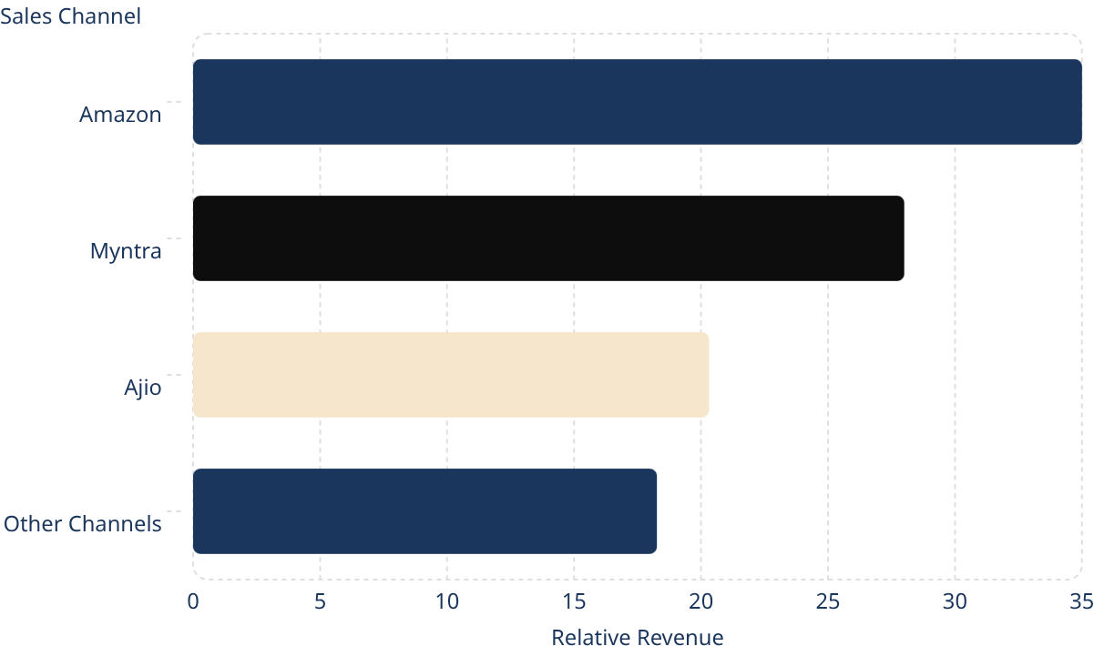
GEOGRAPHY & CHANNELS
State-wise & Sales Channel Analysis
Understanding where sales originate geographically and which platforms generate the most revenue enables targeted investment in marketing spend, logistics, and channel partnerships.
🌍 State-wise Performance
Top-performing states were identified through Pivot Table aggregation by state field.
Regional analysis highlights which geographies deliver the highest order volumes and revenue.
State-level insights directly inform regional marketing and logistics decisions, enabling focused resource allocation.
Lower-performing states represent growth opportunities for targeted promotional campaigns.
🛒 Sales Channel Analysis
Amazon, Myntra, and Ajio emerged as the top revenue-generating platforms.
Online marketplaces collectively dominate total revenue across all channels.
Channel-level breakdown helps prioritize partnership investment and platform-specific strategies.
Illustrative relative channel distribution — replace with actual dashboard screenshot values.

Slide 7
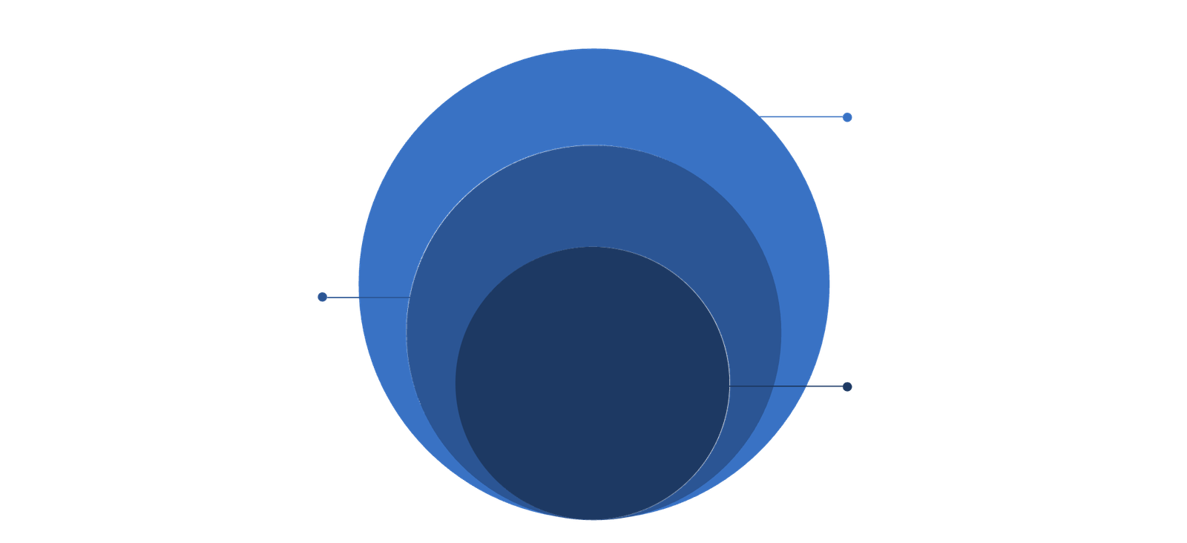
DEMOGRAPHICS
Age vs. Gender Insights
Cross-referencing age group with gender reveals the most commercially valuable customer segments and highlights where marketing efforts should be concentrated for maximum return.
Teenagers
Low contribution but growing influence
Seniors
Moderate contribution, targeted opportunities
Adults
Primary buyers—highest contribution to sales
The Adult age group stands out as the dominant driver of sales across both genders. Teenagers and Senior customers contribute meaningfully but at significantly lower volumes, suggesting that campaigns should prioritize Adult demographics while using tailored messaging for the other segments.
👦 Teenagers
🧑 Adults
👴 Seniors
Contribute the least to overall sales. Represent a growth opportunity with the right product categories and social-media-led campaigns.
The highest-contributing age group across genders. Female adults in particular drive the greatest purchase volumes — the primary target segment.
Contribute less than adults but more than teenagers. Specialized product offerings and ease-of-purchase improvements could boost this segment.

Slide 8

KEY INSIGHTS
Key Findings from the Analysis
The CreepShwal dataset analysis produced four clear, actionable insights that directly inform business strategy, marketing targeting, and operational priorities.
Women Are Primary Buyers
Female customers consistently outperform male customers in both order count and revenue contribution, making them the core demographic to prioritize in marketing and product strategy.
Adults Are Most Active
The Adult age group is the most commercially active segment across all channels and states, delivering the highest sales volumes compared to Teen and Senior cohorts.
Delivered Orders Dominate
The vast majority of orders are successfully delivered with minimal cancellations and returns, indicating robust fulfillment operations and positive customer satisfaction levels.
Marketplace Channels Drive Revenue
Amazon, Myntra, and Ajio collectively account for the lion's share of total revenue, underscoring the strategic importance of maintaining strong presence on these platforms.
These insights were derived entirely from the CreepShwal dataset using Excel Pivot Tables and chart analysis.

Slide 9
CONCLUSION
Conclusion & Business Recommendations
This Excel-based analysis demonstrates the power of accessible tools for generating meaningful business intelligence. The dashboard enables ongoing decision-making without requiring specialized software — empowering teams to act on data quickly.
Excel is a Powerful Analysis Tool
Pivot Tables, calculated columns, and chart features in Excel are sufficient to perform comprehensive sales analysis on real-world e-commerce datasets without any additional BI software.
Dashboard Enables Decision-Making
The interactive dashboard with Gender, Channel, and State filters allows business stakeholders to drill into the data independently and extract the insights most relevant to their role.
Target Female Customers
Marketing budgets and campaign messaging should prioritize women — especially adult female shoppers — as they represent the largest and most active buyer segment in the dataset.
Focus on High-Performing States
Double down on logistics and promotions in top-performing states while designing targeted campaigns to unlock growth potential in underperforming regions.
Strengthen Key Sales Channels
Invest in maintaining and growing the Amazon, Myntra, and Ajio partnerships as these platforms dominate revenue — and explore opportunities to expand on emerging channels.

Slide 10


Thank You
E-commerce Sales Analysis — CreepShwal Dataset | Excel Project

