Slide 1


MAZDOOR HAAZIR
Course: Web Design & Development under BBSHRRDB Program
Presented by:
Danish Ul Hassan
Hammad Rathore
Institute: IBA City Campus, Karachi
Course Instructor: Sir Syed Atif Raza

Slide 2
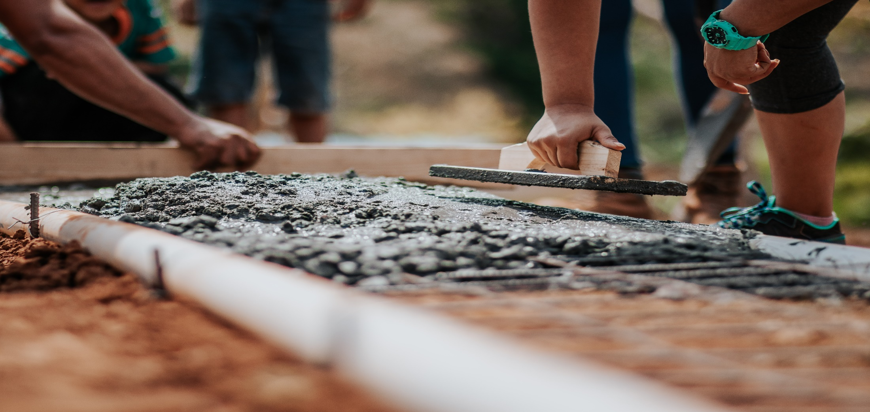
Add Complementing Images
4.75 x 10
MAZDOOR HAAZIR
Startup Name

Slide 3
Objective
The concept of “Mazdoor Haazir” is to develop a platform for the people who are struggling to find good Mistry’s and Labors to build their house. There is not any online platform where we can find them and hire them (locally in Pakistan).
“Mazdoor Haazir” is a platform that connects customers to the skilled, experienced and reliable service professionals in their own locality. “Mazdoor Haazir” is the one-stop destination for all areas needs which includes cemetery, concrete laborers at your doorstep.

Slide 4
Problem Statement
Traditionally if we need any labor and workers to build our house or to paint our house, we usually try to find these workers using different sources (from friends and relatives).
There is no such platform where we can find them, in search of work they (mistris and workers) sit around the road corners and outside the local hotels to find the work and these spots are quite limited and most of the people don’t know about these spots.

Slide 5
Proposed Solution
Develop a platform (website) namely “Mazdoor Haazir” for the mistris and labors where they can get the work opportunities by just registering on the platform and the users will hire them according to their needs.

Slide 6
Benefits
Solution to Local Problem
No Commission (initially)
Verified Profiles
Time Saving
Work opportunities for laborers

Slide 7
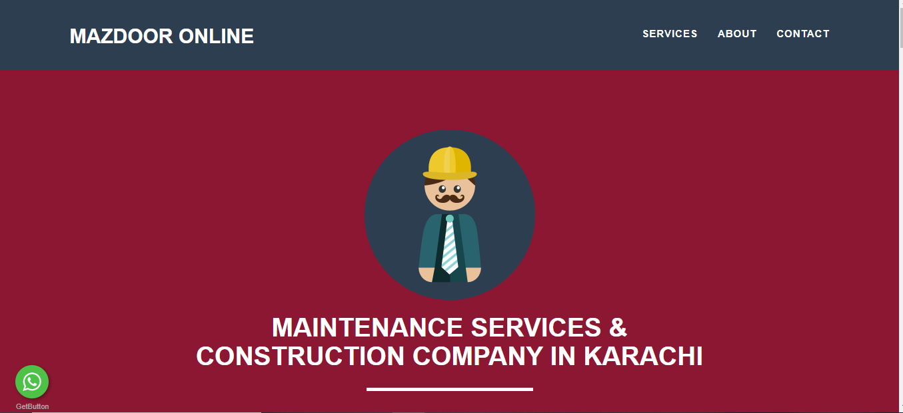
Competitor
Source: https://mazdooronline.pk/

Slide 8
Competitor Vs Us
No concept of hiring
No direct link with labour
General purpose website
Time consuming
Concept of hiring
Search specific area
Labour profiles
Targeted Market
Rating Concept

Slide 9
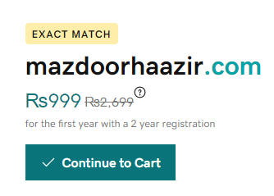
Domain

Slide 10





Resources
PC/Laptop
Internet
Programming Languages
Domain/Hosting
Data Collection

Slide 11
Features
Verified Laborers Profiles
Time Saving
Search using Location wise
Client Satisfaction + Complaint section
Laborer's nearby home location
On plus the potential org/companies can display their ads on the platform who are looking for laborers (Ad-based)
Other types of laborers profile section

Slide 12
Customers and Marketing Strategy
The solution “Mazdoor Haazir” is quite unique, and it has no much competitors.
The competitors that we belong to is the online sector, where people is looking for job opportunities. (but our solely target will be the uneducated/illiterate domain)
The construction market is quite huge in Pakistan which captures the 7.61% of the industry.
Our customers will be the common who is looking for labors/contractors on the doorstep.
For marketing strategy, we will use the social media platforms along with the strong awareness among the laborers.

Slide 13
Any Questions?
Danish Ul Hassan Hammad Rathore
Email: danishulhassan7@gmail.com
Contact: +92 308-2157220
hammadrathore52@gmail.com
+92 314-6637633

Slide 14
Thank you..
Danish Ul Hassan Hammad Rathore
Email: danishulhassan7@gmail.com
Contact: +92 308-2157220
hammadrathore52@gmail.com
+92 314-6637633

