Slide 1




MAZDOOR HAAZIR

Slide 2
Team Members
Danish Ul Hassan
Aaqib Nazeer
Institute: SMIU
MAZDOOR HAAZIR
Startup Name

Slide 3
Introduction
The concept of “Mazdoor Haazir” is to develop a platform for the people who are struggling to find good Mistry’s and Labors to build their house. There is not any online platform where we can find them and hire them (locally in Pakistan).
“Mazdoor Haazir” is a platform that connects customers to the skilled, experienced and reliable service professionals in their own locality. “Mazdoor Haazir” is the one-stop destination for all areas needs which includes cemetery, concrete laborers at your doorstep.

Slide 4
Problem Statement
Traditionally if we need any labor and workers to build our house or to paint our house, we usually try to find these workers using different sources (from friends and relatives).
There is no such platform where we can find them, in search of work they (mistris and workers) sit around the road corners and outside the local hotels to find the work and these spots are quite limited and most of the people don’t know about these spots.

Slide 5
Proposed Solution
Develop a platform (mobile application) namely “Mazdoor Haazir” for the mistris and labors where they can get the work opportunities by just registering on the platform and the users will hire them according to their needs.
“Mazdoor Haazir” is a platform that connects customers to the skilled, experienced and reliable service professionals in their own locality. “Mazdoor Haazir” is the one-stop destination for all areas needs which includes cemetery, concrete laborers at your doorstep.

Slide 6
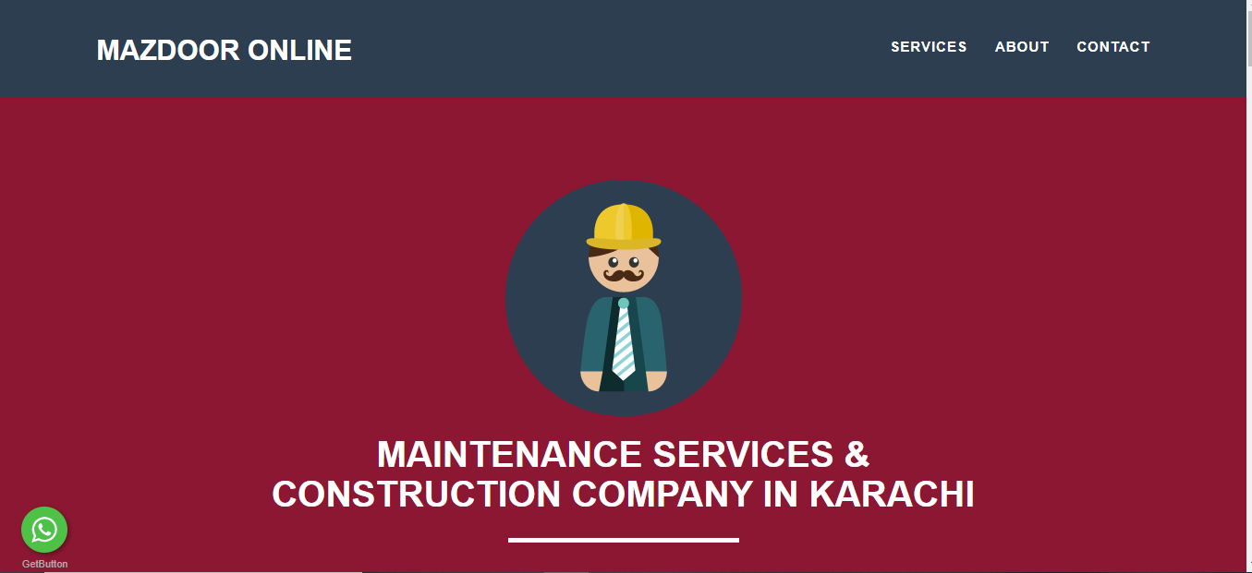


Competitor
Source: https://mazdooronline.pk/

Slide 7
Competitor Vs Us
No concept of hiring
No direct link with labour
General purpose website
Time consuming
Concept of hiring
Search specific area
Labour profiles
Targeted Market
Rating Concept

Slide 8
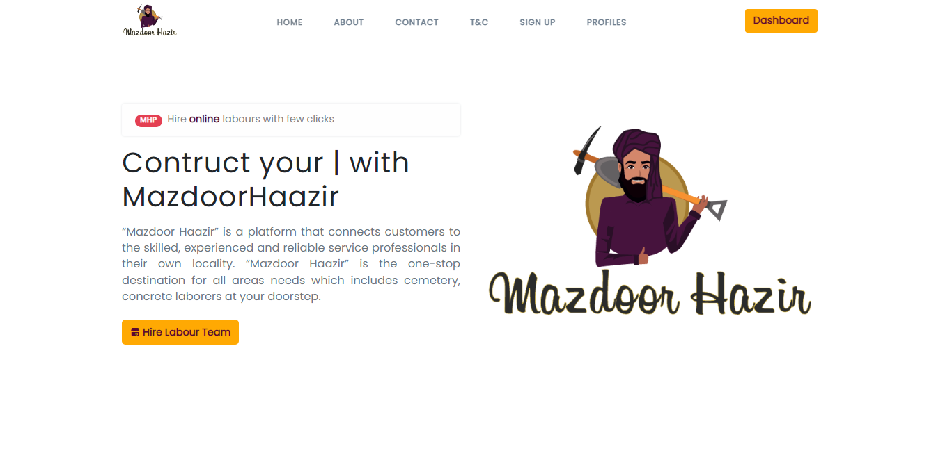
Progress
Web Platform

Slide 9
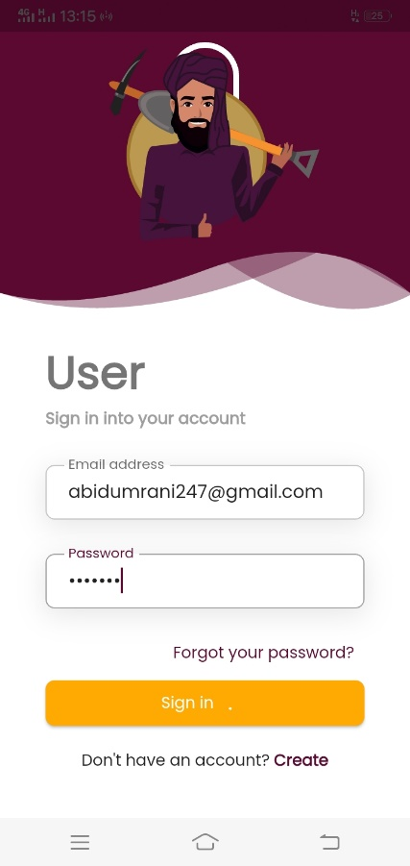
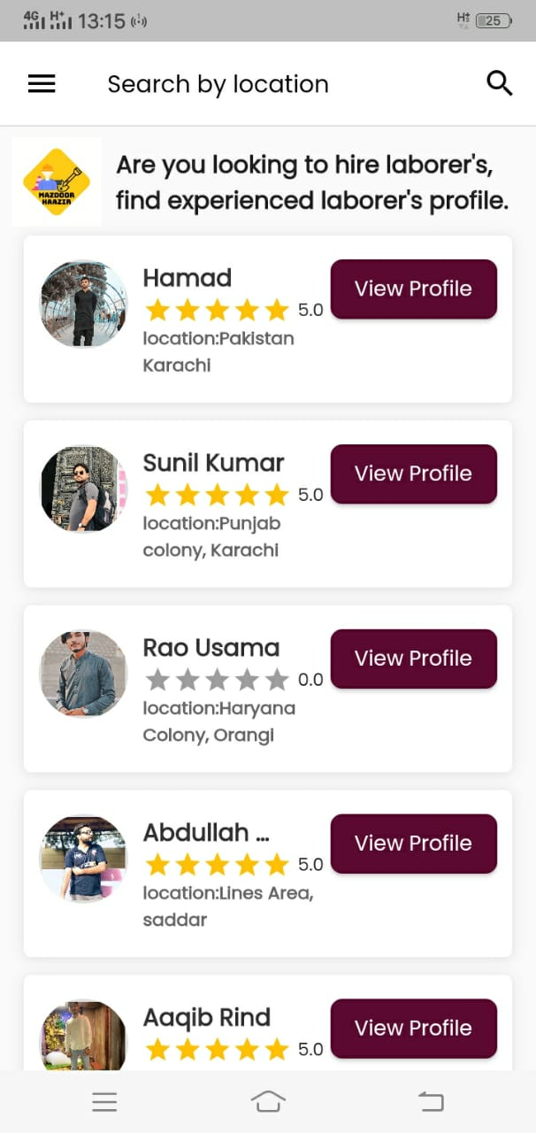
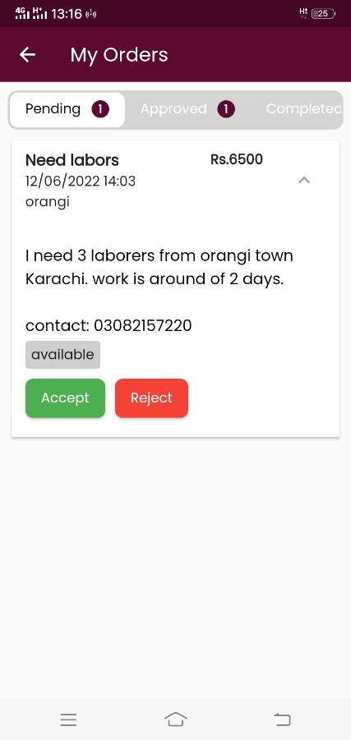
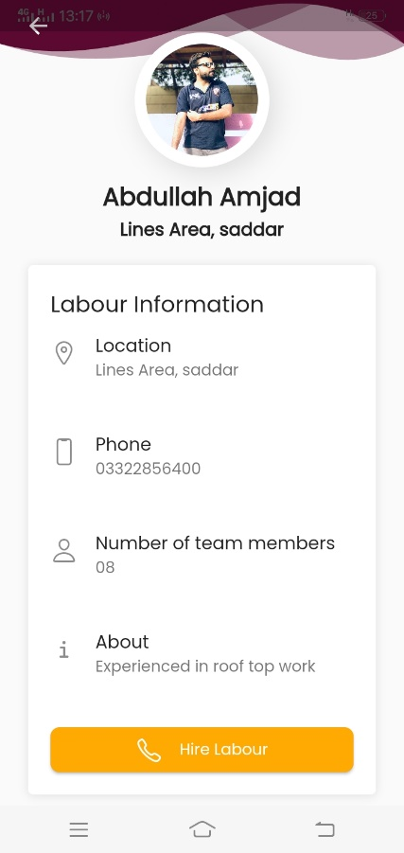
Progress
Mobile App

Slide 10
Customers and Marketing Strategy
The solution “Mazdoor Haazir” is quite unique, and it has no such local competitors.
The competitors that we belong to is the online sector, where people is looking for job opportunities. (but our solely target will be the uneducated/illiterate domain)
The construction market is quite huge in Pakistan which captures the 17% of the industry.
Our customers will be the layman who is looking for labors/contractors on the doorstep.
For marketing strategy, we will use the social media platforms along with the strong awareness among the laborers.

Slide 11
Milestones
Up till, done with the research and requirements parts, now working in the design phase for the end product (application)
The first milestone for the next 1 year to make a product (application) accessible to the users and aware the local laborers and other different construction companies.
For the next three years our milestone will be to make this platform available on almost all over the country.
If we got funded, then the marketing part will get the boom out of it, and we will establish offices and teams to facilitate the users and laborers and our target will be to complete 500+ projects through the platform. (target for three years)

Slide 12
Financials
The platform will adhere the principle of traditional freelance marketplaces and initially we will charge 10% of the contract amount from the user.
The platform will not charge anything from the direct contractors/laborers from their amount.
The platform will get some percentage from the companies (construction companies) if they land a contract through the platform.
On plus the potential org/companies can display their ads on the platform who are looking for laborers (Ad-based)

Slide 13
Contact Details
Name: Danish Ul Hassan
Address: H-75 street 5A sector 4D Orangi Town, Karachi.
Email: danishulhassan7@gmail.com
Contact: +92 308-2157220

