Slide 1
User documentation – Generator and Parser of Submission Review Form for the TSD Conference
Vojtěch Danišík

Slide 2
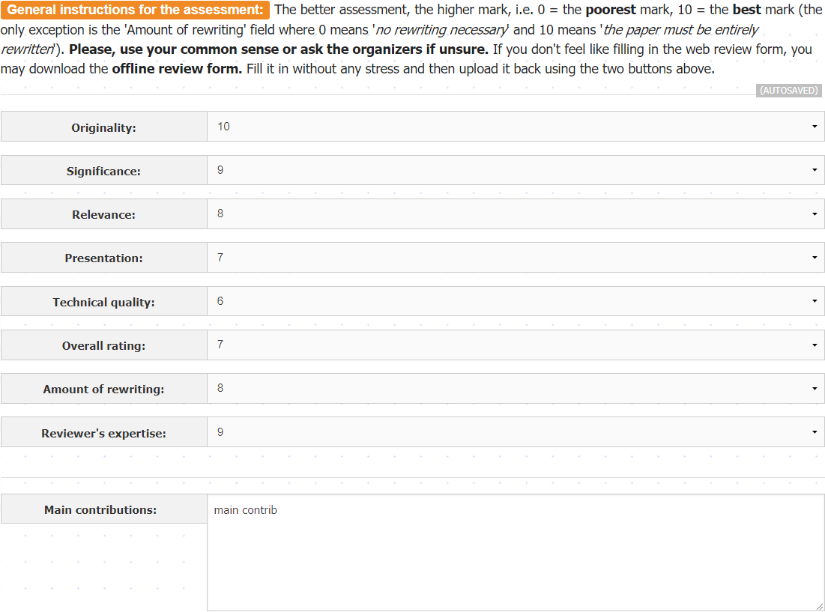
1a. Evaluation form -first part before evaluating

Slide 3
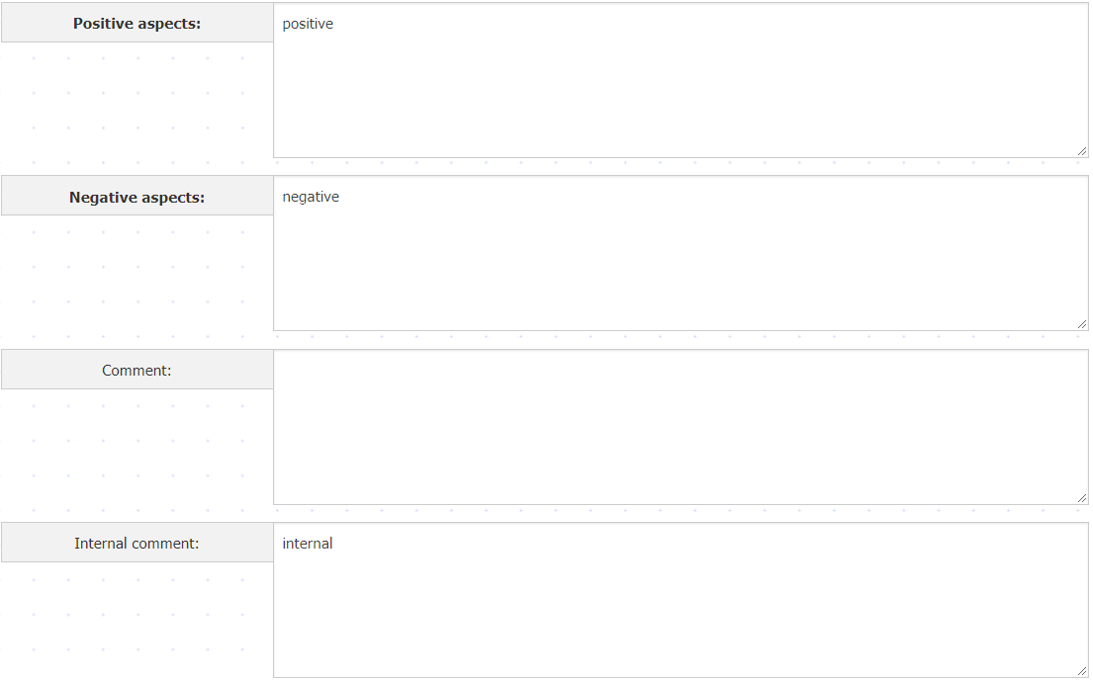
1b. Evaluation form -second part before evaluating

Slide 4
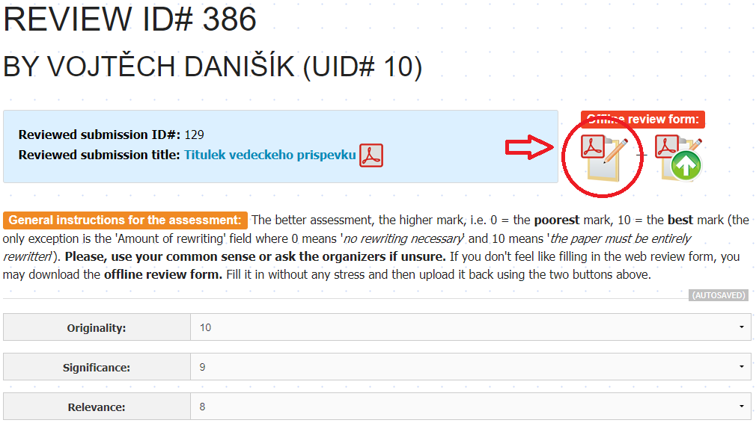
2. Downloading evaluation PDF

Slide 5
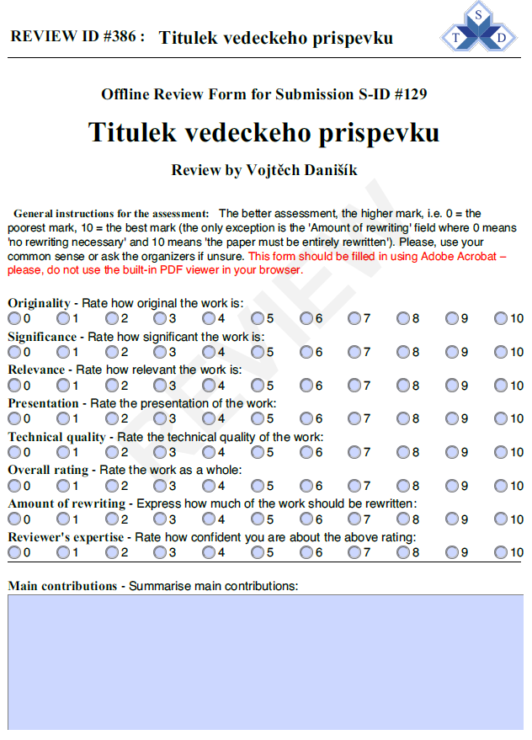
3a. Evaluation PDF – unfilled first part

Slide 6
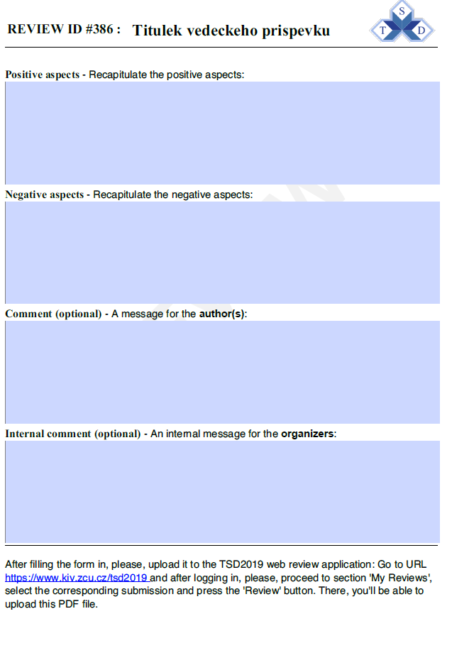
3b. Evaluation PDF – unfilled second part

Slide 7
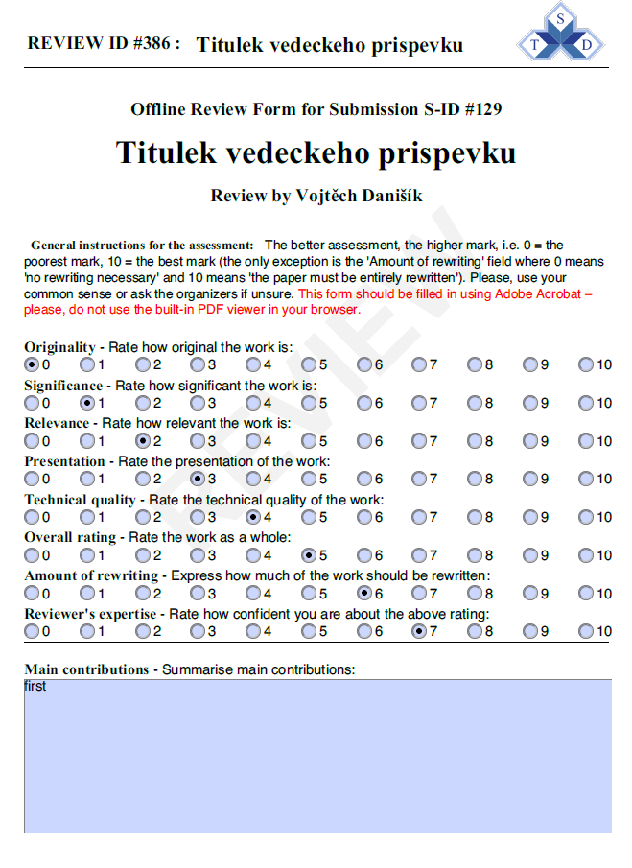
4a. Evaluation PDF – filled first part

Slide 8
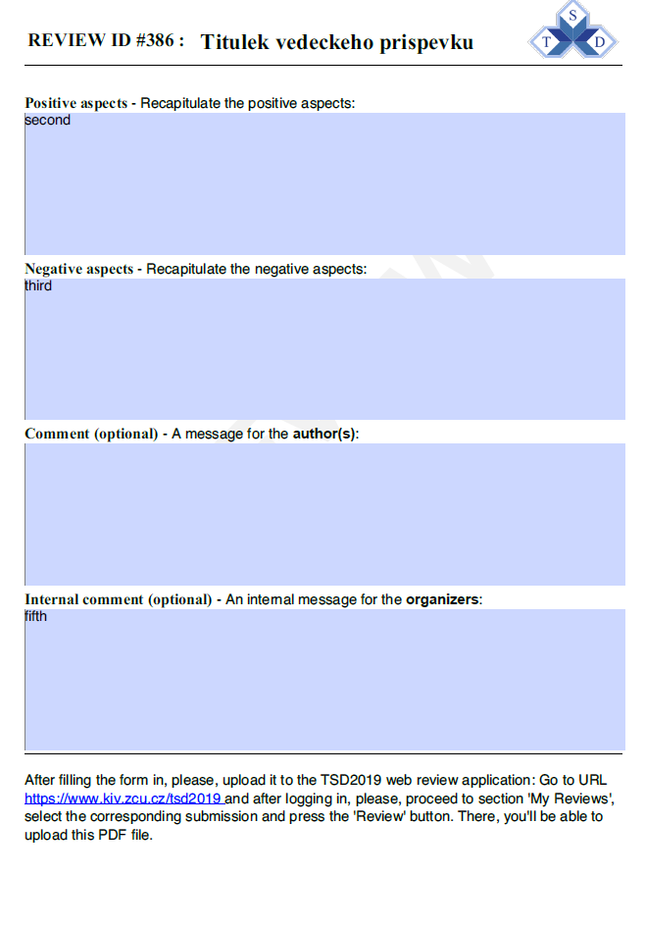
4b. Evaluation PDF – filled second part

Slide 9
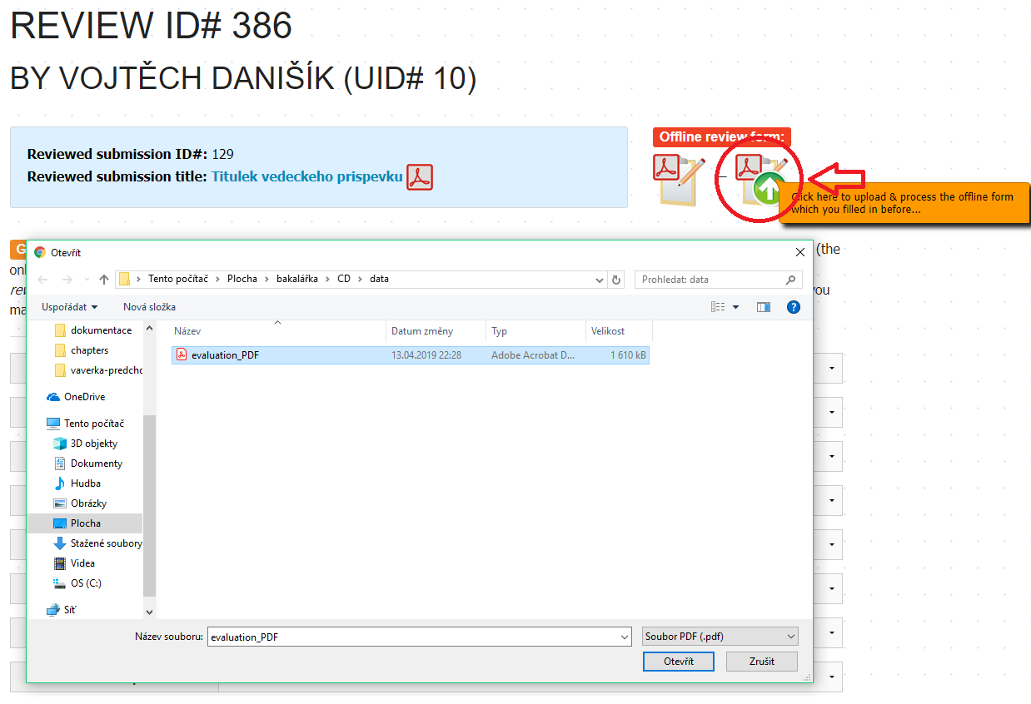
5. Uploading filled evaluation PDF

Slide 10
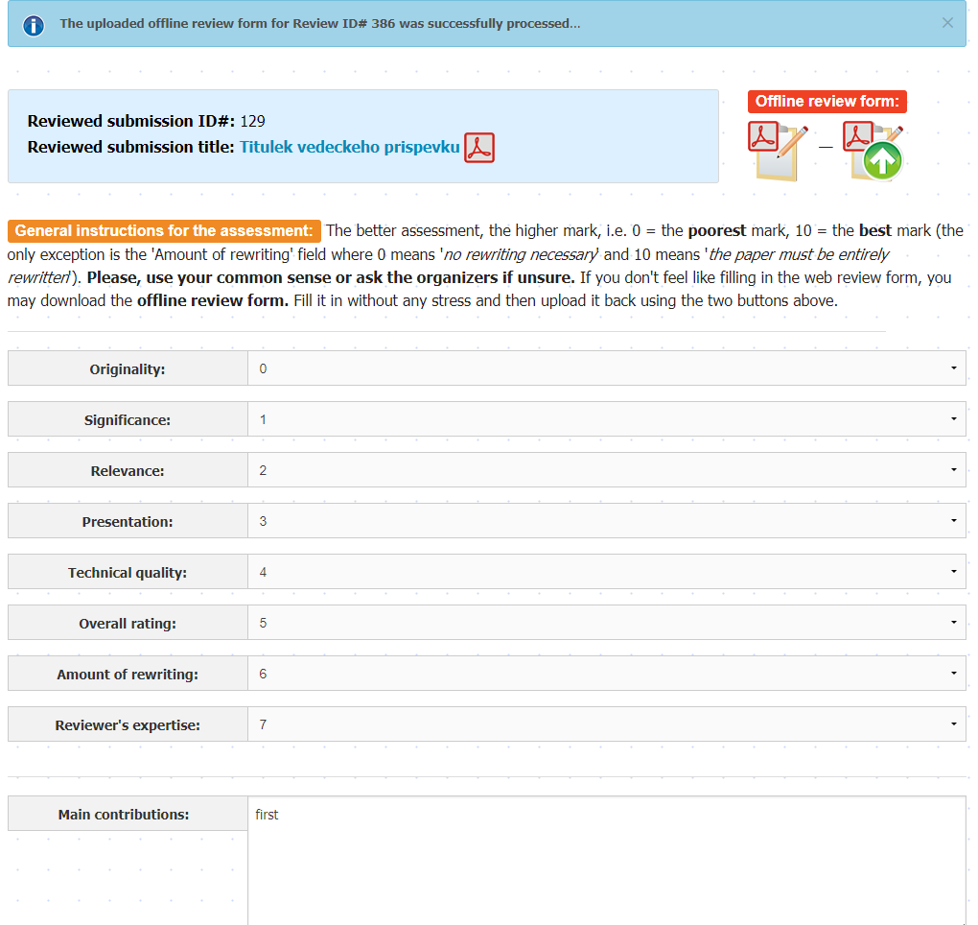
6a. Evaluation form - first part after evaluating

Slide 11
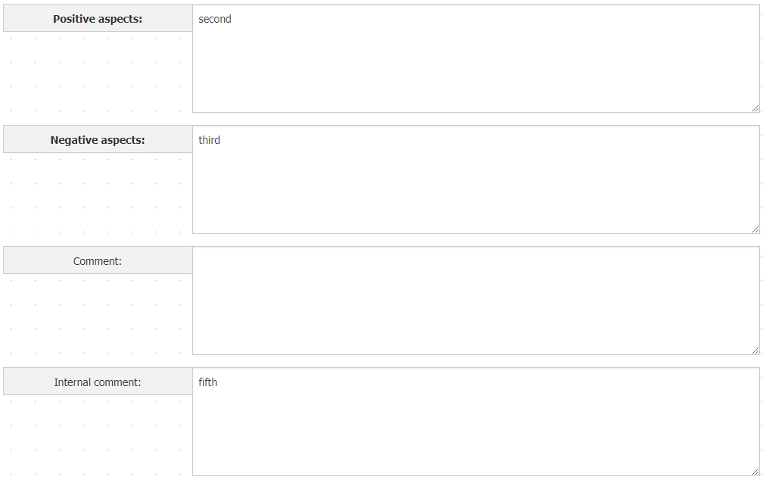
6b. Evaluation form - second part after evaluating

