Slide 1
Spark & GraphX Workshop

Slide 2

Returning Visitors

Slide 3
The Challenge
Accurately identify users over time as they interact with us

Slide 4
Why? Knowledge
To understand how our visitors behave:
They have long buying cycles
They use multiple devices
They engage with us through multiple channels

Slide 5
Why? Cost Analysis
To know how much it costs to acquire new customers:
They visit us from different marketing channels
Each of them have different costs
We remunerate our partners depending on that

Slide 6
Why? Personalization
To adapt their visit while they interact with us:
We can trigger offers depending on the channel they come from
We can prefill fields if they’re recognized
We can change the look and feel of the website

Slide 7
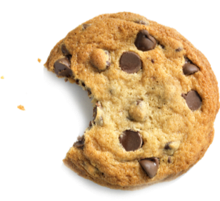
Cookies?
Their work great when you want to identify people coming back to your website.
Challenges:
Different devices
Cleared cookies
Private sessions
What about telephone calls…?

Slide 8
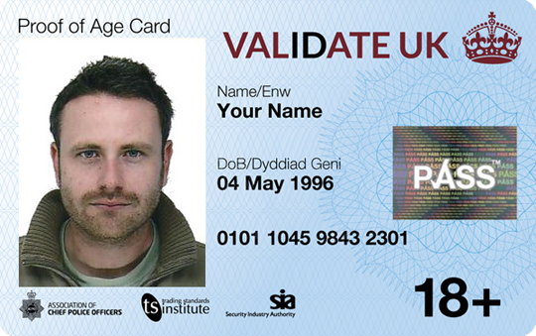
Use More IDs!
We can use other IDs provided by visitors to link sessions:
Login details
Email addresses
Telephone numbers
Credit card numbers
Fingerprints
…

Slide 9
Example
How many visitors do we have here?
Timestamp | Event | Cookie ID | Email
1 | page_view | 111
2 | details_submitted | 111 | a@a.com
3 | page_view | 555
4 | page_view | 888
5 | policy_sold | 555 | a@a.com
6 | details_submitted | 888 | b@b.com

Slide 10
Example
How many visitors do we have here? Only 2
Timestamp | Event | Cookie ID | Email
1 | page_view | 111
2 | details_submitted | 111 | a@a.com
3 | page_view | 555
4 | page_view | 888
5 | policy_sold | 555 | a@a.com
6 | details_submitted | 888 | b@b.com

Slide 11
Example: Streaming
Timestamp | Event | Cookie ID | Email
1 | page_view | 111
2 | details_submitted | 111 | a@a.com
3 | page_view | 555
4 | page_view | 888
5 | policy_sold | 555 | a@a.com
6 | details_submitted | 888 | b@b.com
Visitor A: 111

Slide 12
Example: Streaming
Timestamp | Event | Cookie ID | Email
1 | page_view | 111
2 | details_submitted | 111 | a@a.com
3 | page_view | 555
4 | page_view | 888
5 | policy_sold | 555 | a@a.com
6 | details_submitted | 888 | b@b.com
Visitor A: 111, a@a.com

Slide 13
Example: Streaming
Timestamp | Event | Cookie ID | Email
1 | page_view | 111
2 | details_submitted | 111 | a@a.com
3 | page_view | 555
4 | page_view | 888
5 | policy_sold | 555 | a@a.com
6 | details_submitted | 888 | b@b.com
Visitor A: 111, a@a.com
Visitor B: 555

Slide 14
Example: Streaming
Timestamp | Event | Cookie ID | Email
1 | page_view | 111
2 | details_submitted | 111 | a@a.com
3 | page_view | 555
4 | page_view | 888
5 | policy_sold | 555 | a@a.com
6 | details_submitted | 888 | b@b.com
Visitor A: 111, a@a.com
Visitor B: 555
Visitor C: 888

Slide 15
Example: Streaming
Timestamp | Event | Cookie ID | Email
1 | page_view | 111
2 | details_submitted | 111 | a@a.com
3 | page_view | 555
4 | page_view | 888
5 | policy_sold | 555 | a@a.com
6 | details_submitted | 888 | b@b.com
Visitor A: 111, 555, a@a.com
Visitor C: 888
Visitors A and B were merged!

Slide 16
Example: Streaming
Timestamp | Event | Cookie ID | Email
1 | page_view | 111
2 | details_submitted | 111 | a@a.com
3 | page_view | 555
4 | page_view | 888
5 | policy_sold | 555 | a@a.com
6 | details_submitted | 888 | b@b.com
Visitor A: 111, 555, a@a.com
Visitor C: 888, b@b.com

Slide 17
Batch Solution

Slide 18
Example: Batch
Timestamp | Event | Cookie ID | Email
1 | page_view | 111
2 | details_submitted | 111 | a@a.com
3 | page_view | 555
4 | page_view | 888
5 | policy_sold | 555 | a@a.com
6 | details_submitted | 888 | b@b.com

Slide 19
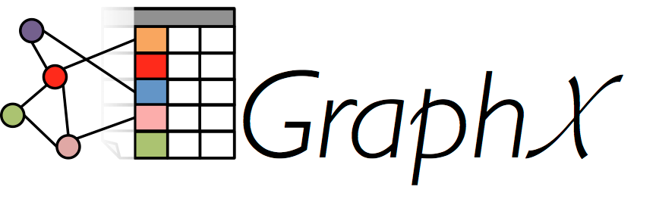
Batch Algorithm
Find the connected components in the graph
Already implemented in GraphX!
Vertices: visitor IDs
Edges: pairs of IDs occurring in the same event

Slide 20
Example: Batch
Timestamp | Event | Cookie ID | Email
1 | page_view | 111
2 | details_submitted | 111 | a@a.com
3 | page_view | 555
4 | page_view | 888
5 | policy_sold | 555 | a@a.com
6 | details_submitted | 888 | b@b.com
111
a@a.com
888
b@b.com
555

Slide 21
GraphX: Issues
There is no Python API for GraphX, and Graphframes performance is worse than GraphX’s
GraphX requires vertices to have numeric IDs
You’ll have to create a mapping between the real IDs and the numeric IDs
Perform the connected components calculation
Map back the numeric IDs to the real IDs
Documentation is not as good as other Spark projects

Slide 22
Beware
That two events share an ID does not necessarily mean that were generated by the same person. Watch out for:
Clashing IDs
Fake IDs: test@test.com, 07123456789, etc.
Shared devices: couples, public computers, etc.
People using your system on behalf of someone else
Bugs
Analyze your data first!

Slide 23


Slide 24
Whizz-Kidz & Simply Business
Whizz-Kidz provides disabled children with the essential wheelchairs and other mobility equipment they need to lead fun and active childhoods.
Simply Business and its employees have pledged to raise £150,000 during the next three years. This amount of money is enough to clear Whizz Kidz' waiting list in both the London and Northampton region!
https://simplybusiness.everydayhero.com/uk/sahara-2016

Slide 25
Thank You!

