Slide 1
File systems: outline
Concepts
File system implementation
  Disk space management
  Reliability
  Performance issues
NTFS
NFS
Operating Systems, Spring 2018, I. Dinur, D. Hendler and R. Iakobashvili

Slide 2
File Systems
Answers three major needs:
Large & cheap storage space
Non-volatility: storage that is not erased when the process using it terminates
Sharing information between processes
Operating Systems, Spring 2018, I. Dinur, D. Hendler and R. Iakobashvili

Slide 3
File System – the abstraction
a collection of files + directory structure
files are abstractions of the properties of storage devices - data is generally stored on secondary storage in the form of files
files can be free-form or structured
files are named and thus become independent of the user/process/creator or system..
some method of file protection
Operating Systems, Spring 2018, I. Dinur, D. Hendler and R. Iakobashvili

Slide 4
File Structure (cont’d)
Unstructured (Unix, Windows):
  For OS, the file is just a sequence of bytes – meaning imposed by user-level programs
  Max flexibility
Records:
  File is a sequence of fixed length records
  Read/write operate on full record
  Mainframe files were like that in the era of punched cards
Tree of keyed variable-length records
  Access by keys
  Mainframes for commercial data processing
Operating Systems, Spring 2018, I. Dinur, D. Hendler and R. Iakobashvili

Slide 5
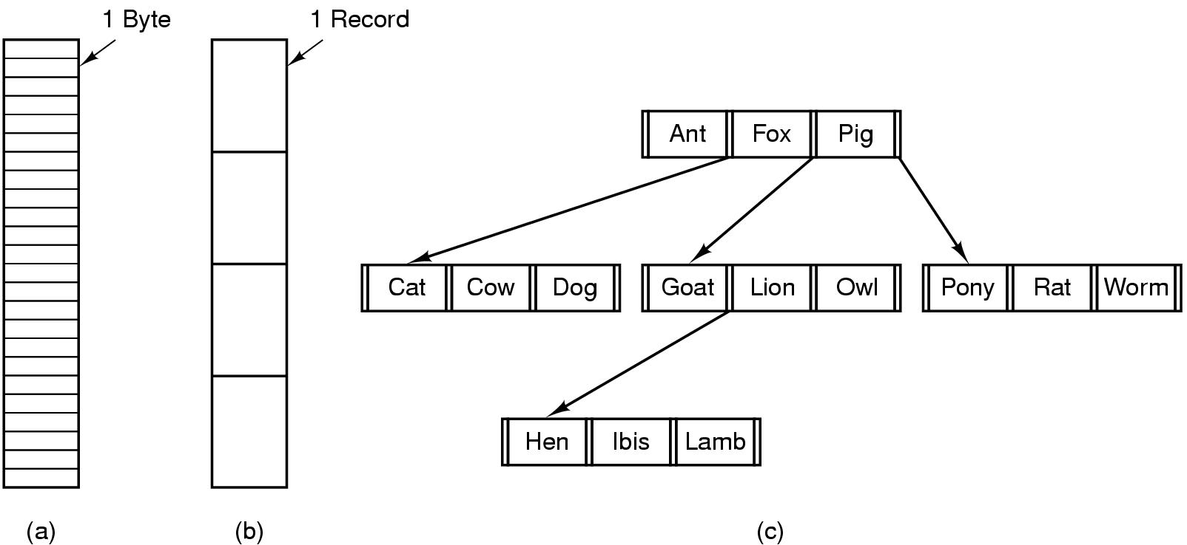
File Structure
Three kinds of files
  byte sequence
  record sequence
  tree of records
Operating Systems, Spring 2018, I. Dinur, D. Hendler and R. Iakobashvili

Slide 6
File types
`Regular’ user files
  ASCII
  Binary
System files
  Directories
  Special files: character I/O, block I/O
Operating Systems, Spring 2018, I. Dinur, D. Hendler and R. Iakobashvili

Slide 7
File Access
Sequential access
  read all bytes/records from the beginning
  cannot jump around, could rewind or back up
  convenient when medium was magnetic tape
Random access
  bytes/records read in any order
  All files of modern operating systems are random access
  read/write functions can…
    Receive a position parameter to read/write from
    Separate seek function, followed by parameter-less read/write operation
Operating Systems, Spring 2018, I. Dinur, D. Hendler and R. Iakobashvili

Slide 8

Sequential-access File
Operating Systems, Spring 2018, I. Dinur, D. Hendler and R. Iakobashvili

Slide 9

Simulation of Sequential Access on a Random-access File
Operating Systems, Spring 2018, I. Dinur, D. Hendler and R. Iakobashvili

Slide 10
Another access method: indexed files
Built on top of direct-access
Index is a list of pointers to file contents
If index itself is too big, it can be organized in multiple levels
IBM ISAM (Indexed sequential-access method)
  Master index points to secondary index blocks
  Secondary index points to actual file blocks
  File is sorted on key
  An extension of ISAM used in IBM’s DB2
Operating Systems, Spring 2018, I. Dinur, D. Hendler and R. Iakobashvili

Slide 11

Index and Relative Files
Operating Systems, Spring 2018, I. Dinur, D. Hendler and R. Iakobashvili

Slide 12
File attributes
Name, creator, owner, creation time, last-access time..
General info - user ID, Group ID, dates, times
Location, size, size limit…
pointer to a device and location on it
ASCII/binary flag, system flag, hidden flag…
Bits that store information for the system
Protection, password, read-only flag,…
possibly special attributes
Operating Systems, Spring 2018, I. Dinur, D. Hendler and R. Iakobashvili

Slide 13
File Operations
Create; Delete
Close; Open
Read; Write
  operations performed at the current location
Seek - a system call to move current location to some specified location
Get Attributes
Set Attributes - for attributes like name; ownership; protection mode; “last change date”
Operating Systems, Spring 2018, I. Dinur, D. Hendler and R. Iakobashvili

Slide 14

Tree-Structured Directories (a.k.a. folders)
Operating Systems, Spring 2018, I. Dinur, D. Hendler and R. Iakobashvili

Slide 15
Directory Operations
Create entry; Delete entry
Search for a file
Create/Delete a directory file
List a directory
Rename a file
Link a file to a directory
Traverse a file system (must be done “right”, on a tree – the issue of links)
Operating Systems, Spring 2018, I. Dinur, D. Hendler and R. Iakobashvili

Slide 16
Path names
Absolute path names start from the root directory
Relative path names start from the working directory (a.k.a. the current directory)
Each process has its own working directory
  Shared by threads
The dot (.) and dotdot (..) directory entries
  cp ../lib/directory/ .
Operating Systems, Spring 2018, I. Dinur, D. Hendler and R. Iakobashvili

Slide 17

Directed-Acyclic-Graph (DAG) Directories
Allows sharing directories and files
Operating Systems, Spring 2018, I. Dinur, D. Hendler and R. Iakobashvili

Slide 18
Shared Files - Links
Symbolic (soft) links:
  A special type of LINK file, containing a path name
  Access through link is slower
“Hard Links”:
  Information about shared file is duplicated in sharing directories
  fast, points to file
  Link count must be maintained
When the source is deleted:
  A soft link becomes a broken link
  Data still accessible through hard link
Problem with both schemes: multiple access paths create problems for backup and other “traversal” procedures
Operating Systems, Spring 2018, I. Dinur, D. Hendler and R. Iakobashvili

Slide 19
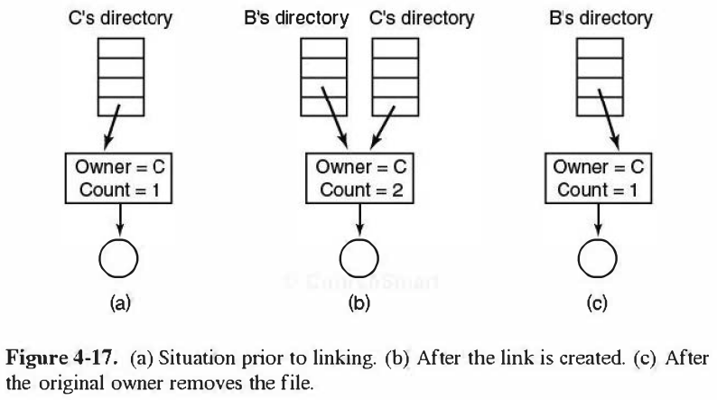
More issues with linked files
LINK files (symbolic link) contain pathname of linked files
Hard links MUST have reference counting, for correct deletion. May create `administrative’ problems
Operating Systems, Spring 2018, I. Dinur, D. Hendler and R. Iakobashvili

Slide 20
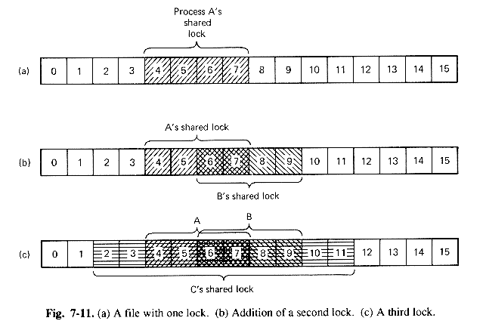
Locking files
any part of a file may be locked, to prevent race conditions
locks are shared or exclusive
blocking or non-blocking possible (blocked processes awakened by system)
flock(file descriptor, operation)
File lock is removed when file closed or process terminates
Supported by POSIX. By default, file locking in Unix is advisory
Operating Systems, Spring 2018, I. Dinur, D. Hendler and R. Iakobashvili

Slide 21
Bottom up view
Users concerns:
  file names
  operations allowed
  Directory structures…
System’s implementer's concerns:
  Storage of files and directories
  Disk space management
  Implementation efficiency and reliability
Operating Systems, Spring 2018, I. Dinur, D. Hendler and R. Iakobashvili

Slide 22
File systems: outline
Concepts
File system implementation
  Disk space management
  Reliability
  Performance issues
NTFS
NFS
Operating Systems, Spring 2018, I. Dinur, D. Hendler and R. Iakobashvili

Slide 23
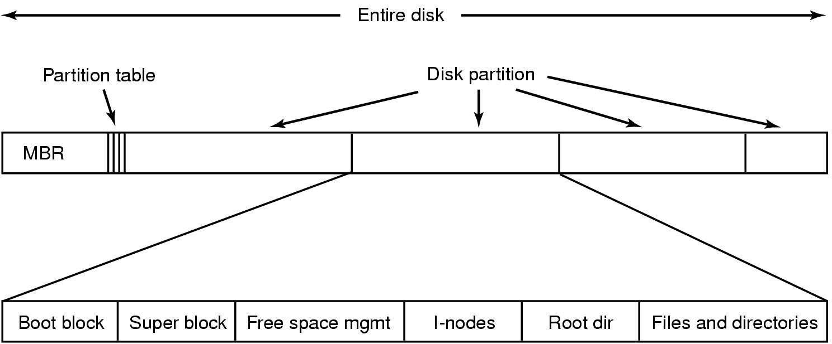
Typical Unix File System Layout
Master boot record
File system type
Number of blocks
…
Operating Systems, Spring 2018, I. Dinur, D. Hendler and R. Iakobashvili

Slide 24
Implementing files
Disk allocation:
  Contiguous
    Simple; fast access
    problematic space allocation (External fragmentation, compaction…)
    How much size should be allocated at creation time?
  Linked list of disk blocks
    No fragmentation, easy allocation
    slow random access, n disk accesses to get to n'th block
    weird block size
  Linked list using in-memory File Allocation Table (FAT)
    none of the above disadvantages
    BUT a very large table in memory
Operating Systems, Spring 2018, I. Dinur, D. Hendler and R. Iakobashvili

Slide 25

Implementing Files (1)
(a) Contiguous allocation of disk space for 7 files
(b) State of the disk after files D and F have been removed
Operating Systems, Spring 2018, I. Dinur, D. Hendler and R. Iakobashvili

Slide 26

Implementing Files (2)
Storing a file as a linked list of disk blocks
Pointers are within the blocks
Operating Systems, Spring 2018, I. Dinur, D. Hendler and R. Iakobashvili

Slide 27
Implementing Files (3)
Use a table to store the pointers of all blocks in the linked list that represent files – last block has a special EOF symbol
Physical block
0 | X
1 | Y
2 | 10
3 | 11
4 | 7
5 | Free
6 | 3
7 | 2
8 | EOF
9 | Free
10 | 12
11 | 8
12 | EOF
13 | Free
Disk size
File A starts here
File B starts here
Unused block
Operating Systems, Spring 2018, I. Dinur, D. Hendler and R. Iakobashvili

Slide 28
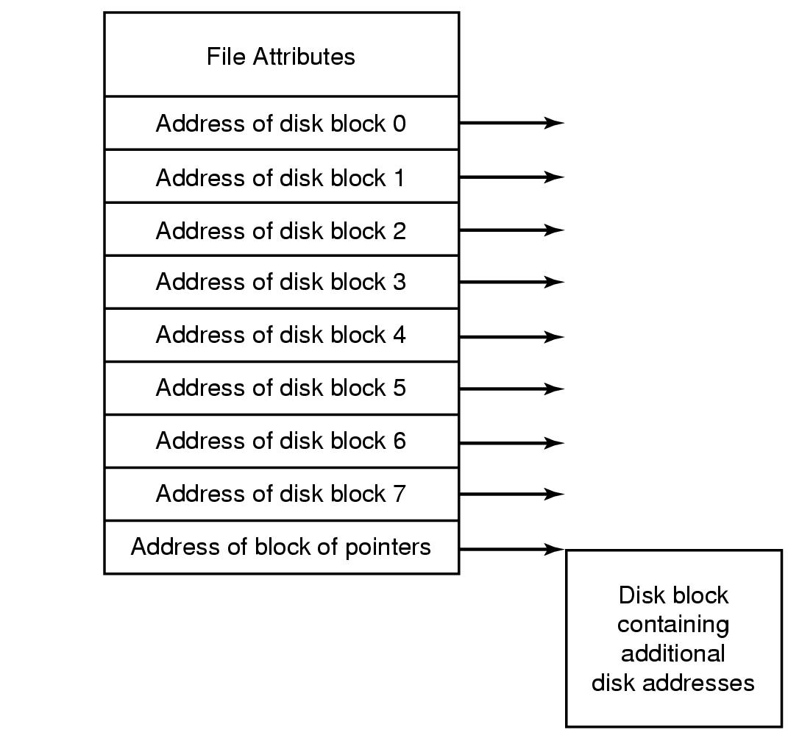
In Unix: index-nodes (i-nodes)
An example i-node (simplified)
Operating Systems, Spring 2018, I. Dinur, D. Hendler and R. Iakobashvili

Slide 29
`Classic’ Unix Disk Structure
A single i-node per file,
64 bytes long
Boot
Sector
Super
Block
i-nodes
Data blocks
i-nodes #
Blocks #
Free blocks #
Pointer to free blocks list
Pointer to free i-nodes list
…
2 bytes
14 bytes
i-node #
File name
Directory entry
Operating Systems, Spring 2018, I. Dinur, D. Hendler and R. Iakobashvili

Slide 30
Unix file system – The superblock
Size of file system (number of blocks)
Size of i-nodes table
Number of free blocks
Start of list of free blocks
Number of free i-nodes
Start of list of free i-nodes
…
Operating Systems, Spring 2018, I. Dinur, D. Hendler and R. Iakobashvili

Slide 31
Unix i-node structure
mode
Owners (2)
data
Timestamps (3)
data
Size
data
data
Block count
data
Number of links
data
data
flags
data
data
Generation number
Direct blocks
data
data
data
Single indirect
data
data
Double indirect
data
Triple indirect
data
Operating Systems, Spring 2018, I. Dinur, D. Hendler and R. Iakobashvili

Slide 32
Structure of i-node in System V
Field | Bytes | Description
Mode | 2 | File type, protection bits, setuid, setgid bits
Nlinks | 2 | Number of directory entries pointing to this i-node
Uid | 2 | UID of the file owner
Gid | 2 | GID of the file owner
Size | 4 | File size in Bytes
Addr | 39 | Addresses of first 10 disk blocks, then 3 indirect blocks
Gen | 1 | Generation number (Incremented every time i-node is reused)
Atime | 4 | Time the file was last accessed
Mtime | 4 | Time the file was last modified
Ctime | 4 | Time the i-node was last changed (except the other times)
Operating Systems, Spring 2018, I. Dinur, D. Hendler and R. Iakobashvili

Slide 33
Unix i-nodes - Counting bytes..
10 direct block numbers
  assume blocks of 1k bytes - 10x1k - up to 10kbytes
1 single indirect block number
  for 1kb blocks & 4 byte block numbers- up to 256kbytes
1 double indirect block number
  same assumptions - 256 x 256k x 1k - up to 64Mbytes
1 triple indirect block number
up to 16 Giga bytes...
Operating Systems, Spring 2018, I. Dinur, D. Hendler and R. Iakobashvili

Slide 34
Unix i-nodes - Example
Byte number 9200 is
1008 in block 367
Byte number 355,000 is calculated as follows:
a. 1st byte of the double indirect block is 256k+10k = 272,384
b. byte number 355,000 is number 82,616 in the double indirect block
c. every single indirect block has 256k bytes
--> byte 355,000 is in the 0th single indirect block - 231
d. Every entry is 1k, so byte 82,616 is in the 80th block - 123
e. within block 123 it is byte #696
size
228
4542
3
243
545
1111
765
101
367
754
428
9156
824
367 data block
123
123
231
80
231
9156
Operating Systems, Spring 2018, I. Dinur, D. Hendler and R. Iakobashvili

Slide 35
The file descriptors table
Each process has a file descriptors table
Indexed by the file descriptor
One entry per each open file
Typical table size: 32
Let’s consider the possible layout of this table…
Operating Systems, Spring 2018, I. Dinur, D. Hendler and R. Iakobashvili

Slide 36
File descriptors table: take 1
23424
232
11
0
17
Per-process
Descriptors table
1001
i-nodes table
Where should we keep the file position information?
Operating Systems, Spring 2018, I. Dinur, D. Hendler and R. Iakobashvili

Slide 37
File descriptors table: take 1 (cont’d)
23424
232
11
0
17
Per-process
Descriptors table
1001
i-nodes table
BUT what if multiple processes simultaneously
have the file open?
Operating Systems, Spring 2018, I. Dinur, D. Hendler and R. Iakobashvili

Slide 38
File descriptors table: take 2
17
102
7453
0
0
77
0
Per-process
Descriptors table
i-nodes table
Would THIS work?
Operating Systems, Spring 2018, I. Dinur, D. Hendler and R. Iakobashvili

Slide 39
File descriptors table: take 2 (cont’d)
Consider a shell script s consisting of two commands: p1, p2
Run: “s > x”
p1 should write to x, then p2 is expected to append its data to x.
With 2’nd implementation, p2 will overwrite p1’s data
Operating Systems, Spring 2018, I. Dinur, D. Hendler and R. Iakobashvili

Slide 40
Solution adopted by Unix
Open files description table
Parent’s file descriptors table
File position
RW
pointer to i-node
File position
RW
pointer to i-node
Child’s file descriptors
table
File position
RW
pointer to i-node
Unrelated process’s file descriptors
table
i-nodes table
Operating Systems, Spring 2018, I. Dinur, D. Hendler and R. Iakobashvili

Slide 41
The open files description tables
Each process has its own file descriptors table that points to the entries in the kernel’s open files description table
The kernel’s open files description table points to the i-node of the file
Every open call adds an entry to both the open file description and the process’ file description table.
The open file description table stores the current location
Since child processes inherit the file descriptors table of the parent and points to the same open file description entries, the current location of children is updated
Operating Systems, Spring 2018, I. Dinur, D. Hendler and R. Iakobashvili

Slide 42
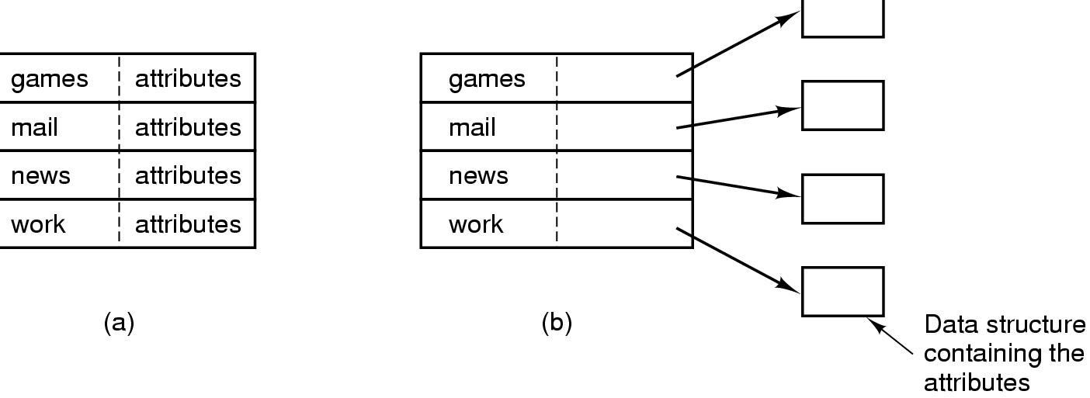
Implementing Directories
(a) A simple directory
  fixed size entries
  disk addresses and attributes in directory entry
(b) Directory entries simply point to i-nodes
Operating Systems, Spring 2018, I. Dinur, D. Hendler and R. Iakobashvili

Slide 43
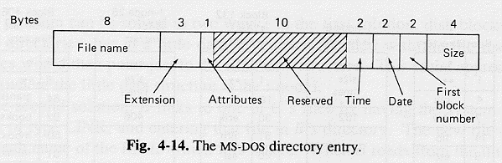
Directories in MS-DOS
Multiple directories starting from version 2.0
Tree structure (no links)
directories provide information about location of file blocks (directly or indirectly..)
Both names and attributes are IN the directory
read-only
hidden
system
archive
An index into the 64K –entry FAT
MS-DOS uses fixed size 32-byte directory entries
Operating Systems, Spring 2018, I. Dinur, D. Hendler and R. Iakobashvili

Slide 44
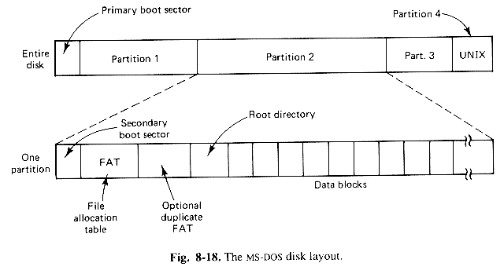
DOS Disk Organization
Operating Systems, Spring 2018, I. Dinur, D. Hendler and R. Iakobashvili

Slide 45
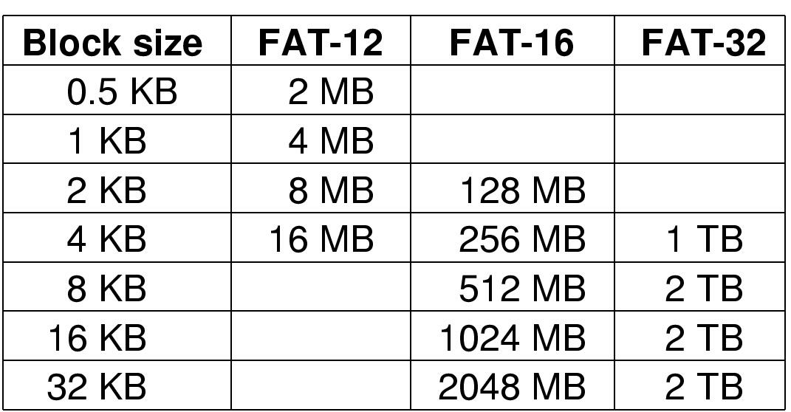
The MS-DOS File System (2)
FAT-12/16/32 respectively store 12/16/28-bit block numbers
Maximum of 4 partitions are supported
The empty boxes represent forbidden combinations
Operating Systems, Spring 2018, I. Dinur, D. Hendler and R. Iakobashvili

Slide 46
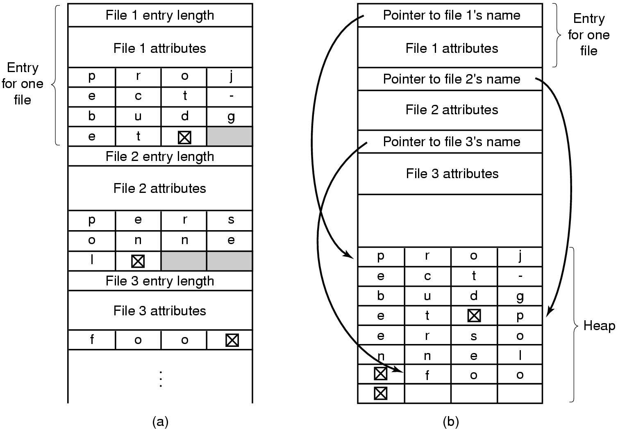
Supporting long file names
Two ways of handling long file names
  (a) In-line
  (b) In a heap
Operating Systems, Spring 2018, I. Dinur, D. Hendler and R. Iakobashvili

Slide 47
BSD Unix Directories
i-node #
Entry size
Type
Filename length
19
F
8
collosal
42
F
10
voluminous
88
D
6
bigdir
unused
Each directory consists of an integral number of disk blocks
Entries are not sorted and may not span disk blocks, so padding may be used
To improve search time, BSD uses (among other things) name caching
Operating Systems, Spring 2018, I. Dinur, D. Hendler and R. Iakobashvili

Slide 48
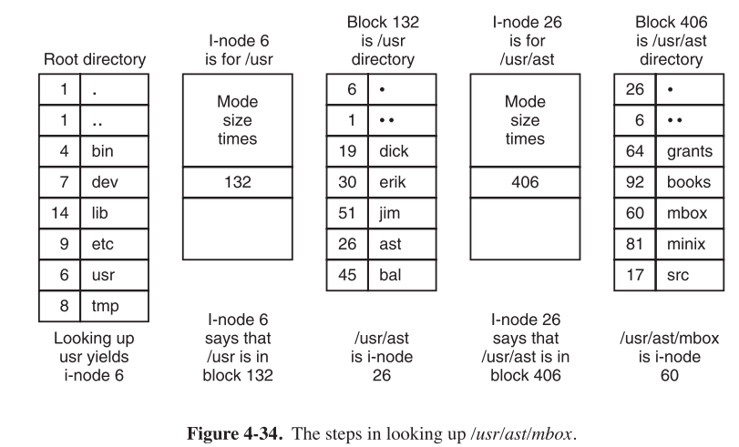
BSD Unix Directories
Only names are in the directory, the rest of the
information is in the i-nodes
Operating Systems, Spring 2018, I. Dinur, D. Hendler and R. Iakobashvili

Slide 49
File systems: outline
Concepts
File system implementation
  Disk space management
  Reliability
  Performance issues
NTFS
NFS
Operating Systems, Spring 2018, I. Dinur, D. Hendler and R. Iakobashvili

Slide 50
Block size Implications
  Large blocks
    High internal fragmentation
    In sequential access, less blocks to read/write – less seek/search
    In random access larger transfer time, larger memory buffers
  Small blocks
    Smaller internal fragmentation
    Slower sequential access (more seeks) but faster
    random access
Operating Systems, Spring 2018, I. Dinur, D. Hendler and R. Iakobashvili

Slide 51
Block size Implications (cont'd)
Disk access time parameters:
average seek-time – average time for head to get above a cylinder
rotation time – time for disk to complete full rotation
Selecting block-size poses a time/space tradeoff
  Large blocks waste space (internal fragmentation)
  Small blocks give worse data rate
Example
block size b, average seek time 10ms, rotation time 8.33ms, track size 32k
Average time to access block: 10+4.165+(b/32)x8.33
Seek time
Avg. time to get to track block
Transfer time
Operating Systems, Spring 2018, I. Dinur, D. Hendler and R. Iakobashvili

Slide 52
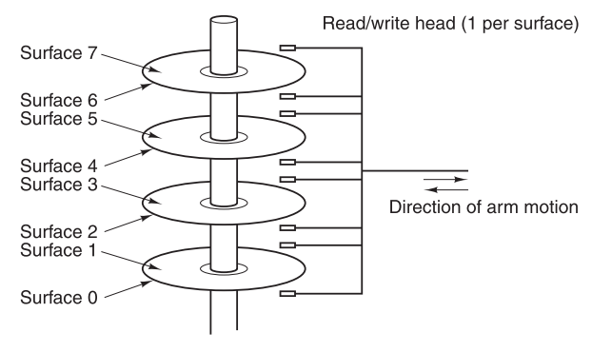
Disk drive structure
Operating Systems, Spring 2018, I. Dinur, D. Hendler and R. Iakobashvili

Slide 53
Disk drive structure
Track
Operating Systems, Spring 2018, I. Dinur, D. Hendler and R. Iakobashvili

Slide 54
Disk drive structure
Cylinder
Operating Systems, Spring 2018, I. Dinur, D. Hendler and R. Iakobashvili

Slide 55
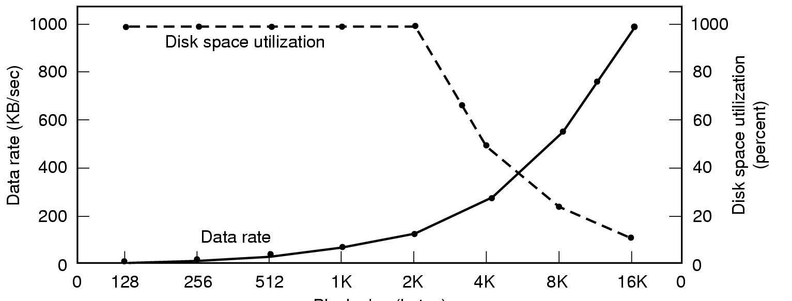
Block size considerations
Block size
Dark line (left hand scale) gives data rate of a disk
Dotted line (right hand scale) gives disk space efficiency
Assumption: most files are 2KB
UNIX supports two block sizes: 1K and 8K
Operating Systems, Spring 2018, I. Dinur, D. Hendler and R. Iakobashvili

Slide 56
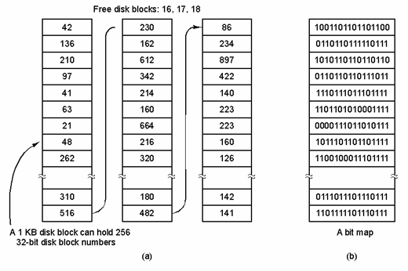
Keeping track of free blocks
(a) Storing the free list on a linked list of blocks
(b) A bit map
Operating Systems, Spring 2018, I. Dinur, D. Hendler and R. Iakobashvili

Slide 57
Free-block lists on Disk - Unix
When a file system is created, the linked list of free-blocks is stored as follows:
  Addresses of the first n free blocks stored at the super-block
  The first n-1 of these blocks are free to be assigned
  The last of these free-blocks numbers contains the address of a block, containing n more free blocks
Addresses of many free blocks are retrieved with one disk access
Unix maintains a single block of free-block addresses in memory
Whenever the last free block is reached, the next block of free-blocks is read and used
Operating Systems, Spring 2018, I. Dinur, D. Hendler and R. Iakobashvili

Slide 58
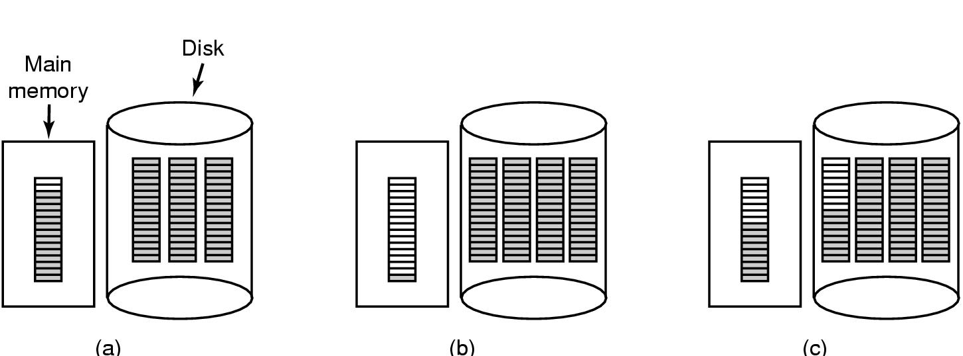
Preventing free-block thrashing
(a) Almost-full block of pointers to free disk blocks in RAM
  - three blocks of pointers on disk
(b) Result of freeing a 3-block file
(c) Alternative strategy for handling 3 free blocks
  - shaded entries are pointers to free disk blocks
Operating Systems, Spring 2018, I. Dinur, D. Hendler and R. Iakobashvili

Slide 59
Keeping track of free blocks (cont’d)
DOS: no list or bit-map – information is in the FAT
Linux: maintains a bit-map
NTFS: A bitmap stored in a special file
Operating Systems, Spring 2018, I. Dinur, D. Hendler and R. Iakobashvili

Slide 60
File systems: outline
Concepts
File system implementation
  Disk space management
  Reliability
  Performance issues
NTFS
NFS
Operating Systems, Spring 2018, I. Dinur, D. Hendler and R. Iakobashvili

Slide 61
File System (hardware) Reliability
Disk damage/destruction can be a disaster
  loss of permanent data
  difficult to know what is lost
  much worse than other hardware
Disks have Bad Blocks that need to be maintained
  Hardware Solution: sector containing bad block list, read by controller and invisible to operating system; some manufacturers even supply spare sectors, to replace bad sectors discovered during use
  Software Solution: operating system keeps a list of bad blocks thus preventing their use
For file systems that use a FAT – a special symbol for signaling a bad block in the FAT
Operating Systems, Spring 2018, I. Dinur, D. Hendler and R. Iakobashvili

Slide 62
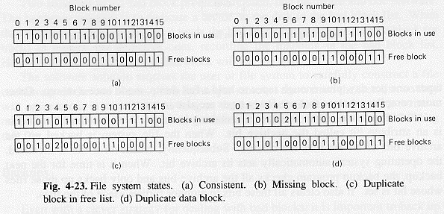
File system consistency - blocks
block consistency - count number of block references in free lists and in files
  if both counts 0 - “missing block”, add to free list
  more than once in free list - delete all references but one
  more than once in files - TROUBLE
  in both file and free list - delete from free list
Operating Systems, Spring 2018, I. Dinur, D. Hendler and R. Iakobashvili

Slide 63
File system consistency - links
Directory system consistency - counting file links
Count references to each i-node by descending down the file system tree
Compare number of references to an i-node with the link-count field in the i-node structure
if count of links larger than the listing in the i-node, correct the i-node structure field
What are the hazards if:
Link-count field < actual links number?
Link-count field > actual links number?
Operating Systems, Spring 2018, I. Dinur, D. Hendler and R. Iakobashvili

Slide 64
File system Reliability – Dumps (a.k.a. backups)
Full dump, incremental dump
Should data be compressed before dumped?
Not simple to dump an active file system
Physical dumps
  Simple, fast
  No use in dumping unused blocks, bad blocks
  Can’t skip specific directories (e.g. /dev) or retrieve specific files
Logical dumps
  widely used
  Free blocks list not dumped – should be restored
  Deal correctly with links and sparse files
Operating Systems, Spring 2018, I. Dinur, D. Hendler and R. Iakobashvili

Slide 65
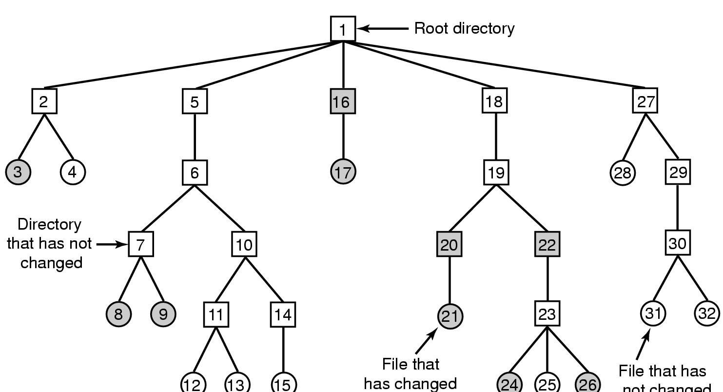
File System Reliability – Incremental Dump
File that has
not changed
A file system to be dumped
  squares are directories, circles are files
  shaded items, modified since last dump
  each directory & file labeled by i-node number
Operating Systems, Spring 2018, I. Dinur, D. Hendler and R. Iakobashvili

Slide 66
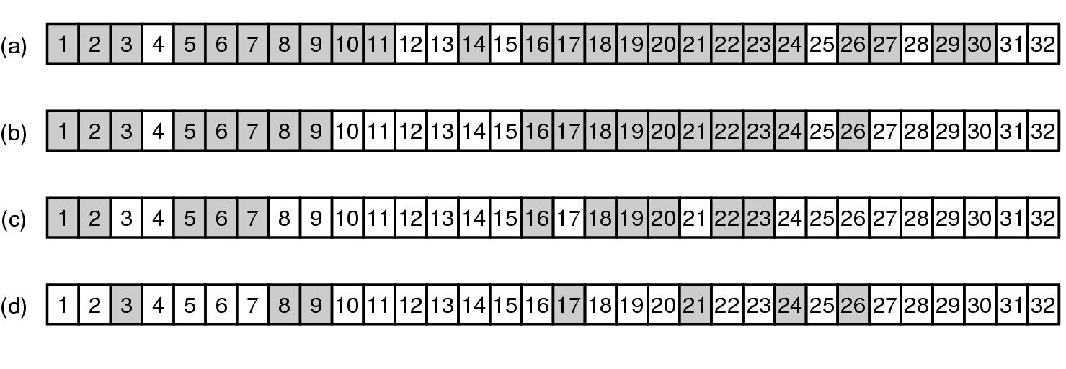
Incremental dump (2)
Bitmap indexed by i-node number
Mark all modified files and all directories
Unmark directories that have no marked files
Scan bitmap in numerical order and dump all directories
Dump files
Operating Systems, Spring 2018, I. Dinur, D. Hendler and R. Iakobashvili

Slide 67
File systems: outline
Concepts
File system implementation
  Disk space management
  Reliability
  Performance issues
NTFS
NFS
Operating Systems, Spring 2018, I. Dinur, D. Hendler and R. Iakobashvili

Slide 68
Performance: Reducing disk arm motion
Block allocation – assign consecutive blocks on same track; possibly rearrange disk periodically
Where should i-nodes be placed?
  Start of disk
  Middle of disk
  divide disk into cylinders and place i-nodes, blocks, and free-blocks lists in each cylinder
For a new file, select any i-node and then select free blocks in its cylinder
Comment: have two types of files, (limited-size, contiguous) random access and sequential access
Operating Systems, Spring 2018, I. Dinur, D. Hendler and R. Iakobashvili

Slide 69

Performance: Reducing disk arm motion (cont’d)
i-nodes placed at the start of the disk
Disk divided into cylinder groups
  each with its own blocks and i-nodes
Operating Systems, Spring 2018, I. Dinur, D. Hendler and R. Iakobashvili

Slide 70
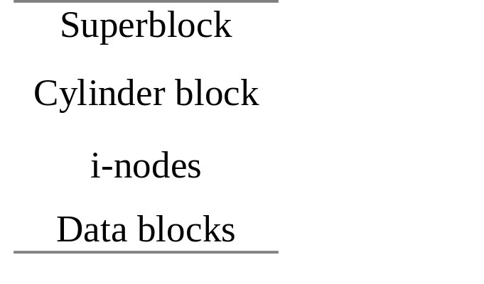
BSD Unix performance enhancements
Filename chaching
Two block sizes are supported
Define cylinder groups, on one or more cylinders, each with own superblock, i-nodes, and data blocks
Keep an identical copy of the superblock at each group
Cylinder blocks, at each cylinder group, keep the relevant local information (free blocks etc.)
Operating Systems, Spring 2018, I. Dinur, D. Hendler and R. Iakobashvili

Slide 71
The Buffer Cache (Unix)
If the kernel would read/write directly to the disk, response time would be bad
The kernel maintains a pool of internal data buffers - the buffer cache (software)
When reading data from disk the kernel attempts to read from the buffer cache:
  if there, no read from disk is needed.
  If not, data is read to cache
Data written to disk is cached, for later use..
High level algorithms instruct the buffer cache to
pre-cache or to delay-write blocks
Operating Systems, Spring 2018, I. Dinur, D. Hendler and R. Iakobashvili

Slide 72
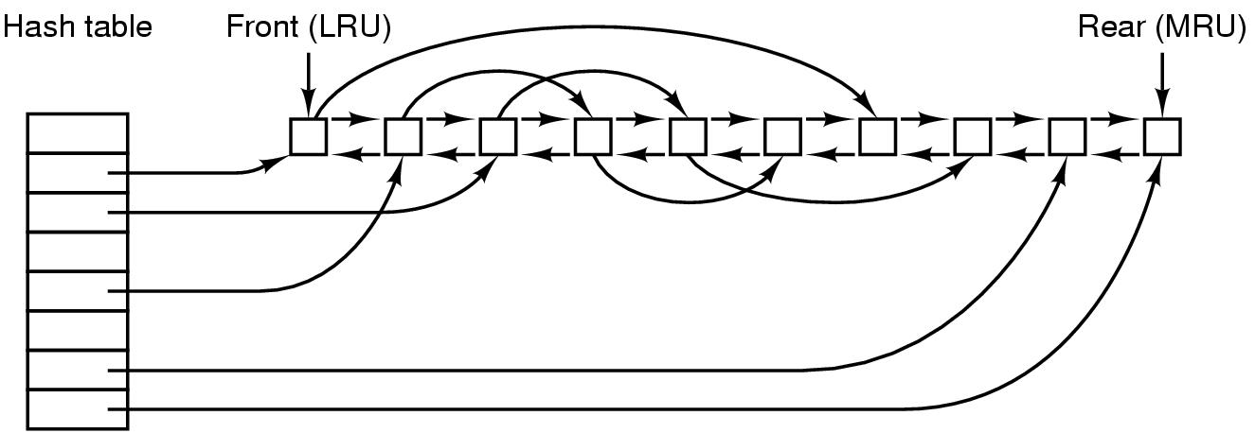
Buffer cache replacement
Essential blocks vs. frequently used blocks
Operating Systems, Spring 2018, I. Dinur, D. Hendler and R. Iakobashvili

Slide 73
Unix - The Buffer Cache (II)
Each buffer has a header that includes the pair <device, block #>
Buffers are on a doubly-linked list in LRU order
Each hash-queue entry points to a linked list of buffers that have same hash value
A block may be in only one hash-queue
A free block is on the free-list in addition to being on a single hash-queue
When looking for a particular block, the hash-queue for it is searched. When in need of a new block, it is removed from the free list (if non-empty)
Operating Systems, Spring 2018, I. Dinur, D. Hendler and R. Iakobashvili

Slide 74
Scenarios for Retrieval of a Buffer
hash queue headers
blkno 0 mod 4
…….
28
4
64
blkno 1 mod 4
…….
17
5
97
blkno 2 mod 4
…….
98
50
10
blkno 3 mod 4
…….
3
35
99
Freelist header
(a) Search for Block 18 – Not in Cache
hash queue headers
blkno 0 mod 4
…….
28
4
64
blkno 1 mod 4
…….
17
5
97
blkno 2 mod 4
…….
98
50
10
18
blkno 3 mod 4
…….
35
99
Freelist header
(b) Remove First Block from Free List, Assign to 18
Figure 3.7. Second Scenario for Buffer Allocation
Operating Systems, Spring 2018, I. Dinur, D. Hendler and R. Iakobashvili

Slide 75
Buffer Cache - Retrieval
Five possible scenarios when the kernel searches a block
The block is found in its hash queue AND is free
  the buffer is marked “busy”
  buffer is removed from free list
The block is found in its hash queue AND is “busy”
  process sleeps until the buffer is freed, then starts algorithm again..
No block is found in the hash queue and there are free blocks
  a free block is allocated from the free list
No block is found in the hash queue AND in searching the free list for a free block one or more “delayed-write” buffer are found
  write delayed-write buffer(s) to disk,
  move them to head of list (LRU) and find a free buffer
No block is found in the hash queue AND free list empty
  block requesting process, when scheduled, go through hash-queue again
Operating Systems, Spring 2018, I. Dinur, D. Hendler and R. Iakobashvili

Slide 76
Buffer Cache - Retrieval
Five possible scenarios when the kernel searches a block
1. The block is found in its hash queue AND is free
  the buffer is marked “busy”
  buffer is removed from free list
2. No block is found in the hash queue - a free block is allocated from the free list
3. No block is found in the hash queue AND in searching the free list for a free block a “delayed-write” buffer is found (or more) - write delayed-write buffer(s) to disk, move them to head of list (LRU) and find a free buffer
4. No block is found in the hash queue AND free list empty – block requesting process, when scheduled, go through hash-queue again
5. The block is found in its hash queue AND is “busy” – process sleeps until the buffer is freed, then starts algorithm again..
Operating Systems, Spring 2018, I. Dinur, D. Hendler and R. Iakobashvili

Slide 77
Fine points of Buffer-cache block retrieval…
Process A allocates buffer to block b, locks it, initiates i/o, blocks
Process B looks up block b on the hash-queue and since it is locked, is blocked
Process A is unblocked by the i/o completion and unblocks all processes waiting for the buffer of block b – process B is unblocked
Process B must check again that the buffer of block b is indeed free, because another process C might have been waiting for it, getting it first and locking it again
Process B must also check that the (now free) buffer actually contains block b, because another process C who might have gotten the buffer (when free), might have loaded it with another block c
Finally, process B , having found that it waited for the wrong buffer, must search for block b again. Another process might have been allocated a buffer for exactly block b while process B was blocked..
Operating Systems, Spring 2018, I. Dinur, D. Hendler and R. Iakobashvili

Slide 78
Why not pure LRU?
Some blocks are critical and should be written as quickly as possible (i-nodes )
Some blocks are likely to be used again (directory blocks?)
Insert critical blocks at the head of the queue, to be replaced soon and written to disk
Partly filled blocks being written go to the end to stay longer in the cache
Have a system daemon that calls sync every 30 seconds, to help in updating blocks
Or, use a write-through cache (DOS)
Operating Systems, Spring 2018, I. Dinur, D. Hendler and R. Iakobashvili

Slide 79
Caching in Windows 2000
Cache services all file systems at the same time (e.g. NTFS, FAT,…)
Keyed by virtual block <file, offset> and not physical block <device, block>
When a file is first referenced, 256K of kernel virtual address space are mapped onto it. Reads/write done by copying between user and kernel address spaces
When a block is missing, a page-fault occurs and the kernel gets the page
Cache is unaware of size and presence of blocks
Memory manager can trade-off cache size dynamically – more user processes → less cache blocks
– more file activity → more cache blocks
Operating Systems, Spring 2018, I. Dinur, D. Hendler and R. Iakobashvili

Slide 80
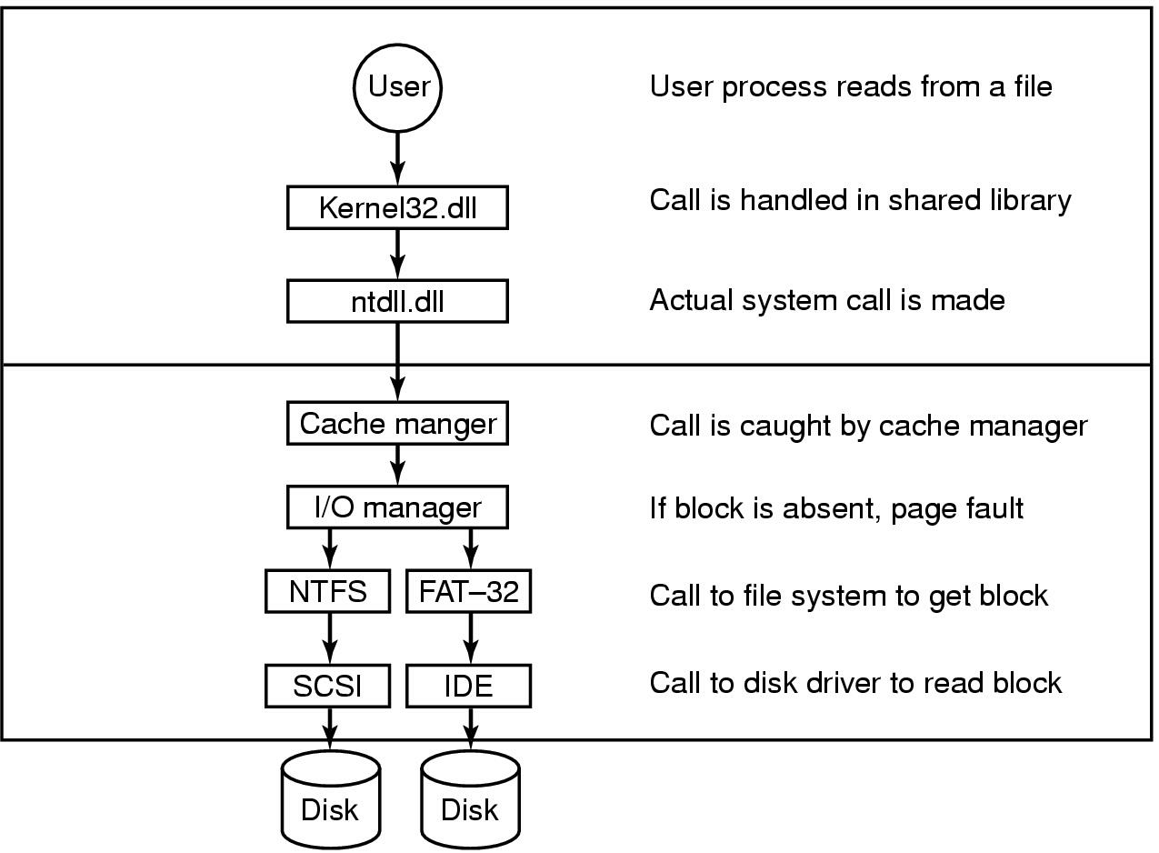
Caching in Windows 2000
The path through the cache to the hardware
Operating Systems, Spring 2018, I. Dinur, D. Hendler and R. Iakobashvili

Slide 81
File systems: outline
Concepts
File system implementation
  Disk space management
  Reliability
  Performance issues
NTFS
NFS
Operating Systems, Spring 2018, I. Dinur, D. Hendler and R. Iakobashvili

Slide 82
NTFS – NT File System
MFT (Master File Table) - a table that has one or more records per file/directory (1-4K, determined upon file system creation)
entries contain file attributes and list of block numbers
larger files need more than one MFT record for the list of blocks - records are extended by pointing to other records
the data can be kept directly in the MFT record (very small files)
if not, disk blocks are assigned in runs, and kept as a sequence of pairs – (offset, length)
no upper limit on file size, each run needs 2 64bit block numbers (i.e. 16 bytes) and may contain any number of blocks
Operating Systems, Spring 2018, I. Dinur, D. Hendler and R. Iakobashvili

Slide 83
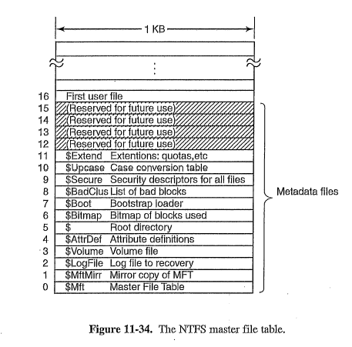
MFT metadata files
The first 16 records in the MFT describe the file system
The boot sector contains the MFT address
Operating Systems, Spring 2018, I. Dinur, D. Hendler and R. Iakobashvili

Slide 84
Storing file data
An MFT record contains a sequence of attributes
File data is one of these attributes
An attribute that is stored within record is called resident
If file is short – all data is within the (single) MFT record (an immediate file)
NTFS tries to allocate blocks contiguously
Blocks describes by sequence of records, each of which is a series of runs (If not a sparse file – just 1 record). A run is a contiguous sequence of blocks.
A run is represented by a pair: <first, len>
No upper bound on file size (except for volume size)
Operating Systems, Spring 2018, I. Dinur, D. Hendler and R. Iakobashvili

Slide 85
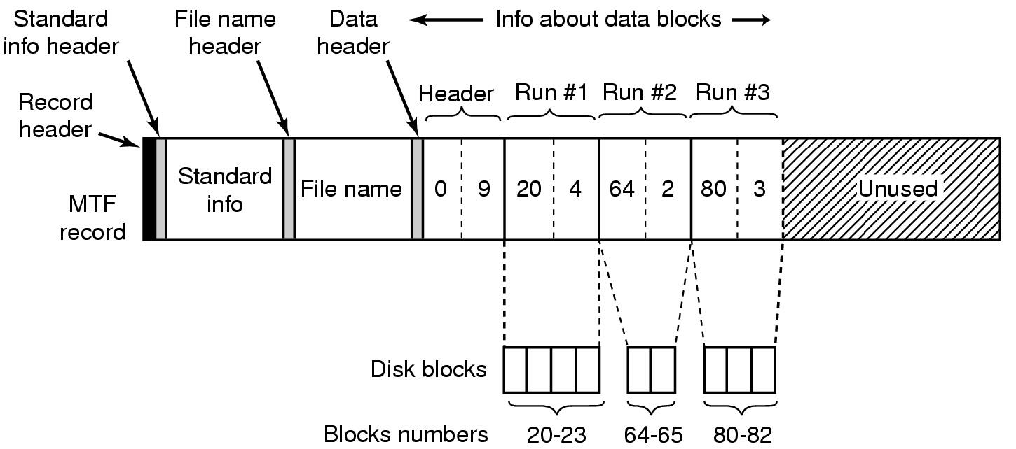
The MFT record of a non-immediate file
An MFT record for a three-run, nine-block file
Operating Systems, Spring 2018, I. Dinur, D. Hendler and R. Iakobashvili

Slide 86
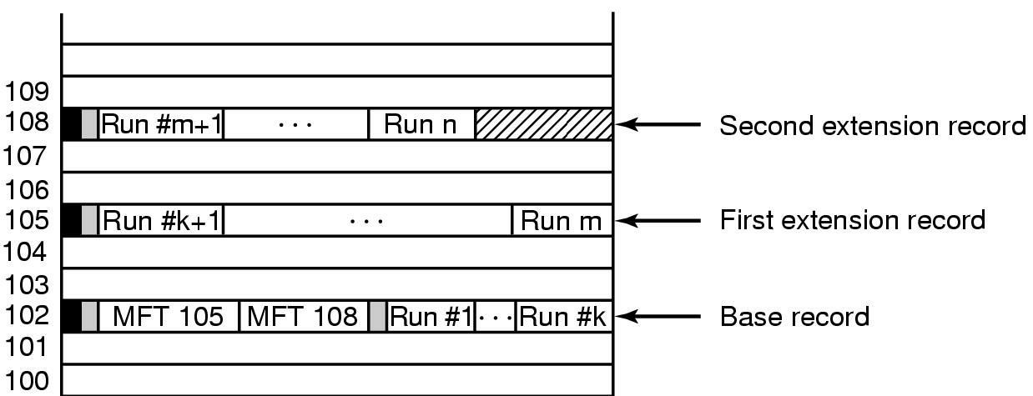
The MFT record of a long file
A file that requires three MFT records to store its runs
Can it be that a short file uses more
MFT records than a longer file?
Operating Systems, Spring 2018, I. Dinur, D. Hendler and R. Iakobashvili

Slide 87
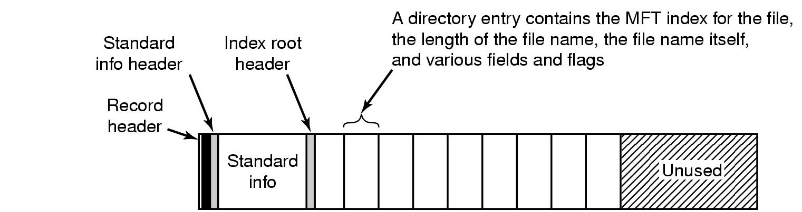
NTFS – Small directories
file
The MFT record for a small directory.
Operating Systems, Spring 2018, I. Dinur, D. Hendler and R. Iakobashvili

Slide 88
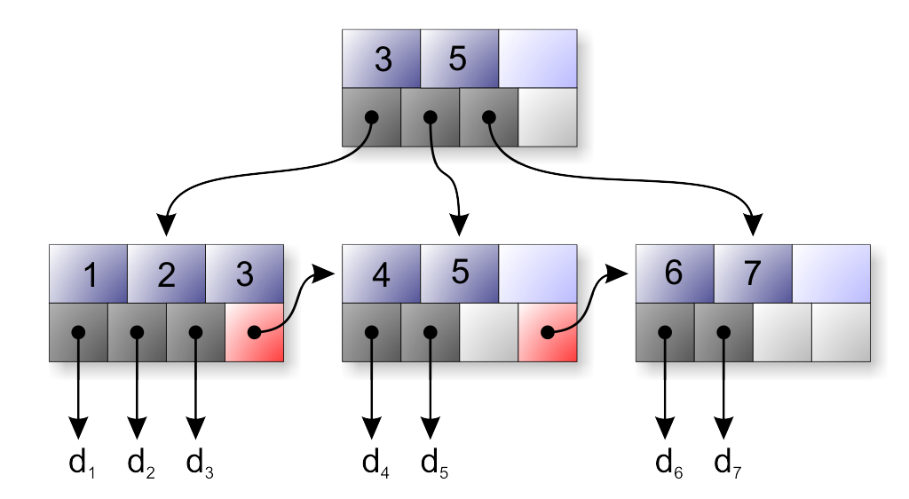
NTFS – Large directories
Large directories are organized as B+ trees
Operating Systems, Spring 2018, I. Dinur, D. Hendler and R. Iakobashvili

Slide 89
NTFS compression
Supports transparent file compression
Compresses (or not) in groups of 16 blocks
  If at least one block saved – writes compressed data, otherwise writes uncompressed data
Compression algorithm: a variant of LZ77
Can select to compress whole volume, specific directories or files
Operating Systems, Spring 2018, I. Dinur, D. Hendler and R. Iakobashvili

Slide 90
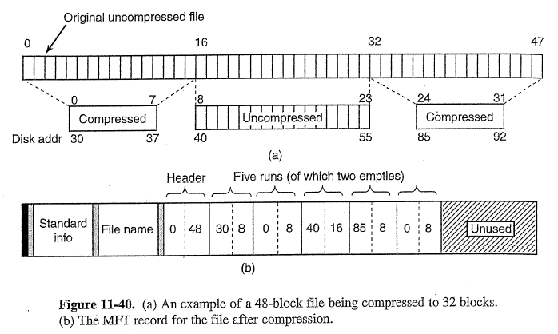
File compression in NTFS
Operating Systems, Spring 2018, I. Dinur, D. Hendler and R. Iakobashvili

Slide 91
File compression in NTFS
Is compression good or bad for performance?
Disk throughput is increased
CPU works much harder
Random access time slowed down as function of compression unit size
Operating Systems, Spring 2018, I. Dinur, D. Hendler and R. Iakobashvili

Slide 92
Windows MFTs vs Unix i-nodes
MFT 1K vs. i-node 64 bytes
MFT file anywhere (pointed by Boot) – i-nodes table immediately after superblock
MFT index similar to i-node number
Name of file in MFT – not in i-node
Data, sometimes in MFT – never in i-node
MFT - Allocation by runs – good for sequential access. Unix – allocation by tree of indexes – good for direct access, more space efficient.
Operating Systems, Spring 2018, I. Dinur, D. Hendler and R. Iakobashvili

Slide 93
File systems: outline
Concepts
File system implementation
  Disk space management
  Reliability
  Performance issues
NTFS
NFS
Operating Systems, Spring 2018, I. Dinur, D. Hendler and R. Iakobashvili

Slide 94
Distributed File Systems - DFS
A distributed system is a collection of interconnected machines that do not share memory or a clock.
a file naming scheme is needed. One possibility is a hostname:path, but this is not transparent
a simple solution to achieve location transparency is to use mount
remote file access can be “stateful” or “stateless”- stateful is more efficient (information kept in server’s kernel); stateless is more immune to server crashes
Operating Systems, Spring 2018, I. Dinur, D. Hendler and R. Iakobashvili

Slide 95
The Concept of Mount
Client 1
Client 2
/
/
/bin
/usr
/bin
/mnt
/usr/ast
/usr/ast/work
/bin
/projects
cat
cp
ls
mv
sh
a
b
c
d
e
Server 1
Server 2
Operating Systems, Spring 2018, I. Dinur, D. Hendler and R. Iakobashvili

Slide 96
Network File System (NFS)
Arbitrary collection of servers and clients - can be different machines and different OSs
Not necessarily on the same LAN
Any machine can be both client and server
Clients access directories by mounting - mounting is not transitive… (remote mounts are invisible)
Servers support directories,
listed in /etc/dfs/dfstab upon boot
File sharing: accessing a file in a directory mounted by the different (sharing) clients
Operating Systems, Spring 2018, I. Dinur, D. Hendler and R. Iakobashvili

Slide 97
NFC protocols - mount
Client asks to mount a directory providing a host-name - gets a file handle from server
File handle contains:
  File system type
  Disk ID
  i-node number
  Protection information
Automatic mounting by clients:
  /etc/vfstab shell script containing remote mount commands, run at boot time
  Automount - associates a set of remote directories with a local diretory and does mounting upon first file access, demand mounting, good when servers are down
Operating Systems, Spring 2018, I. Dinur, D. Hendler and R. Iakobashvili

Slide 98
NFS protocols - file operations
Directory and file access:
  No open or close calls – on server
  lookup provides a file handle
  reads and writes have all the needed information by using file handles - offsets are absolute
  Server does not keep (open files) tables
  Crash of (stateless) server will not cause loss of information for clients (i.e. location in open file)
  Does not provide full Unix semantics, e.g. files cannot be locked.
Operating Systems, Spring 2018, I. Dinur, D. Hendler and R. Iakobashvili

Slide 99
Remote Procedure Calls (RPC)
Activating code on a remote machine is accomplished by a send/receive protocol
A higher abstraction is to use remote procedure calls (RPCs), process on one machine calls a procedure on another machine - synchronous operation (blocking send)
problems - different address spaces; parameters and results have to be passed; machines can crash…
general scheme - a client stub and a server stub; server stub blocked on receive; client stub replaces the call and packs procedure call (dealing with by-reference parameters) and sends it to destination + blocks for returning message
Operating Systems, Spring 2018, I. Dinur, D. Hendler and R. Iakobashvili

Slide 100
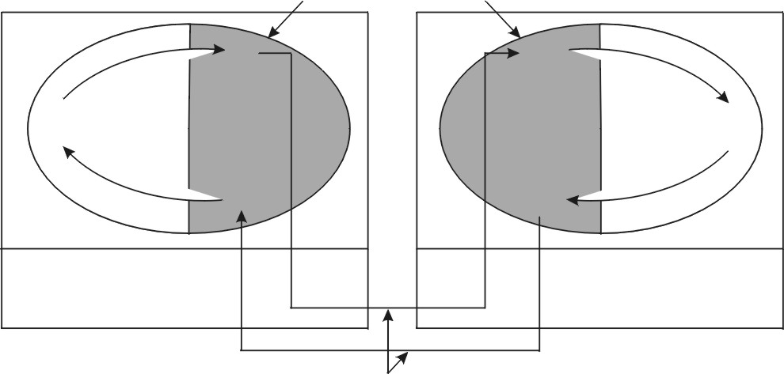
Implementing RPC
Client stub
Server stub
Client machine
Server machine
Pack parameters
Unpack parameters
Call
Call
Client
Server
Unpack result
Pack result
Return
Return
Kernel
Kernel
Message transport
over the network
Fig. 10-15. Calls and messages in an RPC. Each ellipse represents a single process, with the shaded portion being the stub.
Operating Systems, Spring 2018, I. Dinur, D. Hendler and R. Iakobashvili

Slide 101
NFS implementation
Client and server have a virtual file system layer (VFS), and an NFS module
VFS layer keeps v-nodes for open files, similar to the kernel’s i-node table in a Unix file system
at the kernel’s request (after mounting a remote directory) the NFS client code creates r-nodes (remote i-node) in its internal tables and stores the file handle
A v-node points to either:
  i-node (local file)
  r-node (remote file)
Operating Systems, Spring 2018, I. Dinur, D. Hendler and R. Iakobashvili

Slide 102
Layer structure of NFS
Client kernel
Server kernel
System call layer
v-nodes
Virtual file system layer
Virtual file system layer
i-nodes
Local FS1
Local FS2
NFS client
NFS server
Local FS1
Local FS2
r-nodes
Buffer cache
Buffer cache
Message to server
Message from client
Operating Systems, Spring 2018, I. Dinur, D. Hendler and R. Iakobashvili

Slide 103
Implementation of NFS - Interactions
when a remote file is opened, the kernel gets the r-node from the v-node of the remote directory
the NFS client looks up the path on the remote server and gets from it a file handle
the NFS client creates an r-node entry for the open file, stores the file handle in it and the VFS creates a v-node, pointing to the r-node
the calling process is given a file descriptor in return, pointing to the v-node
any subsequent calls that use this file descriptor will be traced by the VFS to the r-node and the suitable read/write operations will be performed
Operating Systems, Spring 2018, I. Dinur, D. Hendler and R. Iakobashvili

Slide 104
NFS: performance issues
Data sent in 8-KB chunks
Read-ahead
Write buffered until 8-KB chunk is full
  When file closed – contents sent to NFS server
client caching is important for efficiency
Client has separate blocks and i-nodes/attributes caches
if the policy is not write-through - problems with coherency and loss of data
  Cached block discarded: data block after 3 seconds, directory blocks after 30 seconds
  Every 30 seconds, all dirty cache blocks are written
  check with server whenever a cached file is opened - if stale then discarded from cache
Operating Systems, Spring 2018, I. Dinur, D. Hendler and R. Iakobashvili

Slide 105
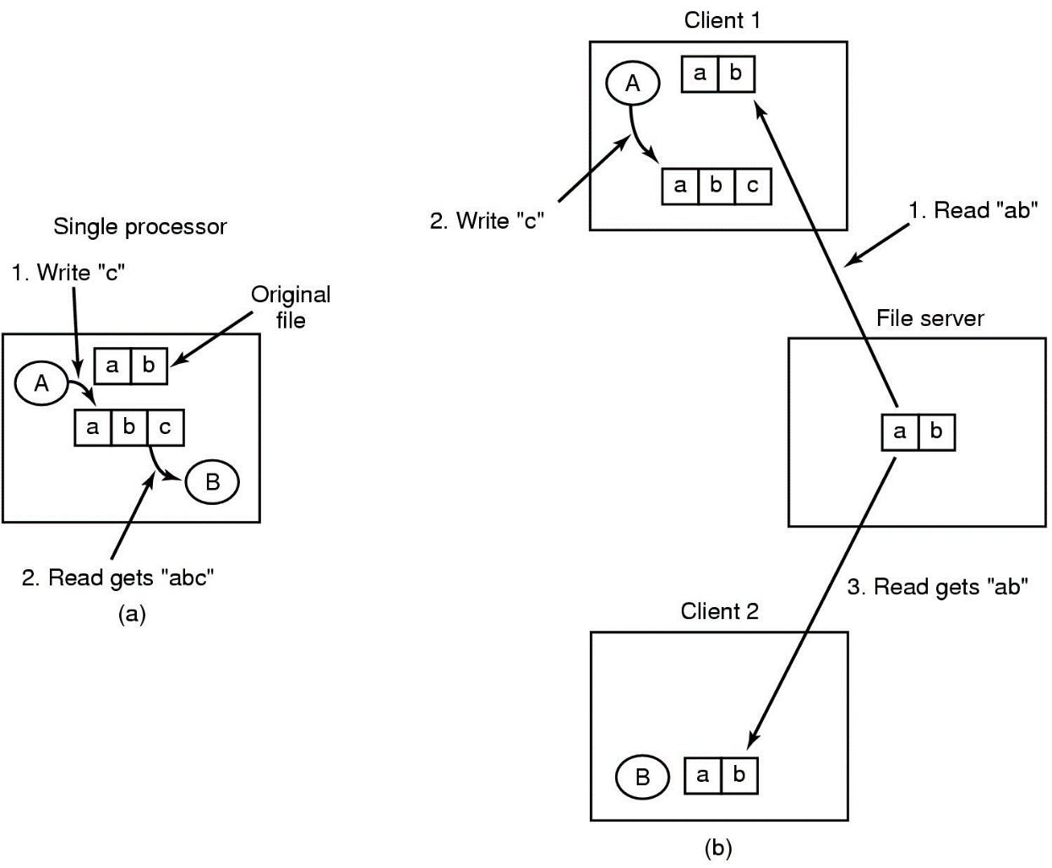
Distributed File System semantics
Semantics of File sharing
  (a) single processor gives sequential consistency
  (b) distributed system may return obsolete value
Operating Systems, Spring 2018, I. Dinur, D. Hendler and R. Iakobashvili

