Slide 1
Memory management, part 3: outline
Segmentation
Case studies
  MULTICS
  x86 (Pentium)
  Unix
  Linux
  Windows
Operating Systems, Spring 2018, I. Dinur, D. Hendler and R. Iakobashvili

Slide 2
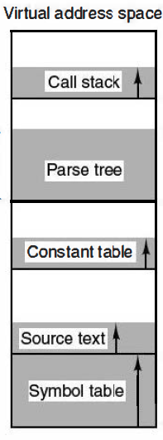
Segmentation
Several address spaces per process
a compiler needs segments for
  source text
  symbol table
  constants segment
  stack
  parse tree
  compiler executable code
Most of these segments grow during execution
Operating Systems, Spring 2018, I. Dinur, D. Hendler and R. Iakobashvili

Slide 3
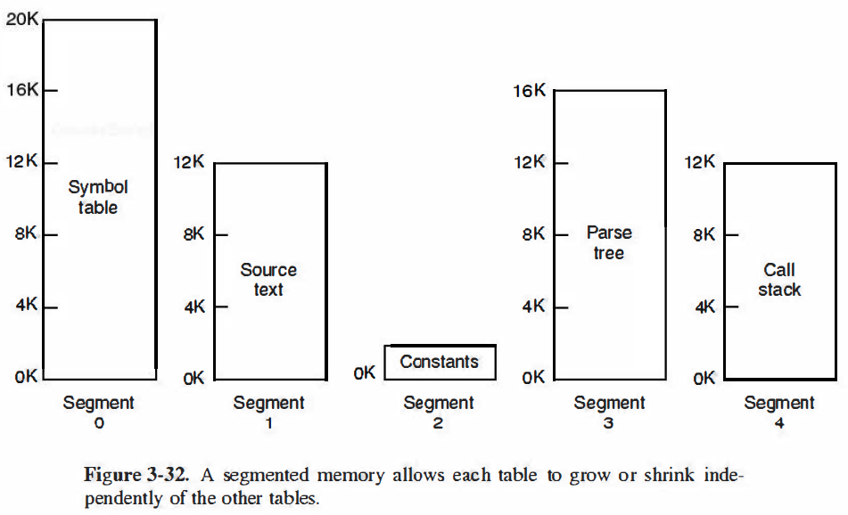
Users' view of segments
Operating Systems, Spring 2018, I. Dinur, D. Hendler and R. Iakobashvili

Slide 4
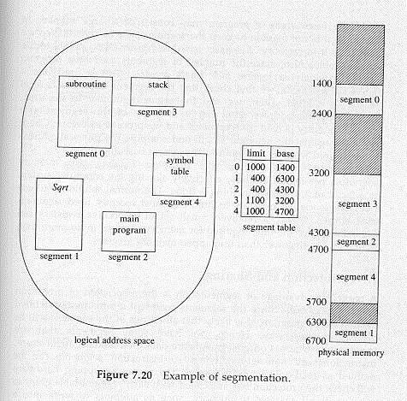
Segmentation - segment table
Operating Systems, Spring 2018, I. Dinur, D. Hendler and R. Iakobashvili

Slide 5
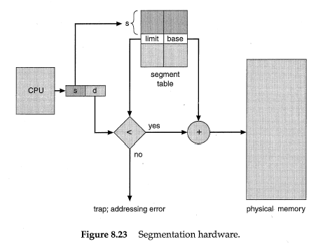
Segmentation Hardware
Operating Systems, Spring 2018, I. Dinur, D. Hendler and R. Iakobashvili

Slide 6
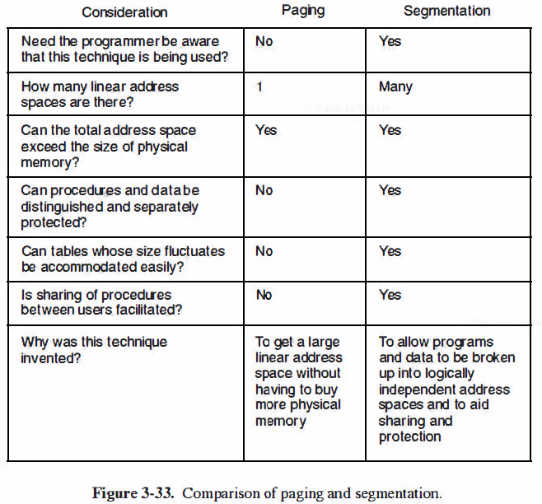
Segmentation vs. Paging
Operating Systems, Spring 2018, I. Dinur, D. Hendler and R. Iakobashvili

Slide 7
Segmentation pros and cons
Advantages:
  Growing and shrinking independently
  Sharing between processes simpler
  Linking is easier
  Protection easier
Disadvantages:
  Pure segmentation --> external Fragmentation revisited
  Segments may be very large. What if they don't fit into physical memory?
Operating Systems, Spring 2018, I. Dinur, D. Hendler and R. Iakobashvili

Slide 8
Segmentation Architecture
Logical address composed of the pair
<segment-number, offset>
Segment table – maps to linear address space; each table entry has:
  base – contains the starting linear address where the segment resides in memory.
  limit – specifies the length of the segment.
Segment-table base register (STBR) points to the segment table’s location in memory.
Segment-table length register (STLR) indicates number of segments used by a program;
segment number s is legal if s < STLR.
Operating Systems, Spring 2018, I. Dinur, D. Hendler and R. Iakobashvili

Slide 9
Segmentation Architecture (Cont.)
Protection: each segment table entry contains:
  validation bit = 0 ⇒ illegal segment
  read/write/execute privileges
Protection bits associated with segments; code sharing occurs at segment level.
Since segments vary in length, memory allocation is a dynamic storage-allocation problem (external fragmentation problem)
Operating Systems, Spring 2018, I. Dinur, D. Hendler and R. Iakobashvili

Slide 10

Sharing of segments
Operating Systems, Spring 2018, I. Dinur, D. Hendler and R. Iakobashvili

Slide 11
Segmentation with Paging
Segments may be too large
Cause external fragmentation
The two approaches may be combined:
  Segment table.
  Pages inside a segment.
  Solves fragmentation problems.
Many systems provide a combination of segmentation and paging
Operating Systems, Spring 2018, I. Dinur, D. Hendler and R. Iakobashvili

Slide 12
Memory management, part 3: outline
Segmentation
Case studies
  MULTICS
  x86 (Pentium)
  Unix
  Linux
  Windows
Operating Systems, Spring 2018, I. Dinur, D. Hendler and R. Iakobashvili

Slide 13

The MULTICS OS
Ran on Honeywell computers
Segmentation + paging
Up to 2¹⁸ segments
Segment length up to 2¹⁶ 36-bit
words
Each program has a segments table (itself a segment)
Each segment has a page table
Operating Systems, Spring 2018, I. Dinur, D. Hendler and R. Iakobashvili

Slide 14
MULTICS data-structures
36 bits
Page 2 entry
Page 2 entry
Page 1entry
Page 1entry
Segment 4 descriptor
18 bits
Page 0 entry
Page 0 entry
Segment 3 descriptor
Page table for segment 3
Page table for segment 1
Segment 2 descriptor
18 bits
Segment 1 descriptor
Segment 0 descriptor
Process descriptor segment
(Process segment table)
18 bits
9 bits
1
1
1
3
3
Main memory address of the page table
Segment length
(in pages)
Segment descriptor
misc
Page size:
0 – 1024 word
1 – 64 words
0 – paged
1 – not paged
Unused
Protection bits
Operating Systems, Spring 2018, I. Dinur, D. Hendler and R. Iakobashvili
Notes:
Address space is 24-bit. Only 18 bit pointers used since page tables aligned to 64-byte boundaries.

Slide 15
MULTICS memory reference procedure
1. Use segment number to find segment descriptor
Segment table is itself paged because it may be large.
The descriptor-base-register points to its page table.
2. Check if segment's page table is in memory
  if not a segment fault occurs
  if there is a protection violation TRAP (fault)
3. page table entry examined, a page fault may occur.
  if page is in memory the start-of-page address is extracted from page table entry
4. offset is added to the page origin to construct main memory address
5. perform read/store etc.
Operating Systems, Spring 2018, I. Dinur, D. Hendler and R. Iakobashvili

Slide 16

MULTICS Address Translation Scheme
Segment number (18 bits)
Page number (6 bits)
Page offset (10 bits)
Operating Systems, Spring 2018, I. Dinur, D. Hendler and R. Iakobashvili

Slide 17
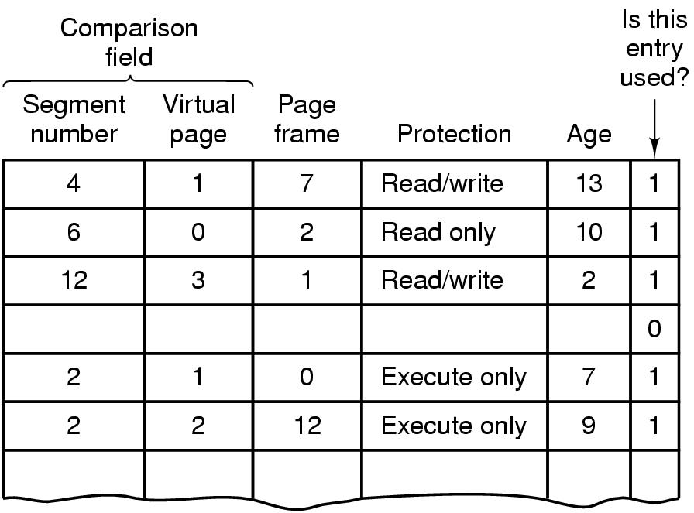
MULTICS TLB
Simplified version of the MULTICS TLB
Existence of 2 page sizes makes actual TLB more complicated
Operating Systems, Spring 2018, I. Dinur, D. Hendler and R. Iakobashvili

Slide 18
Multics - Additional checks during segment link (call)
Since segments are mapped to files, ACLs (access-control list) are checked with first access (open)
Protection rings are checked
A very advanced 1970's Architecture.
Operating Systems, Spring 2018, I. Dinur, D. Hendler and R. Iakobashvili

Slide 19
Memory management, part 3: outline
Segmentation
Case studies
  MULTICS
  x86 (Pentium)
  Unix
  Linux
  Windows
Operating Systems, Spring 2018, I. Dinur, D. Hendler and R. Iakobashvili

Slide 20
Pentium: Segmentation + paging
Segmentation with or without paging is possible
16K segments per process, segment size up to 4G 32-bit words
page size 4K
A single global GDT, each process has its own LDT
6 segment registers may store (16 bit) segment selectors: CS, DS, SS…
When the selector is loaded to a segment register, the corresponding descriptor is stored in microprogram registers
0 = GDT/ 1 = LDT
Privilege level (0-3)
13
1
2
Index
Pentium segment selector
Operating Systems, Spring 2018, I. Dinur, D. Hendler and R. Iakobashvili

Slide 21
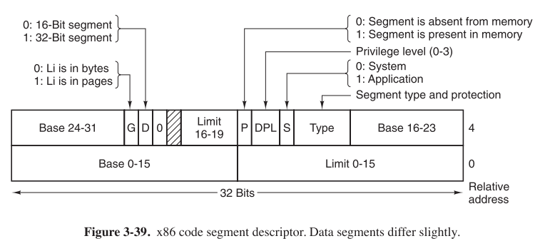
Pentium- segment descriptors
Operating Systems, Spring 2018, I. Dinur, D. Hendler and R. Iakobashvili

Slide 22
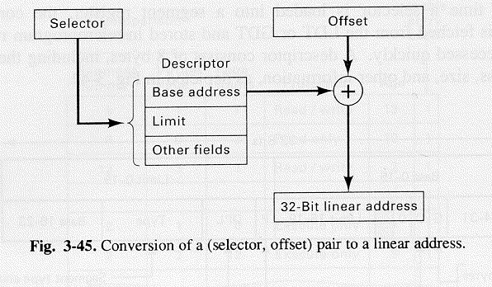
Pentium - Forming the linear address
Segment descriptor is in internal (microcode) register
If segment is not zero (TRAP) or paged out (TRAP)
  Offset size is checked against limit field of descriptor
  Base field of descriptor is added to offset (4k page-size)
Operating Systems, Spring 2018, I. Dinur, D. Hendler and R. Iakobashvili

Slide 23

Intel Pentium address translation
10
10
12
Can cover up to 4 MB
physical address space
Operating Systems, Spring 2018, I. Dinur, D. Hendler and R. Iakobashvili

Slide 24
Memory management, part 3: outline
Segmentation
Case studies
  MULTICS
  x86 (Pentium)
  Unix
  Linux
  Windows
Operating Systems, Spring 2018, I. Dinur, D. Hendler and R. Iakobashvili

Slide 25
UNIX process address space
Process A
Process B
Stack pointer
Stack pointer
20K
BSS
Init. Data
20K
BSS
Init. Data
8K
8K
Text
OS
Text
0
0
Physical memory
Operating Systems, Spring 2018, I. Dinur, D. Hendler and R. Iakobashvili

Slide 26
Memory-mapped file
Process A
Process B
Stack pointer
Stack pointer
Memory mapped file
Memory mapped file
20K
BSS
Data
20K
BSS
Data
8K
8K
Text
OS
Text
0
0
Physical memory
Operating Systems, Spring 2018, I. Dinur, D. Hendler and R. Iakobashvili

Slide 27
Unix memory management sys calls
Not specified by POSIX
Common Unix system calls
  s=brk(addr) – change data segment size. (addr sepcified the first address following new size)
  a=mmap(addr,len,prot,flags,fd,offset) – map (open) file fd starting from offset in length len to virtual address addr (0 if OS is to set address)
  s=unmap(addr,len) – unmap a file (or a portion of it)
Operating Systems, Spring 2018, I. Dinur, D. Hendler and R. Iakobashvili

Slide 28
Unix 4BSD memory organization
Main memory
Core map entry
Used when page frame is on free list
Index of next entry
Index of previous entry
Page frame 3
Disk block number
Page frame 2
Disk device number
Page frame 1
Block hash code
Page frame 0
Index into proc table
Text/data/stack
Core map entries, one per page frame
Offset within segment
Misc.
Kernel
Free
In transit
Wanted
Locked
Operating Systems, Spring 2018, I. Dinur, D. Hendler and R. Iakobashvili

Slide 29
Unix Page Daemon
It is assumed useful to keep a pool of free pages
freeing of page frames is done by a pagedaemon - a process that sleeps most of the time
awakened periodically to inspect the state of memory - if less than ¼ 'th of page frames are free, then it frees page frames
this strategy performs better than evicting pages when needed (and writing the modified to disk in a hurry)
The net result is the use of all of available memory as page-pool
Uses a global clock algorithm – two-handed clock
Operating Systems, Spring 2018, I. Dinur, D. Hendler and R. Iakobashvili

Slide 30
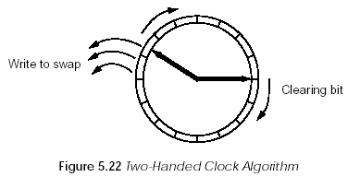
Page replacement - Unix
a two-handed clock algorithm clears the reference bit first with the first hand and frees pages with its second hand. It has the parameter of the “angle” between the hands - small angle leaves only “busy” pages
  If page is referenced before 2’nd hand comes, it will not be freed
Operating Systems, Spring 2018, I. Dinur, D. Hendler and R. Iakobashvili

Slide 31
Page replacement – Unix, cont'd
if there is thrashing, the swapper process removes processes to secondary storage
  Remove processes idle for 20 sec or more
  If none – swap out the oldest process out of the 4 largest
Who get swapped back is a function of:
  Time out of memory
  size
Operating Systems, Spring 2018, I. Dinur, D. Hendler and R. Iakobashvili

Slide 32
Memory management, part 3: outline
Segmentation
Case studies
  MULTICS
  x86 (Pentium)
  Unix
  Linux
  Windows
Operating Systems, Spring 2018, I. Dinur, D. Hendler and R. Iakobashvili

Slide 33
Linux processes
Each process gets 3GB virtual memory
Remaining 1GB for kernel and page tables
Virtual address space composed of areas with same protection, paging properties (pageable or not, direction of growth)
Each process has a linked list of areas, sorted by virtual address (text, data, memory-mapped-files,…)
Operating Systems, Spring 2018, I. Dinur, D. Hendler and R. Iakobashvili

Slide 34
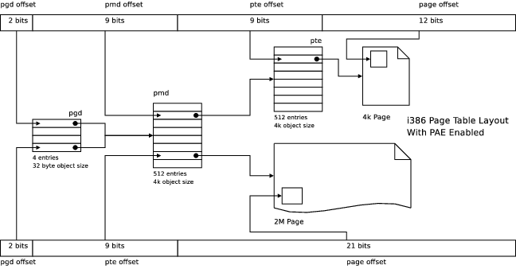
Linux page tables organization (32 bits)
32 bit architecture: Some pages 4K / Some pages 2M http://linux-mm.org/PageTableStructure
Operating Systems, Spring 2018, I. Dinur, D. Hendler and R. Iakobashvili

Slide 35
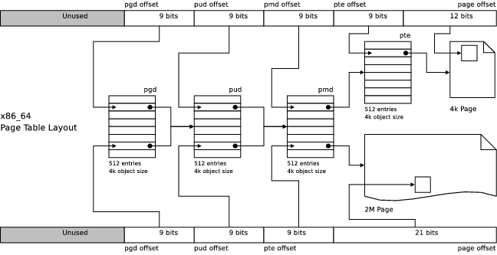
Linux page tables organization (64 bits)
64 bit architecture: Some pages 4K / Some pages 2M http://linux-mm.org/PageTableStructure
Operating Systems, Spring 2018, I. Dinur, D. Hendler and R. Iakobashvili

Slide 36
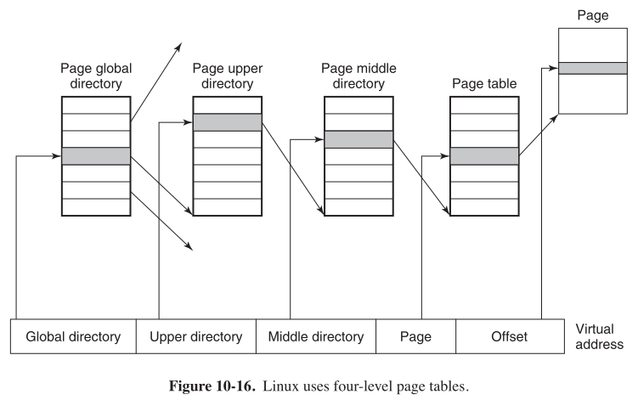
Linux page tables organization
Expanded to 4-level indirect paging in Linux 2.6.10. In Pentium, the two middle levels are degenerated.
Operating Systems, Spring 2018, I. Dinur, D. Hendler and R. Iakobashvili

Slide 37
Linux main memory management
Kernel never swapped
The rest: user pages, file system buffers, variable-size device drivers
The buddy algorithm is used. In addition:
  Linked lists of same-size free blocks are maintained
  To reduce internal fragmentation, a second memory allocation scheme (slab allocator) manages smaller units inside buddy-blocks
Demand paging (no pre-paging)
Dynamic backing store management
Operating Systems, Spring 2018, I. Dinur, D. Hendler and R. Iakobashvili

Slide 38
Linux page replacement algorithm
Variant of clock algorithm
Order of inspection of the page-freeing daemon is
  By size of process – from large to small
  In virtual address order (maybe unused ones are neighbors…)
Freed pages are categorized into clean; dirty; unbackedup
Another daemon writes up dirty pages periodically
Operating Systems, Spring 2018, I. Dinur, D. Hendler and R. Iakobashvili

Slide 39
Memory management, part 3: outline
Segmentation
Case studies
  MULTICS
  x86 (Pentium)
  Unix
  Linux
  Windows
Operating Systems, Spring 2018, I. Dinur, D. Hendler and R. Iakobashvili

Slide 40
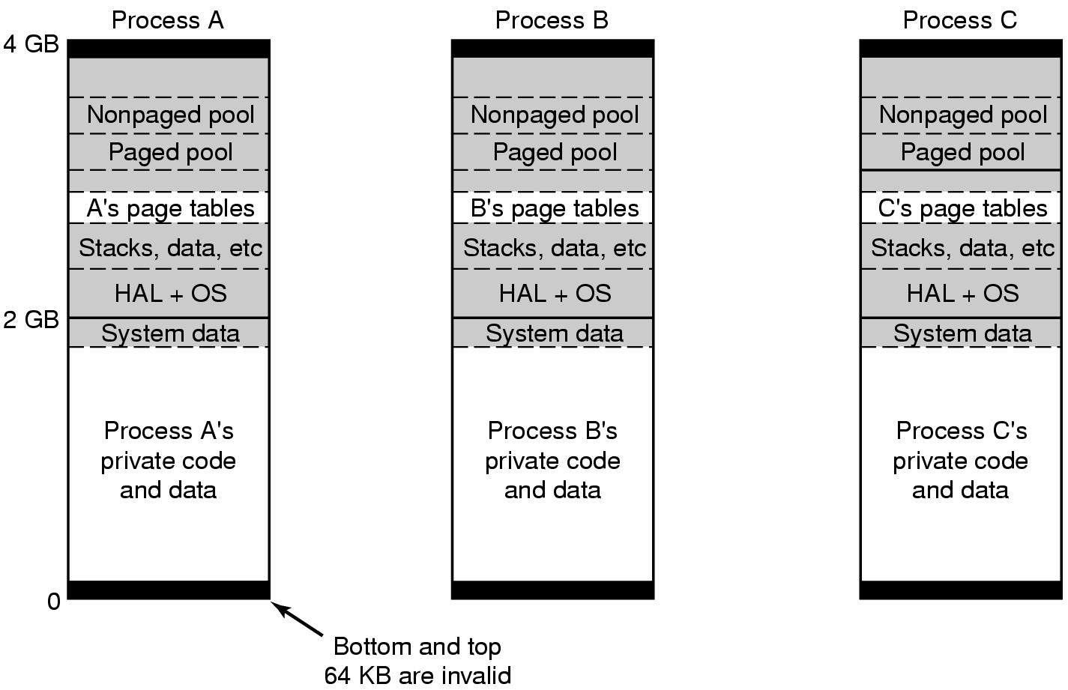
Win 8: virtual address space
Virtual address space layout for 3 user processes
White areas are private per process
Shaded areas are shared among all processes
What are the pros/cons of mapping kernel area into process address space?
Operating Systems, Spring 2018, I. Dinur, D. Hendler and R. Iakobashvili

Slide 41
Win 8: memory mngmt. concepts
Each virtual page can be in one of following states:
  Free/invalid – Currently not in use, a reference causes access violation
  Committed – code/data was mapped to virtual page
  Reserved – allocated to thread, not mapped yet. When a new thread starts, 1MB of process space is reserved to its stack
  Readable/writable/executable
Dynamic (just-in-time) backing store management
  Improves performance of writing modified data in chunks
  Up to 16 pagefiles
Supports memory-mapped files
Operating Systems, Spring 2018, I. Dinur, D. Hendler and R. Iakobashvili

Slide 42
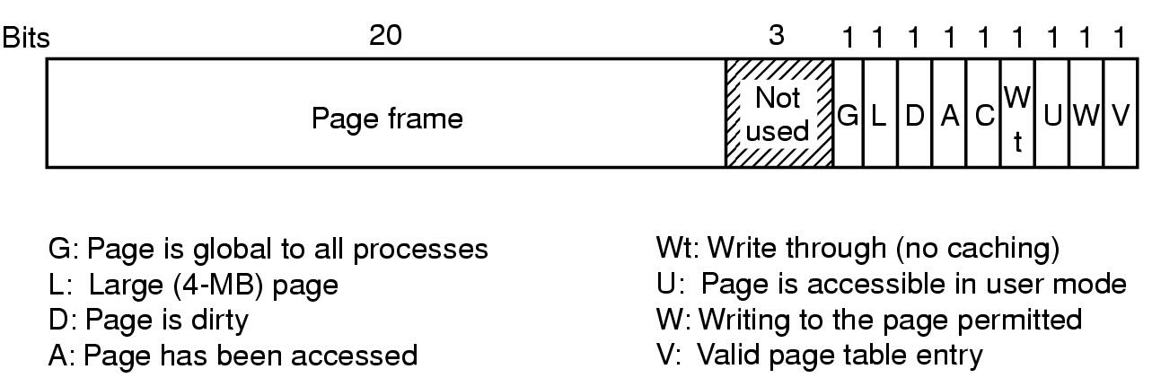
Implementation of Memory Management
A page table entry for a mapped page on the Pentium
Operating Systems, Spring 2018, I. Dinur, D. Hendler and R. Iakobashvili

Slide 43
Win 8: page replacement alg.
Processes have working sets defined by two parameters –
the minimal and maximal # of pages
the WS of processes is updated at the occurrence of each page fault (i.e. the data structure WS) -
  PF and WS < Min add to WS
  PF and WS > Max replace in WS
If a process thrashes, its working set size is increased
Memory is managed by keeping a number of free pages, which is a complex function of memory use, at all times
when the balance-set-manager is run (every second) and it needs to free pages -
  surplus pages (to the WS) are removed from a process (large background before small foreground…)
  Pages `age-counters’ are maintained
Operating Systems, Spring 2018, I. Dinur, D. Hendler and R. Iakobashvili

Slide 44
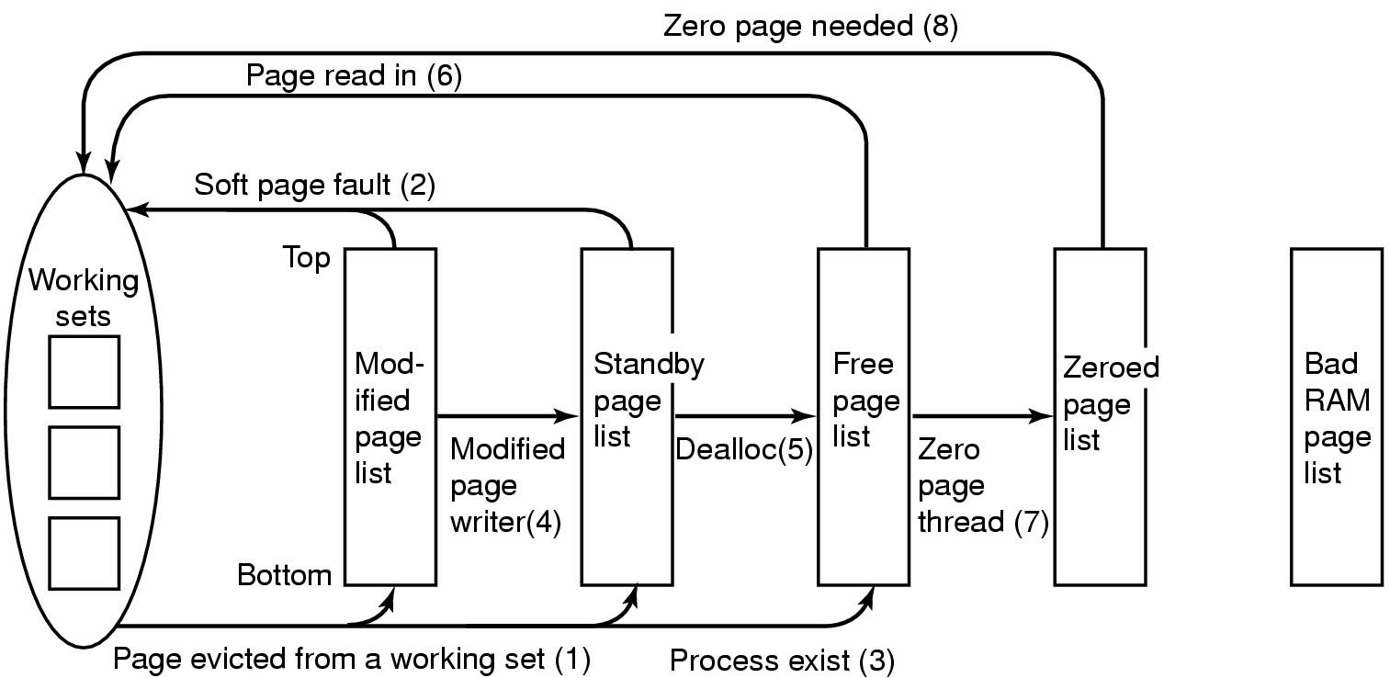
Physical Memory Management (1)
Various page lists and transitions between them
Operating Systems, Spring 2018, I. Dinur, D. Hendler and R. Iakobashvili

