Slide 1
Memory management: outline
Concepts
Swapping
Paging
  Multi-level paging
  TLB & inverted page tables
Operating Systems, Spring 2018, I. Dinur, D. Hendler and R. Iakobashvili

Slide 2
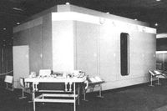
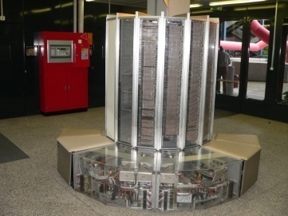
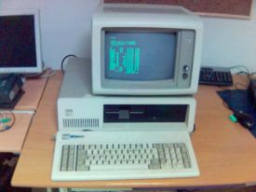
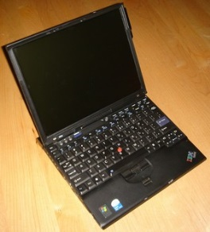
Memory size/requirements are growing…
1951: the UNIVAC computer:
1000 72-bit words!
1971: the Cray 1 supercomputer:
About 200K memory gates!
1983: the IBM XT: 640KB
“should be enough for everybody…”
2017: today's laptops: 4GB-8GB
Operating Systems, Spring 2018, I. Dinur, D. Hendler and R. Iakobashvili

Slide 3
Our requirements from memory
An indispensible resource
Variation on Parkinson's law: “Programs expand to fill the memory available to hold them”
Ideally programmers want memory that is
  fast
  non volatile
  large
  cheap
Operating Systems, Spring 2018, I. Dinur, D. Hendler and R. Iakobashvili

Slide 4
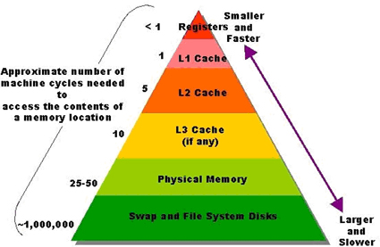
The Memory Hierarchy
Memory hierarchy
  Hardware registers: very small amount of very fast volatile memory
  Cache: small amount of fast, expensive, volatile memory
  Main memory: medium amount of medium-speed, medium price, volatile memory
  Disk: large amount of slow, cheap,
  non-volatile memory
The memory manager is the part of the OS that handles main memory and transfers between it and secondary storage (disk)
Operating Systems, Spring 2018, I. Dinur, D. Hendler and R. Iakobashvili

Slide 5
Mono-programming – no memory abstraction
Programs see physical memory
Mono-programming systems require a simple memory manager
  User types a command
  System loads program to main memory and executes it
  System displays prompt, waits for new command
ROM Device Drivers
User Program
Operating System in RAM
MS DOS memory organization
Operating Systems, Spring 2018, I. Dinur, D. Hendler and R. Iakobashvili

Slide 6
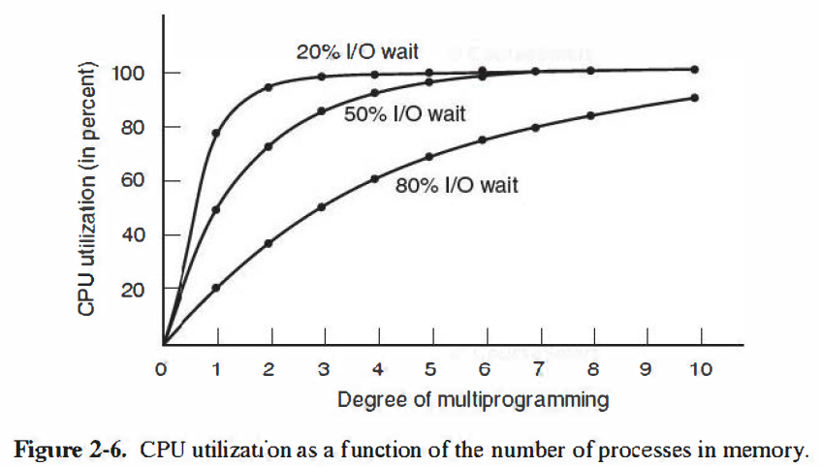
Multi-programming Motivation
n processes, each spending a fraction p of their time
waiting for I/O, gives a probability p^{n} of all processes
waiting for I/O simultaneously
CPU utilization = 1 - p^{n}
This calculation is simplistic
Operating Systems, Spring 2018, I. Dinur, D. Hendler and R. Iakobashvili

Slide 7
Memory/efficiency tradeoff
Assume each process takes 200k and so does the operating system
Assume there is 1Mb of memory available and that p=0.8
space for 4 processes ⇒ 60% cpu utilization
Another 1Mb enables 9 processes
⇒ 87% cpu utilization
Operating Systems, Spring 2018, I. Dinur, D. Hendler and R. Iakobashvili

Slide 8
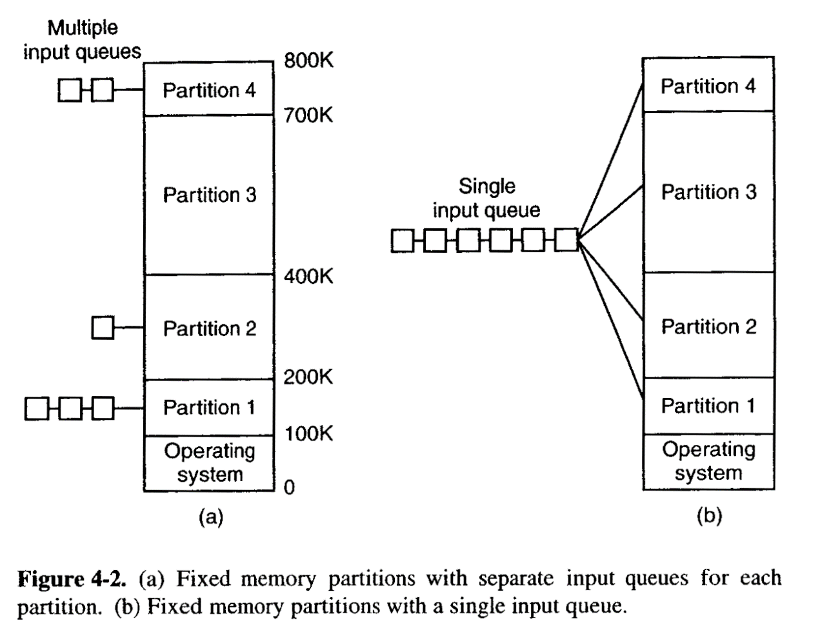
Multiprogramming with Fixed Partitions
(OS/360 MFT)
How to organize main memory?
How to assign processes to partitions?
Separate queues vs. single queue
Operating Systems, Spring 2018, I. Dinur, D. Hendler and R. Iakobashvili
Operating Systems, Spring 2017, Danny Hendler and Amnon Meisels
Notes:
MFT: Multi-programming with a fixed number of tasks
4.2a: put each job in queue for partition of minimum size that accommodates it. Problem: small jobs may wait even though there is plenty of free memory in large partitions.
Alternative: single queue. Whenever a partition becomes empty, the job closest to the front that fits in can be loaded, or some other strategy that avoids starvation

Slide 9
Memory management: outline
Concepts
Swapping
Paging
  Multi-level paging
  TLB & inverted page tables
Operating Systems, Spring 2018, I. Dinur, D. Hendler and R. Iakobashvili

Slide 10

Swapping: schematic view
Operating Systems, Spring 2018, I. Dinur, D. Hendler and R. Iakobashvili

Slide 11
Swapping
Bring a process in its entirety, run it, and then write back to backing store (if required)
Backing store – fast disk large enough to accommodate copies of all memory images for all processes; must provide direct access to these memory images.
Major part of swap time is transfer time; total transfer time is proportional to the amount of memory swapped. This time can be used to run another process
Creates holes in memory (fragmentation), memory compaction may be required
  No need to allocate swap space for memory-resident processes (e.g. Daemons)
Not used much anymore (but still interesting…)
Operating Systems, Spring 2018, I. Dinur, D. Hendler and R. Iakobashvili

Slide 12
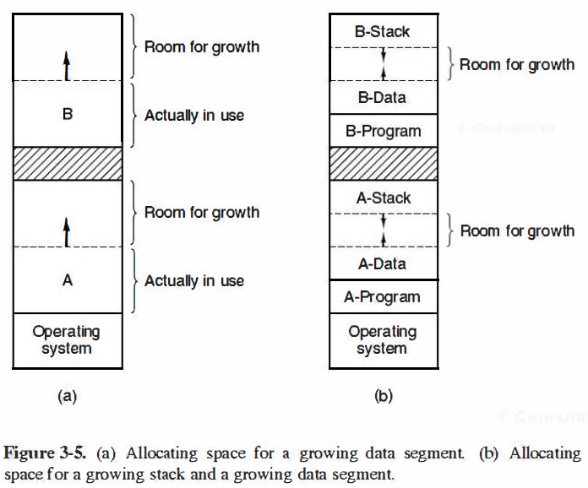
Allocating memory - growing segments
Operating Systems, Spring 2018, I. Dinur, D. Hendler and R. Iakobashvili

Slide 13
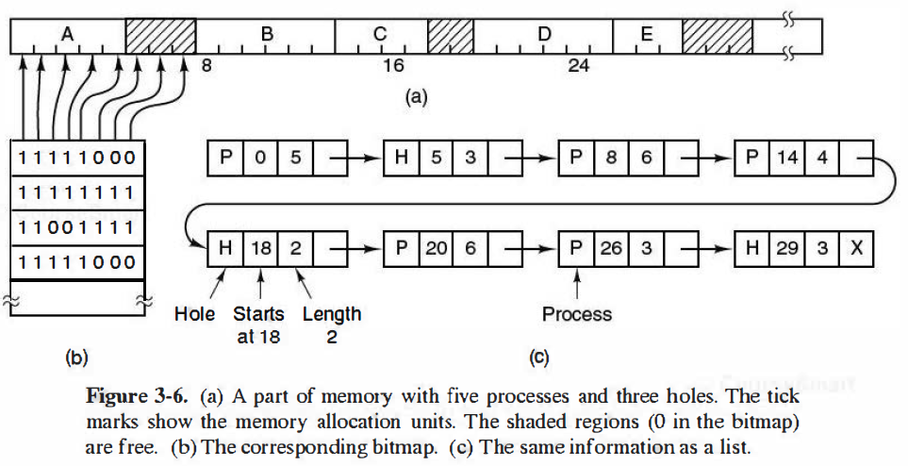
Memory Allocation - Keeping Track (bitmaps; linked lists)
Operating Systems, Spring 2018, I. Dinur, D. Hendler and R. Iakobashvili

Slide 14
Strategies for Memory Allocation
First fit – do not search too much..
Next fit - start search from last location
Best fit - a drawback: generates small holes
Worst fit - solves the above problem, badly
Quick fit - several queues of different sizes
Main problem of such memory allocation – Fragmentation
Operating Systems, Spring 2018, I. Dinur, D. Hendler and R. Iakobashvili

Slide 15
Swapping in Unix (prior to 3BSD)
When is swapping done?
  Kernel runs out of memory
  a fork system call – no space for child process
  a brk system call to expand a data segment
  a stack becomes too large
  A swapped-out process becomes ready
Who is swapped?
  a suspended process with “highest” priority (in)
  a process which consumed much CPU (out)
How much space is swapped? use holes and first-fit (more on this later)
Operating Systems, Spring 2018, I. Dinur, D. Hendler and R. Iakobashvili

Slide 16
Binding of Instructions and Data to Memory
Address binding of instructions and data to memory
addresses can happen at three different stages
Compile time: If memory location known a priori, absolute code can be generated; must recompile code if starting location changes (e.g., MS/DOS .com programs)
Load time: Must generate relocatable code if memory location is not known at compile time
Execution time: Binding delayed until run-time if the process can be moved during its execution from one memory segment to another. Need hardware support for address maps (e.g., base and limit registers or virtual memory support)
Which of these binding-types dictates that a process be swapped back from disk to same location?
Operating Systems, Spring 2018, I. Dinur, D. Hendler and R. Iakobashvili

Slide 17
Dynamic Linking
Linking postponed until execution time
A small piece of code, stub, is used to locate the appropriate memory-resident library routine
Stub replaces itself with the address of the routine, and calls the routine
Operating system makes sure the routine is mapped to processes' memory address
Dynamic linking is particularly useful for libraries (e.g., Windows DLLs)
DLLs save space in both main memory and disk
Operating Systems, Spring 2018, I. Dinur, D. Hendler and R. Iakobashvili

Slide 18
Fragmentation
External Fragmentation – total memory space exists to satisfy a request, but it is not contiguous
Internal Fragmentation – allocated memory may be larger than requested memory; this size difference is memory internal to a partition, but not being used
Reduce external fragmentation by compaction
  Shuffle memory contents to place all free memory together in one large block
  Compaction is possible only if relocation is dynamic, and is done at execution time
Operating Systems, Spring 2018, I. Dinur, D. Hendler and R. Iakobashvili

Slide 19
Memory Compaction
0
0
0
0
Operating system
Operating system
Operating system
Operating system
300k
300k
300k
300k
P₁
P₁
P₁
P₁
500k
500k
500k
500k
600k
P₂
600k
P₂
600k
P₂
600k
P₂
P₃
400K
800k
P₄
400K
1000k
1000k
900K
P₃
P₄
P₃
1200k
1200k
1200k
300K
1500k
1500k
P₄
900K
900K
P₄
1900k
1900k
200K
P₃
2100k
2100k
2100k
2100k
original allocation
moved 600K
moved 400K
moved 200K
Figure 8.11 Comparison of some different ways to compact memory
Operating Systems, Spring 2018, I. Dinur, D. Hendler and R. Iakobashvili
Notes:
handle

Slide 20
The Buddy Algorithm
An example scheme – the Buddy algorithm (Knuth 1973):
  Separate lists of free holes of sizes of powers of two
  For any request, pick the 1st large enough hole and halve it recursively
  Relatively little external fragmentation (as compared with other simple algorithms)
  Freed blocks can only be merged with neighbors of their own size. This is done recursively
Operating Systems, Spring 2018, I. Dinur, D. Hendler and R. Iakobashvili

Slide 21
The Buddy Algorithm
Memory
0 128k 256k 384k 512k 640k 768k 896k 1 M Holes
Initially
Request 70
Request 35
Request 80
Return A
Request 60
Return B
Return D
Return C
1
A
128
256
512
3
A
B
64
256
512
3
A
B
64
C
128
512
3
128
B
64
C
128
512
4
128
B
D
C
128
512
4
128
64
D
C
128
512
4
256
C
128
512
3
1024
1
Fig. 3-9. The buddy algorithm. The horizontal axis represents memory addresses. The numbers are the sizes of unallocated blocks of memory in K. The letters represent allocated blocks of memory.
Operating Systems, Spring 2018, I. Dinur, D. Hendler and R. Iakobashvili

Slide 22
Logical vs. Physical Address Space
The concept of a logical address space that is bound to a separate physical address space is central to modern memory management
  Logical address – generated by the CPU; also referred to as virtual address
  Physical address – address seen by the memory unit
Logical and physical addresses are the same in compile-time and load-time address-binding schemes; logical (virtual) and physical addresses differ in execution-time address-binding schemes
Operating Systems, Spring 2018, I. Dinur, D. Hendler and R. Iakobashvili
Notes:
Handle: what does the last item mean?

Slide 23
Memory management: outline
Concepts
Swapping
Paging
  Multi-level paging
  TLB & inverted page tables
Operating Systems, Spring 2018, I. Dinur, D. Hendler and R. Iakobashvili

Slide 24
Paging and Virtual Memory
Support an address space that is independent of physical memory
Not all program must be in memory: program size may be larger than physical memory
2³² addresses for a 32 bit (address bus) machine - virtual addresses
can be achieved by segmenting the executable (using segment registers), or by dividing memory using another method
Paging - Divide physical memory into fixed-size blocks (page-frames)
Allocate to processes non-contiguous memory chunks – disregarding holes
Operating Systems, Spring 2018, I. Dinur, D. Hendler and R. Iakobashvili
Notes:
Handle – last item not clear

Slide 25
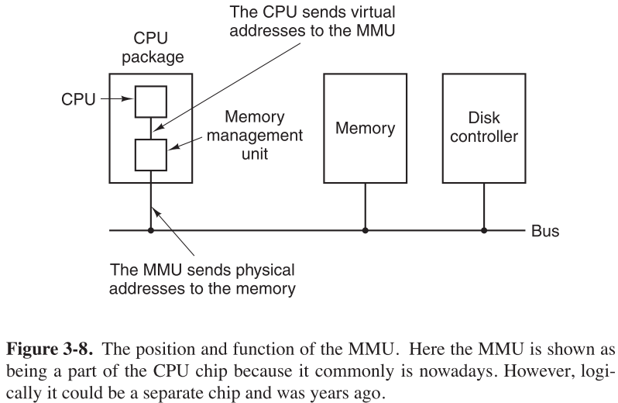
Memory Management Unit
Operating Systems, Spring 2018, I. Dinur, D. Hendler and R. Iakobashvili

Slide 26
Memory-Management Unit (MMU)
Hardware device that maps virtual to physical addresses (among other things). Typically part of CPU
The MMU translates the virtual address generated by a user process before it is sent to memory
The user program deals with logical addresses; it never sees the real physical addresses
mov A, 1000 # virtual (logical) address
is sent to the MMU – which maps this to:
mov A, 9192 # physical (real) address
Operating Systems, Spring 2018, I. Dinur, D. Hendler and R. Iakobashvili

Slide 27
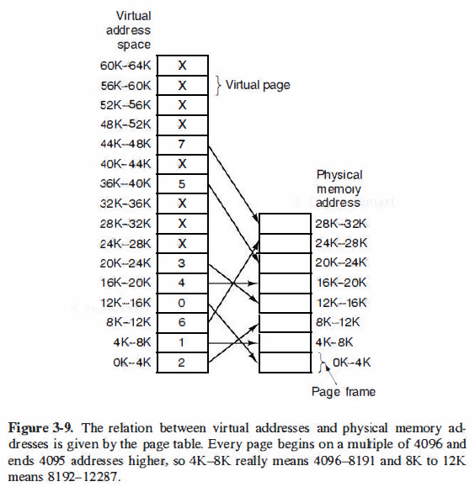
Paging
Page table
64K: virtual space
32K: physical space
Operating Systems, Spring 2018, I. Dinur, D. Hendler and R. Iakobashvili

Slide 28
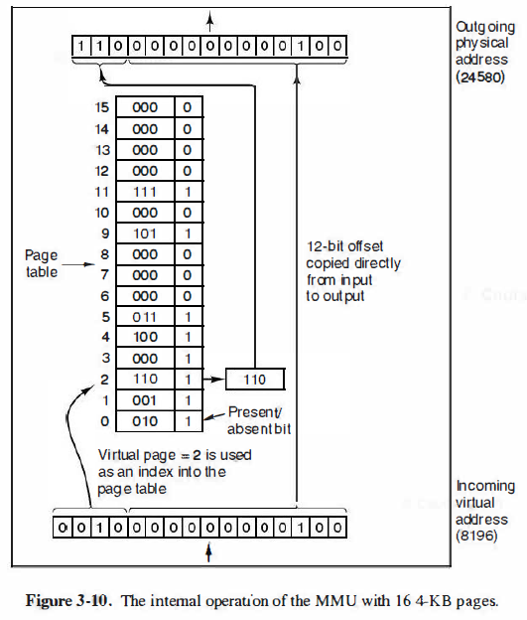
Operation of the MMU
Operating Systems, Spring 2018, I. Dinur, D. Hendler and R. Iakobashvili

Slide 29
Page Faults: Pages In/Out
When MMU tries to access a page which is not currently loaded in RAM – a hardware trap is raised: PAGE FAULT.
This allows the kernel to handle the swapping of one currently loaded page with the requested page.
The kernel maintains copies of the pages on disk. Up to full process virtual memory for each process in swap disk.
Issues:
  Select page to be evicted (Eviction strategy)
  Should evicted page be written to disk to save modifications?
Operating Systems, Spring 2018, I. Dinur, D. Hendler and R. Iakobashvili

Slide 30
Pages: blocks of virtual addresses
Page frames: refer to physical memory blocks
Page Table Entries (PTE) contain (per page):
Page frame number (physical address)
Present/absent (valid) bit
Dirty (modified) bit
Referenced (accessed) bit
Protection
Caching disable/enable
page frame number
Operating Systems, Spring 2018, I. Dinur, D. Hendler and R. Iakobashvili
Notes:
Protection: e.g., read/write/execute
Dirty bit required for knowing whether to write back to disk upon evicition
Referenced bit required for help selecting which page to evict
Caching disabled, when the page is mapped to device memory
Valid bit – is page part of process address space

Slide 31
Page size vs. Page-table size Tradeoffs
A logical address of 32-bits (4GB) can be divided into:
  1K pages and 4M entries table
  4K pages and 1M entries table
Large pages – a smaller number of pages, but higher internal fragmentation
Smaller pages – larger tables (also waste of space)
Large tables, and we need ONE PER PROCESS!
Operating Systems, Spring 2018, I. Dinur, D. Hendler and R. Iakobashvili
Notes:
Handle – calculation not clear here – what’s the 8 stuff?

Slide 32
Page table considerations
Can be very large (1M pages for 32 bits, 4K page size)
Must be fast (every instruction needs it)
One extreme will have it all in hardware - fast registers that hold the page table and are loaded with each process - too expensive for the above size
The other extreme has it all in main memory (using a page table base register – ptbr - to point to it) - each memory reference during instruction translation is doubled...
Possible solution: to avoid keeping complete page tables in memory - make them multilevel, and avoid making multiple memory references per instruction by caching
We do paging on the page-table itself!
Operating Systems, Spring 2018, I. Dinur, D. Hendler and R. Iakobashvili

Slide 33

Two-Level Page-Table Scheme
Operating Systems, Spring 2018, I. Dinur, D. Hendler and R. Iakobashvili
Notes:
- There are 1024 page tables
Each page table has 1024 entries corresponding to 4M, thus a total of 4G.
A memory access may cause 2 page faults: one if the page table is absent, another if the page itself is absent.

Slide 34
Two-Level Paging Example
A logical address (on 32-bit machine with 4K page size) is divided into:
  a page number consisting of 20 bits.
  a page offset consisting of 12 bits.
Since the page table itself is paged, the page number is further divided into:
  a 10-bit p1 index.
  a 10-bit p2 index.
Thus, a logical address has the following structure:
Where p₁ is an index into the top-level (outer) page table, and p₂ is an index into the selected second-level page table
page number
page offset
p₁
p₂
d
10
10
12
Operating Systems, Spring 2018, I. Dinur, D. Hendler and R. Iakobashvili

Slide 35
Two-Level Paging: Motivation
Two-level paging helps because most of the time a process does not need ALL of its virtual memory space.
Example: A process in a 32bit machine uses
  4MB of stack
  4MB of code segment
  4MB of heap
Only 12MB effectively used out of 4GB – only 3 page tables needed (out of 1024)
Operating Systems, Spring 2018, I. Dinur, D. Hendler and R. Iakobashvili

Slide 36
Two-Level Paging Example (cont’d)
1023
Top-level
page table
5
4
1023
3
page
offset
2
4095
page number
0
p₁
p₂
d
4
5
10
10
12
3
4
2
3
1
2
0
0
1023
5
4
3
2
0
Operating Systems, Spring 2018, I. Dinur, D. Hendler and R. Iakobashvili

Slide 37
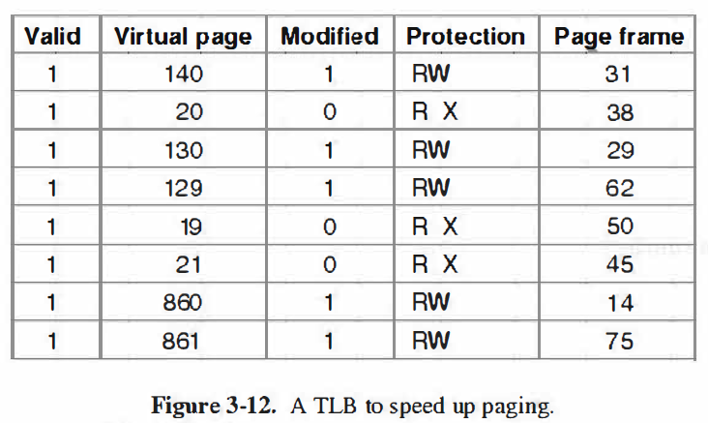
Translation Lookaside Buffer (TLB):
Associative memory for minimizing redundant memory accesses
TLB resides in MMU
Most accesses are to a small set of pages ➔ high hit rate
Locality of reference
Operating Systems, Spring 2018, I. Dinur, D. Hendler and R. Iakobashvili
Notes:
Valid indicates if the page is in use
When a page is evicted from the TLB, the modified bit is copied to the corresponding entry in memory.

Slide 38
Notes about TLB
TLB is an associative memory
Typically, inside the MMU
With a large enough hit-ratio, the extra accesses to page tables are rare
Only a complete virtual address (all levels) can be counted as a hit
with multi-processing, TLB must be cleared on context switch - wasteful..
  Possible solution: add a field to the associative memory to hold process ID and change in context switch.
TLB management may be done by hardware or OS
Operating Systems, Spring 2018, I. Dinur, D. Hendler and R. Iakobashvili

Slide 39
Inverted page tables
Regular page tables impractical for 64-bit address space
4K page size / 2⁵² pages x 8 bytes → 30M GB page tables!
Inverted page table – sorted by (physical) page frames and not by virtual pages
1 GB of RAM & 4K page size / 256K entries → 2 MB table
A single inverted page table used for all processes currently in memory
Each entry stores which process/virtual-page maps to it
A hash table is used to avoid linear search for every virtual page
In addition to the hash table, TLB registers are used to store recently used page table entries
Operating Systems, Spring 2018, I. Dinur, D. Hendler and R. Iakobashvili
Notes:
IBM RT, HP spectrum

Slide 40

Inverted Page Table Architecture
Table Search must
take pid into account
Operating Systems, Spring 2018, I. Dinur, D. Hendler and R. Iakobashvili

Slide 41
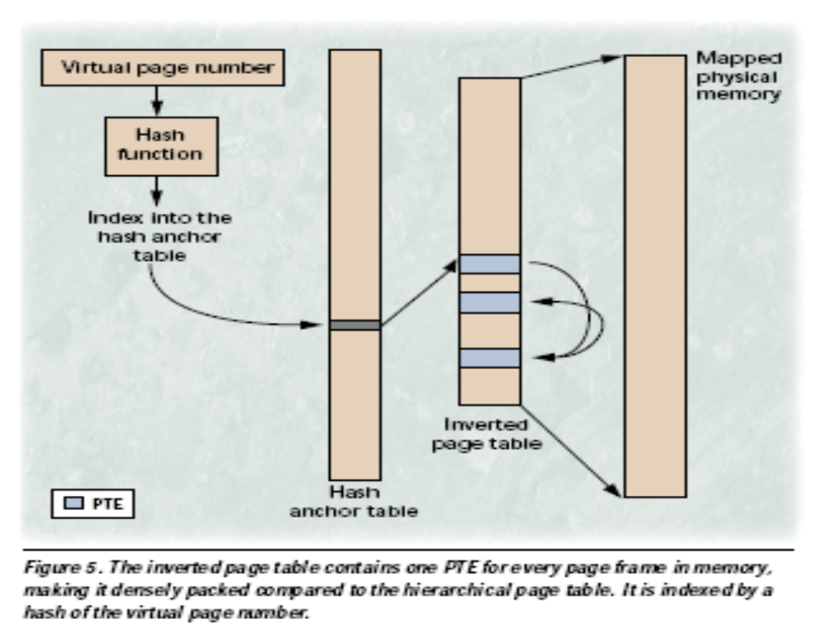
Inverted Table with Hashing
Virtual page number
Mapped physical memory
Hash
function
Index into the
hash anchor table
Inverted
page table
Hash
anchor table
The inverted page table contains one PTE for every page frame in memory, making it densely packed compared to the hierarchical page table. It is indexed by a hash of the virtual page number.
Operating Systems, Spring 2018, I. Dinur, D. Hendler and R. Iakobashvili

Slide 42
Inverted Table with Hashing
The hash function points into the anchor hash table.
Each entry in the anchor table is the first link in a list of pointers to the inverted table.
Each list ends with a Nil pointer.
On every memory call the page is looked up in the relevant list.
TLB still used to prevent search in most cases
Operating Systems, Spring 2018, I. Dinur, D. Hendler and R. Iakobashvili
Notes:
Handle – see description in other book.

Slide 43

Shared Pages
Operating Systems, Spring 2018, I. Dinur, D. Hendler and R. Iakobashvili

