Slide 1
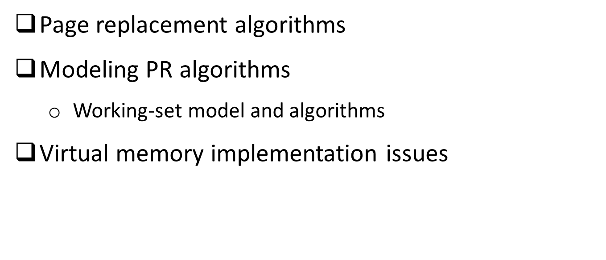
Memory management, part 2: outline
Operating Systems, Spring 2018, I. Dinur, D. Hendler and R. Iakobashvili

Slide 2
Page Replacement Algorithms
Page fault forces choice
  which page must be removed to make room for incoming page?
Modified page must first be saved
  unmodified just overwritten
Better not to choose an often used page
  will probably need to be brought back in soon
Operating Systems, Spring 2018, I. Dinur, D. Hendler and R. Iakobashvili

Slide 3
Optimal page replacement algorithm
Remove the page that will be referenced latest (or not at all)
in the future
Unrealistic: assumes we know future sequence of page references
Example
7
Assume that, starting from this configuration, the sequence of (virtual) page references is: 0, 5, 4, 7, 0, 2, 1, 0, 7
5
1
3 page
frames
First page to remove is last to be used…
Operating Systems, Spring 2018, I. Dinur, D. Hendler and R. Iakobashvili

Slide 4
Optimal page replacement algorithm
Remove the page that will be referenced latest
Unrealistic: assumes we know future sequence of page references
Example
7
Assume that, starting from this configuration, the sequence of references is: 0, 5, 4, 7, 0, 2, 1, 0, 7
5
0
3 page
frames
First page to remove is last to be used…
Operating Systems, Spring 2018, I. Dinur, D. Hendler and R. Iakobashvili

Slide 5
Optimal page replacement algorithm
Remove the page that will be referenced latest
Unrealistic: assumes we know future sequence of page references
Example
7
Assume that, starting from this configuration, the sequence of references is: 0, 5, 4, 7, 0, 2, 1, 0, 7
4
0
3 page
frames
First page to remove is last to be used…
Operating Systems, Spring 2018, I. Dinur, D. Hendler and R. Iakobashvili

Slide 6
Optimal page replacement algorithm
Remove the page that will be referenced latest
Unrealistic: assumes we know future sequence of page references
Example
7
Assume that, starting from this configuration, the sequence of references is: 0, 5, 4, 7, 0, 2, 1, 0, 7
2
0
3 page
frames
First page to remove is last to be used…
Operating Systems, Spring 2018, I. Dinur, D. Hendler and R. Iakobashvili

Slide 7
Optimal page replacement algorithm
Remove the page that will be referenced latest
Unrealistic: assumes we know future sequence of page references
Example
7
Assume that, starting from this configuration, the sequence of references is: 0, 5, 4, 7, 0, 2, 1, 0, 7
1
0
3 page
frames
Altogether 4 page replacements. What if we used FIFO?
Operating Systems, Spring 2018, I. Dinur, D. Hendler and R. Iakobashvili

Slide 8
Optimal vs. FIFO
Example
7
Assume that, starting from this configuration (7,5,1), the sequence of references is: 0, 5, 4, 7, 0, 2, 1, 0, 7
5
1
3 page
frames
First in first out…
Operating Systems, Spring 2018, I. Dinur, D. Hendler and R. Iakobashvili

Slide 9
Optimal vs. FIFO
Example
0
Assume that, starting from this configuration (7,5,1), the sequence of references is: 0, 5, 4, 7, 0, 2, 1, 0, 7
5
1
3 page
frames
First in first out…
Operating Systems, Spring 2018, I. Dinur, D. Hendler and R. Iakobashvili

Slide 10
Optimal vs. FIFO
Example
0
Assume that, starting from this configuration (7,5,1), the sequence of references is: 0, 5, 4, 7, 0, 2, 1, 0, 7
4
1
3 page
frames
First in first out…
Operating Systems, Spring 2018, I. Dinur, D. Hendler and R. Iakobashvili

Slide 11
Optimal vs. FIFO
Example
0
Assume that, starting from this configuration (7,5,1), the sequence of references is: 0, 5, 4, 7, 0, 2, 1, 0, 7
4
7
3 page
frames
First in first out…
Operating Systems, Spring 2018, I. Dinur, D. Hendler and R. Iakobashvili

Slide 12
Optimal vs. FIFO
Example
2
Assume that, starting from this configuration (7,5,1), the sequence of references is: 0, 5, 4, 7, 0, 2, 1, 0, 7
4
7
3 page
frames
First in first out…
Operating Systems, Spring 2018, I. Dinur, D. Hendler and R. Iakobashvili

Slide 13
Optimal vs. FIFO
Example
2
Assume that, starting from this configuration (7,5,1), the sequence of references is: 0, 5, 4, 7, 0, 2, 1, 0, 7
1
7
3 page
frames
First in first out…
Operating Systems, Spring 2018, I. Dinur, D. Hendler and R. Iakobashvili

Slide 14
Optimal vs. FIFO
Example
2
Assume that, starting from this configuration (7,5,1), the sequence of references is: 0, 5, 4, 7, 0, 2, 1, 0, 7
1
0
3 page
frames
First in first out…
Operating Systems, Spring 2018, I. Dinur, D. Hendler and R. Iakobashvili

Slide 15
Optimal vs. FIFO
Example
7
Assume that, starting from this configuration (7,5,1), the sequence of references is: 0, 5, 4, 7, 0, 2, 1, 0, 7
1
0
3 page
frames
FIFO does 7 replacements, 3 more than optimal.
Operating Systems, Spring 2018, I. Dinur, D. Hendler and R. Iakobashvili

Slide 16
Page replacement: NRU - Not Recently Used
Referenced (R) and Modified (M) bits set by hardware, reset by software
There are 4 classes of pages, according to the value-pairs of the referenced and modified bits
Select a page at random from the least-needed class
Easy scheme to implement
 | Referenced=false | Referenced=true
Modified=false | A | C
Modified=true | B | D
Operating Systems, Spring 2018, I. Dinur, D. Hendler and R. Iakobashvili

Slide 17
2'nd chance FIFO replacement algorithm
May be implemented by using a queue
FIFO: “oldest” page may be most referenced page
An improvement: “second chance” FIFO
  Inspect pages from oldest to newest
  If page's referenced bit is on, give it a second chance:
    Clear bit
    Move to end of queue
  Else
    Remove page
“Second chance” FIFO can be implemented more efficiently as a circular queue: the “clock algorithm”
Operating Systems, Spring 2018, I. Dinur, D. Hendler and R. Iakobashvili

Slide 18
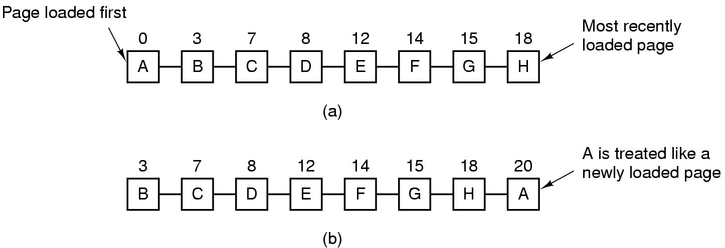
Second Chance Page Replacement Algorithm
Operation of second chance FIFO
  pages sorted in FIFO order
  Page list if fault occurs at time 20, A has R bit set
  (numbers above pages are times of insertion to list)
  When A moves forward its R bit is cleared, timestamp updated
Operating Systems, Spring 2018, I. Dinur, D. Hendler and R. Iakobashvili
Notes:
Assume no R bit is set, how would second chance behave?
Assume ALL R bits are set, how would second chance behave?

Slide 19
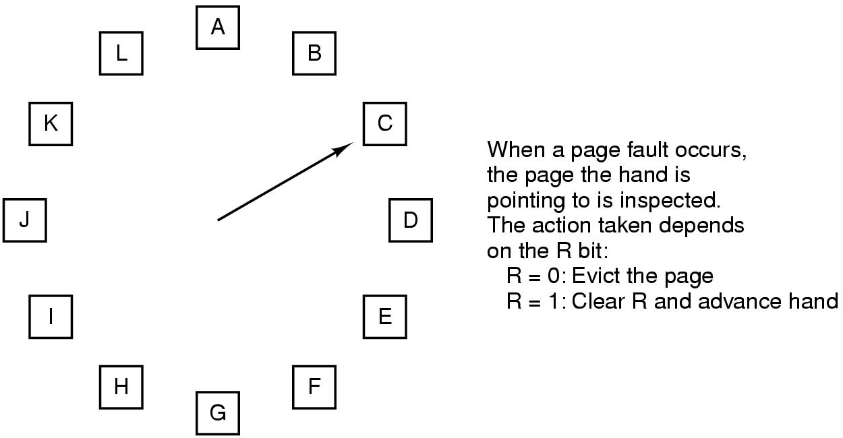
The Clock Page Replacement Algorithm
Operating Systems, Spring 2018, I. Dinur, D. Hendler and R. Iakobashvili

Slide 20
LRU - Least Recently Used
Most recently used pages have high probability of being referenced again (temporal locality of reference)
Replace page used least recently
Not easy to implement – total order must be maintained
Possible hardware solutions
  Use a large HW-manipulated counter, store counter value in page entry on each reference, select page with smallest value.
  Use an nXn bit array (see next slide)
    When page-frame k is referenced, set all bits of row k to 1 and all bits of column k to 0.
    The row with lowest binary value is least recently used
Operating Systems, Spring 2018, I. Dinur, D. Hendler and R. Iakobashvili

Slide 21
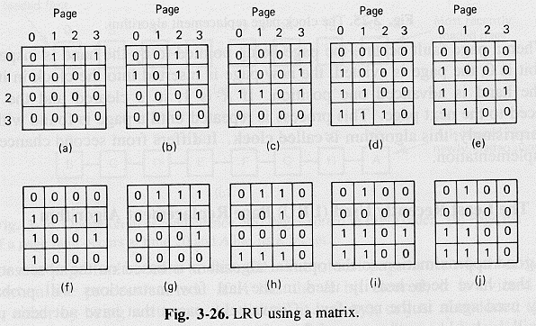
LRU with bit tables
1
2
2
3
0
1
2
3
3
Reference string is: 0,1,2,3,2,1,0,3,2,3
Operating Systems, Spring 2018, I. Dinur, D. Hendler and R. Iakobashvili

Slide 22
Why is this algorithm correct?
Claim 1
The diagonal is always composed of 0’s.
Claim 2
Right after page i is referenced, matrix row i has the maximum binary value (all other rows
have at least one more 0 in addition to that in the i’th column)
Claim 3
For all distinct i, j, k, a reference to page k does not change the order between matrix
lines i, j.
A new referenced page gets line with maximum value and does not change previous
order, so a simple induction proof works.
Operating Systems, Spring 2018, I. Dinur, D. Hendler and R. Iakobashvili

Slide 23
NFU - Not Frequently Used
Approximating LRU in software
In order to record frequently used pages add a counter field to each page frame – but don't update on each memory reference, update every clock tick.
At each clock tick, add the R bit to the counters (and zero the bit)
Select page with lowest counter for replacement
problem: remembers everything…
remedy (an “aging” algorithm):
  shift-right the counter before adding the reference bit
  add the reference bit at the left (most Significant Bit)
Operating Systems, Spring 2018, I. Dinur, D. Hendler and R. Iakobashvili

Slide 24
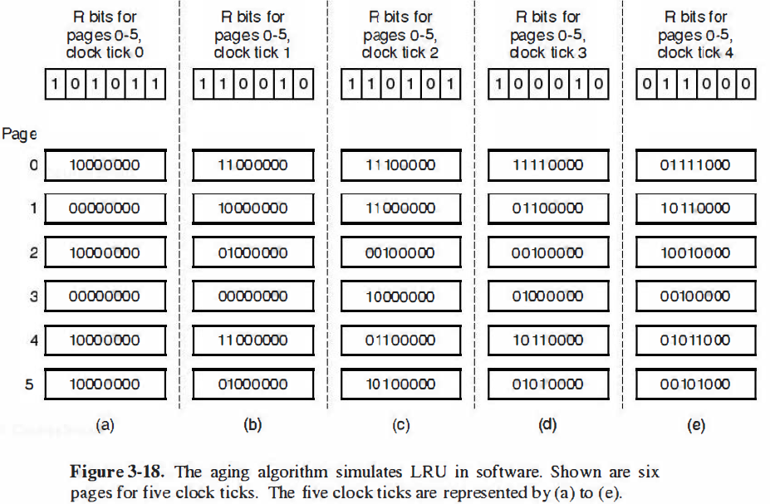
The “aging” algorithm
Operating Systems, Spring 2018, I. Dinur, D. Hendler and R. Iakobashvili

Slide 25
Differences between LRU and NFU
If two pages have the same number of zeroes before the first ‘1’, whom should we select? (E.g., processes 3, 5 after (e) )
If two pages have 0 counters, whom should we select?
(counter has too few bits…)
Therefore NFU is only an approximation of LRU.
Operating Systems, Spring 2018, I. Dinur, D. Hendler and R. Iakobashvili

Slide 26
Memory management, part 2: outline
Operating Systems, Spring 2018, I. Dinur, D. Hendler and R. Iakobashvili

Slide 27
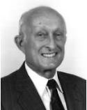
Belady's anomaly
Belady’s anomaly
The same algorithm may cause MORE page faults when given MORE page frames!
Example: FIFO with reference string 012301401234
0 1 2 3 0 1 4 0 1 2 3 4
Youngest frame
 | 0 | 1 | 2 | 3 | 0 | 1 | 4 | 4 | 4 | 2 | 3 | 3
 |  | 0 | 1 | 2 | 3 | 0 | 1 | 1 | 1 | 4 | 2 | 2
 |  |  | 0 | 1 | 2 | 3 | 0 | 0 | 0 | 1 | 4 | 4
Oldest frame
P
P
P
P
P
P
P
P
P
9 page faults
0 1 2 3 0 1 4 0 1 2 3 4
Youngest frame
 | 0 | 1 | 2 | 3 | 3 | 3 | 4 | 0 | 1 | 2 | 3 | 4
 |  | 0 | 1 | 2 | 2 | 2 | 3 | 4 | 0 | 1 | 2 | 3
 |  |  | 0 | 1 | 1 | 1 | 2 | 3 | 4 | 0 | 1 | 2
 |  |  |  | 0 | 0 | 0 | 1 | 2 | 3 | 4 | 0 | 1
Oldest frame
P
P
P
P
P
P
P
P
P
P
10 page faults!
Operating Systems, Spring 2018, I. Dinur, D. Hendler and R. Iakobashvili

Slide 28
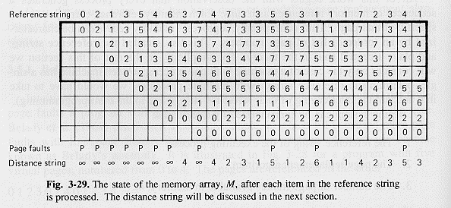
Modeling page replacement algorithms
Reference string – sequence of page accesses made by process
number of virtual pages n
number of physical page frames m (we assume a single process)
a page replacement algorithm can be represented by
an array M of n rows
1
m
n
Operating Systems, Spring 2018, I. Dinur, D. Hendler and R. Iakobashvili

Slide 29
Stack Algorithms
M(m, r): for a fixed process P and reference string, the set of virtual pages in memory after the r’th reference of process P, with memory size m.
Definition: stack algorithms
A page replacement algorithm is a stack algorithm if, for every P, m and reference string r, it holds that M(m, r) ⊆ M(m+1, r)
Stack algorithms do not suffer from Belady’s anomaly
Example: LRU, optimal replacement algorithm
FIFO is not a stack algorithm
Useful definition
  Distance string: distance of referenced page from top of stack
Operating Systems, Spring 2018, I. Dinur, D. Hendler and R. Iakobashvili

Slide 30
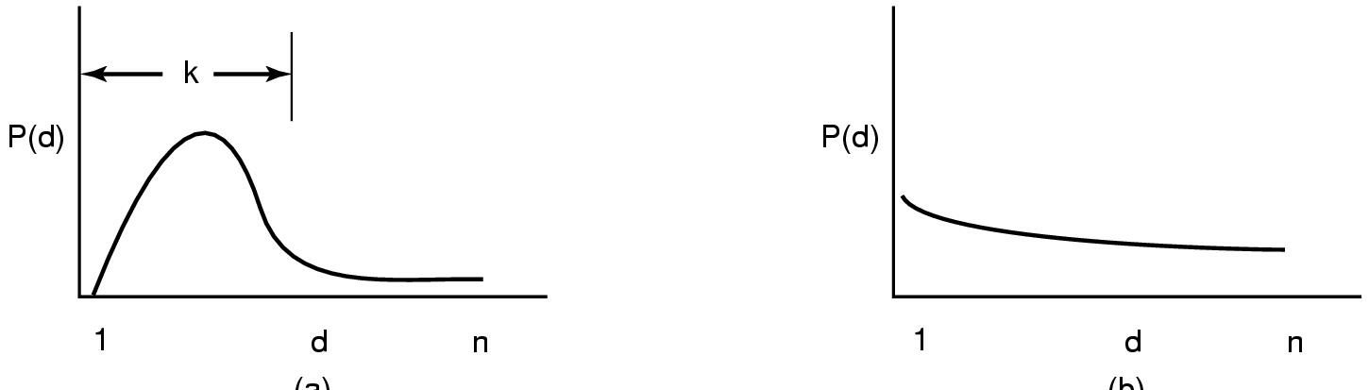
The Distance String
Probability density functions for two hypothetical distance strings
Operating Systems, Spring 2018, I. Dinur, D. Hendler and R. Iakobashvili

Slide 31
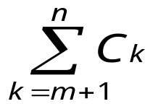

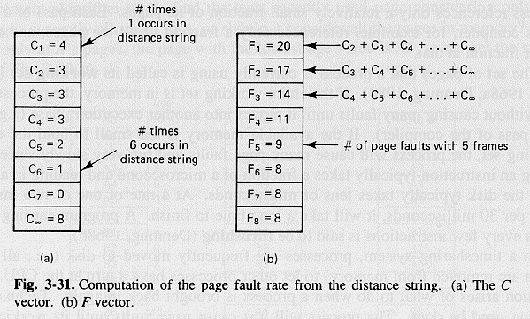
Computing page faults number
C_{i} is the number of times that i is in the distance string
The number of page faults when we have m page frames is
F_{m} = +
Operating Systems, Spring 2018, I. Dinur, D. Hendler and R. Iakobashvili

Slide 32
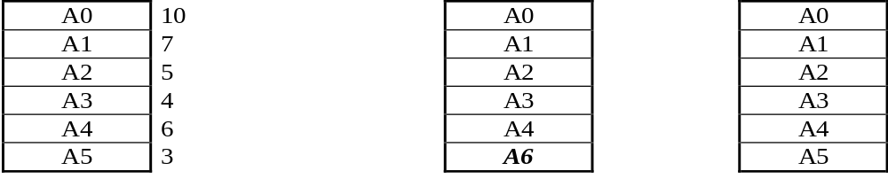
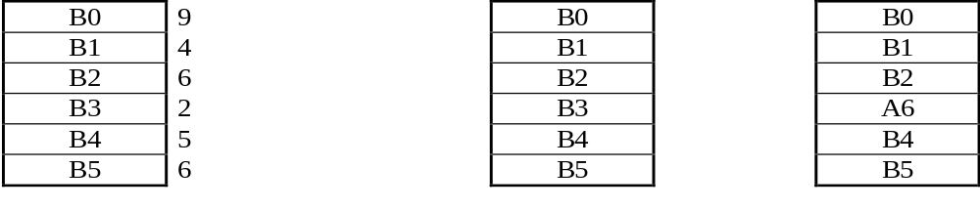
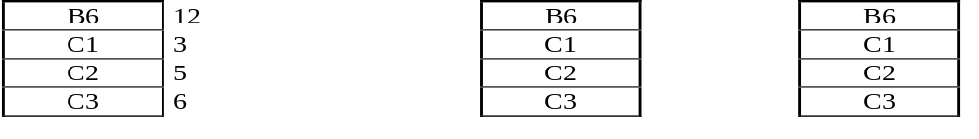
Back to page replacement algorithms:
Taking multiprogramming into account
Local vs. global algorithms
“Fair share” is not the best policy (static !!)
Allocate according to process size – so, so…
Must be a minimum for running a process...
Timestamp
A6
A6
Local policy
Global
policy
Operating Systems, Spring 2018, I. Dinur, D. Hendler and R. Iakobashvili

Slide 33
Thrashing
If a process does not have “enough” pages, the page-fault rate is very high. This leads to:
  Low CPU utilization
  `Chain reaction’ may cause OS to think it needs to increase the degree of multiprogramming
  More processes added to the system
Thrashing ≡ a process busy in swapping pages in and out
Operating Systems, Spring 2018, I. Dinur, D. Hendler and R. Iakobashvili

Slide 34
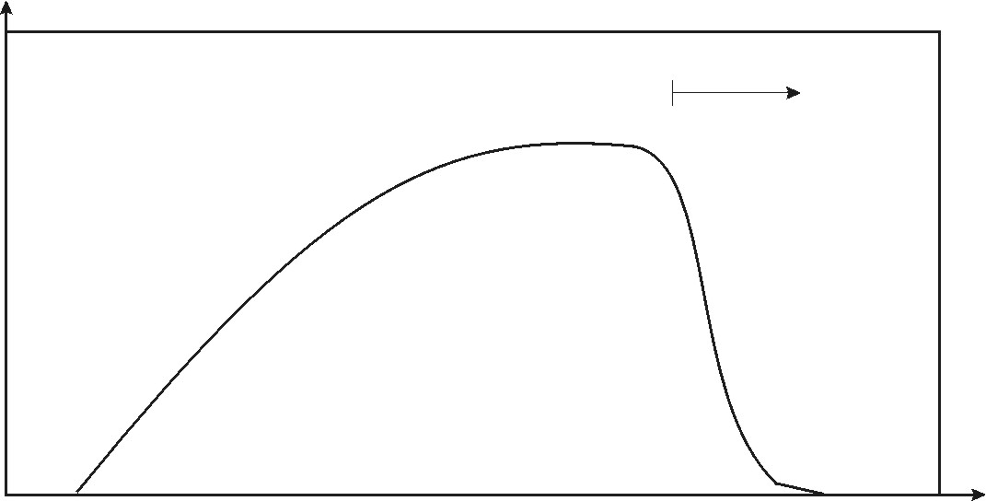
Thrashing Diagram
thrashing
CPU utilization
degree of multiprogramming
Increasing multiprogramming level initially increases CPU utilization
Beyond some point, thrashing sets in and
multiprogramming level must be decreased.
Operating Systems, Spring 2018, I. Dinur, D. Hendler and R. Iakobashvili

Slide 35
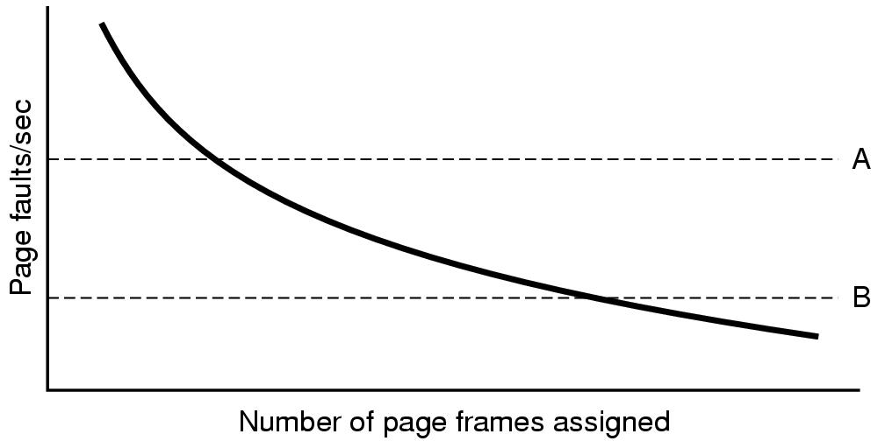
Process thrashing as function of page frames #
Operating Systems, Spring 2018, I. Dinur, D. Hendler and R. Iakobashvili

Slide 36
The impact of page-faults
For a page-fault rate p, memory access time of 100 nanosecs and page-fault service time of 25 millisecs, the effective access time is (1-p) x 100 + p x 25,000,000
For p=0.001 the effective access time is still larger than 100 nanosecs by a factor of 250
For a goal of only 10% degradation in access time we need
p = 0.0 000 004
Difficult to know how much frames to allocate to processes – differ in size; structure; priority;…
Operating Systems, Spring 2018, I. Dinur, D. Hendler and R. Iakobashvili

Slide 37
Memory management, part 2: outline
Operating Systems, Spring 2018, I. Dinur, D. Hendler and R. Iakobashvili

Slide 38
Working-Set Model: assumptions
Locality of reference: during any phase of execution, a process is accessing a small number of pages – the process' working set.
Process migrates from one locality to the other; localities may overlap
If assigned physical memory is smaller than working set we get thrashing
The working set of a process is the set of pages used by the Δ most recent memory references (for some predetermined Δ)
WS(t,Δ) denotes the working set at time t
Optional: use pre-paging to bring a process' WS
Operating Systems, Spring 2018, I. Dinur, D. Hendler and R. Iakobashvili

Slide 39
Working set model
Page reference string
. . . 2 6 1 5 7 7 7 7 5 1 6 2 3 4 1 2 3 4 4 4 3 4 3 4 4 4 1 3 2 3 4 4 4 3 4 4 4 . . .
Δ=10
Δ=10
t₁
t₂
WS(t₁,10) = {1,2,5,6,7}
WS(t₂,10) = {3,4}
Figure 9.16 Working-set model
Operating Systems, Spring 2018, I. Dinur, D. Hendler and R. Iakobashvili

Slide 40
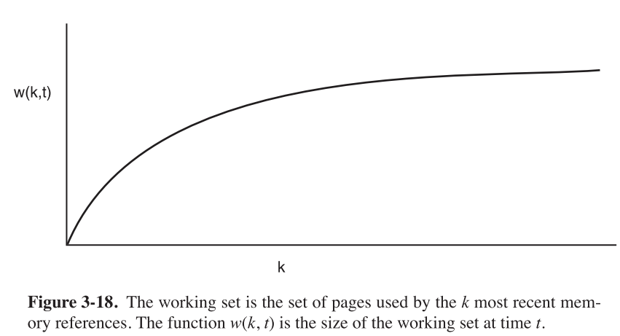
Working-Set Function
Operating Systems, Spring 2018, I. Dinur, D. Hendler and R. Iakobashvili

Slide 41
Working-Set Model
Δ ≡ working-set window ≡ a fixed number of page references
  If Δ too small - will not encompass entire locality.
  If Δ too large - will encompass several localities.
  If Δ = ∞ ⇒ will encompass entire program.
D_{t} = ∑ |WS(t)| ≡ total size of all working sets at time t
  If D_{t} > m ⇒ thrashing
  Policy: if D_{t} > m, then suspend one of the processes.
How can we estimate WS(t) without doing a
memory update at every memory reference?
Operating Systems, Spring 2018, I. Dinur, D. Hendler and R. Iakobashvili

Slide 42
Working set algorithm using virtual time
The working-set window cannot be based on memory references - too expensive
One way to enlarge the time gap between updates is to use some clock tick triggering
  Reference bits are updated by the hardware
  Virtual time maintained for each process (in PCB entry)
  Every timer tick, update process virtual time and virtual time of referenced paging-table entries; then the R bit is cleared
Page p’s age is the diff between the process‘ virtual time and the time of p's last reference
At PF time, the table is scanned and the entry with R=0 and the largest “age” is selected for eviction
We use process virtual time (rather than global time) since it is more correlated to the process' working set
Operating Systems, Spring 2018, I. Dinur, D. Hendler and R. Iakobashvili

Slide 43
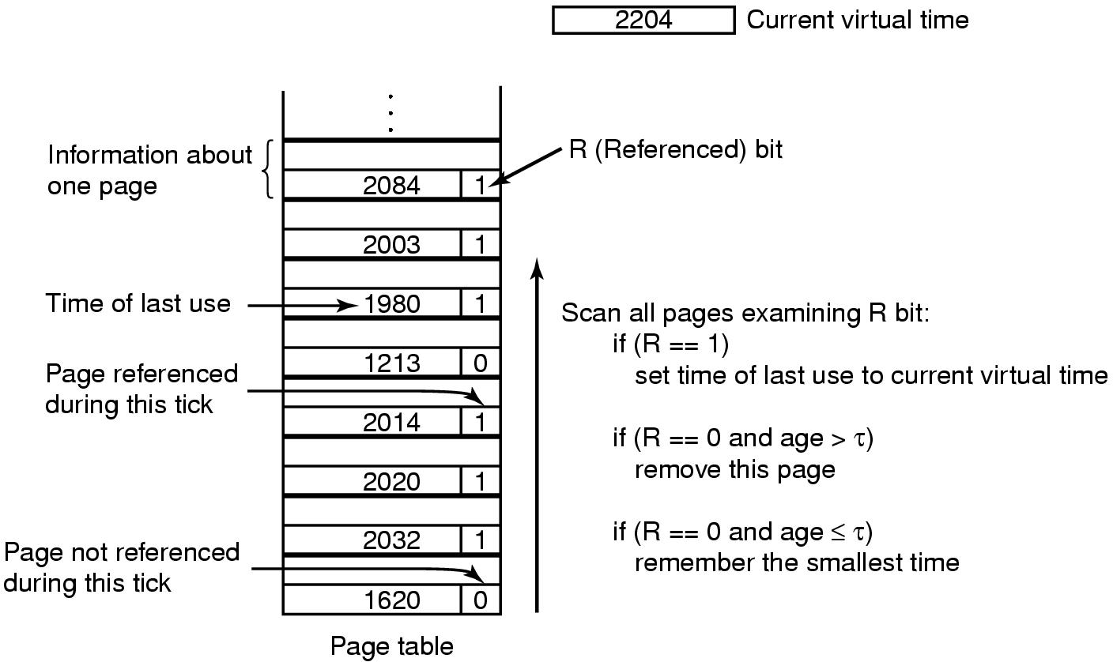
The Working Set Page Replacement Algorithm (2)
The working set algorithm
Operating Systems, Spring 2018, I. Dinur, D. Hendler and R. Iakobashvili

Slide 44
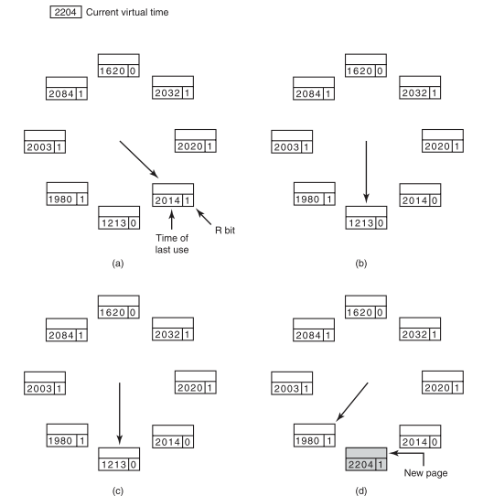
The WSClock Page Replacement Algorithm
Operating Systems, Spring 2018, I. Dinur, D. Hendler and R. Iakobashvili

Slide 45
WSClock: global version
WSClock: global version
Applies same idea for for pages held by all processes in memory
Circling the clock, the algorithm uses pages reference bits and time of last reference [ref(frame)], and current “virtual times” of processes [T_{p}]
Replace page when two conditions apply
  reference bit is unset
  T_{p} - ref(frame) > τ
Operating Systems, Spring 2018, I. Dinur, D. Hendler and R. Iakobashvili

Slide 46
WSClock algorithm: example
3 processes p_{0,} p₁ and p₂
Current (virtual) times of the 3 processes are
Tp₀ = 50; Tp₁ = 70; Tp₂ = 90
WSClock: replace when T_{p} - ref(frame) > τ
The minimal distance (“window size”) is τ = 20
The clock hand is currently pointing to page frame 4
page-frames: 0 1 2 3 4 5 6 7 8 9 10
ref. bit: 0 0 1 1 1 0 1 0 0 1 0
process ID: 0 1 0 1 2 1 0 0 1 2 2
last ref: 10 30 42 65 81 57 31 37 31 47 55
13 13 39 >20
0
0
90
50
Operating Systems, Spring 2018, I. Dinur, D. Hendler and R. Iakobashvili

Slide 47
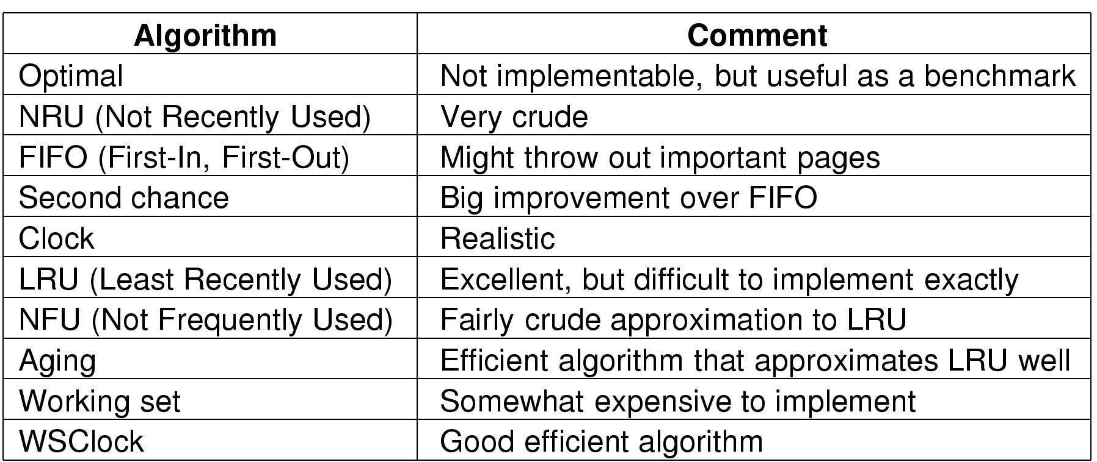
Review of Page Replacement Algorithms
Operating Systems, Spring 2018, I. Dinur, D. Hendler and R. Iakobashvili

Slide 48
Memory management, part 2: outline
Operating Systems, Spring 2018, I. Dinur, D. Hendler and R. Iakobashvili

Slide 49
Operating system involvement in paging
Upon new process creation
  Determine initial size of program + data
  Create a page table: allocate space, initialize
  Allocate space in swap area
  Initialize swap area
  Update info about page-table and swap area in PTE
Upon process scheduling for execution
  Reset MMU and flush TLB
  Select new process' page table as current
  Optionally bring some of the processes pages to memory
Upon process exit
  Release page table, pages and swap area
  Don't release shared pages if still referenced
Operating Systems, Spring 2018, I. Dinur, D. Hendler and R. Iakobashvili

Slide 50
Valid (In-memory) Bit
A valid bit is associated with each page table entry
(1 ➔ in-memory, 0 ➔ not-in-memory)
Initially, valid-invalid is set to 0 on all entries
During address translation, if in-memory bit in page table entry is 0 ➔ page fault
Frame #
Valid bit (in-memory)
1
1
1
1
0
0
0
Page table
Operating Systems, Spring 2018, I. Dinur, D. Hendler and R. Iakobashvili

Slide 51
Page Fault
If there is ever a reference to a page, first reference will trap to
OS ➔ page fault
OS checks:
  Illegal reference ➔ abort
  Or, just not in memory
Get empty frame (page replacement algorithm)
Swap page into frame
Update PTE, in-memory bit = 1
Restart instruction
Operating Systems, Spring 2018, I. Dinur, D. Hendler and R. Iakobashvili

Slide 52
Handling page faults
The MMU sends a hardware interrupt, PC saved on stack
Registers are saved, kernel is called
Kernel discovers the virtual page that caused fault
Kernel checks valid bit and verifies protection. If illegal access – send signal to process. Otherwise…
  Check for a free page frame. If non available, apply a page replacement algorithm
  If selected page frame is dirty – write to disk (context switch). Mark frame as busy
  When page frame is clean, read from disk (process still suspended)
  When page arrives, update page table, mark frame as normal state
  Upon process re-scheduling, re-execute faulting instruction, reload registers, continue execution
Operating Systems, Spring 2018, I. Dinur, D. Hendler and R. Iakobashvili

Slide 53
Instruction backup
MOVE.L #6(A1), 2(A0)
16 bits
1000
Move
1002
6
Block Move
1004
2
  Above instruction makes 3 memory accesses. How does kernel know which caused the fault and where the instruction starts?
  If instruction does auto-increment/decrement, how do we know if it was already done?
Information should be provided to OS via HW registers
Operating Systems, Spring 2018, I. Dinur, D. Hendler and R. Iakobashvili

Slide 54
Memory access with page faults
P = probability of a page fault
MA = memory access time
PF = time to process page faults
EMA – Effective Memory Access =
(1-p) x MA + P x PF
where
PF = page-fault interrupt service time +
Read-in page time (maybe write-page too?) +
Restart process time
Operating Systems, Spring 2018, I. Dinur, D. Hendler and R. Iakobashvili

Slide 55
Demand Paging
Bring a page into memory only when it is needed
  Less memory needed
  Faster response
  More users
Page is needed ➔ reference it
  Invalid reference ➔ abort
  not-in-memory ➔ bring to memory
Operating Systems, Spring 2018, I. Dinur, D. Hendler and R. Iakobashvili

Slide 56
Locking Pages in Memory
Virtual memory and I/O occasionally interact
Process A issues read from I/O device into buffer
  DMA transfer begins, process A blocks
  process B starts executing
  Process B causes a page fault
  Page including buffer copied to by DMA may be chosen to be paged out
Need to be able to lock page until I/O completes
  Page exempted from being considered for replacement
Operating Systems, Spring 2018, I. Dinur, D. Hendler and R. Iakobashvili

Slide 57
Page Sharing
Multiple processes may execute same code, we would like the text pages to be shared
Paging out process A pages may cause many page faults for process B that shares them
Looking up for “evicted” pages in all page tables is impossible
Solution: maintain special data structures for shared pages
Data pages may be shared also. E.g., when doing fork(), the copy-on-write mechanism.
Operating Systems, Spring 2018, I. Dinur, D. Hendler and R. Iakobashvili

Slide 58
Cleaning Policy
Pre-paging more efficient than pure demand-paging
Often implemented by paging daemon
  periodically inspects state of memory. Cleans pages, possibly removing them
When too few frames are free
  selects pages to evict using a replacement algorithm
It can use same circular list (WSclock)
  as regular page replacement algorithm but with a different pointer
Operating Systems, Spring 2018, I. Dinur, D. Hendler and R. Iakobashvili

Slide 59
Handling the backing store
Need to store non-resident pages on disk swap area
Alternative 1 (static) : allocate a fixed chunk of the swap area to process upon creation, keep offset in PTE
  Problem: memory requirements may change dynamically
Alternative 2: Reserve separate swap areas for text, data, stack, allow each to extend over multiple chunks
Alternative 3 (dynamic) : allocate swap space to a page when it is swapped out, de-allocate when back in.
  Need to keep swap address for each page
Operating Systems, Spring 2018, I. Dinur, D. Hendler and R. Iakobashvili

Slide 60
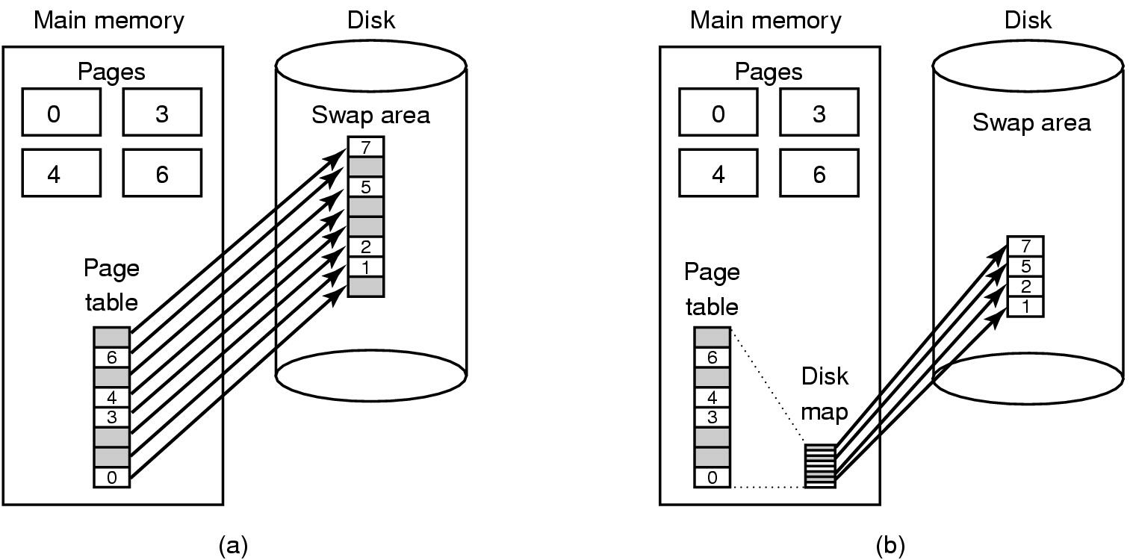
Backing Store
(a) Paging to static swap area
(b) Backing up pages dynamically
Operating Systems, Spring 2018, I. Dinur, D. Hendler and R. Iakobashvili

Slide 61
Virtual Memory - Advantages
Programs may use much smaller physical memory than their maximum requirements (much code or data is unused…)
  Higher level of multiprogramming
Programs can use much larger (virtual) memory
  simplifies programming and enable using powerful software
  swapping time is smaller
External fragmentation is eliminated
More flexible memory protection (but less so than segmentation…)
Operating Systems, Spring 2018, I. Dinur, D. Hendler and R. Iakobashvili

Slide 62
Virtual Memory - Disadvantages
Special hardware for address translation - some instructions may require 5-6 address translations!
Difficulties in restarting instructions (chip/microcode complexity)
Complexity of OS!
Overhead - a page-fault is an expensive operation in terms of both CPU and I/O overhead.
Page-faults bad for real time
Thrashing problem
Operating Systems, Spring 2018, I. Dinur, D. Hendler and R. Iakobashvili

