Slide 1

Processes: The Process Model
Multiprogramming of four programs
Conceptual model of 4 independent, sequential processes
Only one program active at any instant
Operating Systems, Spring 2018, I. Dinur , D. Hendler and R. Iakobashvili

Slide 2
Processes and programs
The difference between a process and a program:
Baking analogy:
  Recipe = Program
  Baker = Processor
  Ingredients = data
  Baking the pie = Process
Interrupt analogy
  Baker's child rushes in…
Operating Systems, Spring 2018, I. Dinur , D. Hendler and R. Iakobashvili

Slide 3
Main OS Process-related Goals
Interleave the execution of existing processes to maximize processor utilization
Provide reasonable response times
Allocate resources to processes
Support inter-process communication and
synchronization
Operating Systems, Spring 2018, I. Dinur , D. Hendler and R. Iakobashvili

Slide 4
How are these goals achieved?
Schedule and dispatch processes for execution by the processor
Implement a safe and fair policy for
resource allocation to processes
Respond to requests by user programs
Construct and maintain tables for each process managed by the operating system
Operating Systems, Spring 2018, I. Dinur , D. Hendler and R. Iakobashvili

Slide 5
Process Creation
When is a new process created?
System initialization (Daemons)
Execution of a process creation system call by a running process
A user request to create a process
Initiation of a batch job
Operating Systems, Spring 2018, I. Dinur , D. Hendler and R. Iakobashvili

Slide 6
Process Termination
When does a process terminate?
Normal exit (voluntary)
Error exit (voluntary)
Fatal error (involuntary)
Killed by another process (involuntary)
Operating Systems, Spring 2018, I. Dinur , D. Hendler and R. Iakobashvili

Slide 7
Processes: outline
Basic concepts
Process states and structures
Process management
signals
Threads
Specific implementations
Operating Systems, Spring 2018, I. Dinur , D. Hendler and R. Iakobashvili

Slide 8
Process States
Running - actually using the CPU
Ready – runnable, temporarily stopped to let another process run
Blocked - unable to run until some external event happens
A process can block itself, but not “run” itself
Operating Systems, Spring 2018, I. Dinur , D. Hendler and R. Iakobashvili

Slide 9
Process State Transitions
When do these transitions occur?
Running
1. Process blocks for input or waits for an event
2. End of time-slice, preemption
3. Scheduler switches back to this process
4. Input becomes available, event arrives
1
2
3
Blocked
Ready
4
Operating Systems, Spring 2018, I. Dinur , D. Hendler and R. Iakobashvili

Slide 10
Five-State Process Model
Dispatch
Release
Admit
New
Ready
Running
Exit
Time-out
Event
Occurs
Event
Wait
Blocked
Operating Systems, Spring 2018, I. Dinur , D. Hendler and R. Iakobashvili

Slide 11

Scheduling: Single Blocked Queue
Ready Queue
Dispatch
Release
Admit
Processor
Time-out
Event Wait
Event
Occurs
Blocked Queue
Operating Systems, Spring 2018, I. Dinur , D. Hendler and R. Iakobashvili

Slide 12

Scheduling: Multiple Blocked Queues
Ready Queue
Dispatch
Release
Admit
Processor
Time-out
Event 1
Occurs
Event 1 Wait
Event 1 Queue
Event 2
Occurs
Event 2 Wait
Event 2 Queue
Operating Systems, Spring 2018, I. Dinur , D. Hendler and R. Iakobashvili

Slide 13
Suspended Processes
Processor is much faster than I/O so many processes could be waiting for I/O
Swap some of these processes to disk to free up more memory
Blocked state becomes blocked-suspended state when swapped to disk, ready becomes
ready-suspended
Two new states
  Blocked-suspended
  Ready-suspended
Operating Systems, Spring 2018, I. Dinur , D. Hendler and R. Iakobashvili

Slide 14
Process State Transition Diagram with Two Suspend States
New
Admit
Suspend
Admit
Activate
Dispatch
Ready,
suspend
Ready
Running
Exit
Suspend
Time out
Event
Occurs
Event
Wait
Event
Occurs
Activate
Blocked,
suspend
Blocked
Suspend
Operating Systems, Spring 2018, I. Dinur , D. Hendler and R. Iakobashvili

Slide 15
Process Management Operations
Process creation and termination
Process scheduling and dispatching
Process switching
Process synchronization and support for inter-
process communication
The OS maintains process data in the
Process Control Blocks (PCB)
Operating Systems, Spring 2018, I. Dinur , D. Hendler and R. Iakobashvili

Slide 16
Process Table
Process image consists of program (code/text), data, stack, and attributes
Control Attributes form the Process Control Block – PCB stored in an entry of the process table
  Unique ID (may be an index into the PT)
  User ID; User group ID, Parent process ID
  process control information
  Processor state information
Operating Systems, Spring 2018, I. Dinur , D. Hendler and R. Iakobashvili

Slide 17
Process Control Information
Additional information needed by the operating system to control and coordinate the various active processes
  Scheduling-related information - state; priority; scheduling info
  inter-process communication - signals; pipes
  Time of next alarm
  memory management - pointers to text/data/stack
  segments
  resource ownership and utilization - open files
  Process relationships: Parent, process group…
  Environment variables
Operating Systems, Spring 2018, I. Dinur , D. Hendler and R. Iakobashvili

Slide 18
Processor State Information
Contents of processor registers
  General registers
  Program counter
  Program Status Word (PSW)
    condition codes
    mode (user/kernel)
    status register - interrupts disabled/enabled
  Stack pointers - user and kernel stacks
Operating Systems, Spring 2018, I. Dinur , D. Hendler and R. Iakobashvili

Slide 19
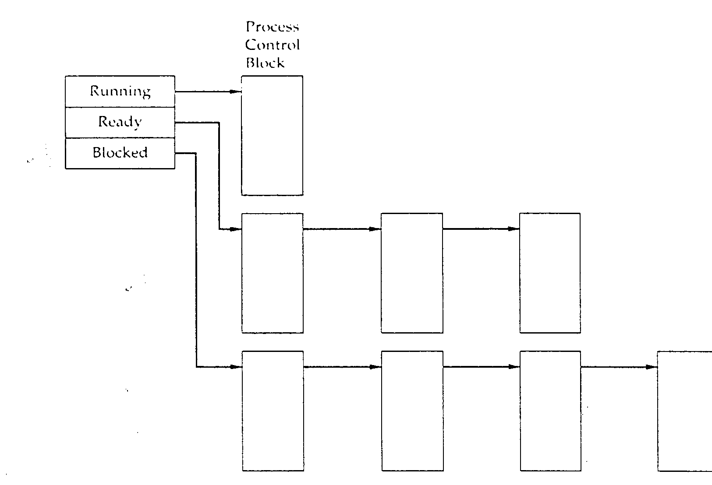
Process-State-Management
Process
Control
Block
Running
Ready
Blocked
Operating Systems, Spring 2018, I. Dinur , D. Hendler and R. Iakobashvili

Slide 20
Processes: outline
Basic concepts
Process states and structures
Process management
signals
Threads
Specific implementations
Operating Systems, Spring 2018, I. Dinur , D. Hendler and R. Iakobashvili

Slide 21
Process Creation
Assign a unique process identifier
Allocate space for the process
Initialize process control block
Set up appropriate linkage to the scheduling queue:
  In the former example: add the PCB to the ready queue
Operating Systems, Spring 2018, I. Dinur , D. Hendler and R. Iakobashvili

Slide 22
Stop a running process: when?
Some options:
  Clock event: process has executed a full
  time-slice (a.k.a. time-quantum)
  Process becomes blocked
  Another process becomes ready
  Error occurred
  Signal received
Operating Systems, Spring 2018, I. Dinur , D. Hendler and R. Iakobashvili

Slide 23
Process Context Switch
Save processor context, including program counter and other registers
Update the process control block with the new state and any accounting information
Move process control block to appropriate queue - ready, blocked
Select another process for execution
Update the process control block of the process selected
Restore context of selected process
Operating Systems, Spring 2018, I. Dinur , D. Hendler and R. Iakobashvili

Slide 24
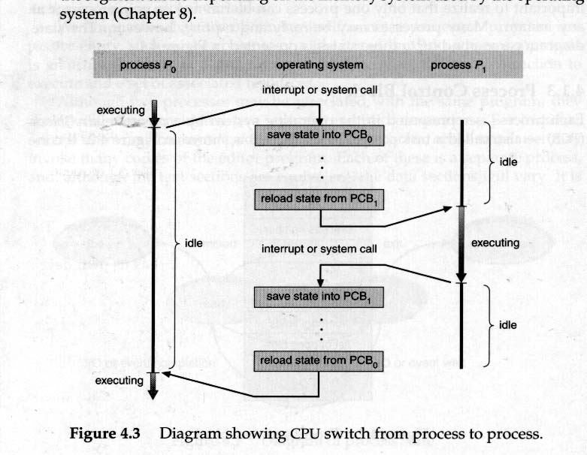
Switching Processes
Operating Systems, Spring 2018, I. Dinur , D. Hendler and R. Iakobashvili

Slide 25
Managing Processes (Unix)
pid = fork() - create a child process
wait(status) / waitpid(pid, status, opts) - wait for termination of a specific child or any child
execvp(name, args) – replace image by name, with arguments args
exit(status)
Operating Systems, Spring 2018, I. Dinur , D. Hendler and R. Iakobashvili

Slide 26
The Unix Process
fork system call:
  memory address space is “copied”
  parent receives pid of child (return value of fork())
  child gets 0 (return value of fork())
pid = fork(); /* upon success of fork() pid > 0 in parent */
if (pid < 0) { /* fork failed - memory full ... table full */
} else if (pid > 0) { /* Parent code goes here ... */
} else { /* Child code goes here ... */
}
* to find own pid - getpid()
Operating Systems, Spring 2018, I. Dinur , D. Hendler and R. Iakobashvili

Slide 27
Process Creation in Unix – fork()
Check to see if process table is full
Try to allocate memory to child’s data and stack
Copy the parent’s code, data and stack to the child’s memory (“copy on write” trick…)
Find a free process slot and copy parent’s slot to it
Return the appropriate PIDs to parent and child
Operating Systems, Spring 2018, I. Dinur , D. Hendler and R. Iakobashvili

Slide 28
Executing a New Program (Unix)
Children are duplications of their parents
In order to perform another program, the program code is loaded to the process' image:
  the fork() system call creates a new process
  execvp system call (used after fork() ) replaces the process core image with that of another executable program
Operating Systems, Spring 2018, I. Dinur , D. Hendler and R. Iakobashvili

Slide 29
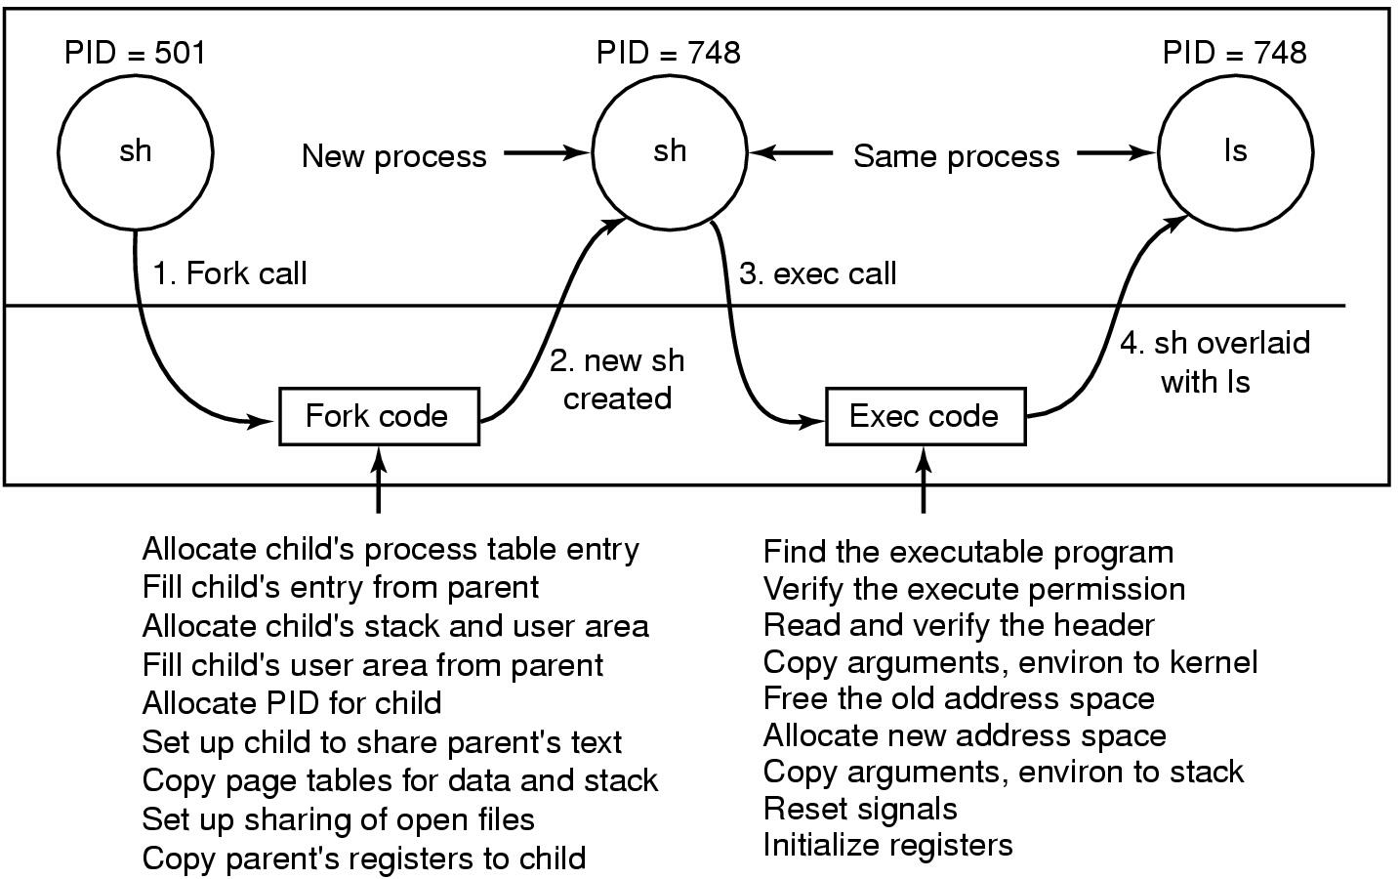
Executing the ls command
User
code
Kernelcode
Steps in executing the command ls, typed to the shell
Operating Systems, Spring 2018, I. Dinur , D. Hendler and R. Iakobashvili

Slide 30
Processes: outline
Basic concepts
Process states and structures
Process management
Signals
Threads
Specific implementations
Operating Systems, Spring 2018, I. Dinur , D. Hendler and R. Iakobashvili

Slide 31
Unix signals
A signal is a software interrupt
Signals are generated:
  From the keyboard: Ctrl-C, Ctrl-Z, …
  From the command line: kill -<sig> <PID>
  Using a system call: kill(PID, sig)
A process can send a signal to all processes within its process group
Operating Systems, Spring 2018, I. Dinur , D. Hendler and R. Iakobashvili

Slide 32
Handling signals
Upon receiving a signal the process can:
  Ignore it (not always…)
  Let the system take default action
  Catch it by a process' signal handler
Defining action to take on signals done by calling:
signal(signum, [function | SIG_IGN | SIG_DFL ]);
Operating Systems, Spring 2018, I. Dinur , D. Hendler and R. Iakobashvili

Slide 33
More on Unix signals
kernel sets signal bits in the PCB upon receiving signals (software interrupt)
Some Examples (predefined signal numbers):
  sigabrt - abort process (core dump)
  sigalrm - alarm clock (alarm, sleep, pause)
  sigsegv - segmentation violation (invalid address)
  sigkill – kill the process
  sigill - illegal instruction
Upon child process termination, the signal SIGCHILD is sent to parent. If parent executes wait(), it gets the exit code
Operating Systems, Spring 2018, I. Dinur , D. Hendler and R. Iakobashvili

Slide 34
Signals: a simple example
int main(void) {
if (signal(SIGUSR1, sig_usr) == SIG_ERR)
printf(“can’t catch SIGUSR1”);
if (signal(SIGUSR2, sig_usr) == SIG_ERR)
printf(“can’t catch SIGUSR2”)
for ( ; ; )
pause(); }
Static void sig_usr(int signo) {
if (signo == SIGUSR1)
write(STDOUT_FILENO, “received SIGUSR1\n”);
else if (signo == SIGUSR2)
write(STDOUT_FILENO, “received SIGUSR2\n”);
else
write(STDOUT_FILENO,“received a wrong signal\n”) }
Operating Systems, Spring 2018, I. Dinur , D. Hendler and R. Iakobashvili

Slide 35
Unix signals: terminology & semantics
A signal is generated for a process when the event that causes it occurs. This usually causes the setting of a bit in the PCB
A signal is delivered to a process when the action for the signal is taken
During the time when a signal is generated and until it is delivered, the signal is pending
A process has the option of blocking the signal (signals mask)
If a signal is generated multiple times while it is blocked, it is typically delivered only once
Operating Systems, Spring 2018, I. Dinur , D. Hendler and R. Iakobashvili

Slide 36
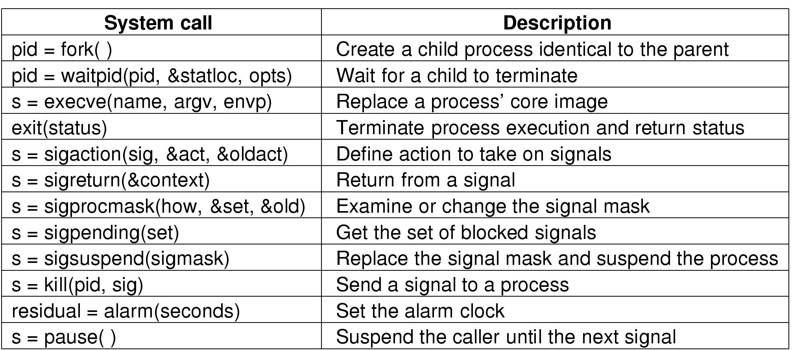

System Calls for Process Management
Operating Systems, Spring 2018, I. Dinur , D. Hendler and R. Iakobashvili

Slide 37
Terminated processes
If a child process terminates and the parent doesn’t execute the wait() system call, the child is called
a zombie – it still holds a PTE
Zombie entries are erased by the kernel when the parent executes a wait() system call and receives the child's exit code
What happens if the parent terminates before the child?
Operating Systems, Spring 2018, I. Dinur , D. Hendler and R. Iakobashvili

Slide 38
Processes: outline
Basic concepts
Process states and structures
Process management
Signals
Threads
Specific implementations
Operating Systems, Spring 2018, I. Dinur , D. Hendler and R. Iakobashvili

Slide 39
Threads
Need:
  Multiprogramming within a single application
  Using the same environment for performing different tasks concurrently
Operating Systems, Spring 2018, I. Dinur , D. Hendler and R. Iakobashvili

Slide 40
Single and multithreaded processes
process control block
code
data
files
process control block
code
data
files
registers
user/kernel stacks
registers
registers
registers
Thread control blocks
user
/kernel
stacks
user
/kernel
stacks
user
/kernel
stacks
thread
thread
thread
thread
single threaded
multithreaded
Operating Systems, Spring 2018, I. Dinur , D. Hendler and R. Iakobashvili

Slide 41
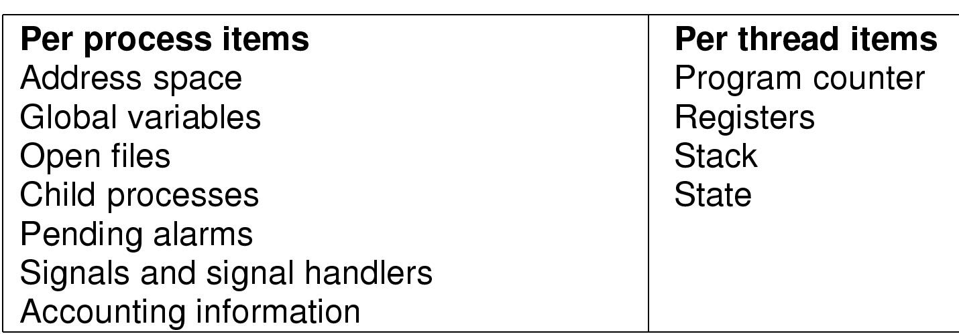
The Thread Model
Operating Systems, Spring 2018, I. Dinur , D. Hendler and R. Iakobashvili

Slide 42
Processes Threads
The basic unit of CPU scheduling - threads:
  program counter; register set; stack space
Peer threads share resources like code section and data section
a process is created with a single thread
multi-threaded tasks (processes) can have one thread running while another is blocked
Good for applications that require sharing a common buffer by server threads
A word processor can use three threads
  Updating the display (WYSIWYG)
  Interacting with the user (keyboard & mouse)
  Dealing with i/o to the disk
Operating Systems, Spring 2018, I. Dinur , D. Hendler and R. Iakobashvili

Slide 43
Processes Threads
Multithreading in different operating systems:
  Operating systems support multiple threads of execution within a single process
  Old UNIX systems supported multiple user processes but only one thread per process; current Unix systems have multiple threads
  Windows supports multiple threads
Operating Systems, Spring 2018, I. Dinur , D. Hendler and R. Iakobashvili

Slide 44
The Benefits of Threads
Takes less time to create a new thread than a process
Less time to terminate a thread than a process
Less time to switch between two threads within the same process
Threads within the same process share memory and files --> they can communicate without invoking the kernel
Operating Systems, Spring 2018, I. Dinur , D. Hendler and R. Iakobashvili

Slide 45
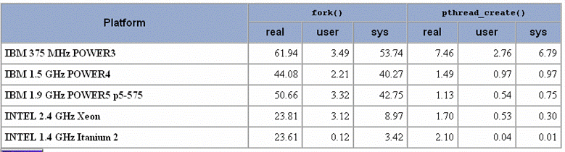
Creation time: process vs. thread
Operating Systems, Spring 2018, I. Dinur , D. Hendler and R. Iakobashvili

Slide 46
More on Threads
Thread-local storage (TLS): per-thread dynamic storage for local variables
Access to process' memory and resources
  all threads of a process share these
Suspending a process suspends all process threads since all threads share the same PTE
Termination of a process, terminates all threads within the process
Operating Systems, Spring 2018, I. Dinur , D. Hendler and R. Iakobashvili

Slide 47
Implementation Issues of threads
Fork – should all threads be inherited?
If so, and a parent thread was blocked on keyboard read, would the corresponding child thread be in the same state?
What if one thread closes a file while the other is still reading it?
Which threads should receive signals?
…
POSIX: only thread calling fork is duplicated
Operating Systems, Spring 2018, I. Dinur , D. Hendler and R. Iakobashvili
Ben-Gurion University

Slide 48
Kernel vs Application (User) threads
threads
processes
threads
processes
User space
User space
Kernel space
kernel
Kernel space
kernel
Runtime system
Process table
Process table
Threads table
Threads table
Operating Systems, Spring 2018, I. Dinur , D. Hendler and R. Iakobashvili

Slide 49
User-Level Threads
All thread management is done by the application
The kernel is not aware of the existence of threads
Thread switching does not require kernel mode privileges (and is thus faster)
Scheduling is application specific (can thus be more efficient)
System calls by threads block the process
Operating Systems, Spring 2018, I. Dinur , D. Hendler and R. Iakobashvili

Slide 50
User-level Threads - Problems
Blocking read – all other threads are blocked!
  In Unix, use “select” - if data not in buffer, switch to another thread
Page fault – all other threads are blocked!
Time limit– cannot handle clock interrupts PER THREAD! Need other method e.g, thread_yield
Stack growth fault – kernel is not aware of which thread’s stack caused the fault!
Operating Systems, Spring 2018, I. Dinur , D. Hendler and R. Iakobashvili

Slide 51
Kernel-level Threads
Kernel maintains context information for the process and the threads
Kernel can schedule different threads of the same process to different processors
Switching between threads requires the kernel
Kernel threads can simplify context switch of system functions
Operating Systems, Spring 2018, I. Dinur , D. Hendler and R. Iakobashvili

Slide 52
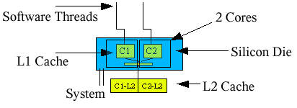
Multi-cores:
Chip Multi-Threading (CMT)
Multiple cores on the same silicon die
On-core L1 cache
External L2 cache (may be either split or joined)
Operating Systems, Spring 2018, I. Dinur , D. Hendler and R. Iakobashvili
Notes:
The figure shows a dual-core chip, where each core has on-chip level-1 cache and an external
L2-cache. In some designs, the L2 cache is shared between the 2 cores.

Slide 53
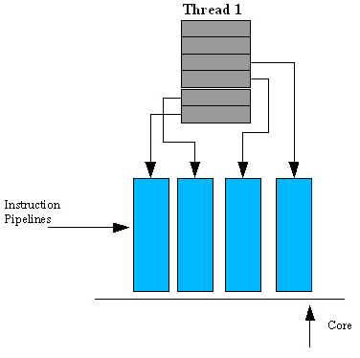
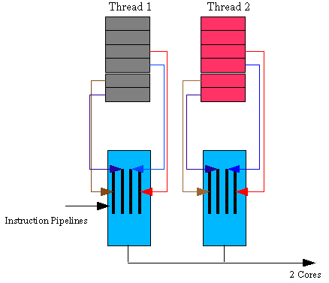
Execution on single-core vs. multi-core
Pipelining permits instruction-level parallelism (ILP)
Multi-core permits both ILP and Thread-Level-Parallelism (TLP) on same CPU
Execution on single-core
Execution on dual-core
Operating Systems, Spring 2018, I. Dinur , D. Hendler and R. Iakobashvili

Slide 54
Simultaneous multi-threading:
Hardware threads
Core stores more registers and logic for much faster thread context-switch
A hardware thread appears as a logical processor to the operating system
  Scheduler more efficient if OS aware of HW threads
E.g., Sun's UltraSPARC T2 chip contains 8 cores, each comprising 8 HW cores for a total of 64 concurrent threads
Operating Systems, Spring 2018, I. Dinur , D. Hendler and R. Iakobashvili

Slide 55
Processes: outline
Basic concepts
Process states and structures
Process management
Signals
Threads
Specific implementations
Operating Systems, Spring 2018, I. Dinur , D. Hendler and R. Iakobashvili

Slide 56
Solaris 2-8: A Combined Approach for Threads
Thread creation, scheduling and synchronization can be done in user space
Multiple user-level threads are mapped onto some (smaller or equal) number of kernel-level threads
In Unix Solaris, user threads can be mapped to a kernel thread via a LWP (light-weight process) object and an API is provided to perform this mapping
Some kernel threads have no associated LWP
A user thread may be bound to a LWP for quick response
Many-to-many model
Operating Systems, Spring 2018, I. Dinur , D. Hendler and R. Iakobashvili

Slide 57
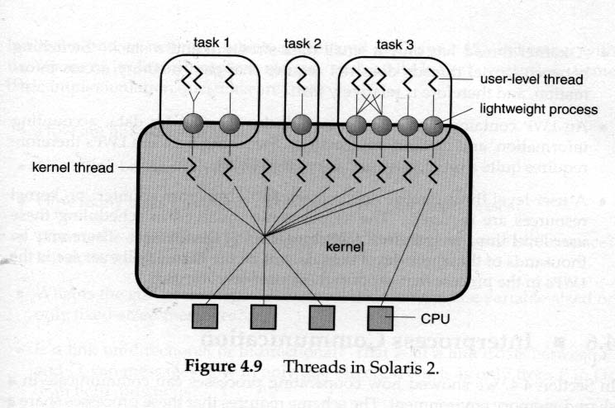
Threads in Solaris
Operating Systems, Spring 2018, I. Dinur , D. Hendler and R. Iakobashvili

Slide 58
Threads & LWP Structure
Threads
Threads library
LWPs
Kernel - OS Scheduler
Operating Systems, Spring 2018, I. Dinur , D. Hendler and R. Iakobashvili

Slide 59
Threads in Unix-Solaris
thr_create create thread
thr_join causes the calling thread to wait until target thread is finished
thr_exit destroy calling thread
thr_suspend suspend target thread
thr_continue make suspended thread active
thr_setconcurrency set desired number threads active at the same time to a new parameter
thr_getconcurrency get current concurrency level
thr_setprio set thread relative priority
thr_getprio get relative priority of the thread
thr_yield causes the current thread to yield its execution in favor of another thread with the same or greater priority
thr_kill kill a thread
thr_keycreate allocate a key that locates data specific to each thread in the process
thr_min_stack amount of space needed to execute a null thread
thr_setspecific binds thread-specific value to the key
thr get-specific gets thread-specific value of the key
Operating Systems, Spring 2018, I. Dinur , D. Hendler and R. Iakobashvili

Slide 60
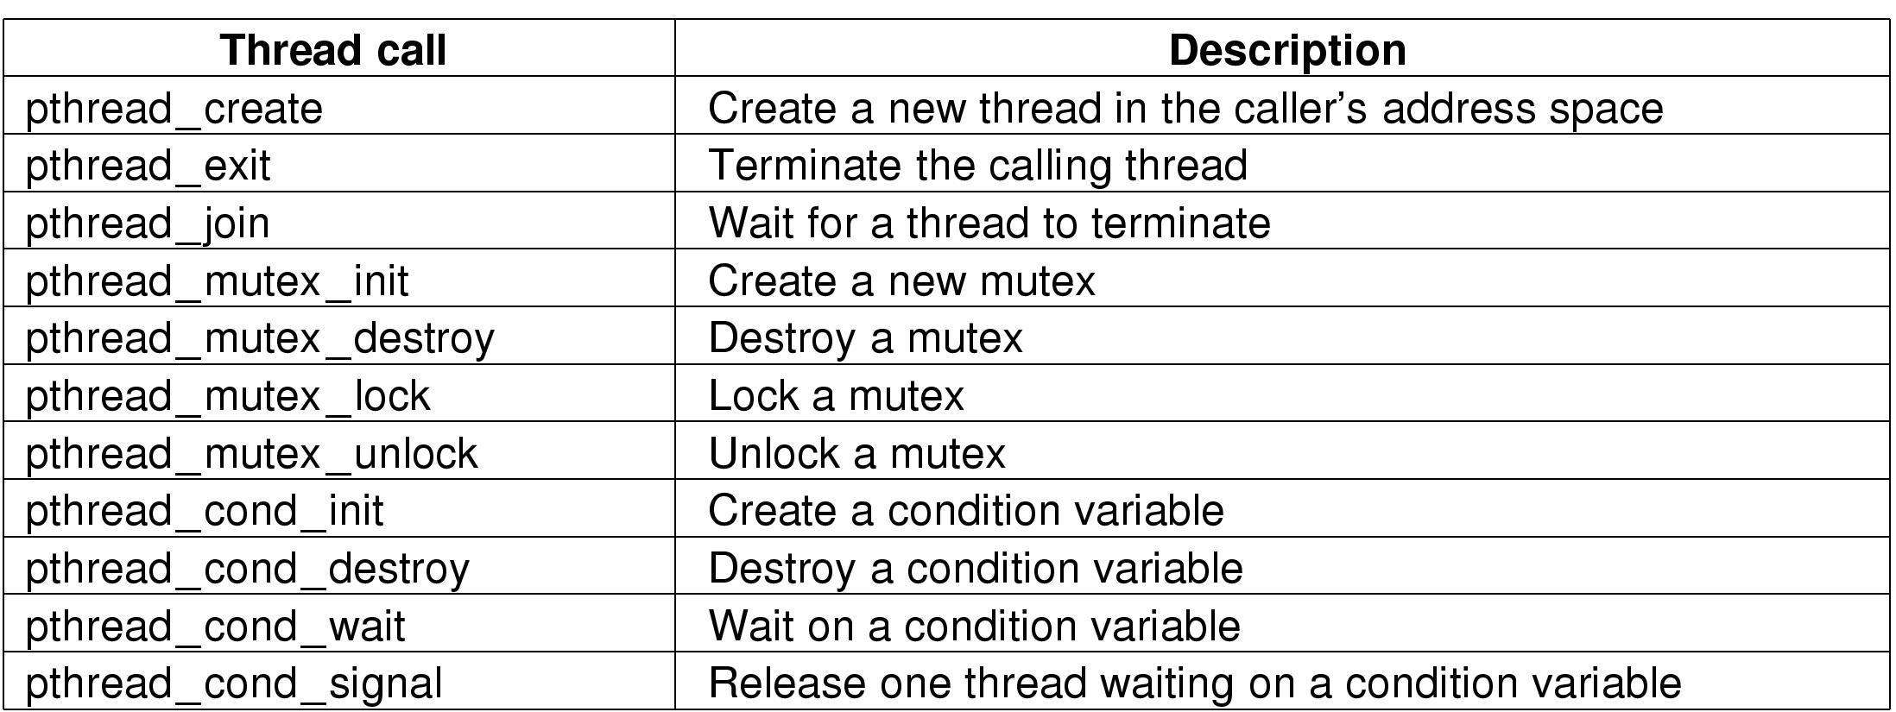
Threads in POSIX
The principal POSIX thread calls.
Operating Systems, Spring 2018, I. Dinur , D. Hendler and R. Iakobashvili

Slide 61
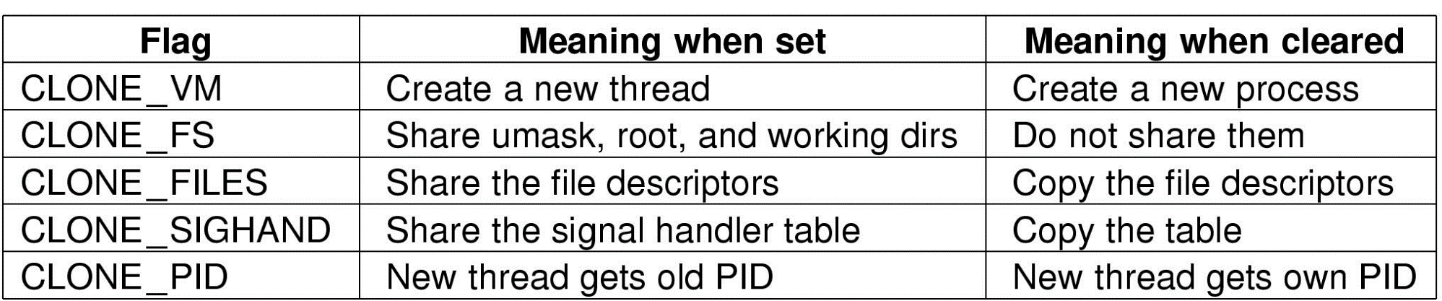
Threads – Sharing options (Linux)
Pid = clone(function, stack_ptr, sharing_flags, arg);
Bits in the sharing_flags bitmap
Operating Systems, Spring 2018, I. Dinur , D. Hendler and R. Iakobashvili

Slide 62
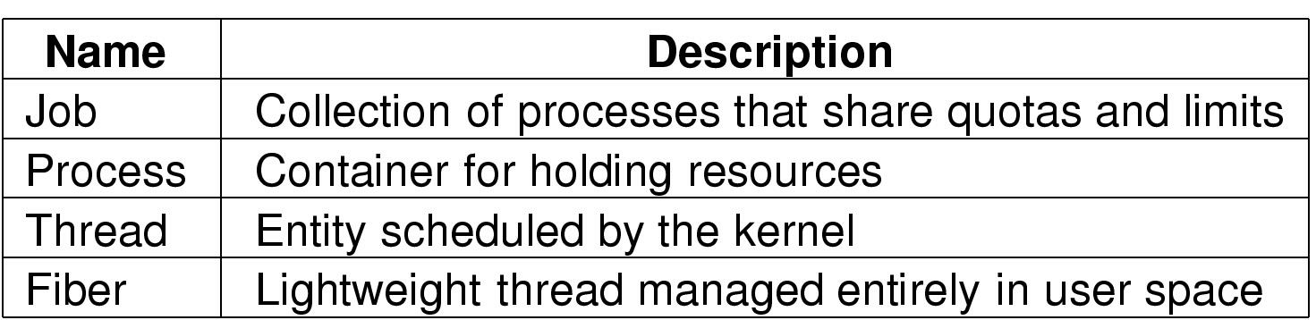
Windows – Processes and Threads
Basic concepts used for CPU and resource management
Operating Systems, Spring 2018, I. Dinur , D. Hendler and R. Iakobashvili

Slide 63
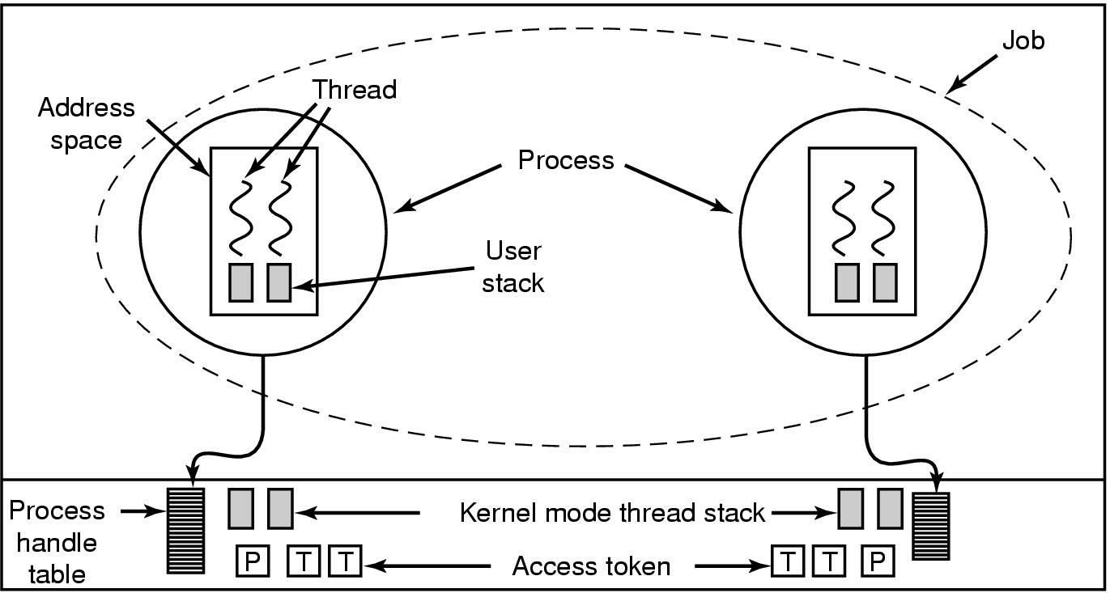
Windows: jobs, processes, threads
Relationship between jobs, processes,
threads (fibers not shown in figure)
Operating Systems, Spring 2018, I. Dinur , D. Hendler and R. Iakobashvili

Slide 64
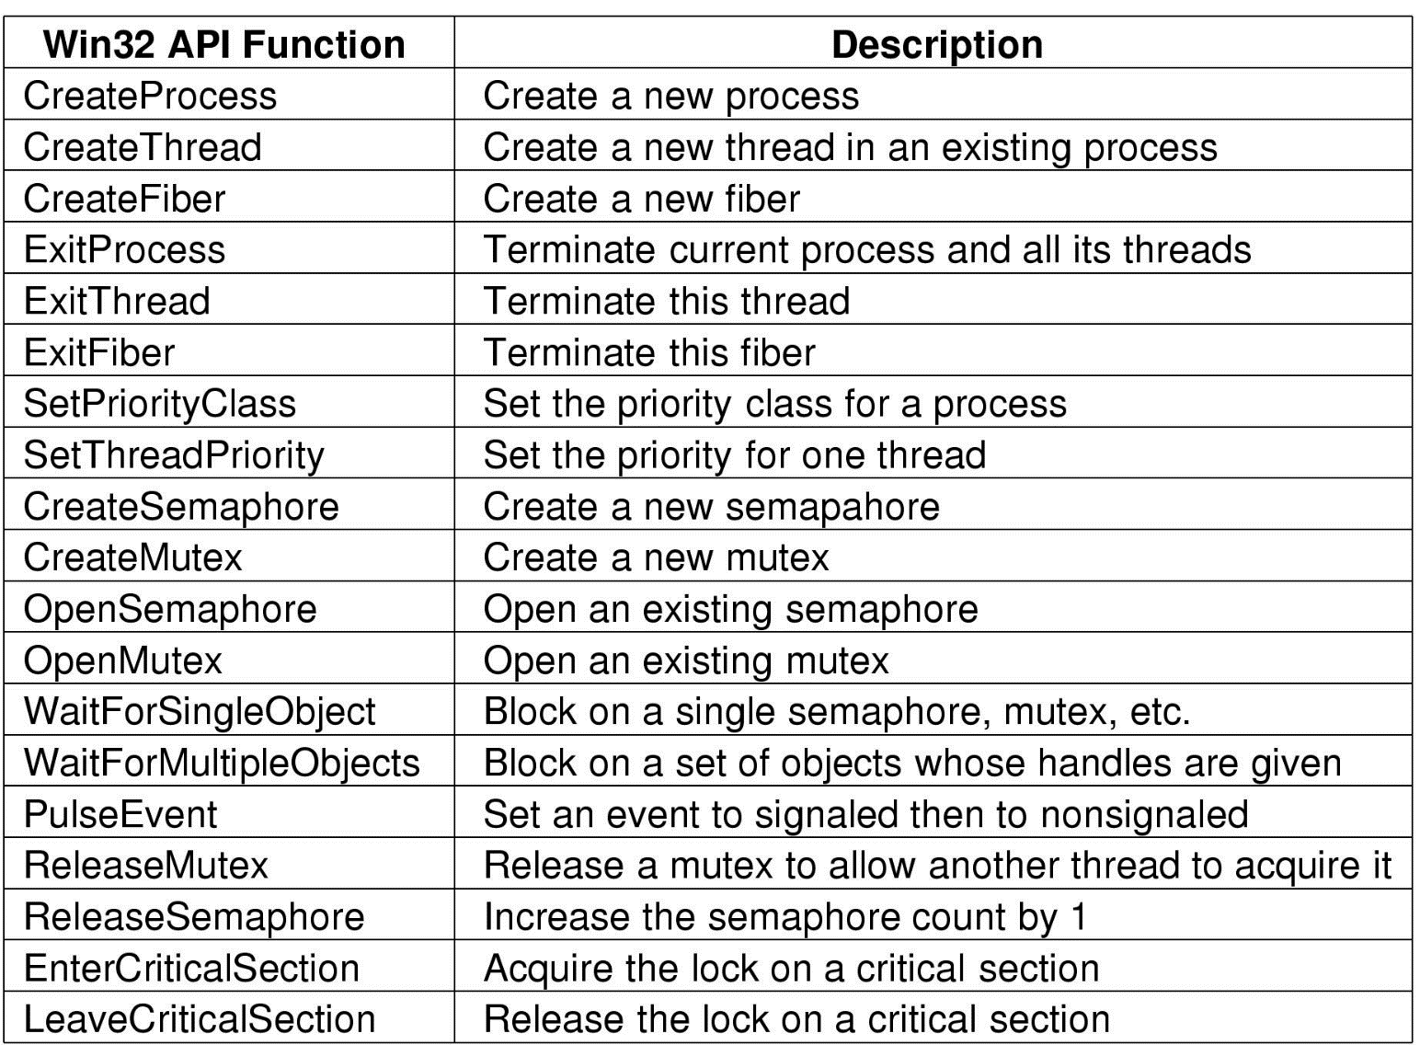
Job, Process, Thread & Fiber - Mgmt. API Calls
Some Win32 calls for managing processes, threads and fibers
Operating Systems, Spring 2018, I. Dinur , D. Hendler and R. Iakobashvili

Slide 65
Inter-Process Communication
Shared memory – the fastest way
  Need to avoid race conditions
Non-shared Memory:
  File/Pipes
  Unbuffered messages - Rendezvous
  Buffered messages – Mailboxes and Sockets
  Sockets: Address – Domain+Port
  Sockets: Types – Stream or Datagrams
  Sockets: API: Socket, Bind, Connect, Read/Write
Operating Systems, Spring 2018, I. Dinur , D. Hendler and R. Iakobashvili

