Slide 1
RT-OS-I Basics and RT-Scheduling
Version 2.1, September 2020
Robert Iakobashvili, robert@ghotit.com

Slide 2
RT-Basics
Definitions
An RT-OS means that results to come within specific deadlines.
Classified by consequences of not meeting the deadlines:
A Safety-Critical System is a type of RT-OS with catastrophic consequences
A Hard RT System guarantees meeting the deadlines for all RT-Tasks. No value of a result after the deadline
A Soft RT System provides prioritization of RT-Tasks over non-RT tasks. It meets most deadlines most of the time. There is still value of a result after the deadline
Embedded System != RT-OS
Hard-RT: VxWorks, QNX (Blackberry, Infotainment for Automotive), LynxOS (military), eCos, GreenHills Integrity (avionics)
Soft-RT: RT-Linux, Windows-CE.

Slide 3
RT-Basics
Features and Memory-Addressing
Less features than in Desktop/Server OS:
Some RT-OSes are single-purpose, i.e. packet switching or routing, directing a missile, GPS interfacing and shortest path calculation
No user-interfacing with UI
Limited hardware capabilities
Memory Addressing:
Real Addressing working with physical addresses – very rare nowadays
Relocation Addressing – adding a relocation register value for translation
Full VM implementation

Slide 4
RT-Basics
Implementation Requirements
Preemptive kernel
Priority-based preemptive scheduler
Low latency
Minimized jitter (maximized predictability) i.e. variations of packet latency or deviation from true periodicity in relation to a reference clock signal
Event Latency – time from an event comes till the action is done (car brake applied -> car fully stops).
Interrupt Latency – time from when an interrupts comes till the start of the ISR function
Dispatch Latency of Scheduler – time required by Scheduler to stop one task and start another

Slide 5
RT Scheduling
RT Isn’t Fair
The main goal of an RT-Scheduler is to meet the deadlines for all scheduled RT-tasks.
Forget about:
maximum CPU-utilization
best throughput
minimum average turnaround
response and waiting times
all are less relevant or irrelevant.
If you have a deadline for your OS-assignment today, there’s no time and no bandwidth for fairness. You are doing the most urgent task to meet the deadline.
Fairness never helps you to meet the deadline.

Slide 6
RT Scheduling
RT Scheduling Policies
Which Scheduling Algorithm guarantees meeting all deadlines for a given taskset?
How to prove that a given Scheduling Algorithm will work for a certain workload?
What is the meaning of the term “optimal algorithm” for RT-Scheduling?

Slide 7
RT Scheduling
Job Timing – Definitions
a – arrival (release) time – when job is ready for exec
d – absolute deadline – when the job to be completed
s / f – when the job starts/finishes
C – computation time or Worst Case Execution Time (WCET) – the time length necessary for CPU to compete the job without interruptions
R – response time – the time length since arrival till job finishes: (f – a)
D – relative deadline – the time length since arrival till the absolute deadline: (d - a)
Missing the Deadline: if R > D or f > d
C=WCET
time
a
s
f
d
R
D

Slide 8
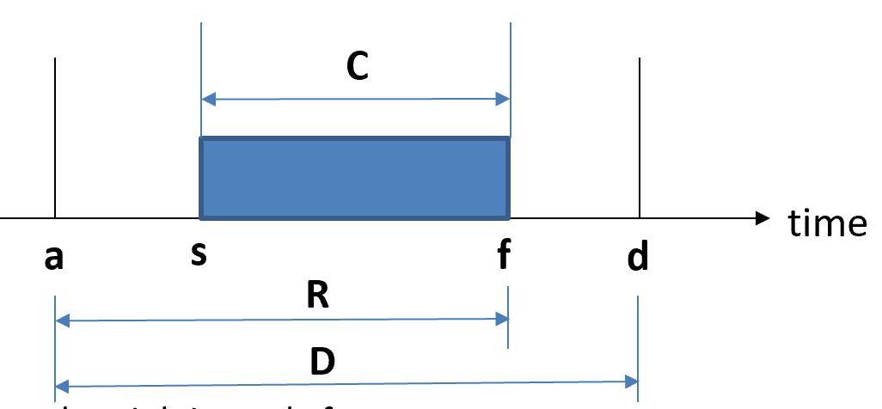
RT Scheduling
Job Timing - Definitions 1(Continued)
Total Utilization of all RT-Tasks: U = ∑ (Ci/Pi).
P is activation period usually equal to relative deadline D
If U > number of CPUs, the scheduler cannot meet all deadlines – the load is too high.
An RT-Task is characterized by: Task (C, D, P)

Slide 9
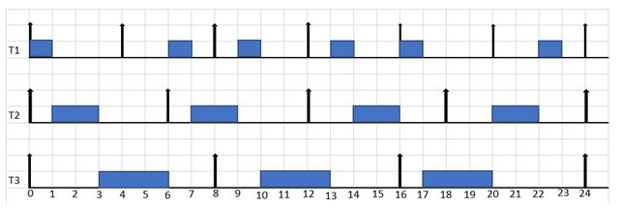
RT Scheduling
Earliest Deadline First (EDF)
EDF – no assumption on periodicity of tasks:
periodic tasks, aperiodic tasks or a mix of periodic and aperiodic tasks
Arrival/Release time zero (0) for the tasks:
T1 (1,4,4), T2 (2,6,6) and T3 (3,8,8)
Task (C, D, P), U = ∑ (Ci/Pi)
U = 1/4 + 2/6 + 3/8 = 0.250 + 0.333 + 0.375 = 0.958 – feasible for 1 CPU
ל T1 נשאר רק 3 עד לD
ל T2 נשאר 5 יח זמן עד לD
ל T3 נשאר 7 יח זמן עד לD
לכן T1 נבחר להרצה
D=4
C=1
ETF=4
ETF=2
ETF=3
D=6
C=2
ETF=5
ETF=5
D=8
C=3
ETF=5
ETF=6
Notes:
בכל רגע החלטה את מי להריץ בודקים למי יש ETF הקצר ביותר ואותו מריצים למשך C יחידות זמן

Slide 10
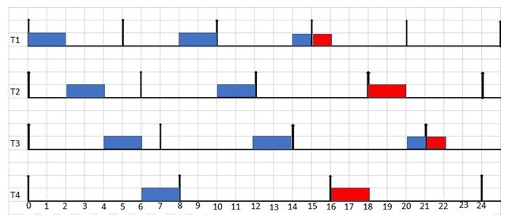
RT Scheduling
Earliest Deadline First (EDF) - continued
EDF – Transient Overload and Domino Effect
Arrival/Release time zero (0) for the tasks:
T1 (2,5,5), T2 (2,6,6), T3 (2,7,7) and T4 (2,8,8)
U = 2/5 + 2/6 + 2/7 + 2/8 = 0.4 + 0.333 + 0.286 + 0.25 = 1.269 – not feasible

Slide 11
RT Scheduling
Optimal Algorithm - Definition
For RT, “optimality” is a fundamental property of a scheduling meaning that an algorithm can meet all task deadlines when the total utilization demand does not exceed the capacity of the processors in the system.
EDF is an optimal algorithm for the following conditions:
single processor
processor preemption is allowed
no contention for (non-preemptable) resources
arbitrary release times and arbitrary deadlines
For the proof and more details:
http://www.cs.fsu.edu/~baker/realtime/restricted/notes/edfscheduling.html
An optimal algorithm always has a feasible schedule if such schedule exists under any other algorithm.

Slide 12
RT Scheduling
Recurrent Tasks
Same jobs released recurrently could be modeled by a recurrent task
Periodic Task ti: jobs are released periodically with period Ti
A phase F indicates when the first job was released
A relative deadline Di for each job from task ti
(F, C, T, D) is the characteristic function where C is taken as WCET (C=WCET)
Sporadic Task ti: jobs are released sporadically with Ti as the minimal time between two consecutive job releases
A relative deadline Di for each job from task ti
(C, T, D) is the characteristic function where C is taken as WCET
Aperiodic Task: Identical jobs released arbitrarily
Notes:
worst-case execution time (WCET)
סְפּוֹרָדִי - זכר
מופיע בסדר לא קבוע ולא רצוף; אקראי; ארעי; רנדומלי

Slide 13
RT Scheduling
Recurrent Tasks - Monotonic Scheduling Algos
The term “rate monotonic” derives from a method of assigning priorities to a set of tasks as a monotonic function of their rates.
A function is called monotonic if and only if:
it is either entirely non-increasing
It is entirely non-decreasing.
Scheduling and feasibility for:
Static Priority Scheduling: RM and DM
Dynamic Priority Scheduling: EDF

Slide 14
RT Scheduling
ל T1 זמן מחזור קצר הוא בעדיפות
T3 נקטע לאחר 3 כי ל1T עדיפות
לכן T1 נבחר להרצה
Rate-Monotonic (RM) Scheduling
Liu and Layland: A task with a smaller period has higher priority.
Example using T(C,T,D): T1 = (1,6,6), T2=(2,8,8) and T3(4,12, 12)
T1
T1
T1
T1
0
2
4
6
8
10
12
14
16
18
20
22
24
T2
T2
T2
0
2
4
6
8
10
12
14
16
18
20
22
24
T3
T3
T3
T3
0
2
4
6
8
10
12
14
16
18
20
22
24

Slide 15
RT Scheduling
Deadline-Monotonic (DM) Scheduling
Leung and Whitehead: A task with a smaller relative deadline has higher priority.
D – relative deadline – the time length since arrival till the absolute deadline: (d - a)
Example using T(C,T,D): T1 = (2,8,4), T2=(1,6,6) and T3(4,12, 12)
D=4
D=4
T1
D=4
T1
T1
0
2
4
6
8
10
12
14
16
18
20
22
24
D=6
D=6
D=6
D=6
T2
T2
T2
T2
0
2
4
6
8
10
12
14
16
18
20
22
24
D=12
D=12
T3
T3
T3
T3
0
2
4
6
8
10
12
14
16
18
20
22
24

Slide 16
RT Scheduling
RM/DM Schedulability and Optimality
Example using T(C,T,D): T1 = (2,5,5), T2=(4,7,7)
U = 2/5 + 4/7 = 0.97 - Schedulable, but missing the deadline
U < 1 is not enough for RM. However, its fine by EDF.
So, is RM an optimal algorithm?
T1
T1
T1
T1
0
2
4
6
8
10
12
14
16
18
20
T2
T2
0
2
4
6
8
10
12
14
16
18
20
Missing the deadline for T2

Slide 17
RT Scheduling
RM/DM Schedulability and Optimality – Continued
Liu and Layland, "Scheduling algorithms for multiprogramming in a hard real-time environment", Journal of the ACM, 1973, 20 (1): 46–61, proved that for RM the bound is:
n (2 ^{1/n} -1) >= 0.693, n – number of independent preemptable periodic tasks
Let U = ∑ (Ci/Pi) and B(n) = n (2 ^{1/n} -1).
Three possible outcomes:
0 <= U <= B(n): schedulable
B(n) < U <=1: no conclusion
1 < U: overload
Utilization test is too conservative. Precise/Exact test exists but beyond the scope. Just a spoiler: Worst-case response time for each task Ri <= Di
RM is an optimal algorithm. For the proof and more details: https://www.iiitd.edu.in/~amarjeet/EmSys2013/UCLA-EE202a-L05-RateMonotonic.pdf

Slide 18
RT Scheduling
RM vs EDF
RM | EDF
Low overhead of scheduling: O(1) with priority sorting in advance | High overhead of scheduling: O(log n) with AVL tree
For static-priority | For dynamic priority. Optimal
The exact schedulability test is complex, but boundary test is simple | Schedulability test is easy (D == T)
Least upper bound of U: 0.693 | Least upper bound of U: 1.0 (D == T)
In general, requires more preemption. | In general, requires less preemption.
Practice: easy to implement. | Practice: Complex to implement due to dynamic priorities, but there are known industry designs (Linux).
Rather stable. Even if some lower priority tasks fail to meet the deadlines, others still can do it. | Not stable. If a task fails to meet its deadline, the system may fail due to domino effect. Admission control is desired.

Slide 19
Linux and Real-Time
General vs RT Systems
RT systems:
Timing guarantees
Worst case is under scrutiny
General purpose systems:
High throughput
Fairness
Average-case is considered
Vanilla Linux (from www.kernel.org):
General-purpose OS
A broad range of functionalities
Optimized for average-case
Latency could be high and unbounded

Slide 20
Linux and Real-Time
Why Linux is not a RT System?
HW-interaction is done by kernel:
However, most user applications are running in user-space
Kernel is not preempted by user-tasks:
If the highest priority user thread is scheduled, it cannot preempt kernel activities
Latency above 100 msec is a reality
Linux is using classic time-sharing scheduling algorithms.

Slide 21
Linux and Real-Time
How to make from vanilla Linux a Real-Time OS?
Who is Ingo Molnar?
CONFIG_PREEMPT_RT patch from https://wiki.linuxfoundation.org/realtime/start
“Reduce” the special status of kernel tasks:
Outside of spinlocks and interrupts, kernel could be preempted
Worst-case latency drops to 1 -10 msec
Preemptible locking rtmutex:
rtmutexes are using priority inheritance protocol
Linux semaphores and spinlocks upgraded:
Now using priority inheritance protocol
More spinlocks to decrease latency

Slide 22
Linux and Real-Time
How to make from vanilla Linux a Real-Time OS?
Interrupt handlers:
Converted to pre-emptible kernel threads
High resolution POSIX timers implemented for user-space
Linux for Soft Real-Time starts to be an option. Still, application developers should care about:
Preventing paging (lock all pages allocated by mlockall())
Start all threads at the program start and touch all page threads
Don’t use system calls like mmap2 leading to page faults
Make all allocations to memory pools at the program start
DMA activities
Firmware housekeeping activities

Slide 23
Linux and Real-Time
Linux Scheduling
SCHED_OTHER / SCHED_NORMAL
Standard Round-Robin time-sharing policy
SCHED_BATCH
Round-Robin. Tasks are assumed to be non-interactive and CPU-bound with default slice of 1.5 sec. Cache-friendly policy.
SCHED_IDLE
Round-Robin with higher slice given to low-priority tasks
SCHED_FIFO
POSIX RT-class. FIFO without time-slicing
SCHED_RR
POSIX RT-class. RR time-slices with preemption

Slide 24
Linux and Real-Time
Linux Scheduling – SCHED_DEADLINE
SCHED_DEADLINE – a new policy delivered by the patch
EDF scheduler
Constant Bandwidth Server (CBS) Scheduling to help with:
Stability of EDF
Domino Effect prevention
CBS makes:
Admission Control
Task CPU utilization accounts
Complex accounts seems to be working
“Soft” tasks are more constrained

