Slide 1
Scheduling: high-level goals
Interleave the execution of processes to maximize CPU utilization while providing reasonable response time
The scheduler determines:
    Who will run
    When it will run
    For how long
Operating Systems, Spring 2018, I. Dinur, D. Hendler and R. Iakobashvili

Slide 2
Scheduling algorithms: quality criteria
Fairness: Comparable processes should get comparable service
Efficiency: keep CPU and I/O devices busy
Response time: minimize, for interactive users
Turnaround time: average time for a job to complete
Waiting time: minimize the average time in ready queue
over processes
Throughput: number of completed jobs per time unit
Operating Systems, Spring 2018, I. Dinur, D. Hendler and R. Iakobashvili

Slide 3
More on quality criteria
Throughput – number of processes completed per unit time
Turnaround time – interval of time from process submission to completion
Waiting time – sum of time intervals the process spends in the ready queue
Response time – the time between submitting a command and the generation of the first output
CPU utilization – the percentage of time in which the CPU is not idle
Operating Systems, Spring 2018, I. Dinur, D. Hendler and R. Iakobashvili

Slide 4
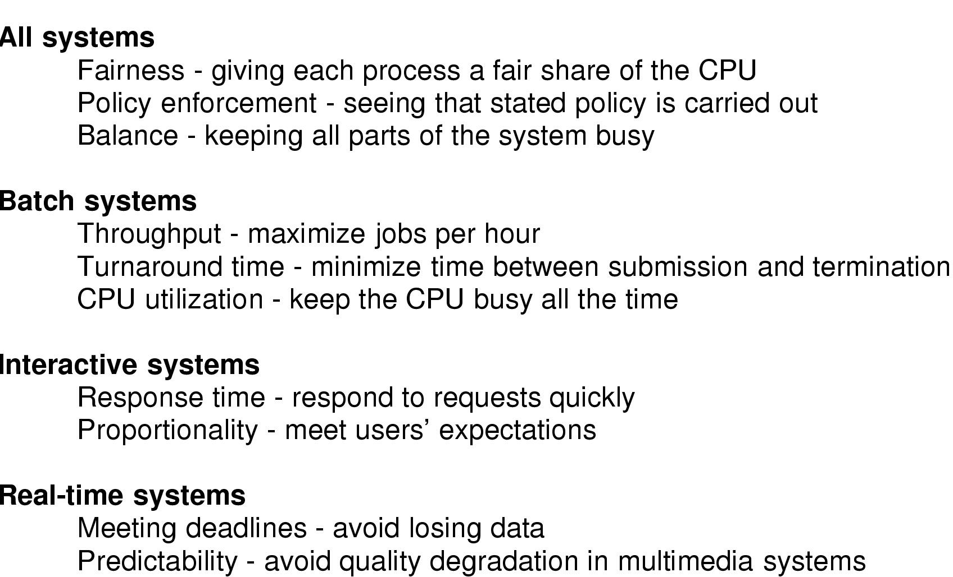
Criteria by system type
Operating Systems, Spring 2018, I. Dinur, D. Hendler and R. Iakobashvili

Slide 5
Conflicting Goals
Response Time vs. Turnaround time:
A conflict between interactive and batch users
Fairness vs. Throughput:
How should we schedule very long jobs?
Operating Systems, Spring 2018, I. Dinur, D. Hendler and R. Iakobashvili

Slide 6

Scheduling – Types of behavior
Bursts of CPU usage alternate with periods of I/O wait
  CPU-bound processes
  I/O bound processes
Operating Systems, Spring 2018, I. Dinur, D. Hendler and R. Iakobashvili

Slide 7
CPU Utilization vs. Turnaround time
We have 5 interactive jobs i1…i5 and one batch job b
Interactive jobs: 10% CPU; 20% disk I/O; 70% terminal I/O; total time for each job 10 sec.
Batch job: 90% CPU; 10% disk I/O; total time 50 sec.
Cannot run all in parallel !!
i1..i5 in parallel - disk I/O is 100% utilized
b and one i in parallel - CPU is 100% utilized
Operating Systems, Spring 2018, I. Dinur, D. Hendler and R. Iakobashvili

Slide 8
CPU utilization vs. Turnaround time (II)
Two possible schedules:
1. First i1…i5, then b
UT = (10x0.5 + 50x0.9)/60 = 83%
TA = (10x5 + 60x1)/6 = 18.33sec.
2. b and each of the i’s (in turn) in parallel:
UT = (50x(0.9+0.1))/50 = 100%
TA = (10+20+30+40+50+50)/6 = 33sec.
Operating Systems, Spring 2018, I. Dinur, D. Hendler and R. Iakobashvili

Slide 9
When are Scheduling Decisions made ?
1. Process switches from Running to Waiting (e.g. I/O)
2. New process created (e.g. fork)
3. Upon clock interrupt
4. Process switches from Waiting to Ready (e.g. I/O completion)
5. Process terminates
6. Process yields
Non-preemptive scheduler:
Process runs until it blocks, terminates, or voluntarily releases CPU
Which of above possible for non-preemptive scheduling?
1,5,6
Operating Systems, Spring 2018, I. Dinur, D. Hendler and R. Iakobashvili

Slide 10
Scheduling: outline
Scheduling criteria
Scheduling algorithms
Unix scheduling
Linux scheduling
Win 8 scheduling
Operating Systems, Spring 2018, I. Dinur, D. Hendler and R. Iakobashvili

Slide 11
First-come-first-served (FCFS) scheduling
Processes get the CPU in the order they request it and run until they release it
Ready processes form a FIFO queue
Operating Systems, Spring 2018, I. Dinur, D. Hendler and R. Iakobashvili

Slide 12
FCFS may cause long waiting times
Process
Burst time (milli)
P1
24
P2
3
P3
3
If they arrive in the order P1, P2, P3, we get:
P1
P2
P3
0
24
27
30
Average waiting time:
(0+24+27) / 3 = 17
Operating Systems, Spring 2018, I. Dinur, D. Hendler and R. Iakobashvili

Slide 13
FCFS may cause long waiting times (cont’d)
Process
Burst time (milli)
P1
24
P2
3
P3
3
If they arrive in the order P1, P2, P3, average waiting time 17
What if they arrive in the order P2, P3, P1?
P2
P3
P1
0
3
6
30
Average waiting time:
(0+3+6) / 3 = 3
Operating Systems, Spring 2018, I. Dinur, D. Hendler and R. Iakobashvili

Slide 14
(Non preemptive) Shortest Job First (SJF) scheduling
The CPU is assigned to the process that has the smallest next CPU burst
In some cases, this quantity is known or can be approximated
Process
Burst time (milli)
A
5
B
2
C
4
FCFS schedule
D
1
A
B
D
C
Average waiting time: 5.75
0
5
7
11
12
SJF schedule
D
B
C
A
Average waiting time: 2.75
0
1
3
7
12
Operating Systems, Spring 2018, I. Dinur, D. Hendler and R. Iakobashvili

Slide 15
Approximating next CPU-burst duration
Can be done by using the length of previous CPU bursts
  t_{n} = actual length of n^{th} CPU burst
  T_{n+1} = predicted value for the next CPU burst
  for 0 ≤ α ≤ 1 define the exponential average:
  T_{n+1} = α t_{n}+ (1 - α ) T_{n}
  α determines the relative weight of recent bursts
Operating Systems, Spring 2018, I. Dinur, D. Hendler and R. Iakobashvili

Slide 16
Non-preemptive SJF: example
(varying arrival times)
Process
Arrival time
Burst time
P1
0
7
P2
2
4
P3
4
1
P4
5
4
Non-preemptive SJF schedule
P1
P3
P2
P4
0
2
4
5
7
8
12
16
P2
P3
P4
Average waiting time:
(0+6+3+7) / 4 = 4
Operating Systems, Spring 2018, I. Dinur, D. Hendler and R. Iakobashvili

Slide 17
Preemptive SJF (Shortest Remaining Time First)
Process
Arrival time
Burst time
P1
0
7
P2
2
4
P3
4
1
P4
5
4
Preemptive SJF schedule
P1
P2
P3
P2
P4
P1
0
2
4
5
7
11
16
P1(5)
P2(2)
P4(4)
Average waiting time:
(9+1+0+2) / 4 = 3
Operating Systems, Spring 2018, I. Dinur, D. Hendler and R. Iakobashvili

Slide 18
Yet another example
Process | Arrival Time | Service Time
1 | 0 | 3
2 | 2 | 6
3 | 4 | 4
4 | 6 | 5
5 | 8 | 2
Operating Systems, Spring 2018, I. Dinur, D. Hendler and R. Iakobashvili

Slide 19
First-Come-First-Served (FCFS)
Each process joins the Ready queue
When the current process finishes executing, the oldest process in the Ready queue is selected
Average waiting time is 4.6; Average Turnaround is 8.6
0
5
10
15
20
1
2
3
4
5
Operating Systems, Spring 2018, I. Dinur, D. Hendler and R. Iakobashvili

Slide 20
Shortest Remaining Time First - SRTF
Preemptive version of the ‘Shortest Job First’ policy
Must estimate processing time
Average waiting time is 3.2; Average Turnaround is 7.2
0
5
10
15
20
1
2
3
4
5
Operating Systems, Spring 2018, I. Dinur, D. Hendler and R. Iakobashvili

Slide 21
Round Robin - the oldest method
Each process gets a small unit of CPU time (time-quantum), usually 10-100 milliseconds
For n ready processes and time-quantum q, no process waits more than (n - 1)q
Approaches FCFS when q grows
Time-quantum ~ switching time (or smaller)
    relatively large waste of CPU time
Time-quantum >> switching time
    long response (waiting) times, FCFS
Operating Systems, Spring 2018, I. Dinur, D. Hendler and R. Iakobashvili

Slide 22
Context switch overhead
Context Switching is time consuming
Choosing a long time quantum to avoid switching:
  Deteriorates response time.
  Increases CPU utilization
Choosing a short time quantum:
  Faster response
  CPU wasted on switches
Operating Systems, Spring 2018, I. Dinur, D. Hendler and R. Iakobashvili

Slide 23
Context switch overhead - example
Assume a context switch takes 5 milliseconds
Switching every 20 ms. quantum would mean 20% of the CPU time is wasted on switching
Switching after a 500 ms. quantum and having 10 concurrent users could possibly mean a 5 second response time
possible solution: settle for 100 ms.
Operating Systems, Spring 2018, I. Dinur, D. Hendler and R. Iakobashvili

Slide 24
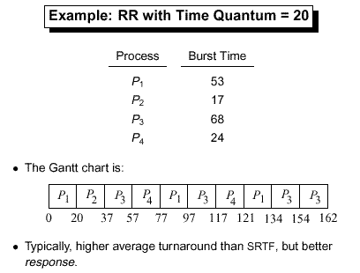
Operating Systems, Spring 2018, I. Dinur, D. Hendler and R. Iakobashvili

Slide 25
Guaranteed (Fair-share) Scheduling
To achieve guaranteed 1/n of cpu time (for n processes/users logged on):
Monitor the total amount of CPU time per process and the total logged on time
Calculate the ratio of allocated cpu time to the amount of CPU time each process is entitled to
Run the process with the lowest ratio
Switch to another process when the ratio of the running process has passed its “goal ratio”
Operating Systems, Spring 2018, I. Dinur, D. Hendler and R. Iakobashvili

Slide 26


Guaranteed scheduling example
0
Process 1
Process 2
Process 3
Operating Systems, Spring 2018, I. Dinur, D. Hendler and R. Iakobashvili

Slide 27
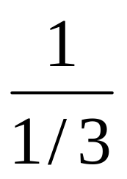
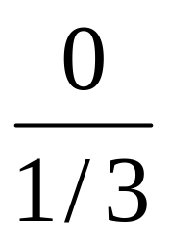
Guaranteed scheduling example
1
Process 1
Process 2
Process 3
Operating Systems, Spring 2018, I. Dinur, D. Hendler and R. Iakobashvili

Slide 28
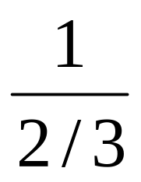
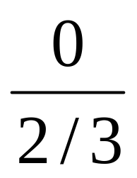
Guaranteed scheduling example
2
Process 1
Process 2
Process 3
Operating Systems, Spring 2018, I. Dinur, D. Hendler and R. Iakobashvili

Slide 29
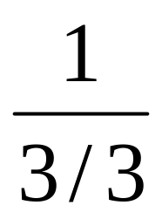
Guaranteed scheduling example
3
Process 1
Process 2
Process 3
Operating Systems, Spring 2018, I. Dinur, D. Hendler and R. Iakobashvili

Slide 30
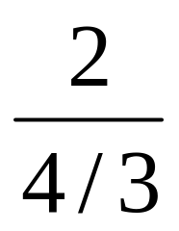
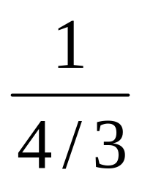
Guaranteed scheduling example
4
Process 1
Process 2
Process 3
Operating Systems, Spring 2018, I. Dinur, D. Hendler and R. Iakobashvili

Slide 31
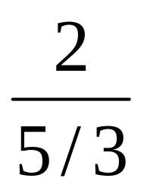
Guaranteed scheduling example
5
Process 1
Process 3
Operating Systems, Spring 2018, I. Dinur, D. Hendler and R. Iakobashvili

Slide 32
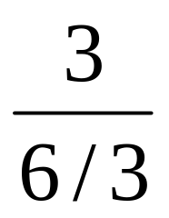
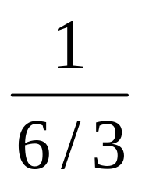
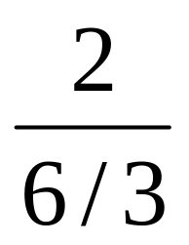
Guaranteed scheduling example
6
Process 1
Process 2
Process 3
Operating Systems, Spring 2018, I. Dinur, D. Hendler and R. Iakobashvili

Slide 33
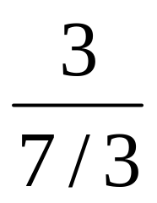
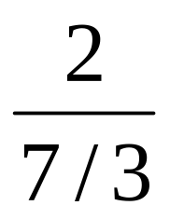

Guaranteed scheduling example
7
Process 1
Process 2
Process 3
Operating Systems, Spring 2018, I. Dinur, D. Hendler and R. Iakobashvili

Slide 34
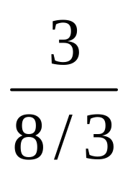
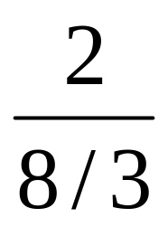
Guaranteed scheduling example
8
Process 1
Process 2
Process 3
Operating Systems, Spring 2018, I. Dinur, D. Hendler and R. Iakobashvili

Slide 35
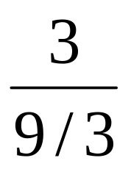

Guaranteed scheduling example
9
Process 1
Process 2
Process 3
Operating Systems, Spring 2018, I. Dinur, D. Hendler and R. Iakobashvili

Slide 36
Priority Scheduling
Select ready/runnable process with highest priority
When there are several classes of processes with the same priority:
  each priority group may use round robin scheduling
  A process from a lower priority group runs only if there is no higher-priority process waiting
Operating Systems, Spring 2018, I. Dinur, D. Hendler and R. Iakobashvili

Slide 37
Multi-Level Queue Scheduling
Highest priority
system processes
interactive processes
Interactive editing processes
Runnable processes
batch processes
Low-priority batch processes
Lowest priority
Disadvantage?
Operating Systems, Spring 2018, I. Dinur, D. Hendler and R. Iakobashvili

Slide 38
Dynamic multi-level scheduling
The main drawback of priority scheduling: starvation!
To avoid it:
Prevent high priority processes from running indefinitely by changing priorities dynamically:
  Each process has a base priority
  increase priorities of waiting processes at each clock tick
Approximation SJF scheduling
  increase priorities of I/O bound processes
  (decrease those of CPU bound processes)
    priority = 1/f (f is the fraction of time-quantum used)
Operating Systems, Spring 2018, I. Dinur, D. Hendler and R. Iakobashvili

Slide 39
Parameters defining multi-level scheduling
Number of queues and scheduling policy in each queue (FCFS, RR,…)
When to demote a process to a lower queue
Which queue to insert a process to according to:
  Elapsed time since process received CPU (aging)
  Expected CPU burst
  Process priority
Operating Systems, Spring 2018, I. Dinur, D. Hendler and R. Iakobashvili

Slide 40
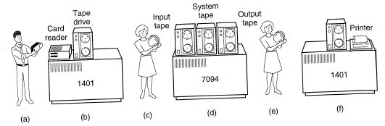
Dynamic multi-level scheduling example:
Compatible Time Sharing System (CTSS)
IBM 7094 could hold a SINGLE process in memory
Process switch was VERY expensive…
Operating Systems, Spring 2018, I. Dinur, D. Hendler and R. Iakobashvili

Slide 41
Compatible Time Sharing System (CTSS)
Assign time quanta of different lengths to different priority classes
Highest priority class: 1 quantum, 2nd class: 2 quanta, 3rd class: 4 quanta, etc.
Move processes that used their quanta to a lower class
Net result - longer runs for CPU-bound processes; higher priority for I/O-bound processes
for a CPU burst of 100 time quanta - 7 switches instead of 100 (in RR)
Operating Systems, Spring 2018, I. Dinur, D. Hendler and R. Iakobashvili

Slide 42
Highest Response Ratio Next (HRRN)
Choose next process with the highest ratio of:
Similar to non-preemptive SJF but avoids starvation
time spent waiting + expected service time
expected service time
Operating Systems, Spring 2018, I. Dinur, D. Hendler and R. Iakobashvili

Slide 43
Feedback Scheduling: example
Higher priority
quantum=8
quantum=16
Lower priority
FCFS
Demote jobs that have been running longer
Need not know remaining process execution time
Always perform a higher-priority job (preemptive)
Aging may be used to avoid starvation
Operating Systems, Spring 2018, I. Dinur, D. Hendler and R. Iakobashvili

Slide 44
Two-Level Scheduling
Recall that processes can be either in memory or swapped out (to disk)
Schedule memory-resident processes by a CPU (low-level) scheduler as before
Swap in/out by a Memory (high-level) scheduler using:
  Elapsed time since process swapped in/out
  CPU time allocated to process
  Process memory size
  Process priority
Operating Systems, Spring 2018, I. Dinur, D. Hendler and R. Iakobashvili

Slide 45
Two level scheduling
CPU
CPU scheduler
disk
Memory scheduler
Memory
Operating Systems, Spring 2018, I. Dinur, D. Hendler and R. Iakobashvili

Slide 46
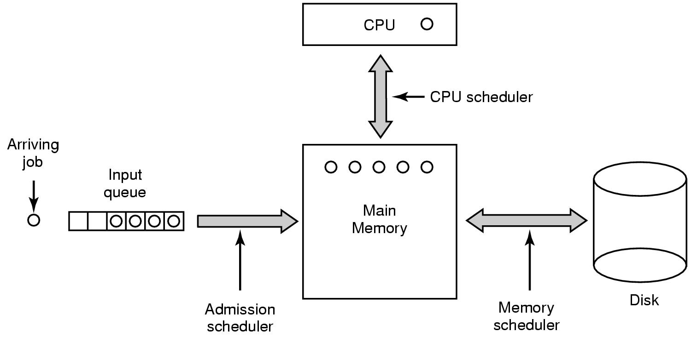
Scheduling in Batch Systems (2)
Three level scheduling
Operating Systems, Spring 2018, I. Dinur, D. Hendler and R. Iakobashvili

Slide 47
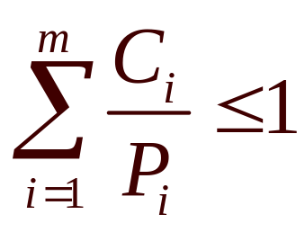
Scheduling in Real-Time Systems
Must respond to external events within fixed time (CD player, autopilot, robot control,…)
Schedulable real-time system
Given
  m periodic events
  event i occurs with period P_{i} and requires C_{i} seconds
Then the load can only be handled if
Operating Systems, Spring 2018, I. Dinur, D. Hendler and R. Iakobashvili

Slide 48
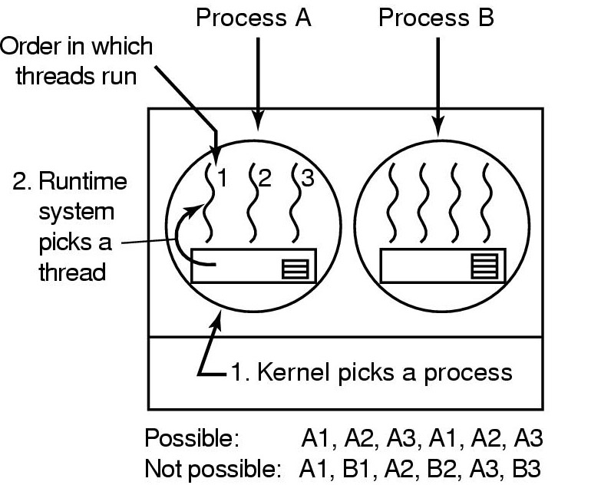
User-level Thread Scheduling
Scheduling within a 60-msec quantum, when threads have 10-msec CPU bursts
Different scheduling algorithms for threads/processes possible
No way to preempt user threads
Thread context switch much faster for user threads
Application-specific scheduling possible
Operating Systems, Spring 2018, I. Dinur, D. Hendler and R. Iakobashvili

Slide 49
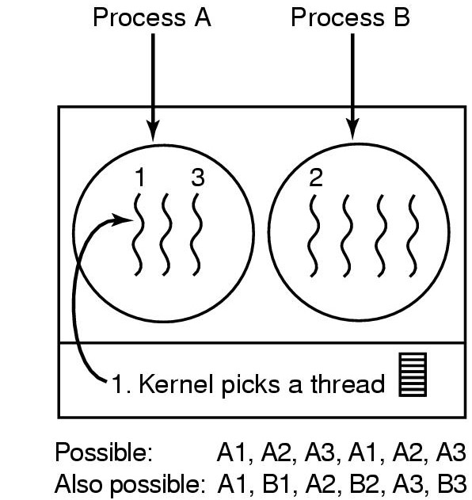
Kernel-level Thread Scheduling
Scheduling within a 60-msec quantum, when threads have 10-msec CPU bursts
Scheduler may prefer switches within same process
Context switch more expensive
A blocking thread does not block all process threads
Operating Systems, Spring 2018, I. Dinur, D. Hendler and R. Iakobashvili

Slide 50
Scheduling: outline
Scheduling criteria
Scheduling algorithms
Unix scheduling
Linux Scheduling
Win 8 scheduling
Operating Systems, Spring 2018, I. Dinur, D. Hendler and R. Iakobashvili

Slide 51
Scheduling in Unix
Two-level scheduling
Low level (CPU) scheduler uses multiple queues to select the next process, out of the processes in memory, to get a time quantum.
High level (memory) scheduler moves processes from memory to disk and back, to ensure that all processes receive their share of CPU time
Low-level scheduler keeps queues for each priority
Processes in user mode have positive priorities
Processes in kernel mode have negative priorities (lower is higher)
Operating Systems, Spring 2018, I. Dinur, D. Hendler and R. Iakobashvili

Slide 52
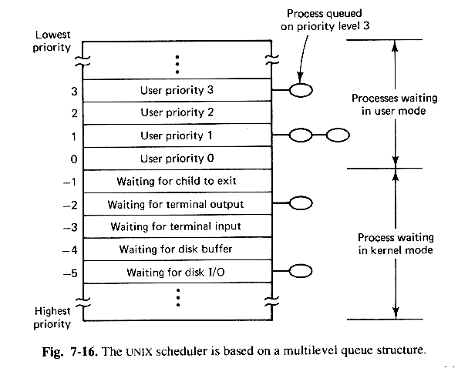
Unix priority queues
Operating Systems, Spring 2018, I. Dinur, D. Hendler and R. Iakobashvili

Slide 53
Unix low-level Scheduling Algorithm
Pick process from highest (non-empty) priority queue
Run for 1 quantum (usually 100 ms.), or until it blocks
Increment CPU usage count every clock tick
Every second, recalculate priorities:
  Divide cpu usage by 2
  New priority = base + cpu_usage + nice
  Base is negative if the process is released from waiting in kernel mode
Use round robin for each queue (separately)
Operating Systems, Spring 2018, I. Dinur, D. Hendler and R. Iakobashvili

Slide 54
Unix low-level scheduling Algorithm - I/O
Blocked processes are removed from queue, but when the blocking event occurs, are placed in a high priority queue
The negative priorities are meant to release processes quickly from the kernel
Negative priorities are hardwired in the system, for example, -5 for Disk I/O is meant to give high priority to a process released from disk I/O
Interactive processes get good service, CPU bound processes get whatever service is left...
Operating Systems, Spring 2018, I. Dinur, D. Hendler and R. Iakobashvili

Slide 55
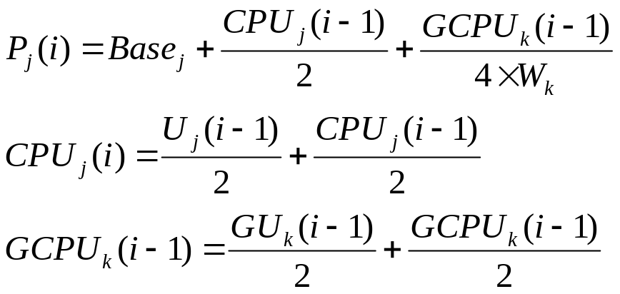

Priority Calculation in Unix
P_{j}(i) = Priority of process j at beginning of interval i
Base_{j} = Base priority of process j
U_{j}(i) = Processor utilization of process j in interval i
Gu_{k}(i) = Total processor utilization of all processes in group k during interval i
CPU_{j}(i) = Exponentially weighted average processor utilization by
process j through interval i
GCPUk(I)= Exponentially weighted average total processor utilization of group k
through interval i
W_{k} = Weighting assigned to group k, with the constraint that 0 ≤ W_{k} ≤ 1
and
Operating Systems, Spring 2018, I. Dinur, D. Hendler and R. Iakobashvili

Slide 56
Scheduling: outline
Scheduling criteria
Scheduling algorithms
Unix scheduling
Linux Scheduling
Win 8 scheduling
Operating Systems, Spring 2018, I. Dinur, D. Hendler and R. Iakobashvili

Slide 57
Three classes of threads
Real-time FIFO
  Have highest priority, can only be preempted by a higher-priority real-time FIFO thread
Real-time round robin
  Assigned time quantum
Timesharing
  Priorities 100-139
Priority determines the number of clock ticks (jiffys) assigned to a round-robin or timesharing thread
Operating Systems, Spring 2018, I. Dinur, D. Hendler and R. Iakobashvili

Slide 58
Linux runqueues
Per-CPU runqueue
<…>
Active
T
Priority 0
Expired
T
T
T
<…>
T
T
Priority 139
Array[0]
T
T
Priority 0
Array[1]
T
T
Priority 139
Operating Systems, Spring 2018, I. Dinur, D. Hendler and R. Iakobashvili

Slide 59
Linux runqueues (cont'd)
Per-CPU runqueue
<…>
Active
T
Priority 0
Expired
T
T
T
<…>
T
T
Priority 139
Array[0]
T
T
Priority 0
Array[1]
T
T
Priority 139
Scheduler selects tasks from highest-priority active queue
  If time-slice expires – moved to an expired list
  If blocked then, when event arrives, returned to active queue (with smaller time-slice)
Higher-priority threads receive larger quanta
When no more active tasks – swap active and expired pointers
Operating Systems, Spring 2018, I. Dinur, D. Hendler and R. Iakobashvili

Slide 60
Multiprocessor support
Runqueue per processor
Affinity scheduling
Perform periodic load-balancing between runqueues
  But in most cases, a process will run on the same process it ran before.
Operating Systems, Spring 2018, I. Dinur, D. Hendler and R. Iakobashvili

Slide 61
Scheduling: outline
Scheduling criteria
Scheduling algorithms
Unix scheduling
Linux Scheduling
Win 8 scheduling
Operating Systems, Spring 2018, I. Dinur, D. Hendler and R. Iakobashvili

Slide 62
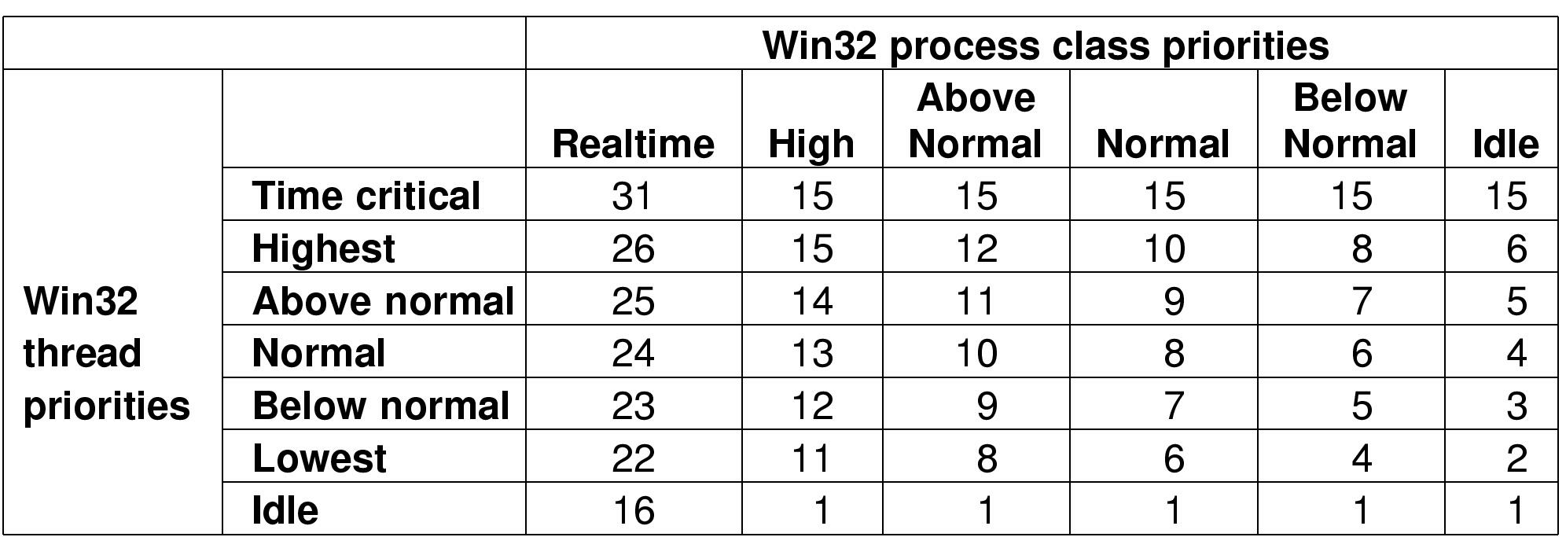
WINDOWS 8 Scheduling
Mapping of Win32 priorities to Windows 2000 priorities
Operating Systems, Spring 2018, I. Dinur, D. Hendler and R. Iakobashvili

Slide 63
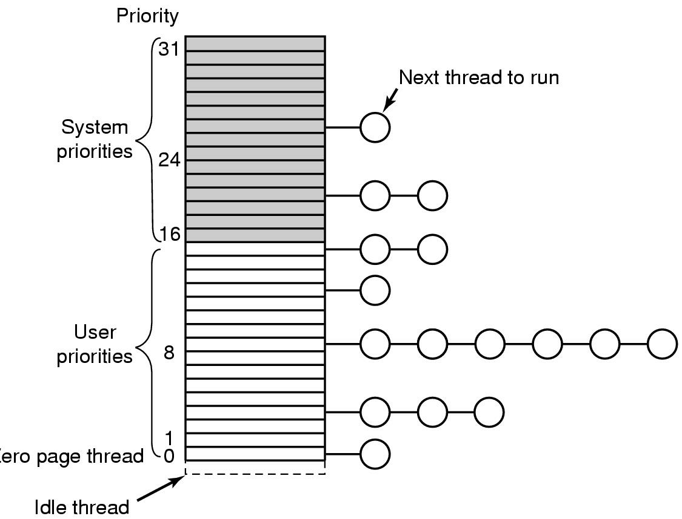
WINDOWS 8 Scheduling (II)
Windows 2000 supports 32 priorities for threads
Operating Systems, Spring 2018, I. Dinur, D. Hendler and R. Iakobashvili

Slide 64
Windows 8 scheduling: dynamic changes
Priority is raised:
  Upon I/O completion (disk: 1, serial line: 2, keyboard: 6, sound card: 8)
  Upon event reception (semaphore, mutex…): by 2 if in the foreground process, by 1 otherwise
  If a thread waits `too much’ – it is moved to priority 15 for two quanta (for solving priority inversion – see next slide)
Priority is decreased:
  By 1 if quantum is fully used
  Never bellow base value (normal thread priority)
Operating Systems, Spring 2018, I. Dinur, D. Hendler and R. Iakobashvili

Slide 65
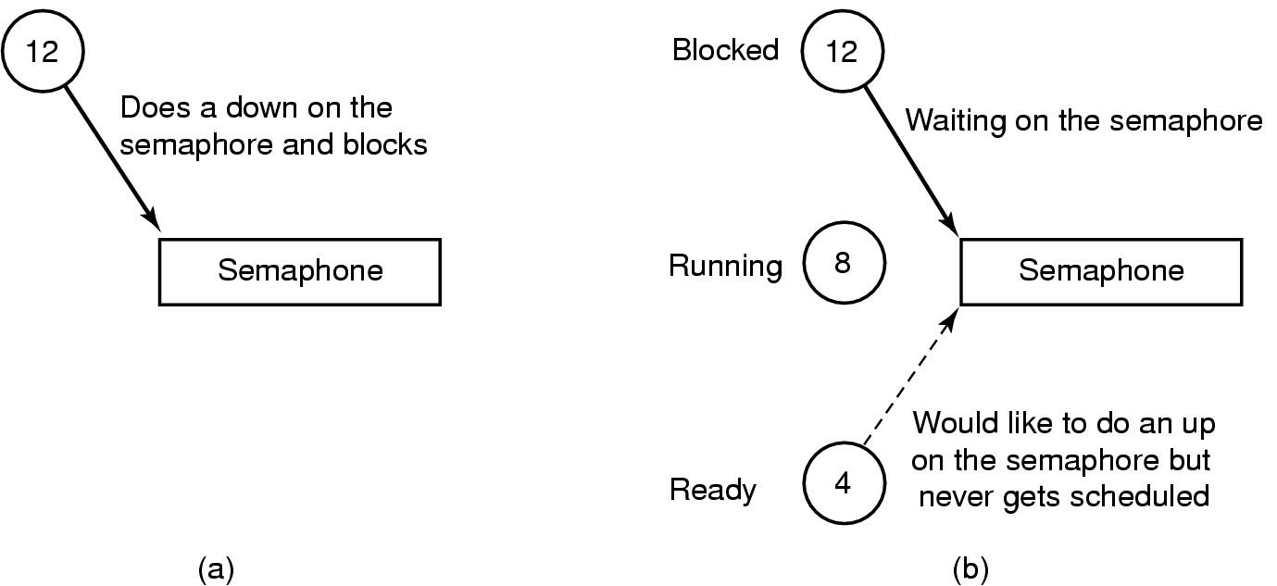
An example of priority inversion
Operating Systems, Spring 2018, I. Dinur, D. Hendler and R. Iakobashvili

