Slide 1
Outline
Monitors
  Monitors in Java
Barrier synchronization
Readers and Writers
One-way tunnel
The Mellor-Crummey and Scott (MCS) algorithm
Operating Systems, Spring 2018, I. Dinur, D. Hendler and R. Iakobashvili

Slide 2
Monitors - higher-level synchronization
(Hoare, Hansen, 1974-5)
Monitors are a programming-language construct
Mutual exclusion constructs generated by the compiler. Internal data structures are invisible. Only one process is active in a monitor at any given time - high level mutual exclusion
Monitors support condition variables for thread cooperation.
Monitor disadvantages:
  May be less efficient than lower-level synchronization
  Not available from all programming languages
Operating Systems, Spring 2018, I. Dinur, D. Hendler and R. Iakobashvili

Slide 3
Monitors
Only one monitor procedure active at any given time
monitor example
integer i;
condition c;
procedure p1( );
.
.
.
end;
procedure p2( );
.
.
.
end;
end monitor;
Slide taken from a presentation by Gadi Taubenfeld from IDC
Operating Systems, Spring 2018, I. Dinur, D. Hendler and R. Iakobashvili

Slide 4
Monitors: Condition variables
Monitors guarantee “automatic” mutual exclusion
Conditional variables enable other types of synchronization
Condition variables support two operations: wait and signal
  Signaling has no effect if there are no waiting threads!
The monitor provides queuing for waiting procedures
When one operation waits and another signals there are two ways to proceed:
  The signaled operation will execute first: signaling operation immediately followed by block() or exit_monitor (Hoare semantics)
  The signaling operation is allowed to proceed
Operating Systems, Spring 2018, I. Dinur, D. Hendler and R. Iakobashvili

Slide 5
type monitor-name = monitor
variable declarations
procedure entry P1 (…);
begin … end;
procedure entry P2 (…);
begin … end;
.
.
.
procedure entry Pn (…);
begin … end;
begin
initialization code
end
Figure 6.20 Monitor with Condition Variable
Entry queue
Shared data
Queues associated with x, y conditions
x
y
…
operations
Initialization code
Operating Systems, Spring 2018, I. Dinur, D. Hendler and R. Iakobashvili

Slide 6
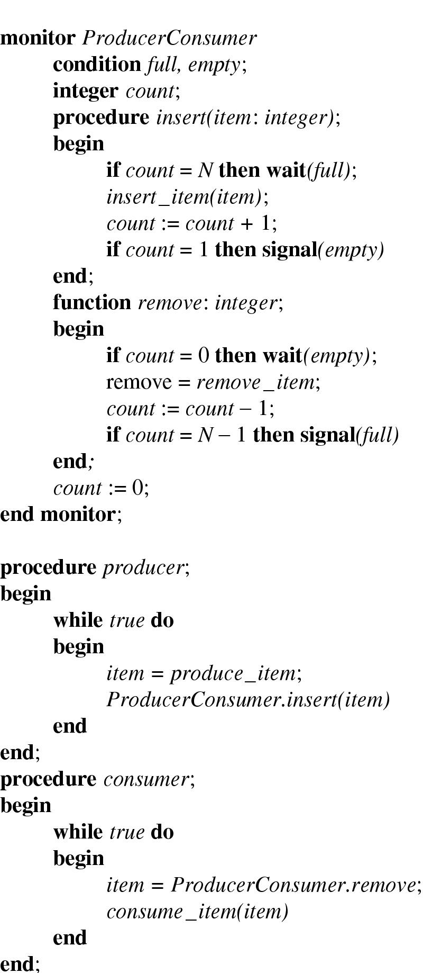
Bounded Buffer Producer/Consumer with Monitors
This code only works if a signaled thread is the next to enter the monitor (Hoare)
Any problem with this code?
Slide taken from a presentation by Gadi Taubenfeld from IDC
Operating Systems, Spring 2018, I. Dinur, D. Hendler and R. Iakobashvili
Notes:
Here are 2 scenarios establishing that the code is wrong if the signaled thread is NOT the next to enter the monitor
The buffer is full, k producers (for some k>1) are waiting on the full condition variable. Now, N consumers enter the monitor one after the other, but only the first sends a signal (since count==N-1) holds for it. Therefore only a single producer is released and all others are not. The corresponding problem can occur on the empty semaphore.
The buffer is full, a single producer p1 sleeps on the full condition variable. A consumer executes and makes p1 ready but then another producer, p2, enters the monitor and fills the buffer. Now p1 continues its execution and adds another item to an already full buffer.
In general, if the monitor does not follow Hoare semantics, a thread must check the condition in a loop, since the condition may be
violated between the time it is signaled and the time it enters the monitor.

Slide 7
Problems if non-Hoare semantics
The buffer is full, k producers (for some k>1) are waiting on the full condition variable. Now, N consumers enter the monitor one after the other, but only the first sends a signal (since count==N-1) holds for it. Therefore only a single producer is released and all others are not. The corresponding problem can occur on the empty semaphore.
Slide taken from a presentation by Gadi Taubenfeld from IDC
Operating Systems, Spring 2018, I. Dinur, D. Hendler and R. Iakobashvili
Notes:
Here are 2 scenarios establishing that the code is wrong if the signaled thread is NOT the next to enter the monitor
The buffer is full, k producers (for some k>1) are waiting on the full condition variable. Now, N consumers enter the monitor one after the other, but only the first sends a signal (since count==N-1) holds for it. Therefore only a single producer is released and all others are not. The corresponding problem can occur on the empty semaphore.
The buffer is full, a single producer p1 sleeps on the full condition variable. A consumer executes and makes p1 ready but then another producer, p2, enters the monitor and fills the buffer. Now p1 continues its execution and adds another item to an already full buffer.
In general, if the monitor does not follow Hoare semantics, a thread must check the condition in a loop, since the condition may be
violated between the time it is signaled and the time it enters the monitor.

Slide 8
Problems if non-Hoare semantics (cont'd)
The buffer is full, a single producer p1 sleeps on the full condition variable. A consumer executes and makes p1 ready but then another producer, p2, enters the monitor and fills the buffer. Now p1 continues its execution and adds another item to an already full buffer.
Slide taken from a presentation by Gadi Taubenfeld from IDC
Operating Systems, Spring 2018, I. Dinur, D. Hendler and R. Iakobashvili
Notes:
Here are 2 scenarios establishing that the code is wrong if the signaled thread is NOT the next to enter the monitor
The buffer is full, k producers (for some k>1) are waiting on the full condition variable. Now, N consumers enter the monitor one after the other, but only the first sends a signal (since count==N-1) holds for it. Therefore only a single producer is released and all others are not. The corresponding problem can occur on the empty semaphore.
The buffer is full, a single producer p1 sleeps on the full condition variable. A consumer executes and makes p1 ready but then another producer, p2, enters the monitor and fills the buffer. Now p1 continues its execution and adds another item to an already full buffer.
In general, if the monitor does not follow Hoare semantics, a thread must check the condition in a loop, since the condition may be
violated between the time it is signaled and the time it enters the monitor.

Slide 9
Monitors - some comments
Condition variables do not accumulate signals for later use
  wait() must come before signal() in order to be signaled
No race conditions, because monitors have mutual exclusion
More complex to implement – but done by compiler
Implementation issues:
  How to interpret nested monitors?
  How to define wait, priority scheduling, timeouts, aborts ?
  How to Handle all exception conditions ?
  How to interact with process creation and destruction ?
Operating Systems, Spring 2018, I. Dinur, D. Hendler and R. Iakobashvili

Slide 10
Implementing Monitors with Semaphores – take 1
semaphore mutex=1; /*control access to monitor*/
semaphore c /*represents condition variable c */
void enter_monitor(void) {
down(mutex); /*only one-at-a-time*/
}
void leave(void) {
up(mutex); /*allow other processes in*/
}
void leave_with_signal(semaphore c) /* leave with signaling c*/
{ up(c) /*release the condition variable, mutex not released */
}
void wait(semaphore c) /* block on a condition c */
{ up(mutex); /*allow other processes*/
down (c); /*block on the condition variable*/
}
Any problem with this code?
May deadlock
Operating Systems, Spring 2018, I. Dinur, D. Hendler and R. Iakobashvili
Notes:
If a process signals but no processes wait deadlock results.

Slide 11
Implementing Monitors with Semaphores - Correct
Semaphore mutex = 1; /* control access to monitor */
Cond c; /* c = {count;semaphore} */
void enter_monitor(void) {
down(mutex); /* only one-at-a-time */
}
void leave(void) {
up(mutex); /* allow other processes in */
}
void leave_with_signal(cond c) { /* cond c is a struct */
if(c.count == 0) up(mutex); /* no waiting, just leave.. */
else {c.count--;
up(c.s)}
}
void wait(cond c) { /* block on a condition */
c.count++; /* count waiting processes */
up(mutex); /* allow other processes */
down(c.s); /* block on the condition */
}
Operating Systems, Spring 2018, I. Dinur, D. Hendler and R. Iakobashvili

Slide 12
Outline
Monitors
  Monitors in Java
Barrier synchronization
Readers and Writers
One-way tunnel
The Mellor-Crummey and Scott (MCS) algorithm
Operating Systems, Spring 2018, I. Dinur, D. Hendler and R. Iakobashvili

Slide 13
Monitors in Java
No named condition variables, only a single implicit one
Procedures are designated as synchronized
Synchronization operations:
  Wait
  Notify
  Notifyall
Operating Systems, Spring 2018, I. Dinur, D. Hendler and R. Iakobashvili

Slide 14
Producer-consumer in Java (cont’d)
Class ProducerConsumer {
Producer prod = new Producer();
Consumer cons = new Consumer();
BundedBuffer bb = new BoundedBuffer();
Public static void main(String[] args) {
prod.start();
cons.start();
}}
Operating Systems, Spring 2018, I. Dinur, D. Hendler and R. Iakobashvili

Slide 15
Producer-consumer in Java
Class Producer extends Thread {
void run() {
while(true) {
int item = produceItem();
bb.insert(item);
}}}
Class Consumer extends Thread {
int item
void run() {
while(true) {
item = bb.extract();
consume(item);
}}}
Operating Systems, Spring 2018, I. Dinur, D. Hendler and R. Iakobashvili

Slide 16
Producer-consumer in Java (cont’d)
Class BoundedBuffer {
private int[] buffer = new int buff[N];
int first = 0, last = 0;
public synchronized void insert(int item) {
while((last – first) == N)
wait();
buff[last % N] = item;
notify();
last++; }
What is the problem with this code?
public synchronized int extract(int item) {
while(last == first)
wait();
int item = buff[first % N];
first++;
notify();
return item;
}}
Operating Systems, Spring 2018, I. Dinur, D. Hendler and R. Iakobashvili

Slide 17
The problem with the code in previous slide
Assume a buffer of size 1
The buffer is empty, consumers 1, 2 enter the monitor and wait
A producer enters the monitor and fills it, performs a notify and exits. Consumer 1 is ready.
The producer enters the monitor again and waits.
Consumer 1 empties the buffer, performs a notify and exits.
Consumer 2 gets the signal and has to wait again. DEADLOCK.
We must use notifyAll()!
Operating Systems, Spring 2018, I. Dinur, D. Hendler and R. Iakobashvili

Slide 18
Monitors in Java: comments
notify() does not have to be the last statement
wait() adds the calling Thread to the queue of waiting threads
a thread performing notify() is not blocked - just moves one waiting Thread to state ready
once the monitor is open, all queued ready threads (including former waiting ones) are contesting for entry
To ensure correctness, wait() operations must be part of a condition-checking loop
Operating Systems, Spring 2018, I. Dinur, D. Hendler and R. Iakobashvili

Slide 19
Monitors in Java.Util.Concurrent (Java 7)
Explicit lock interface
Multiple condition variables per lock
  Condition interface with lock.newCondition()
Operating Systems, Spring 2018, I. Dinur, D. Hendler and R. Iakobashvili

Slide 20
Producer-consumer in Java
class BoundedBuffer {
final Lock lock = new ReentrantLock();
final Condition notFull = lock.newCondition();
final Condition notEmpty = lock.newCondition();
final Object[] items = new Object[100];
int putptr, takeptr, count;
public void put(Object x) throws InterruptedException {
lock.lock();
try {
while (count == items.length) notFull.await();
items[putptr] = x;
if (++putptr == items.length) putptr = 0;
++count;
notEmpty.signal();
} finally {
lock.unlock();
}
}
public Object take() throws InterruptedException {
lock.lock();
try {
while (count == 0) notEmpty.await();
Object x = items[takeptr];
if (++takeptr == items.length) takeptr = 0;
--count;
notFull.signal();
return x;
} finally {
lock.unlock();
}
}
}
Java7 supports multiple condition variables
on a single lock using the Lock interface
and the newCondition() factory.
The java.util.concurrent.ArrayBlockingQueue class
provides this functionality (with generic types)
so there is no reason to implement this class.
condition.await() and signal()
require that the underlying lock
be acquired – else throw IllegalMonitorState.
Observe the pattern:
lock.lock();
try {…} finally { lock.unlock();}
to enforce mutex using an explicit lock
(instead of the implicit synchronized).
Explicit locks support testing for locking and timeout.
From http://www.docjar.com/docs/api/java/util/concurrent/locks/Condition.html
Written by Doug Lea with assistance from members of JCP JSR-166
Operating Systems, Spring 2018, I. Dinur, D. Hendler and R. Iakobashvili

Slide 21
Producer-consumer in Java
class Producer implements Runnable {
private BoundedBuffer bb;
public Producer(BoundedBuffer b) {bb = b;}
void run() {
while(true) {
Integer item = produceItem();
bb.insert(item);
}
}
protected Integer produceItem() { …}
}
class Consumer implements Runnable {
private BoundedBuffer bb;
public Consumer(BoundedBuffer b) {bb = b;}
void run() {
while(true) {
int item = bb.extract();
consume(item);
}
}
protected void consume(Integer item) { …}
}
class ProducerConsumer {
private Producer p;
private Consumer c;
private BoundedBuffer b;
public ProducerConsumer() {
b = new BoundedBuffer();
p = new Producer(b);
c = new Producer(b);
}
public static int main(String args[]){
(new Thread(p)).start();
(new Thread(c)).start();
}
}
Operating Systems, Spring 2018, I. Dinur, D. Hendler and R. Iakobashvili

Slide 22
Outline
Monitors
  Monitors in Java
Barrier synchronization
Readers and Writers
One-way tunnel
The Mellor-Crummey and Scott (MCS) algorithm
Operating Systems, Spring 2018, I. Dinur, D. Hendler and R. Iakobashvili

Slide 23
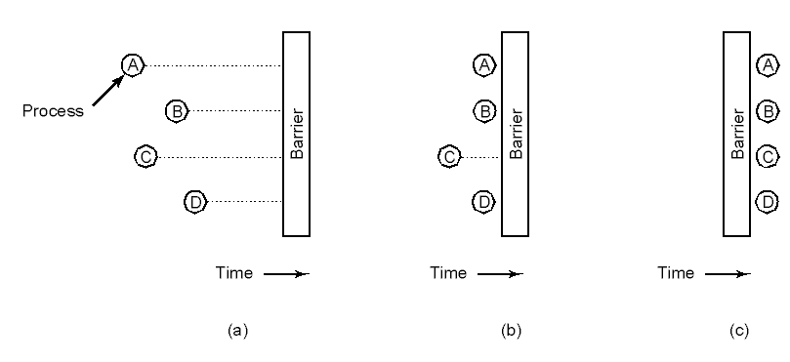
Barriers
Useful for computations that proceed in phases
Use of a barrier:
  (a) processes approaching a barrier
  (b) all processes but one blocked at barrier
  (c) last process arrives, all are let through
Operating Systems, Spring 2018, I. Dinur, D. Hendler and R. Iakobashvili

Slide 24
The fetch-and-increment instruction
Fetch-and-increment(w)
do atomically
prev:=w
w:=w+1
return prev
Operating Systems, Spring 2018, I. Dinur, D. Hendler and R. Iakobashvili

Slide 25
A simple barrier using fetch-and-inc
shared integer counter=0, bit go
local local-go, local-counter
Barrier()
local-go := go
local-counter := Fetch-and-increment(counter)
if (local-counter = n-1)
counter := 0
go := 1-go
else
await (local-go ≠ go)
Operating Systems, Spring 2018, I. Dinur, D. Hendler and R. Iakobashvili

Slide 26
Would this code work?
Nope!
shared integer counter=0, bit go
local local-go
Barrier()
local-go := go
fetch-and-increment(counter)
if (counter = n)
counter := 0
go := 1-go
else
await (local-go ≠ go)
Operating Systems, Spring 2018, I. Dinur, D. Hendler and R. Iakobashvili

Slide 27
Outline
Monitors
  Monitors in Java
Barrier synchronization
Readers and Writers
One-way tunnel
The Mellor-Crummey and Scott (MCS) algorithm
Operating Systems, Spring 2018, I. Dinur, D. Hendler and R. Iakobashvili

Slide 28
The readers and writers problem
Motivation: database access
Two groups of processes: readers, writers
Multiple readers may access database simultaneously
A writing process needs exclusive database access
Operating Systems, Spring 2018, I. Dinur, D. Hendler and R. Iakobashvili

Slide 29
Readers and Writers: 1'st algorithm
Int rc = 0 // # of reading processes
semaphore mutex = 1; // controls access to rc
semaphore db = 1; // controls database access
void reader(void){
while(TRUE){
down(mutex);
rc = rc + 1;
if(rc == 1)
down(db);
up(mutex);
read_data_base();
down(mutex);
rc = rc - 1;
if(rc == 0)
up(db);
up(mutex); }
}
void writer(void){
while(TRUE){
down(db);
write_data_base()
up(db)
}
Who is more likely to run: readers or writers?
Operating Systems, Spring 2018, I. Dinur, D. Hendler and R. Iakobashvili

Slide 30
Comments on 1'st algorithm
No reader is kept waiting, unless a writer has already obtained the db semaphore
Writer processes may starve - if readers keep coming in and hold the semaphore db (even if db is fair)
An alternative version of the readers-writers problem requires that no writer is kept waiting once it is “ready” - when a writer is waiting, no new reader can start reading
Operating Systems, Spring 2018, I. Dinur, D. Hendler and R. Iakobashvili

Slide 31
Readers and Writers: writers’ priority
Int rc, wc = 0 // # of reading/writing processes
semaphore Rmutex, Wmutex = 1; // controls readers/writers access to rc/wc
semaphore Rdb, Wdb = 1; // controls readers/writers database access
void reader(void){
while(TRUE){
down(Rdb);
down(Rmutex)
rc = rc + 1;
if(rc == 1)
down(Wdb);
up(Rmutex);
up(Rdb)
read_data_base();
down(Rmutex);
rc = rc - 1;
if(rc == 0)
up(Wdb);
up(Rmutex); }
}
void writer(void){
while(TRUE){
down(Wmutex);
wc = wc + 1
if (wc == 1)
down (Rdb)
up(Wmutex)
down(Wdb)
write_data_base()
up(Wdb)
down(Wmutex)
wc=wc-1
if (wc == 0)
up(Rdb)
up(Wmutex)
Operating Systems, Spring 2018, I. Dinur, D. Hendler and R. Iakobashvili

Slide 32
Comments on 2’nd algorithm
When readers are holding Wdb, the first writer to arrive decreases Rdb
All Readers arriving later are blocked on Rdb
all writers arriving later are blocked on Wdb
only the last writer to leave Wdb releases Rdb – readers can wait…
If a writer and a few readers are waiting on Rdb, the writer may still have to wait for these readers. If Rdb is unfair, the writer may again starve
Operating Systems, Spring 2018, I. Dinur, D. Hendler and R. Iakobashvili

Slide 33
Readers and Writers: improved writers' priority
Int rc, wc = 0 // # of reading/writing processes
semaphore Rmutex, Wmutex, Mutex2 = 1;
semaphore Rdb, Wdb = 1;
void reader(void){
while(TRUE){
down(Mutex2)
down(Rdb);
down(Rmutex)
rc = rc + 1;
if(rc == 1)
down(Wdb);
up(Rmutex);
up(Rdb)
up(Mutex2)
read_data_base();
down(Rmutex);
rc = rc - 1;
if(rc == 0)
up(Wdb);
up(Rmutex); }
}
void writer(void){
while(TRUE){
down(Wmutex);
wc = wc + 1
if (wc == 1)
down (Rdb)
up(Wmutex)
down(Wdb)
write_data_base()
up(Wdb)
down(Wmutex)
wc=wc-1
if (wc == 0)
up(Rdb)
up(Wmutex)
Operating Systems, Spring 2018, I. Dinur, D. Hendler and R. Iakobashvili

Slide 34
Improved writers' priority
After the first writer does down(Rdb), the first reader that enters
is blocked after doing down(Mutex2) and before doing up(Mutex2). Thus no other readers can block on Rdb.
This guarantees that the writer has to wait for at most a single reader.
Operating Systems, Spring 2018, I. Dinur, D. Hendler and R. Iakobashvili

Slide 35
Readers-writers from Monitors
Monitor reader_writer{
int numberOfReaders = 0;
boolean writing = FALSE;
condition okToRead, okToWrite;
public:
procedure startRead() {
if(writing || (notEmpty(okToRead.queue))) okToRead.wait;
numberOfReaders = numberOfReaders + 1;
okToRead.signal;
};
procedure finishRead() {
numberOfReaders = numberOfReaders - 1;
if(numberOfReaders == 0) okToWrite.signal;
};
Operating Systems, Spring 2018, I. Dinur, D. Hendler and R. Iakobashvili

Slide 36
Readers-writers from Monitors (cont'd)
procedure startWrite() {
if((numberOfReaders != 0) || busy) okToWrite.wait;
writing = TRUE
};
procedure finishWrite() {
writing = FALSE;
if(notEmpty(okToWrite.queue))
okToWrite.signal
else
okToRead.signal;
};
}
Operating Systems, Spring 2018, I. Dinur, D. Hendler and R. Iakobashvili

Slide 37
Outline
Monitors
  Monitors in Java
Barrier synchronization
Readers and Writers
One-way tunnel
The Mellor-Crummey and Scott (MCS) algorithm
Operating Systems, Spring 2018, I. Dinur, D. Hendler and R. Iakobashvili

Slide 38
The one-way tunnel problem
One-way tunnel
Allows any number of processes in the same direction
If there is traffic in the opposite direction – have to wait
A special case of readers/writers
Operating Systems, Spring 2018, I. Dinur, D. Hendler and R. Iakobashvili

Slide 39
One-way tunnel - solution
int count[2];
Semaphore mutex = 1, busy = 1;
Semaphore waiting[2] = {1,1};
void arrive(int direction) {
down(waiting[direction]);
down(mutex);
count[direction] += 1;
if(count[direction] == 1)
up(mutex);
down(busy)
else
up(mutex);
up(waiting[direction]);
}
void leave(int direction) {
down(mutex);
count[direction] -= 1;
if(count[direction] == 0)
up(busy)}
up(mutex);
}
Operating Systems, Spring 2018, I. Dinur, D. Hendler and R. Iakobashvili

Slide 40
Outline
Monitors
  Monitors in Java
Barrier synchronization
Readers and Writers
One-way tunnel
The Mellor-Crummey and Scott (MCS) algorithm
Operating Systems, Spring 2018, I. Dinur, D. Hendler and R. Iakobashvili

Slide 41
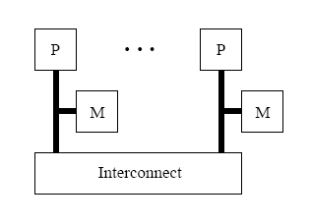
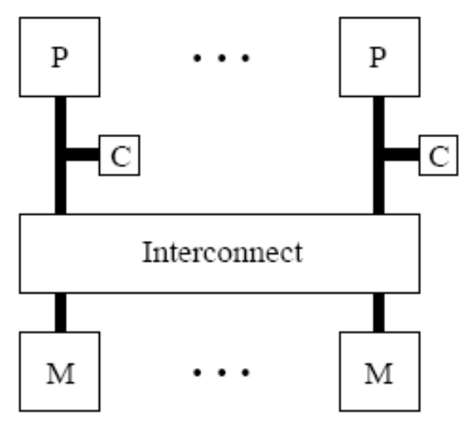
Remote and local memory references
In a Distributed Shared-memory (DSM) system:
local
remote
In a Cache-coherent system:
An access of v by p is remote if it is the first access of v or if v has been written by another process since p’s last access of it.
Operating Systems, Spring 2018, I. Dinur, D. Hendler and R. Iakobashvili

Slide 42
Local spin algorithms
In a local-spin algorithm, all busy waiting (‘await’) is done by read-only loops of local-accesses, that do not cause interconnect traffic.
The same algorithm may be local-spin on one architecture (DSM or CC) and non-local spin on the other.
For local-spin algorithms, the complexity metric is the
worst-case number of Remote Memory References (RMRs)
Operating Systems, Spring 2018, I. Dinur, D. Hendler and R. Iakobashvili

Slide 43
Peterson's 2-process algorithm
Program for process 0
b[0]:=true
turn:=0
await (b[1]=false or turn=1)
CS
b[0]:=false
Program for process 1
b[1]:=true
turn:=1
await (b[0]=false or turn=0)
CS
b[1]:=false
Is this algorithm local-spin on a DSM machine?
No
Yes
Is this algorithm local-spin on a CC machine?
Operating Systems, Spring 2018, I. Dinur, D. Hendler and R. Iakobashvili
Notes:
In the DSM model, each variable is statically placed in the memory segment of one of the processors. So, we would put b[0] in the segment of p1 (because p1 awaits on it) and vice-versa, but wherever we will put turn, one process will busy-wait on a remote variable.
On the other hand, in CC systems, this algorithm only incurs a constant number of RMRs.

Slide 44


The MCS queue-based algorithm
Mellor-Crummey and Scott (1991)
Uses Read, Write, Swap, and Compare-And-Swap (CAS) operations
Provides starvation-freedom and FIFO
O(1) RMRs per passage in both CC/DSM
Widely used in practice (also in Linux)
Operating Systems, Spring 2018, I. Dinur, D. Hendler and R. Iakobashvili
Notes:
It is is a queue-based lock that uses read, write, swap and CAS operations and provides starvation-freedom and FIFO fairness. It was also the first lock to have constant RMRs complexity on both the CC and DSM models and is therefore widely used In practice.

Slide 45
Swap & compare-and-swap
Swap(w, new)
do atomically
prev:=w
w:=new
return prev
Compare-and-swap(w, old, new)
do atomically
prev:=w
if prev = old
w:=new
return true
else
return false
Operating Systems, Spring 2018, I. Dinur, D. Hendler and R. Iakobashvili

Slide 46
The MCS algorithm
Qnode: structure {bit locked, Qnode *next}
shared Qnode *myNode, Qnode *tail initially null
Program for process i
myNode->next := null; prepare to be last in queue
pred=swap(&tail, myNode ) ;tail now points to myNode
if (pred ≠ null) ;I need to wait for a predecessor
myNode->locked := true ;prepare to wait
pred->next := myNode ;let my predecessor know it has to unlock me
await myNode->locked := false
CS
if (myNode->next = null) ; if not sure there is a successor
if (compare-and-swap(&tail, myNode, null) = false) ; if there is a successor
await (myNode->next ≠ null) ; spin until successor lets me know its identity
successor := myNode->next ; get a pointer to my successor
successor->locked := false ; unlock my successor
else ; for sure, I have a successor
successor := myNode->next ; get a pointer to my successor
successor->locked := false ; unlock my successor
Notes:
Each process owns a qnode structure that contains a next pointer to its successor and a locked flag on which it busy waits when required. There is also a tail pointer, initialized to null, that points to the tail of the queue.

Slide 47
The MCS algorithm
Qnode: structure {bit locked, Qnode *next}
shared Qnode *myNode, Qnode *tail initially null
Program for process i
myNode->next := null; prepare to be last in queue
pred=swap(&tail, myNode ) ;tail now points to myNode
if (pred ≠ null) ;I need to wait for a predecessor
myNode->locked := true ;prepare to wait
pred->next := myNode ;let my predecessor know it has to unlock me
await myNode->locked := false
CS
if (myNode->next = null) ; if not sure there is a successor
if (compare-and-swap(&tail, myNode, null) = false) ; if there is a successor
await (myNode->next ≠ null) ; spin until successor lets me know its identity
successor := myNode->next ; get a pointer to my successor
successor->locked := false ; unlock my successor
else ; for sure, I have a successor
successor := myNode->next ; get a pointer to my successor
successor->locked := false ; unlock my successor
Notes:
To enter the CS, a process initiazlies its next pointer to null and then performs an atomic swap operation that writes a pointer to its Qnode structure to tail and returns its previous value to a local variable preve.

Slide 48
The MCS algorithm
Qnode: structure {bit locked, Qnode *next}
shared Qnode *myNode, Qnode *tail initially null
Program for process i
myNode->next := null; prepare to be last in queue
pred=swap(&tail, myNode ) ;tail now points to myNode
if (pred ≠ null) ;I need to wait for a predecessor
myNode->locked := true ;prepare to wait
pred->next := myNode ;let my predecessor know it has to unlock me
await myNode->locked := false
CS
if (myNode->next = null) ; if not sure there is a successor
if (compare-and-swap(&tail, myNode, null) = false) ; if there is a successor
await (myNode->next ≠ null) ; spin until successor lets me know its identity
successor := myNode->next ; get a pointer to my successor
successor->locked := false ; unlock my successor
else ; for sure, I have a successor
successor := myNode->next ; get a pointer to my successor
successor->locked := false ; unlock my successor
Notes:
If prev equals null then the queue was empty, so p can immediately enter the CS. Otherwise, p has a predecessor, so p sets its locked field to prepare for waiting, updates its predecessor by writing to its next field, and starts waiting. Once notified, it may enter the CS.

Slide 49
The MCS algorithm
Qnode: structure {bit locked, Qnode *next}
shared Qnode *myNode, Qnode *tail initially null
Program for process i
myNode->next := null; prepare to be last in queue
pred=swap(&tail, myNode ) ;tail now points to myNode
if (pred ≠ null) ;I need to wait for a predecessor
myNode->locked := true ;prepare to wait
pred->next := myNode ;let my predecessor know it has to unlock me
await myNode->locked := false
CS
if (myNode->next = null) ; if not sure there is a successor
if (compare-and-swap(&tail, myNode, null) = false) ; if there is a successor
await (myNode->next ≠ null) ; spin until successor lets me know its identity
successor := myNode->next ; get a pointer to my successor
successor->locked := false ; unlock my successor
else ; for sure, I have a successor
successor := myNode->next ; get a pointer to my successor
successor->locked := false ; unlock my successor
Notes:
In the exit section, process p first checks if it has a successor. If its next field is null, then it may or may not have a successor. So to mae sure, p tries to compare-and-swap tail back to null. If it succeeds then it had no successor, so p simply returns to the remainder section. If the CAS fails, then p waits for its successor to update next and, once it does, notifies the successor that it may now proceed to the CS and returns to the remainder section.

Slide 50
The MCS algorithm
Qnode: structure {bit locked, Qnode *next}
shared Qnode *myNode, Qnode *tail initially null
Program for process i
myNode->next := null; prepare to be last in queue
pred=swap(&tail, myNode ) ;tail now points to myNode
if (pred ≠ null) ;I need to wait for a predecessor
myNode->locked := true ;prepare to wait
pred->next := myNode ;let my predecessor know it has to unlock me
await myNode->locked := false
CS
if (myNode->next = null) ; if not sure there is a successor
if (compare-and-swap(&tail, myNode, null) = false) ; if there is a successor
await (myNode->next ≠ null) ; spin until successor lets me know its identity
successor := myNode->next ; get a pointer to my successor
successor->locked := false ; unlock my successor
else ; for sure, I have a successor
successor := myNode->next ; get a pointer to my successor
successor->locked := false ; unlock my successor
Notes:
If next was non-null when p checked it in line 8, then p immediately proceeds to signal the successor and exits the CS.

Slide 51
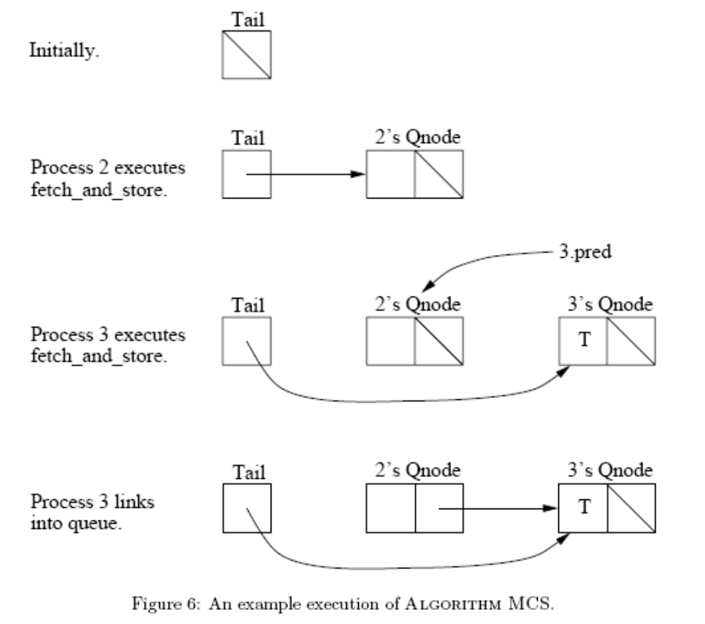
MCS: execution scenario
Operating Systems, Spring 2018, I. Dinur, D. Hendler and R. Iakobashvili

