Slide 1

Operating Systems 371-1-1631
Tutorial 10&11 – Memory II: page replacement alg’s
Ben-Gurion University of the Negev Communication Systems Engineering Department

Slide 2

Optimal algorithm
Furthest next use
But there’s a little problem…
So what is the usage of this alg’?

Slide 3

FIFO: Question 1
Evict the oldest page
Problem: implementation cost
Solutions:
Increase the time granularity
Use smart implementation
Problem: consider the series a, b, c, a, a, a, d with 3-pages mem. Which page will be evicted for d?
We may remove a page that is constantly in use
Solution: FIFO 2nd chance

Slide 4
FIFO 2nd-chance: Question 1 (cont’)
Add a reference bit
When a “swap out” is needed:
Go over the pages from the oldest to newest
if the page’s reference bit is on, clear it
otherwise, remove the page.
Consider again the series a, b, c, a, a, a, d. Which page will be evicted for d now?
Which page will be evicted for d in the series
a, b, a, a, a, b, a, a, c, a, c, a, a, a, a, d?

Slide 5
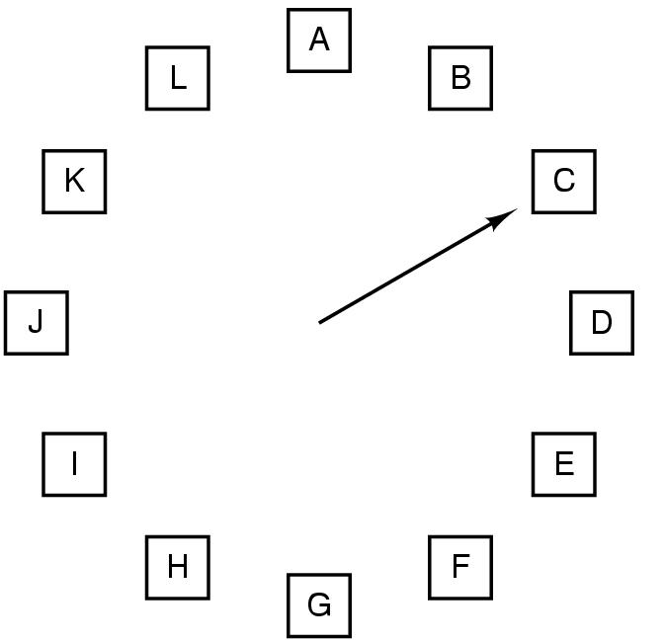
The clock algorithm
Used for implementing both FIFO / FIFO 2nd-Chance

Slide 6
Least Recently Used
Seems promising
Is it?
Notes:
Why is LRU different from FIFO 2nd-chance?
Scenario:
Page 1 arrived 100 ticks ago, and was referenced also in the next tick.
The 2nd oldest page is Page 2, which arrived 10 ticks ago, and hasn’t been referenced since then.
FIFO 2nd chance will evict p.2, though it was accessed 10 ticks ago, while p.1 was accessed 99 ticks ago.

Slide 7
Question 2: Least Recently Used
Program A Program B
a is stored consecutively: a[0][0], a[0][1]
The size of each entry: one word
Page size = 200 words
The program’s code is in page 0. a[0][0] is in the beginning of page 1.
Physical memory size: 3 frames.
Page replacement algorithm: LRU
How many page faults will occur during the run?
How many of them are compulsory misses?
int i, j, a[100][100];
for (i=0; i<100; i++)
for (j = 0; j < 100; j++)
a[i][j] = 0;
int i, j, a[100][100];
for (j = 0; j < 100; j++)
for (i = 0; i < 100; i++)
a[i][j] = 0;
Notes:
Note: Due to the use of the LRU algorithm, page 0, which holds the code, will be in memory at all times.
Then:
Prog A:
Comp’ 1. Then: a[0][0…99] and a[1][0…99] are in the page.
Then: a[2] and a[3] and so on.
Total: 50 page faults (comp’ for each page).
Prog’ B:
a[0][0] to a[1][99] are in mem. So a[0][0] and a[1][0] will be OK. A[2][0] will cause a page fault. A[3][0] is OK. A[4][0] replaces the LRU page – p. fault.
Total: 50 faults only for a[0][0] through a[99][0].
A[1][0] is again fault. Total: 10K mem accss, p. fault every other access → 5K faults!

Slide 8
Question 2 – Solution
a is stored in 50 different virtual pages.
Program A:
The reference string: 0,1,0,2,0,3...50 (0 contains program code)
→ 50 page faults.
Program B:
The reference string: 0,1,0,2,0,3,...,0,50,0,1,0,2,...,0,50,…
→ 100*50=5000 page faults.

Slide 9
Question 3
Consider the following reference string:
7 0 1 2 0 3 0 4 2 3 0 3 2 1 2 0 1 7 0 1
Memory’s size: 3 frames
How many page faults would occur for:
FIFO
LRU
Optimal (without prefetching)
Note: all frames are initially empty
Notes:
7,0,1,2,0,3,0,4,2,3,0,3,2,1,2,0,1,7,0,1
FIFO
7 7
0 07
1 107
2 210
0
3 321
0 032
4 403
2 240
3 324
0 032
3 032
2 032
1 103
2 210
0 210
1 210
7 721
0 072
1 107
LRU
7 7
0 07
1 107
2 210
0 021
3 302
0 032
4 403
2 240
3 324
0 023
3 302
2 230
1 123
2 213
0 021
1 102
7 710
0 071
1 107
LRU: 12 faults
7,0,1,2,0,3,0,4,2,3,0,3,2,1,2,0,1,7,0,1
Opt (on the right: contents of the mem after each step). 9 faults
7 7
0 07
1 107
2 210
0
3 320
0
4 432
2
3
0 032
3
2
1 102
2
0
1
7 701
0
1

Slide 10
Least Recently Used: implementation issues
Problem: HW implementation cost (area of counters)
Solution: Increase the time granularity
Problem: Implementation challenge
Consistency / cyclic count
Solution: Switch to Not Frequently Used
Problem: HW implementation cost (time & power)
Problem: Old data may be irrelevant
Solution: Use a shift reg. instead of a counter
Aka aging
Notes:
Why is LRU different from FIFO 2nd-chance?
Reference string: 1,1,2,2,3, 4, 3-pages mem.
Fifo 2nd chance will evict p. 3, while LRU will evict p.1.

Slide 11
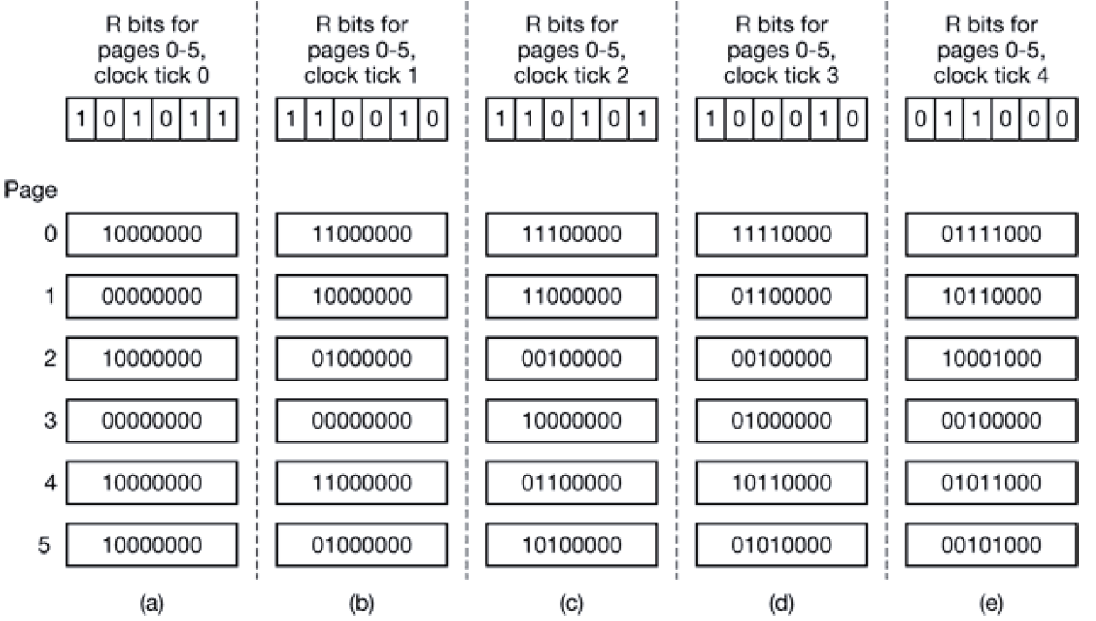
Not Recently Used

Slide 12
Question 4: Not Recently Used
Part 1) Consider an NRU policy, breaking ties by an increasing ordinal #.
For an n-bits counter, page A is evicted before page B.
for an n+1 bits counter, is it possible that B is evicted before A, for the same reference string?
Part 2) Consider an NRU policy, breaking ties randomly.
Is it possible that surely A is evicted before B with n-bits counter, but after B with n+1 bits counter?
Notes:
Part 1)
A: 001
B: 000
Using 2 bits counter, A is evicted. Using 3 bits counter, B is evicted.
Part 2)
For being sure that surely A is evicted before B, the n-bits counter of A should be strictly smaller than that of B. E.g. 00 < 01. Therefore, also when switching to n+1 bits, the counter of A is smaller. So the answer is negative.

Slide 13
Question 4, part 3: NRU, LRU with 6-bit counter
Part 3) given a 3-pages mem, and a reference string: 1,1,1,1,1,1,1,1,1,2,1,1,1,1,1,2,3,4
Which page will be evicted for p. 4 using:
NRU?
LRU?
Is there a better (though, very expensive) policy?
Answer: yes. LRU-K

Slide 14
LRU with Bit Tables
Reference string is 0,1,2,3,2,1,0,3,2,3
 | 0 | 1 | 2 | 3
0 | 0 | 1 | 1 | 1
1 | 0 | 0 | 0 | 0
2 | 0 | 0 | 0 | 0
3 | 0 | 0 | 0 | 0
 | 0 | 1 | 2 | 3
 | 0 | 0 | 1 | 1
 | 1 | 0 | 1 | 1
 | 0 | 0 | 0 | 0
 | 0 | 0 | 0 | 0
 | 0 | 1 | 2 | 3
 | 0 | 0 | 0 | 1
 | 1 | 0 | 0 | 1
 | 1 | 1 | 0 | 1
 | 0 | 0 | 0 | 0
 | 0 | 1 | 2 | 3
 | 0 | 0 | 0 | 0
 | 1 | 0 | 0 | 0
 | 1 | 1 | 0 | 0
 | 1 | 1 | 1 | 0
 | 0 | 1 | 2 | 3
 | 0 | 0 | 0 | 0
 | 1 | 0 | 0 | 0
 | 1 | 1 | 0 | 1
 | 1 | 1 | 0 | 0
 | 0 | 1 | 2 | 3
0 | 0 | 0 | 0 | 0
1 | 1 | 0 | 1 | 1
2 | 1 | 0 | 0 | 1
3 | 1 | 0 | 0 | 0
 | 0 | 1 | 2 | 3
 | 0 | 1 | 1 | 1
 | 0 | 0 | 1 | 1
 | 0 | 0 | 0 | 1
 | 0 | 0 | 0 | 0
 | 0 | 1 | 2 | 3
 | 0 | 1 | 1 | 0
 | 0 | 0 | 1 | 0
 | 0 | 0 | 0 | 0
 | 1 | 1 | 1 | 0
 | 0 | 1 | 2 | 3
 | 0 | 1 | 0 | 0
 | 0 | 0 | 0 | 0
 | 1 | 1 | 0 | 1
 | 1 | 1 | 0 | 0
 | 0 | 1 | 2 | 3
 | 0 | 1 | 0 | 0
 | 0 | 0 | 0 | 0
 | 1 | 1 | 0 | 0
 | 1 | 1 | 1 | 0

Slide 15
Local Vs Global allocation policies – Q4, part 1
Using LRU alg’, which page will be evicted for A6?
Memory
Map
Last
Ref.
Local policy
Global policy
A6
A6

Slide 16
Local Vs Global allocation policies: Q4, part 2
Which policy is easier to implement?
Which policy obtains higher performance?
Observation: local policy may be both easier to implement AND more efficient

Slide 17
Working set
How to allocate frames per processes?
Idea: inspect the process’s working set
Namely, the # of pages it accessed during the last T cycles

Slide 18
Working set clock
A modified version of the clk alg’
Each frame has a
Reference bit
Field, containing the last time it was used, by the proc’s internal clk.
A page is removed if
Its ref’ bit == 0, AND
The time elapsed since the last ref’ to the page is > TAU
TAU takes into account the proc’s virt’ time

Slide 19
The size does matter (…or not?) Question 5
distance vector: המרחק של דף מ"ראש התור" של הדפים בזיכרון על פי העדיפות באלג' מסויים.
כאשר מרחק זה גדול מגודל הזיכרון, יתרחש Page fault.
מושג זה מסייע לבדוק עד כמה הגדלת הזיכרון תקטין את מס' ה-page faults.
נתונה סדרת דרישות הדפים הבאה:
1,2,3,4,2,1,5,6,2,1,2,3,7,6,3,2
משתמשים ב-LRU.
כתוב את ה-Distance String עבור הסדרה הנתונה.
כמה Page Faults יהיו עבור זיכרון פיזי בן 4 דפים?
האם כדאי להגדיל את הזיכרון הפיזי ל-5 דפים במקרה זה?

Slide 20
Question 5 - solution
עבור LRU וזיכרון בגודל 4 דפים:
1 | 2 | 3 | 4 | 2 | 1 | 5 | 6 | 2 | 1 | 2 | 3 | 7 | 6 | 3 | 2
Page fault
distance | ∞
Notes:
1,2,3,4,2,1,5,6,2,1,2,3,7,6,3,2

Slide 21
Question 5 - solution (Cont’)
עבור LRU וזיכרון בגודל 4 דפים:
1 | 2 | 3 | 4 | 2 | 1 | 5 | 6 | 2 | 1 | 2 | 3 | 7 | 6 | 3 | 2
 | 1 | 2 | 3 | 4 | 2 | 1 | 5 | 6 | 2 | 1 | 2 | 3 | 7 | 6 | 3 | 2
 |  | 1 | 2 | 3 | 4 | 2 | 1 | 5 | 6 | 2 | 1 | 2 | 3 | 7 | 6 | 3
 |  |  | 1 | 2 | 3 | 4 | 2 | 1 | 5 | 6 | 6 | 1 | 2 | 3 | 7 | 6
 |  |  |  | 1 | 1 | 3 | 4 | 2 | 1 | 5 | 5 | 6 | 1 | 2 | 2 | 7
 |  |  |  |  |  |  | 3 | 4 | 4 | 4 | 4 | 5 | 6 | 1 | 1 | 1
 |  |  |  |  |  |  |  | 3 | 3 | 3 | 3 | 4 | 5 | 5 | 5 | 5
 |  |  |  |  |  |  |  |  |  |  |  |  | 4 | 4 | 4 | 4
Page fault | p | p | p | p |  |  | p | p |  |  |  | p | p | p
distance | ∞ | ∞ | ∞ | ∞ | 3 | 4 | ∞ | ∞ | 4 | 4 | 2 | 6 | ∞ | 5 | 3 | 4
Notes:
1,2,3,4,2,1,5,6,2,1,2,3,7,6,3,2
בשביל לחשב את מספר ה-Page Faults כשמשתמשים בזיכרון פיזי בן 5 דפים, נצטרך לסכום על כל המרחקים הגדולים מ-5. בעבור זאת קיבלנו 8. כלומר, מנענו בהגדלת הזיכרון Page Fault אחד.

Slide 22
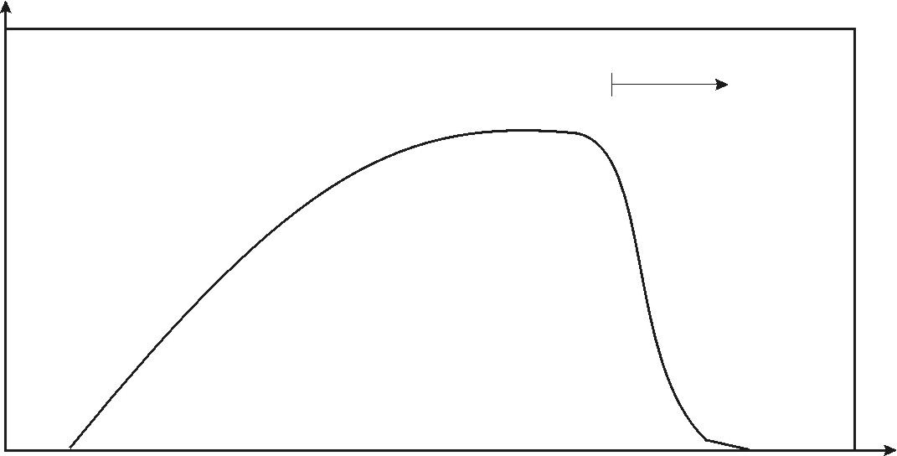
Question 6
הסבירו את הקשר בין High Level Scheduling לבין הגרף הבא:
CPU utilization
Degree of Multiprogramming

Slide 23
Question 6 – Solution
תפקידו של ה-High Level Scheduler הוא לקבוע את מס' התהליכים בזיכרון.
כשה-CPU Utilization נמוך, ה-Scheduler צריך לקבוע האם הסיבה לירידה ביעילות היא:
מיעוט תהליכים בזיכרון (כמו בחלק שמאל של העקומה) ורצוי שיוסיף תהליך לקבוצת התהליכים בזיכרון.
יש thrashing (כמו בצד ימין של העקומה), ועליו להסיר תהליך מקבוצת התהליכים בזיכרון.

