Slide 1

Operating Systems 371-1-1631
Tutorial – Virtualization & the cloud
Ben-Gurion University of the Negev Communication Systems Engineering Department

Slide 2

Motivation: the situation w/o virtualization
Web server
Mail server
FTP server
E-commerce server
Need to buy, maintain and operate 24/7 all servers
Various OSs: Linux, windows, OS X (Mac), …

Slide 3
Motivation - virtualization
Use the same physical machine to support multiple tasks
Web server, Email server, …
☺ Easier & cheaper acquisition and maintenance
☺ Easily practicing & trying new ideas
☺ Using popular software of different OSs
Eg, Windows Office and VMware‘ Linux

Slide 4


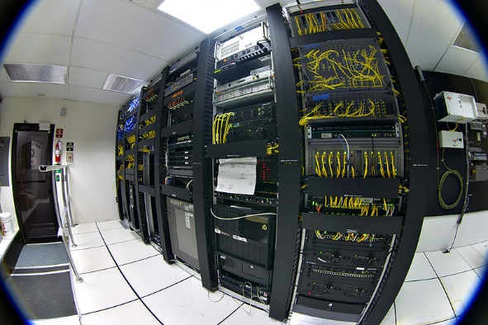

Motivation – cloud computing
XaaS – see Dream-lab ppt 3, s6 and on
Private / public? Dream-lab ppt 5
Notes:
PaaS:
https://apprenda.com/library/paas/
“This one platform technique streamlines development by eliminating the need to customize the code to run on different platforms. Additionally, the developer can make changes to the product on the PaaS directly, avoiding the need to distribute updates.”
SaaS: DropBox / Google Drive? ShareLatex. pixlr. CAD tools. Pixlr, accounting / invoicing.

Slide 5
Outline
Motivation
Challenges
Solutions

Slide 6
Challenges
what does the customer like?
See Dream-lab ppt 2, s15 and on
What’s virtualization, anyway?
“The construction of isomorphism between a guest OS and a host” [Popek & Goldberg, 1974]
We already know virtual address space

Slide 7
Challenges: basic concepts
Process₁
Process₂
∙∙∙
User space/ kernel separation
OS
HW interface
HW (disk, NIC,…)
Multi-processing
Notes:
Basic blocks
Virtual Machine (VM)
Guest Vs. host
Hypervisor
Aka VMM (Virtual Machine Monitor)

Slide 8
Challenges: basic concepts
Process₁
Process₂
∙∙∙
User space/ kernel separation
OS
HW interface
HW (disk, NIC,…)
Multi-processing
Pr₁
Pr₂
Pr₁
Pr₂
∙∙∙
VM
OS₁
OS₂
∙∙∙
Virtual HW interface
VMM/Hypervisor
Virtualization
Real HW interface
HW (disk, NIC,…)
Notes:
Basic blocks
Virtual Machine (VM)
Guest Vs. host
Hypervisor
Aka VMM (Virtual Machine Monitor)

Slide 9
Conditions for virt’ - Popek & Goldberg (1974)
Equivalence
Resource control
Efficiency
Notes:
Equivalence / Fidelity
A program running under the VMM should exhibit a behavior essentially identical to that demonstrated when running on an equivalent machine directly.
Resource control / Safety
The VMM must be in complete control of the virtualized resources.
Rsrc ctrl: e.g., interrupts – timers, over-heat, OS update etc.
Efficiency / Performance
A statistically dominant fraction of machine instructions must be executed without VMM intervention.

Slide 10
Challenges: sensitive instructions
CPU registers
I/O calls & interrupts
Memory mapping
Page tables
Code segments
Every sensitive instruction should be privileged to the host OS / VMM
Notes:
Interrupts – eg timers, over-heat, OS update

Slide 11
Outline
Motivation
Challenges
Solutions

Slide 12
Interpreter

Slide 13
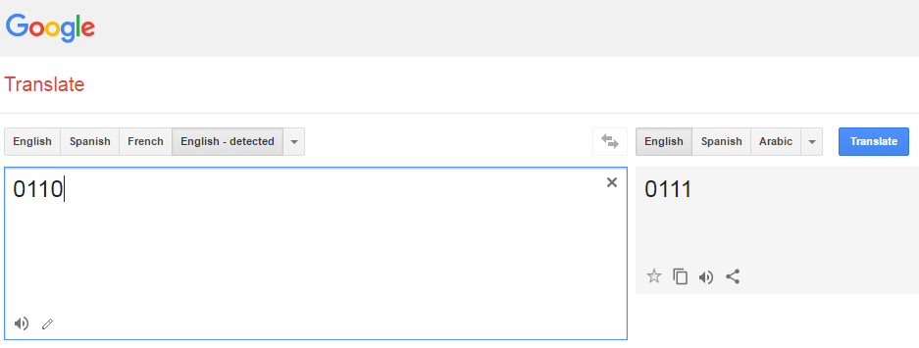
Binary translation
Very complex and expensive
Is it?

Slide 14
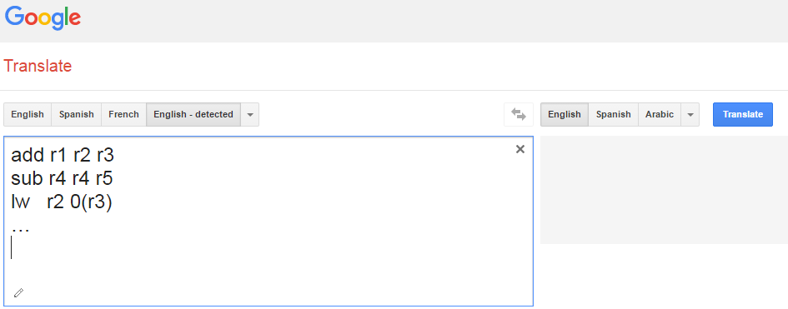
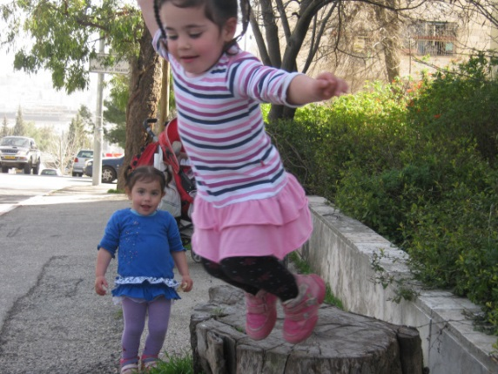
Binary translation optimizations: basic blocks
beq r1 r2 Loop
Where to jump to?
Every jmp/ br / call inst’ ends the basic block
Still very expensive

Slide 15


Binary translation optimizations: caching
“trace cache”
Code optimization

Slide 16
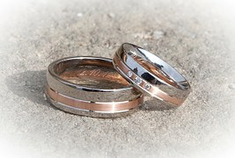
Efficient binary translation: x86 rings
Ring 3: user processes
By careful HW configuration, no translation is needed
Ring 2: unused
Ring 1: guest OS
Translate basic blocks which are not already cached
Ring 0: hypervisor

Slide 17


Yet another challenge: scenario
Guest is running
An interrupt occurs
The hypervisor needs to reconfigure the HW for running the host OS’s device handler
Once the handler finishes handling the interrupt:
Notes:
device handler - driver
World’s switch

Slide 18
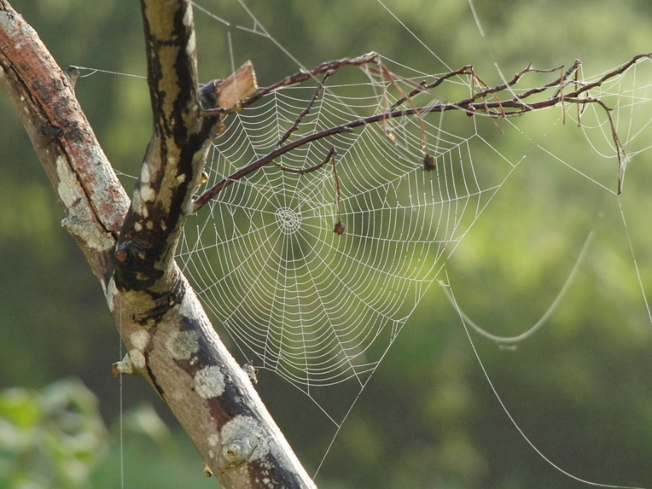
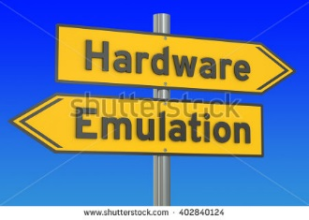
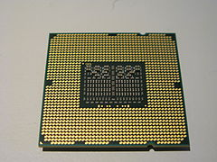
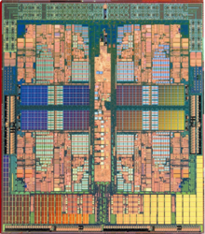
Virtualization: HW support
Virtualization Technology (Intel)
Secure VM (AMD)
Notes:
Trap & emulate
Secure VM: the set of instructions that trap are controlled by a HW bitmap, set by the hypervisor.

Slide 19

Paravirtualization
Compile the guest OS, and force it to use hypercalls
☹ But now we’re HW-depended again
→ Use Virtual Machine Interface

Slide 20
Hypervisor types
Pr₁
Pr₂
Pr₁
Pr₂
Pr₁
Pr₂
Pr₁
Pr₂
∙∙∙
OS₁
OS₂
OS₁
OS₂
∙∙∙
App
Hypervisor
Hypervisor
Host OS
HW (disk, NIC,…)
HW (disk, NIC,…)
Type 1 Hypervisor (bare metal)
Type 2 Hypervisor (over host OS)

Slide 21
Real hypervisors and type
Vmware
ESX server – type 1
Work station – type 2 (actually 1.5…)
XEN – type 1, and loads a para-virtualized OS to DOM-0 (usually Linux or BSD).
KVM – Linux kernel module transforming it to type 1.
QEMU – type 2.
Microsoft hyper-V – type 1
Virtual Box – type 2

Slide 22


Memory virtualization
Scenario:
VM1 maps pp. 1-2 to 13, 17
VM2 maps pp. 3-4 to 17, 19
Solution: shadow page tables
When to update them?
Option 1: every time the guest OS changes its page tables
Option 2: only upon a “page fault”
Both options cause many page faults
Notes:
Option 1: changing the p.table is merely a mem write. Therefore, the VMM has to identify the top level p.table because the HW registers point to this page; and then mark all the p.tables as rd_only. Upon every attempt of the guest OS to write to these pages, a p.fault will happen, and the VMM will take ctrl and change the shadow p.table accordingly.
Option 2: the VMM intervenes only:
when the VM tries to access a new page, in which case a p.fault occurs, and the VMM adds a new entry to the VM’s p.table.
Upon eviction. In that case the inst. INVLPG, which invalidates a TLB entry, is executed. The VMM intercepts this inst. As well, and removes the mapping of the evicted p. from the shadow p.table.

Slide 23
Memory virtualization: page faults types
“Real” (guest-induced p. fault)
The requested p. isn’t in the RAM
“Virtual” (hypervisor-induced p. fault)
Need only to update the shadow p. table
Both cause VM exit – namely, a switch from the VM to the hypervisor
Paravirtualization makes it more efficient by “batching” p.tables updates

Slide 24
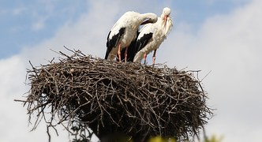
HW support for mem. Virt’
Nested page tables (AMD)
Extended page tables (Intel)
Let handling the shadow p.table in HW, w/o traps

Slide 25

Paging pages of VMs
How to allocate pages for VMs?
How can the hypervisor know which page to evict?
(Partial) Solutions
Deduplicating share pages
Eg, Linux kernel
Ballooning
Notes:
Balloon: a small pseudo device driver, that talks to the VMM.

