Slide 1

Operating Systems 371-1-1631
Tutorial 7 – Synchronization III
Ben-Gurion University of the Negev Communication Systems Engineering Department

Slide 2
Motivation
The problem: disadvantages of solutions based on…
Standard C-Code
Semaphores
The solution: higher-level synchronization tools
Easier to program
Processes and sync’ can be developed independently
Notes:
C code: busy waiting / not satisfactory mutex.
Semaphores: exposed to bug (order, num of “down” operations); requires global knowledge and examination of all processes.

Slide 3
Monitor
Abstract Data Type
The calling process does not see the monitor’s details
Only a procedure name
And vice versa
Implemented in higher-level programming
Guaranteed mutual exclusion: only one process active in a monitor at a time
Accomplished by the compiler, e.g. by locks / semaphores
A collection of
Condition variables
Procedures
(Optional) shared data structures
Notes:
Hoare and Brinch-Hansen
Monito: a more abstract tool.
Have implicit mutex

Slide 4
Condition Variables
Two basic operations
Wait
A thread A may block itself
Signal
Wakes up thread A
If multiple threads are waiting on the same CV, the scheduler decides which of them to wake up
Either the signaler / the signaled process waits
Notes:
Java’s equivalents: synchronized, signal and notify
CVs are NOT counters: if a thread signals, and no other thread is waiting, the signal is lost
Semaphores styles: Hoare, Brinch-Hansen

Slide 5
Condition Variables Vs semaphores
wait (CV) always block the process; down blocks the process only if someone else already acquired the lock
signal (CV) wakes up only a process which is currently waiting (if such exists); up may let (additional) future process to acquire the lock
Notes:
Java’s equivalents: synchronized, signal and notify

Slide 6
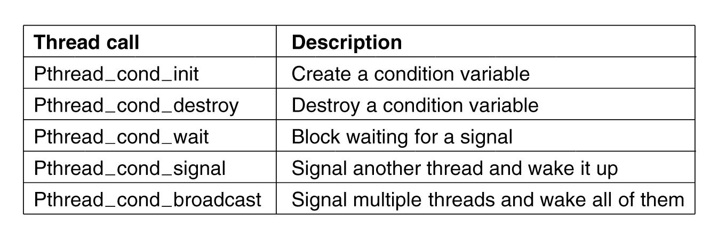
Condition variable calls

Slide 7
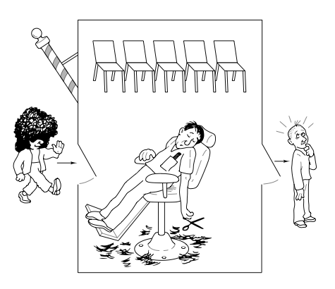
The Sleeping Barber problem
The barber shop has 1 barber chair, and a waiting room
When there’re customers in his shop, the barber serves them, one at a time.
When none are in his shop, the barber sleeps.
When a customer arrives
If the barber is sleeping, the customer awakens him and sits in the barber’s chair
If the barber is busy, the customer waits in one of the chairs in the waiting room
If all of them are occupied, the customer leaves
After a haircut is done, the barber checks whether there’re waiting customers in the waiting room

Slide 8
The Sleeping Barber problem
What happens if…
the barber finishes a hair-cut exactly when a customer is on his way to the waiting room / outside?
2 customers arrive simultaneously, when there’s only 1 free chair in the waiting room?

Slide 9
Q1
Write monitors for the barber and the customers in the sleeping barber problem

Slide 10
Question 1 - Solution
barbershop: monitor
waiting : integer := 0; % customers waiting for haircut
customers : condition :=0; % used by barber, wait for a customer
barber : condition := 0; % used by customer, wait for barber
procedure seek-customer( ) begin % called by the barber
if (waiting==0) then
WAIT(customers); % sleeps if no customers
cut_hair();
waiting--; % one less customer waiting
SIGNAL(barber); % free a waiting customer
end seek-customer;
Notes:
procedure seek-customer( ) % called by the barber
begin
if (waiting==0)
wait (customers);
hair_cut();
waiting--;
signal (barber);
end seek-customer;

Slide 11
Question 1 - Solution
procedure get-haircut( ) begin % called by a customer
if waiting < chairs then % is there a free chair
% if no free chairs just go away
{
waiting = waiting+1; % one more customer waiting
SIGNAL(customers) % if the barber is asleep
WAIT(barber); % wait for turn with the barber
}
end get-haircut;
end barbershop; % End of monitor
Notes:
If (waiting < chairs) {
waiting++;
signal (customers);
wait (barber);
}
If (waiting >= chairs)
return;
waiting++;
signal (customers);
wait (barber);

Slide 12
Monitors’ limitations
☹ Not supported by all languages
E.g., C doesn’t support monitors
Actually, C doesn’t support semaphores either, but adding them is relatively easy
See Tenenbaum 4th Ed. pp.143-144
☹ Don’t provide information exchange
Notes:
* Not true for Java

Slide 13
Monitor – Semaphore Example
monitor class Semaphore {
int s := 0
Condition IsPositive; /* associated with s > 0 */
procedure down() {
if s = 0 then WAIT(IsPositive); /* block */
s := s - 1;
}
procedure up() {
s := s + 1;
SIGNAL(IsPositive); /* wake up blocked processes */
}
}

Slide 14
Message Passing
Used in distributed systems (when there is no shared memory)
Uses two functions:
send (destination, &message)
source = receive (&message)
Methods are called using system calls (why?)
A process may be blocked as long as no message received
Notes:
בעיה: למשל כאשר הודעה אובדת.

Slide 15
Message Passing – implementation issues
Lost msgs →
Acks
sequencing
Addressing
Authentication
Efficiency
Msgs are slower then semaphores / monitors
Notes:
בעיה: למשל כאשר הודעה אובדת.

Slide 16
Question 2 : Message Passing
Write a solution to the reader/writer problem using Message Passing
Assume the following:
Three groups of processes:
Readers
Multiple readers may access the DB simultaneously
Writer
A writer needs exclusive access to the DB
Manager
A reader (writer) must receive a confirmation msg from the Mgr. before starting reading (writing)
Use the “functions”: send (dest, msg); src rcv (msg); rcv_from (src, msg_type)
Readers are preferred over writers

Slide 17
Question 2 - Solution
Reader:
while(true) {
read_db();
}
Writer:
while(true) {
write_to_db();
}
Synchronized Section
Synchronized Section
Notes:
Full solution: T7_Sync3_spares.pptx
send (mgr, start_rd);
rcv (mgr, &msg);
read_db():
send (mgr, end_rd);
use_data():
Writer:
gen_data();
send (mgr, start_wr);
rcv (mgr, &msg);
read_db():
send (mgr, fin_wr);

Slide 18
Question 2 - Solution
Manager:
int rd_cnt=0; % number of readers accessing DB boolean writing=FALSE; % writing flag Message msg; Queue rd_Q, wr_Q; % Queues for waiting readers and writer ProcessID src; % PID
while (true){ src = RECEIVE(msg); switch msg.type{
case(rd_req):
Notes:
Case rd_req:
If (!writing) {rd_cnt++; send (src, ack); } else rdQ.push (src);
Case fin_rd:
Rd_cnt--;
If (rd_cnt==0 && !WrQ.empty ()) {
writing=T;
dst = wrQ.pop ():
send (dst, acK);
}
Case wr_req:
If (!writing && rd_cnt==0) {writing=T; send (src, ack);} else wrQ.push(src);
Case fin_wr:
writing=F;
if (rdQ.empty() && !wrQ.empty()) {
writing = T;
dst = wrQ.pop();
send (dst, ack):
}
else {
while (!rdQ.empty()) {
rd_cnt++;
dst = rdQ.pop();
send (dst, ack);
}
}
}

Slide 19
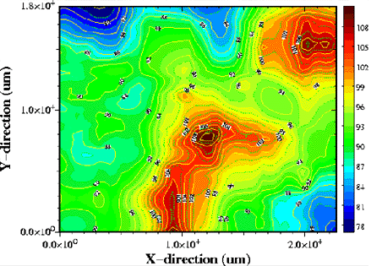
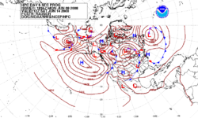
Barriers: motivation
Temp. of a chip
Fig taken from Eetimes
Weather forecasting

