Slide 1

Operating Systems 371-1-1631
Tutorial 8 – Deadlocks
Ben-Gurion University of the Negev Communication Systems Engineering Department

Slide 2
4 necessary conditions for deadlock
Mutual exclusion:
Resource is used by only one process at any given time.
Hold and wait:
Process can request resource while holding another resource.
No preemption:
Only a process can release a resource it holds.
Circular wait:
Two or more processes waiting for resources held by other (waiting) processes.
Absence can cause loss of control of resources and harmful violations.
Absence can make programs run for longer times with more waiting time.
Absence can cause loss of important data that was not backed-up.
Almost impossible to implement, and if so, not scalable.
So, we can “easily” avoid deadlock by avoiding one of these conditions…
Notes:
Mutex: eg, use printer spooling (daemon); minimize the mutex code.
Hold & wait:
* Let a proc run only after it declares, and rcvs, all the rsrcs. Prob’: rsrcs are not always known in advance. Another prob’: this isn’t optimal – it causes much more mutexes.
*reading from mem to printer, using (small) buff.
Preemption: virtualization. Eg, again, printer spooling over disk.
Circular wait: Eg, order the rsrcs / legitimate requests in some way. The problem: not always feasible for all processes – some processes may not be able to run at all.

Slide 3
Solving Deadlock
Prevent
Ensure that always at least one of the four conditions for a deadlock is not satisfied
Avoid
Allocate resources only after assuring it is “safe”
Namely, cannot lead to a deadlock
Detect & recover
Find a cyclic graph of processes and resources
Recover, by either
Killing
Preempt a resource from a process
Restart / enroll a process to a stored checkpoint
Ignore
Probabilistic analysis (MTBF)
Drivers

Slide 4
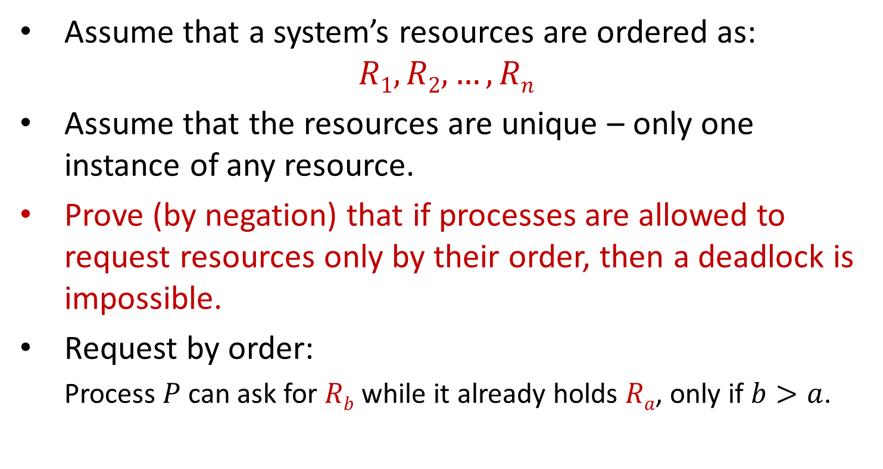
Question 1
Assume that a system’s resources are ordered as:
$$R1, R2, …, Rn$$
Assume that the resources are unique – only one instance of any resource.
Prove (by negation) that if processes are allowed to request resources only by their order, then a deadlock is impossible.
Request by order:
Process $P$ can ask for $Rb$ while it already holds $Ra$, only if $b>a$.

Slide 5
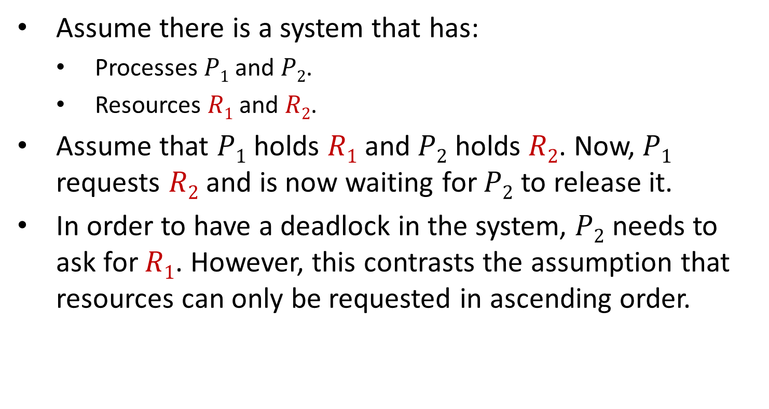
Question 1 – Intuitive Solution
Assume there is a system that has:
Processes $P1$ and $P2$.
Resources $R1$ and $R2$.
Assume that $P1$ holds $R1$ and $P2$ holds $R2$. Now, $P1$ requests $R2$ and is now waiting for $P2$ to release it.
In order to have a deadlock in the system, $P2$ needs to ask for $R1$. However, this contrasts the assumption that resources can only be requested in ascending order.
Which one of the conditions is prevented?
Condition 4 : Circular Wait

Slide 6
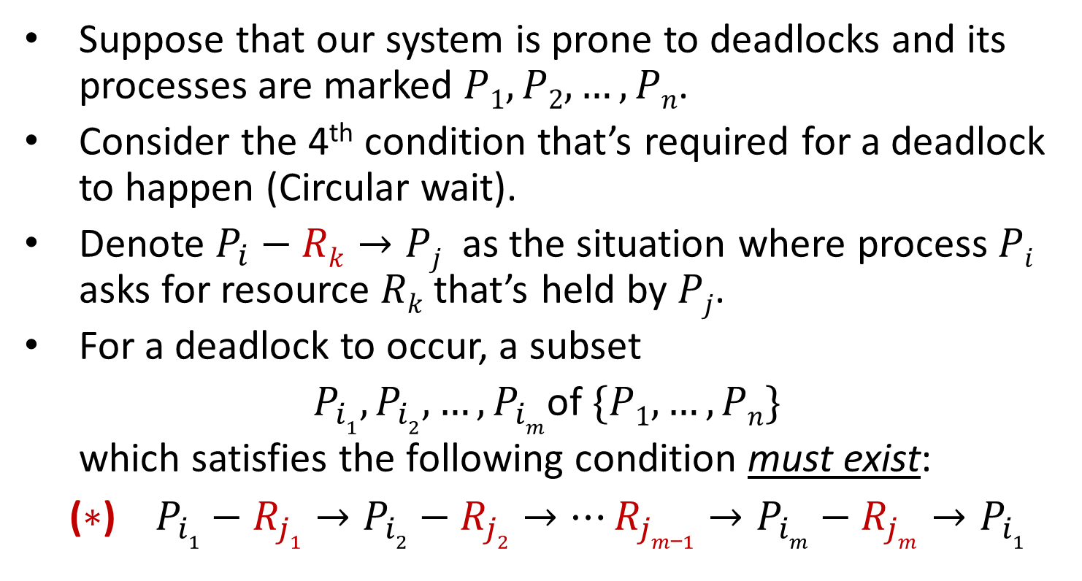
Question 1 – Formal Solution
Suppose that our system is prone to deadlocks and its processes are marked $P1,P2,…,Pn$.
Consider the 4th condition that’s required for a deadlock to happen (Circular wait).
Denote $P_{i}−Rk→Pj$ as the situation where process $Pi$ asks for resource $Rk$ that’s held by $Pj$.
For a deadlock to occur, a subset
$P_{i1},P_{i2}, …,P_{im}$of $\{P1,…, Pn\}$
which satisfies the following condition must exist:
($∗$) $P_{i1}−R_{j1}→P_{i2}−R_{j2}→…R_{jm_1}→P_{im}−R_{jm}→P_{i1}$

Slide 7
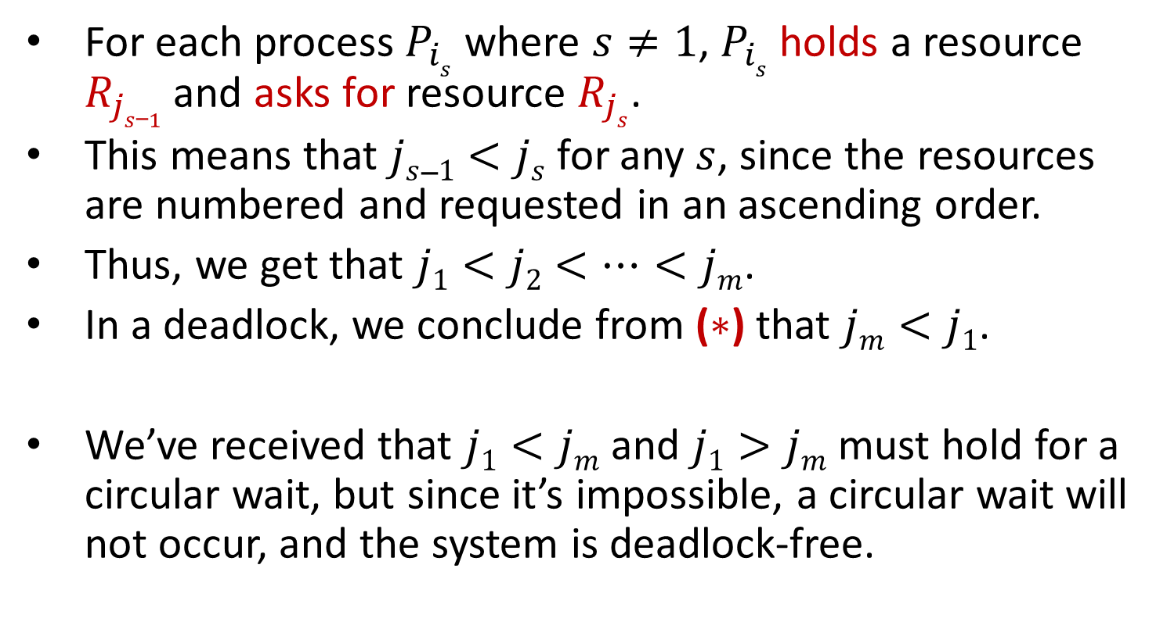
Question 1 – Formal Solution
For each process $P_{is}$ where $s≠1$, $P_{is}$ holds a resource $R_{js_1}$ and asks for resource $R_{js}$.
This means that $js_1<js$ for any $s$, since the resources are numbered and requested in an ascending order.
Thus, we get that $j1<j2<…<jm$.
In a deadlock, we conclude from ($∗$) that $jm<j1$.
We’ve received that $j1<jm$ and $j1>jm$ must hold for a circular wait, but since it’s impossible, a circular wait will not occur, and the system is deadlock-free.

Slide 8
The Banker’s Algorithm
A deadlock avoidance algorithm
The system state is either:
Safe
Not deadlocked.
There is some scheduling order in which every process can run to completion, even if all of them suddenly request their maximum number of resources immediately.
Unsafe

Slide 9
The Banker’s Algorithm
Resources:
Vectors:
E Number of Existing resources of each type.
P Number of resources of each type in Possession by the processes.
A Number of Available resources of each type.
Matrices (rows-processes, columns-resources):
C Current allocation matrix.
R Request matrix.

Slide 10
The Banker’s Algorithm
Look for a row in matrix R whose unmet resource needs are all smaller than or equal to A. If no such row exists, the system may eventually deadlock.
Assume the process of the row chosen finishes (which is possible). Mark that process as terminated and add all its resources to the A vector.
Repeat steps 1 and 2 until either all processes are marked as terminated, which means the system is safe, or until a deadlock occurs, which means the system is unsafe.

Slide 11

Question 2 : The Banker’s Algorithm
Consider the following snapshot of a system with processes $P1, …, P5$ and resources $R1,…, R4$.
A= Is this system currently deadlocked, may become deadlocked?
R₁ | R₂ | R₃ | R₄
2 | 1 | 0 | 0
 | current allocation |  |  |  | max demand |  |  |  | still needs
Process | R₁ | R₂ | R₃ | R₄ | R₁ | R₂ | R₃ | R₄ | R₁ | R₂ | R₃ | R₄
P₁ | 0 | 0 | 1 | 2 | 0 | 0 | 1 | 2
P₂ | 2 | 0 | 0 | 0 | 2 | 7 | 5 | 0
P₃ | 0 | 0 | 3 | 4 | 6 | 6 | 5 | 6
P₄ | 2 | 3 | 5 | 4 | 4 | 3 | 5 | 6
P₅ | 0 | 3 | 3 | 2 | 0 | 6 | 5 | 2

Slide 12
Question 2 – Solution
Is this system currently deadlocked, may become deadlocked?
A=
R₁ | R₂ | R₃ | R₄
2 | 1 | 0 | 0
 | current allocation |  |  |  | max demand |  |  |  | still needs
Process | R₁ | R₂ | R₃ | R₄ | R₁ | R₂ | R₃ | R₄ | R₁ | R₂ | R₃ | R₄
P₁ | 0 | 0 | 1 | 2 | 0 | 0 | 1 | 2 | 0 | 0 | 0 | 0
P₂ | 2 | 0 | 0 | 0 | 2 | 7 | 5 | 0 | 0 | 7 | 5 | 0
P₃ | 0 | 0 | 3 | 4 | 6 | 6 | 5 | 6 | 6 | 6 | 2 | 2
P₄ | 2 | 3 | 5 | 4 | 4 | 3 | 5 | 6 | 2 | 0 | 0 | 2
P₅ | 0 | 3 | 3 | 2 | 0 | 6 | 5 | 2 | 0 | 3 | 2 | 0

Slide 13
Question 2 – Solution
A=
A=
A=
A=
A=
A=
R₁ | R₂ | R₃ | R₄
2 | 1 | 0 | 0
R₁ | R₂ | R₃ | R₄
2 | 1 | 1 | 2
 | current allocation |  |  |  | still needs
Process | R₁ | R₂ | R₃ | R₄ | R₁ | R₂ | R₃ | R₄
P₁ | 0 | 0 | 1 | 2 | 0 | 0 | 0 | 0
P₂ | 2 | 0 | 0 | 0 | 0 | 7 | 5 | 0
P₃ | 0 | 0 | 3 | 4 | 6 | 6 | 2 | 2
P₄ | 2 | 3 | 5 | 4 | 2 | 0 | 0 | 2
P₅ | 0 | 3 | 3 | 2 | 0 | 3 | 2 | 0
R₁ | R₂ | R₃ | R₄
4 | 4 | 6 | 6
R₁ | R₂ | R₃ | R₄
4 | 7 | 9 | 8
R₁ | R₂ | R₃ | R₄
6 | 7 | 9 | 8
R₁ | R₂ | R₃ | R₄
6 | 7 | 12 | 12
This is the total amount of resources of the system.

Slide 14
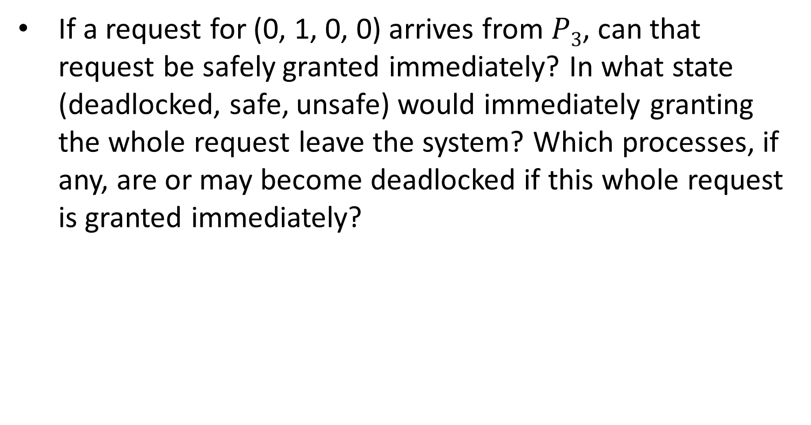
Question 3
If a request for (0, 1, 0, 0) arrives from $P3$, can that request be safely granted immediately? In what state (deadlocked, safe, unsafe) would immediately granting the whole request leave the system? Which processes, if any, are or may become deadlocked if this whole request is granted immediately?

Slide 15

Question 3 – Solution
Let’s see what may happen if the request of $P3$would grant immediately:
A=
R₁ | R₂ | R₃ | R₄
2 | 0 | 0 | 0
 | current allocation |  |  |  | max demand |  |  |  | still needs
Process | R₁ | R₂ | R₃ | R₄ | R₁ | R₂ | R₃ | R₄ | R₁ | R₂ | R₃ | R₄
P₁ | 0 | 0 | 1 | 2 | 0 | 0 | 1 | 2 | 0 | 0 | 0 | 0
P₂ | 2 | 0 | 0 | 0 | 2 | 7 | 5 | 0 | 0 | 7 | 5 | 0
P₃ | 0 | 0 | 3 | 4 | 6 | 6 | 5 | 6 | 6 | 5 | 2 | 2
P₄ | 2 | 3 | 5 | 4 | 4 | 3 | 5 | 6 | 2 | 0 | 0 | 2
P₅ | 0 | 3 | 3 | 2 | 0 | 6 | 5 | 2 | 0 | 3 | 2 | 0

Slide 16
Question 3 – Solution
A=
A=
A=
A=
A=
A=
R₁ | R₂ | R₃ | R₄
2 | 0 | 0 | 0
R₁ | R₂ | R₃ | R₄
2 | 0 | 1 | 2
 | current allocation |  |  |  | still needs
Process | R₁ | R₂ | R₃ | R₄ | R₁ | R₂ | R₃ | R₄
P₁ | 0 | 0 | 1 | 2 | 0 | 0 | 0 | 0
P₂ | 2 | 0 | 0 | 0 | 0 | 7 | 5 | 0
P₃ | 0 | 0 | 3 | 4 | 6 | 5 | 2 | 2
P₄ | 2 | 3 | 5 | 4 | 2 | 0 | 0 | 2
P₅ | 0 | 3 | 3 | 2 | 0 | 3 | 2 | 0
R₁ | R₂ | R₃ | R₄
4 | 3 | 6 | 6
R₁ | R₂ | R₃ | R₄
4 | 6 | 9 | 8

Slide 17
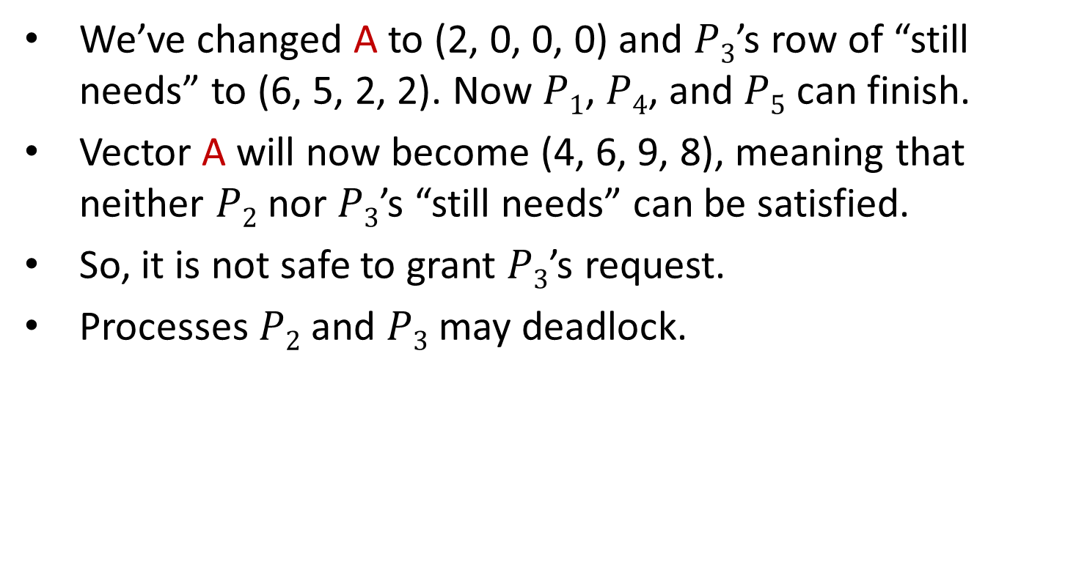
Question 3 – Solution
We’ve changed A to (2, 0, 0, 0) and $P3$’s row of “still needs” to (6, 5, 2, 2). Now $P1$, $P4$, and $P5$ can finish.
Vector A will now become (4, 6, 9, 8), meaning that neither $P2$ nor $P3$’s “still needs” can be satisfied.
So, it is not safe to grant $P3$’s request.
Processes $P2$ and $P3$ may deadlock.

