Slide 1
High Speed Networks Switches and Switching Algorithms
Robert Iakobashvili,
Author: Akiva Sadovski from Broadcom
Spring 2022

Slide 2
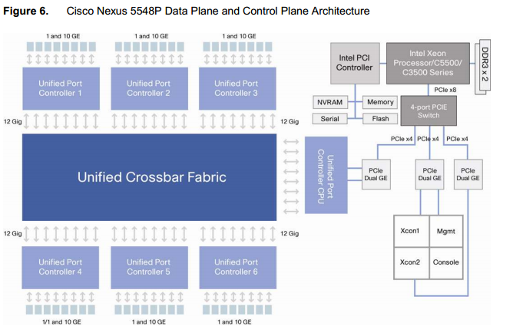
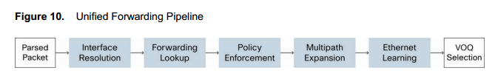
Ethernet Switch/Router architecture overview
Source: Cisco Nexus 5548P Switch Architecture © 2010 Cisco

Slide 3
Requirements
Capacity of switch is the maximum rate at which it can move information, assuming all data paths are simultaneously active
Primary goal: maximize capacity – work at wire speed at all ports
subject to cost and reliability constraints
Circuit switch must reject call if can’t find a path for samples from input to output
goal: minimize call blocking
Packet switch must reject a packet if it can’t find a buffer to store it awaiting access to output trunk
goal: minimize packet loss
Subgoal: Don’t reorder packets

Slide 4
Basic concepts
Accessibility
Blocking
Complexity
Scalability
Reliability
Throughput

Slide 5
Accessibility
A network has full accessibility (=connectivity) when each ingress can be connected to each egress
A network has a limited accessibility when the above property does not exist
Interconnection networks applied in today’s switch fabrics usually have full accessibility

Slide 6
Blocking: definition and types
Blocking means that it is possible that no connection can be set between the idle input/output pair
Class | Type | Switch state
Non-blocking | Strict sense non blocking | Without blocking states
 | Wide sense non blocking | With blocking states
 | Rearrangeably non blocking
Blocking | Others

Slide 7
Definition of blocking types
Strict-sense non-blocking - a path can always be set up between any idle ingress and any idle egress without disturbing paths already set up
Wide-sense non-blocking - a path can be set up between any idle ingress and any idle egress without disturbing existing connections, provided that certain rules are followed. These rules prevent network from entering a state for which new connections cannot be made
Rearrangeably non-blocking - when establishing a path between an idle ingress and an idle egress, paths of existing connections may have to be changed (rearranged) to set up that connection

Slide 8
Complexity
Complexity of an interconnection network is expressed by cost index
Traditional definition of cost index gives the number of cross-points in a network
used to be a reasonable measure of space division switching systems
Nowadays cost index alone does not characterize cost of an interconnection network for broadband applications
VLSIs and their integration degree has changed the way how cost of a switch fabric is formed (number of ICs, power consumption)
management and control of a switching system has a significant contribution to cost

Slide 9
Scalability
Due to constant increase of transport links and data rates on links, scalability of a switching system has become a key parameter in choosing a switch fabric architecture
Scalability describes ability of a system to evolve with increasing requirements

Slide 10
Reliability, Availability, Fault Tolerance
Reliability defines probability that a system does not fail within a given time interval provided that it functions correctly at the start of the interval.
Availability defines probability that a system will function at a given time instant
Fault tolerance is the capability of a system to continue its intended function in spite of having a fault(s)
Reliability measures:
MTTF (Mean Time To Failure)
MTTR (Mean Time To Repair)
MTBF (Mean Time Between Failures)
Reliability and fault tolerance are system measures that have an impact on all functions of a switching system
Notes:
אמינות, זמינות ועמידות לתקלות

Slide 11
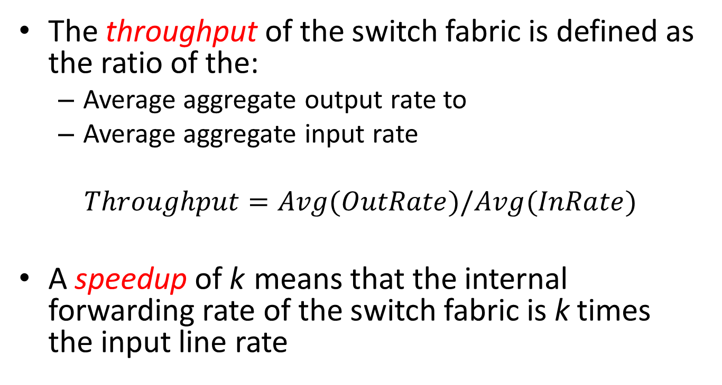
Throughput and speedup
The throughput of the switch fabric is defined as the ratio of the:
Average aggregate output rate to
Average aggregate input rate
$$Throughput=Avg(OutRate)/Avg(InRate)$$
A speedup of k means that the internal forwarding rate of the switch fabric is k times the input line rate
Notes:
האצה
תפוקה

Slide 12
Blocking in packet switch
Can have both internal and output blocking
Internal
no path to output
Example: head of line blocking
Output
output link busy
Output blocking is also called the output contention

Slide 13
Dealing with the blocking
Overprovisioning
internal links much faster than inputs
Buffers: if packet is blocked, the switch must either buffer or drop it
at input, switch fabric itself or at the output
Backpressure
if switch fabric doesn’t have buffers, prevent packet from entering until path is available
Parallel switch fabrics
increases effective switching capacity

Slide 14
Dealing with the scalability
A large scale switch is built with multiple switch modules interconnected in different structures
They are partitioned into:
Single stage
Multistage

Slide 15
First generation switch
CPU
computer
queues in memory
linecard
linecard
linecard
Most Ethernet switches and cheap packet routers
Bottleneck can be CPU, host-adaptor or I/O bus

Slide 16
Second generation switch
computer
bus
front end processors
or line cards
Port mapping intelligence in line cards
Bottleneck is the bus (or ring)

Slide 17
Third generation switches
Third generation switch provides parallel paths (fabric)
OLC
ILC
NxN
packet
switch
fabric
OLC
OUT
IN
ILC
OLC
ILC
control

Slide 18
Third generation switches: the features
self-routing fabric
output buffer is a point of contention
unless we arbitrate access to fabric
potential for unlimited scaling
as long as we can resolve contention for output buffer

Slide 19
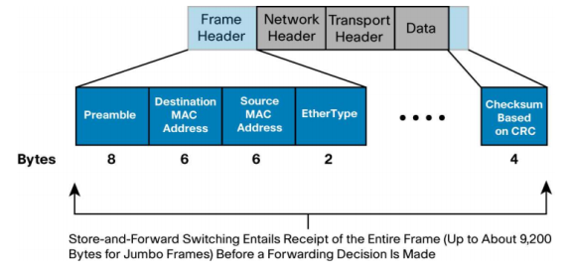
Store-and-forward and cut-through Layer 2 switches
Both base their forwarding decisions on the destination MAC address of data packets;
Store-and-forward
makes a forwarding decision on a data packet after it has received the whole frame and checked its integrity
Ingress buffering: flexibility to support any mix of Ethernet speeds, starting with 10 Mbps
Access Control Lists
Cut-through
a cut-through switch can make a forwarding decision as soon as it has looked up the DMAC address of the data packet
A cut-through switch may parse an incoming packet until it has collected enough information from the frame content to make more sophisticated forwarding decision
Notes:
a cut-through switch can quickly decide whether it needs to examine a larger portion of the packet
headers. It can parse past the first 14 bytes (the SMAC, DMAC, and EtherType) and handle, for
example, 40 additional bytes in order to perform more sophisticated functions relative to IPv4
Layer 3 and 4 headers. At 10 Gbps, it may take approximately an additional 100 nanoseconds to
receive the 40 bytes of the IPv4 and transport headers.

Slide 20
Switching Fabric

Slide 21
The Place of Switching Fabric

Slide 22
Space Switching: an abstract model

Slide 23
Multiplexors and demultiplexors - 1
Multiplexor: aggregates sessions
N input lines
Output runs N times as fast as input
Demultiplexor: distributes sessions
one input line and N outputs that run N times slower

Slide 24
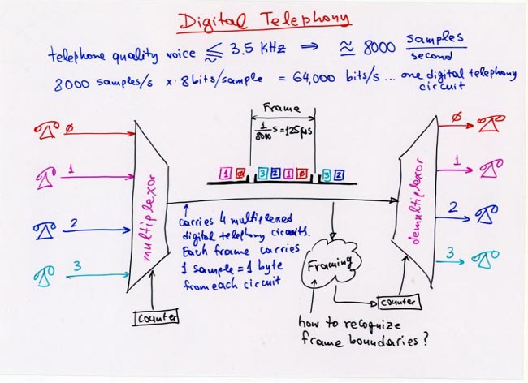
Multiplexors and demultiplexors - 2

Slide 25
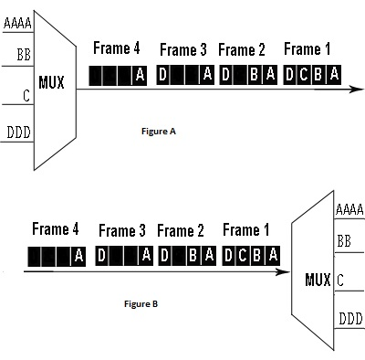
Multiplexors and demultiplexors - 3

Slide 26
Time division switching
Key idea: when demultiplexing, position in frame determines an output link
Time division switching interchanges sample position within a frame

Slide 27
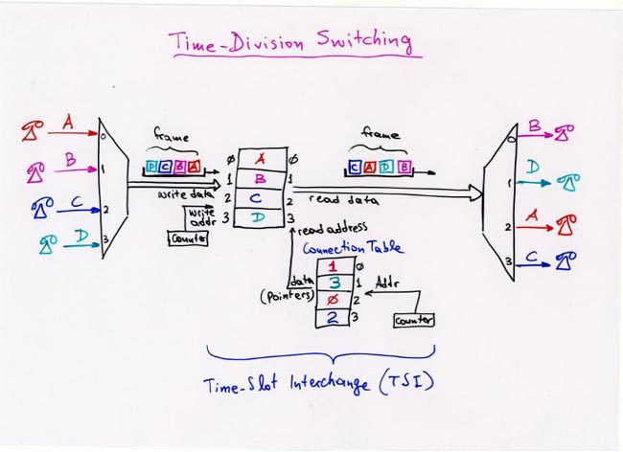
Time Slot Interchange

Slide 29
Time Division Switching Pros and Cons
Pros
Simple to build.
Multicast: easy (why?)
Cons
Limit is the time taken to read and write to memory
For 120,000 telephone circuits
Each circuit reads and writes memory once every 125 ms
Number of operations per second : 120,000 x 8000 x2
each operation takes around 0.5 ns => impossible with current technology

Slide 30
Space division switching
Each sample takes a different path through the switch, depending on its destination
Crossbar: Simplest possible space-division switch
Crosspoints can be turned on or off
sessions: (1,2) (2,4) (3,1) (4,3)
inputs
1
2
3
4
1
2
3
4
output

Slide 31
Time-Space: Example
time 1
time 2
2 1
2 1
TSI
4 3
3 4
3
1
2
4
TSI
Internal speed = double link speed

Slide 32
Buffering strategy in Switching Fabrics
Buffers are required to temporary store packets or cells to lose the congestion
Buffering strategies:
Shared Memory Queuing
Output Queuing (OQ)
Input Queuing
Virtual Output Queuing (VOQ)
Combined Input and Output Queuing (CIOQ)
Crosspoint Queuing

Slide 33
Shared-Memory Queuing
The memory unit is used to store cells for all output ports
The memory contains N output queues, one per output port
Each queue stores the cells destined for the corresponding output

Slide 34
Output Queuing
Cells are immediately forwarded to the destined output ports once they arrive at the inputs
Buffers are needed at the output ports
Benefit: better QoS
Drawbacks:
Memory speed constrains
Switch side limitations

Slide 35
Input Queuing
One FIFO per input port
Only one cell heading to an output port can be forwarded per time slot
Head of Line (HoL) blocking

Slide 36
Virtual Output Queuing
Cells are buffered at input ports
The input buffer is divided into N logical queues (VOQs) storing the cells destined to the associated output port
Eliminates HoL blocking

Slide 37
Combined Input and Output Queuing
Switch fabric operates faster than the line rate
Each output can receive more than one cell in each timeslot
Notes:
It is proved that with the speedup of four, the CIOQ switch can achieve the 99% throughput

Slide 38
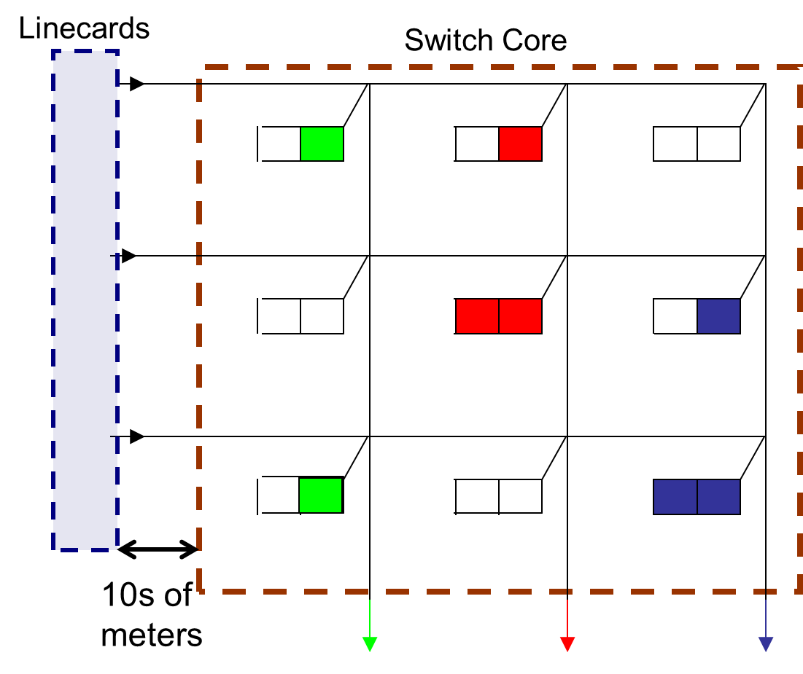
Crosspoint Queuing
A buffer can be placed at each crossbar
Pros: no HoL blocking
Cons: no buffers sharing, N² discrete buffers
Source: INFOCOM 2009, IEEE
Kanizo, Y. ; Dept. of Comput. Sci., Technion - Israel Inst. of Technol., Haifa

Slide 39
Take a Ticket - definition
Each output line card S maintains a distributed queue for all input line cards R waiting to send to S
The queue for S is actually stored at the input line card itself (instead of being at S) using a simple ticket number mechanism

Slide 40
Take a Ticket – operation guidelines
Line card R wants to send a packet to line card S:
makes a request over a separate control bus to S
S provides a queue number back to R over the control bus
The queue number is the number of R’s position in the output queue for S
R then monitors the control bus; whenever S finishes accepting a new packet, S sends the current queue number it is serving on the control bus
R notices that its number is being “served,” – R places its packet on the input data bus for R. At the same time, S ensures that the R–S crosspoint is turned on

Slide 41
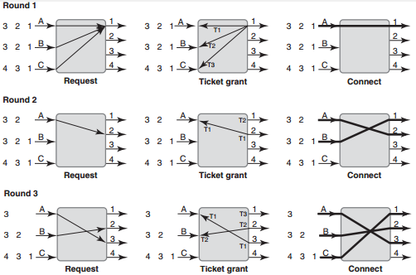
Take a Ticket – operation example

Slide 42
Take a Ticket – pros and cons
Pros
Scales well in control state, requiring only two (log2N)-bit counters at each output port to store the current ticket number being served and the highest ticket number dispensed
Able to handle variable-size packets directly
Cons
Head Of Line blocking
Cannot handle multicast

Slide 43
Take a Ticket – Hunt Group
Any set of line cards (not just physically contiguous line cards) can be aggregated to form an effectively higher-bandwidth link called a hunt group
The next packet destined to the group is served by the first free output port in the hunt group
Notes:
While basic hunt groups can cause reordering of packets
sent to different links, a small modification allows packets from one input to be sent to only
one output port in a hunt group via a simple deterministic hash. This modification avoids
reordering, at the cost of reduced parallelism

Slide 44
Head of Line blocking avoidance
Allowing an input port to schedule not just the head of its input queue, but also other cells, which can make progress when the head is blocked
Do not schedule any cells other than the first cell sent to every distinct output port
Provide a separate input queue per output at each input port - virtual output queue(VOQ)

Slide 45
Communicating the scheduling needs
Communicating the scheduling needs of any input port takes a bitmap of only N bits, where N is the size of the switch
A 1 in position i implies that there is at least one cell destined to output port i
The scheduler needs to process only N² bits

Slide 46
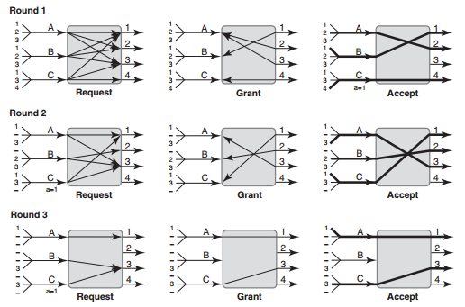
Parallel Iterative Matching operation example
Notes:
Resolving output-port contention is insufficient because there is also input port contention.
Two output ports can randomly grant to the same input port, which must
choose exactly one to send a cell to.

Slide 47
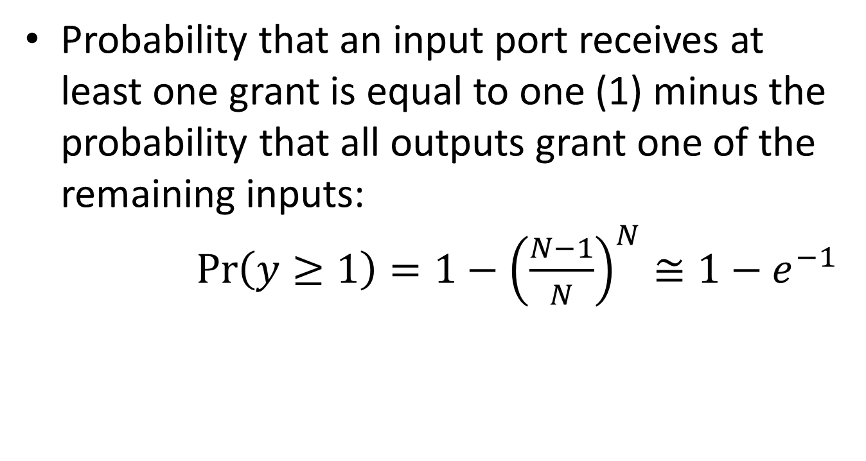
PIM Input Utilization
Probability that an input port receives at least one grant is equal to one (1) minus the probability that all outputs grant one of the remaining inputs: $\operatorname{Pr}\left(y≥1\right)=1−{\left(\frac{N−1}{N}\right)}^{N}≅1−e^{−1}$

Slide 48
Iterative Matching
If ports 1, 2, and 3 all choose A, the match size will only be of size 2
The algorithm shall mask out all matched inputs and outputs and iterate more times (for the same forthcoming time slot)
If the match on the current iteration is not maximal, a further iteration will improve the size of the match by at least 1

Slide 49
Avoiding randomization with iSlip
PIM “derandomization”
iSLIP provides fairness by choosing the next winner among multiple contenders in round-robin fashion using a rotating pointer
Each output maintains a pointer g initially set to the first input port
The output chooses the lowest input number that is equal to or greater than g
Each input port maintains a pointer a initially set to the first output port
When an input port has to choose between multiple output-port grants, it chooses the lowest output port number that is equal to or greater than a

Slide 50
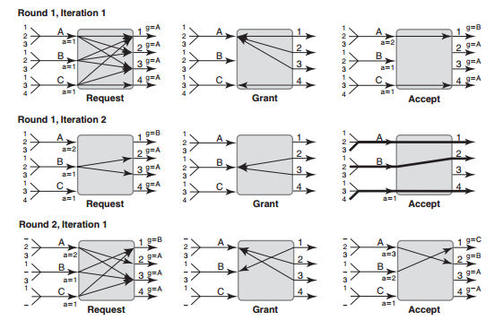
iSLIP operation example - 1
Source: Network Algorithmics by George Varghese
Notes:
The second iteration starts with only inputs unmatched on
previous iterations (i.e, B) requesting and only to hitherto unmatched outputs. Thus B requests
to 2 and 3 (and not to 1, though B has a cell destined for 1 as well). Both 2 and 3 grant B, and
B chooses 2 (the lowest one that is greater than or equal to its accept pointer of 1). One might
think that B should increment its accept pointer to 3 (1 plus the last accepted, which was 2).
However, to avoid starvation iSLIP does not increment pointers on iterations other than the
first, for reasons that will be explained.
Thus even after B is connected to 2 2’s grant pointer remains at A and 2’s accept pointer
remains at 1. Since this is the final iteration, all matched pairs, including pairs, such as A,1,
matched in prior iterations, are all connected and data transfer (solid lines) occurs.

Slide 51
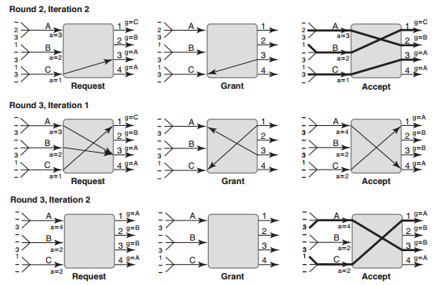
iSLIP operation example - 2
Source: Network Algorithmics by George Varghese

Slide 52
Extending iSLIP to handle priorities
Each output port keeps a separate grant pointer g^{k} for priority level k, and each input port keeps a separate accept pointer a^{k} for each priority level k.
The iSLIP algorithm is performed with each entity (input port, output port) performing the iSLIP algorithm on the highest-priority level among inputs it sees

Slide 53
Extending iSLIP to handle multicast
Multicast uses only one queue and, as such, is subject to some HOL blocking because a multicast packet cannot begin to be processed unless the multicast packets ahead of it are sent
ESLIP maintains only a shared multicast grant pointer and no multicast accept pointer at all
Notes:
However, unlike unicast scheduling, the grant pointer for multicast is not incremented to
1 past I until I completes its fanout.
How should an output port balance between multicast and unicast packets? ESLIP does so by giving multicast
and unicast traffic higher priority in alternate cell slots.

Slide 54
Two Stage Network
Only one cell can be transmitted between any pair of modules (only one path between them)
Very high blocking probability

Slide 55
Fat Network example - Clos Network
Multistage circuit switching network, first formalized by Charles Clos in 1953
Clos networks have three stages:
ingress stage (A)
middle stage(B)
egress stage (C )
The routing problem: how to direct the input packets/cells to the respective outputs without conflicts
Notes:
Each ingress stage crossbar switch has m outlets, and there are m middle stage crossbar switches. There is exactly one connection between each ingress stage switch and each middle stage switch. There are r egress stage switches, each with m inputs and n outputs. Each middle stage switch is connected exactly once to each egress stage switch. Thus, the ingress stage has r switches, each of which has n inputs and m outputs. The middle stage has m switches, each of which has r inputs and r outputs. The egress stage has r switches, each of which has m inputs and n outputs.

Slide 56
Routing in Clos Network
The routing problem in Clos network interpreted as three equivalent questions:
How to assign central routes in a Clos network with m central modules to accommodate a set of connection requests?
How to edge color a given bipartite graph with maximum degree m?
How to decompose a matrix with row/column sum ≤ m into m matrices with row/column sum ≤ 1?

Slide 57
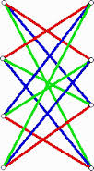
Clos Network: edge coloring in bipartite graph
Matching algorithms has a linear complexity O(N)

Slide 58
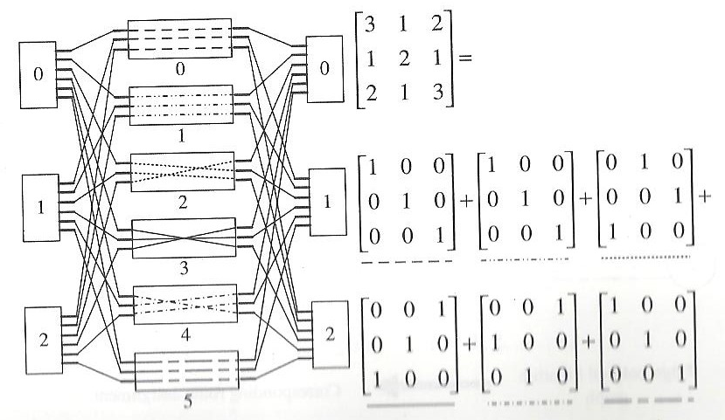
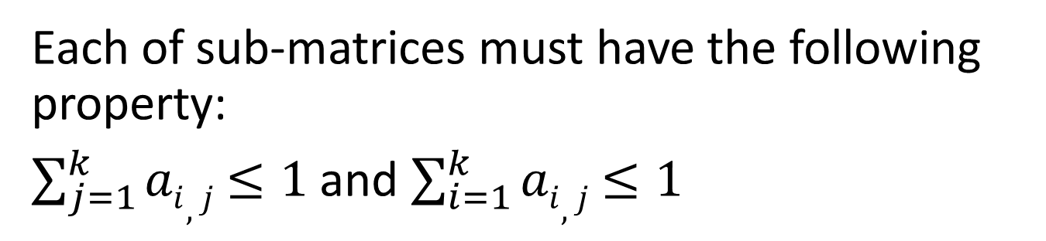
Clos Network: matrix decomposition
Each of sub-matrices must have the following property:
$\sum_{j=1}^{k}{ai,j}$ $≤1$and $\sum_{i=1}^{k}{ai,j}$ $≤1$
Source: High Performance Switches and Routers H. Jonathan Chao, Bin Liu May 2007, Wiley-IEEE Press

Slide 59
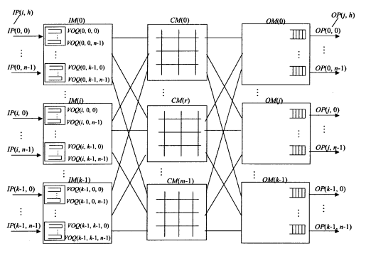
Clos Network Heuristics: Concurrent Round-Robin-Dispatching (CRRD)
IM - Input module at the first stage.
CM - Central module at the second stage.
OM - Output module at the third stage.
n - Number of input/output ports (IPs)/OPs in each IM/OM, respectively.
k - Number of IMs/OMs.
m - Number of CMs.
Source: High Performance Switches and Routers H. Jonathan Chao, Bin Liu May 2007, Wiley-IEEE Press

Slide 60
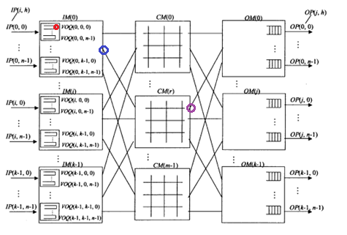
Clos Network CRRD phase 1
Matching within IM:
Step 1: At each time slot, each nonempty VOQ sends a request to every output-link arbiter.
Step 2: Each output-link arbiter chooses one nonempty VOQ request in a round-robin fashion
Step 3: The VOQ arbiter sends the accept to the granting output-link arbiter among all those received in a round-robin fashion
Source: High Performance Switches and Routers H. Jonathan Chao, Bin Liu May 2007, Wiley-IEEE Press

Slide 61
Clos Network CRRD phase 2
Matching between IM and CM
Step 1: A request that is associated with L_{I}(i,r) is sent out to the corresponding CM(r). A CM(r) has output links , each of which corresponds to an OM(r). An arbiter that is associated with L_{C}(r,j) selects one request among k requests.
Step 2: If a VOQ at the IM receives the grant from the CM, it sends the corresponding cell at next time slot.
Source: High Performance Switches and Routers H. Jonathan Chao, Bin Liu May 2007, Wiley-IEEE Press
Notes:
L_{I}(i,r) – r-th outgoing link of IM(i)
L_{C}(r,j) – j-th outgoing link of CM(r)

Slide 62
Clos Network CRRD arbitration

Slide 63
Difference between CRRD and iSLIP
in CRRD: a VOQ sends a request to every output-link arbiter
in iSLIP: a VOQ sends a request to only the destined output-link arbiter

Slide 64
Clos Network - strict sense non-blocking
Holds for m ≥ 2n-1
Proof:
Consider an idle input and output
Input box connected to at most n-1 middle layer switches
output box connected to at most n-1 middle layer switches
There exists an ”unused" middle switch good for both.
n-1
m x n
n x m
n-1

Slide 65
Clos Network - re-arrangeable
If m ≥ n, the Clos network is re-arrangeably non-blocking, meaning that an unused input on an ingress switch can always be connected to an unused output on an egress switch, but for this to take place, existing calls may have to be rearranged by assigning them to different center stage switches in the Clos network
Proof:
Consider the routing graph.
find a perfect matching.
route the perfect matching through a single middle switch!
remaining network is Clos(m-1,n-1,r-1)

Slide 66
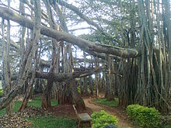
Banyan Network
It is named for its resemblance to the roots of the banyan tree which cross over in complex patterns
In Hinduism, the leaf of the Banyan tree is said to be the resting place for the god Krishna
In Buddhism's Pali canon, the banyan (Pali: nigrodha) is referenced numerous times

Slide 67
Banyan (Delta) Network
Recursively constructed of:
Two smaller (N/2)-size Delta networks
a first stage of 2-by-2 switches
If the output is in the upper half (MSB of output is 0), then the input is routed to the upper N/2 Delta Network
If the output is in the lower half (i.e., MSB=1), the input is routed to the lower N/2 Delta network

Slide 68
Banyan Network: unwinding the recursion

Slide 69
Banyan (Delta) Networks properties
Self-routing
the unique path from a given input to a given output o=o₁,o₂,...,o_{s} expressed in binary can be found by following the link corresponding to the value of o_{i} in stage I
Reversible
It is possible to trace a path from an output to an input by following bits of the input in the same way

Slide 70
Congestion in Delta Networks
There is a unique path from each input to each output
If each successive pair of inputs wishes to send a cell to the same output half, only half of the cells can proceed to second stage

Slide 71
Conditions for non-blocking operation of Banyan network
No idle input between any two active inputs
Output addresses of the cells are in either an ascending or descending order

Slide 72
Sort Banyan Network

Slide 73
Batcher Sorting Network
A sorting network is formed by a series of merge networks

Slide 74
Broadcast Banyan Network
A broadcast Banyan Network is a Banyan Network with switches capable of replicating cells

Slide 75
Benes Network
Third stage of 2-by-2 switches
These third stages to the two (N/2)-sized networks in the middle in the same way as the first-stage switches are connected to the two middle (N/2)-sized networks

Slide 76
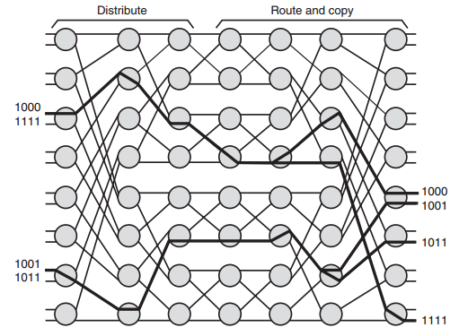
Benes Network
The left half is a standard Delta Network
The right half is a mirror reversed Delta Network
Source: Network Algorithmics by George Varghese

Slide 77
Resources
Network Algorithmics: An Interdisciplinary Approach to Designing Fast Networked Devices by George Varghese (The Morgan Kaufmann Series in Networking) ISBN-13: 978-0120884773 December 29, 2004
High Performance Switches and Routers by H. Jonathan Chao and Bin Liu ISBN: 978-0-470-05367-6 May 2007, Wiley-IEEE Press
Concurrent Round-Robin-Based Dispatching Schemes for Clos-Network Switches, by Eiji Oki, Member, IEEE, Zhigang Jing, Member, IEEE, Roberto Rojas-Cessa, Member, IEEE, and H. Jonathan Chao, Fellow, IEEE http://eeweb.poly.edu/labs/hsnetworking/docs/public/concurrent.pdf
Parallel Routing Algorithms in Benes-Clos Networks, by Tony T. Lee and Soung-Yne Liew http://ieeexplore.ieee.org/xpl/login.jsp?tp=&arnumber=497904&url=http%3A%2F%2Fieeexplore.ieee.org%2Fiel2%2F3539%2F10628%2F00497904.pdf%3Farnumber%3D497904

Slide 78
Questions?

